Slide 1


Large Language Models: Prompting
Dongwook Choi
Language & AGI Lab, Yonsei University
2025.06.18

Slide 2
Contents
Introduction
Recap
Emergent of Large Language Models
In-Context Learning
Instruction Tuning
How can we better use LLMs?
Chain-of-Thoughts
Self-Consistency
ReAct

Slide 3
Introduction

Slide 4

Introduction

Slide 5
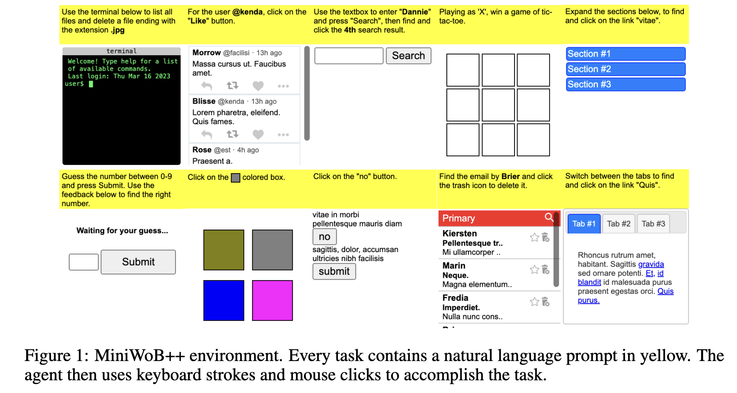
Introduction
Language models can solve computer tasks (Kim et al., 2023)

Slide 6
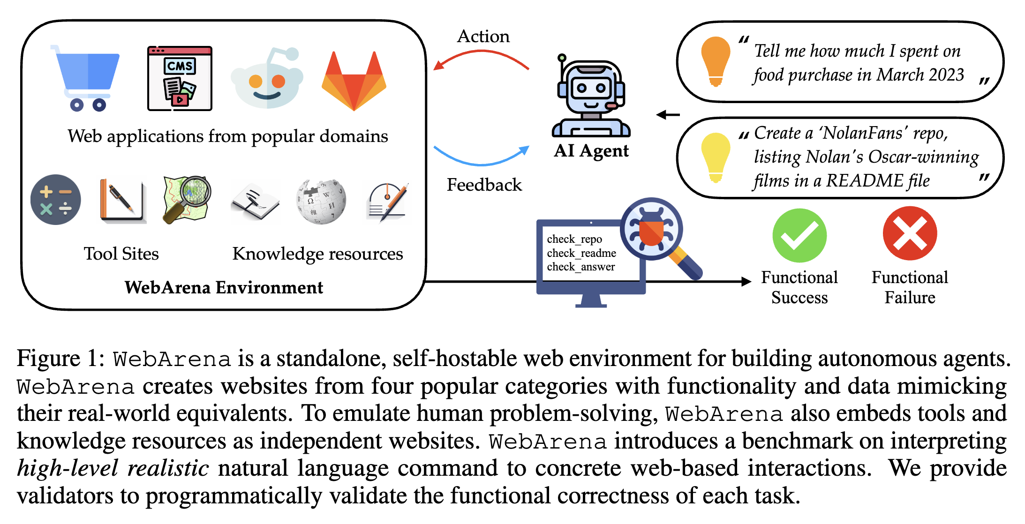
Introduction
LLMs can also automate web navigation (Zhou et al., 2023)

Slide 7
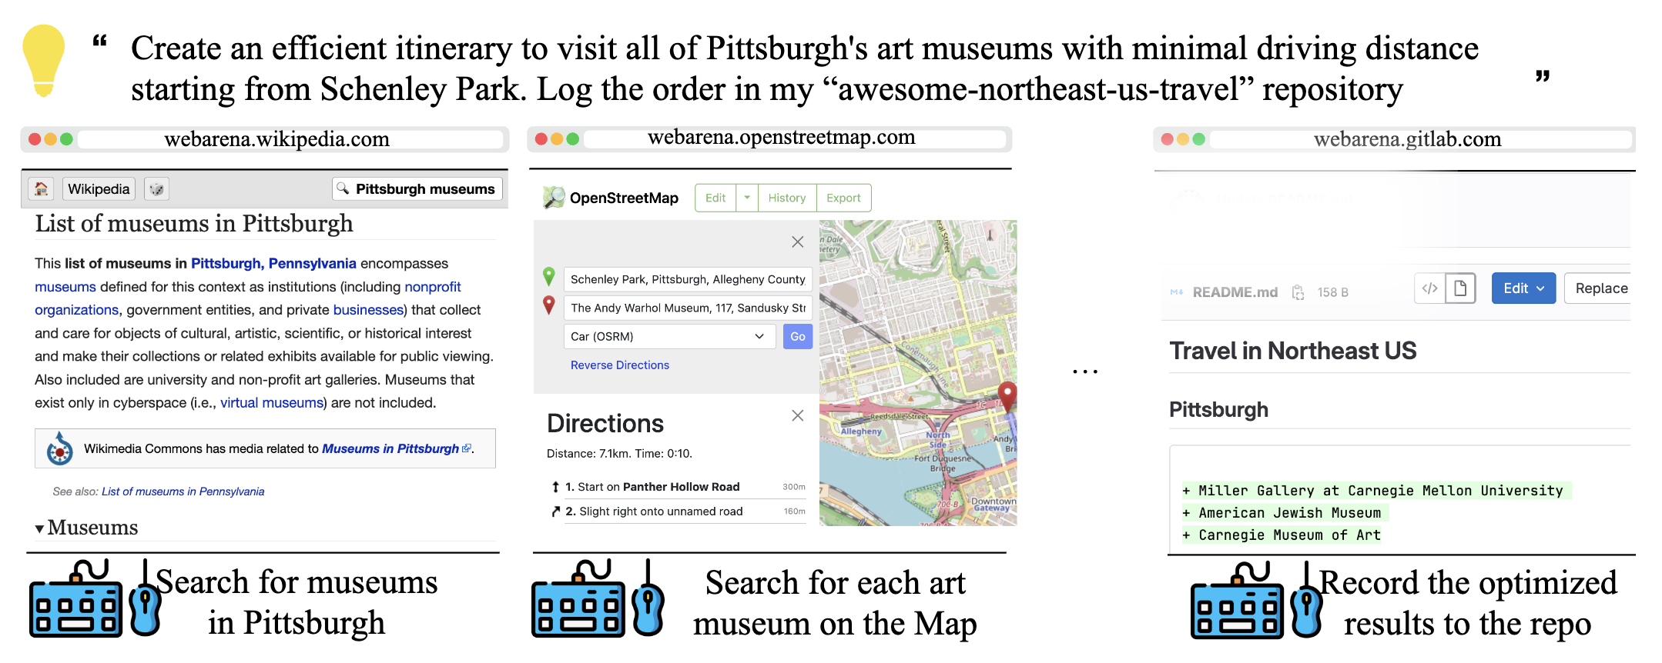
Introduction
LLMs can also automate web navigation (Zhou et al., 2023)

Slide 8
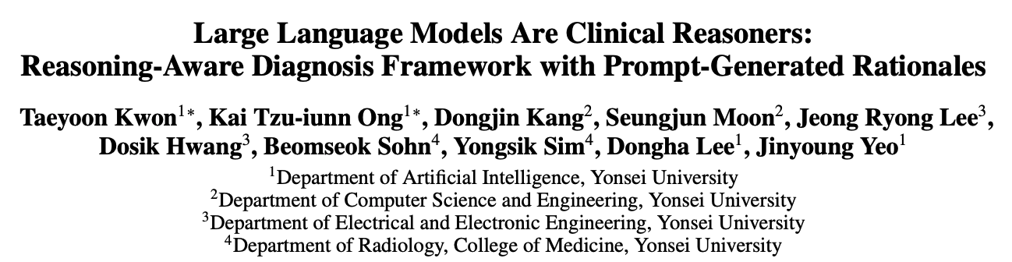
Introduction
LLMs can also be clinical reasoners (Kwon et al., 2023)

Slide 9
Introduction
Let’s see how this progress become possible within just a few years!!!

Slide 10
Recap

Slide 11
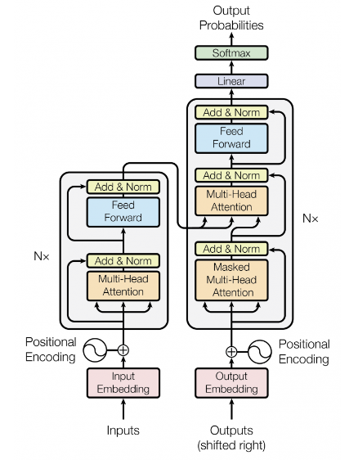
Recap – Transformer
Attention is All you Need (2017)
Why Transformer?
Self-Attention
No recurrence
Scalability
Parallelizability
...
➔ The foundation of nearly all modern DL models
Vaswani et al. “Attention is All you Need”, NeurIPS 2017

Slide 12

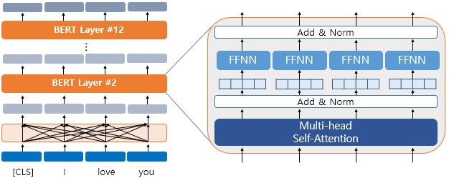
Recap – BERT
Encoder
Devlin, Jacob et al. “BERT: Pre-training of Deep Bidirectional Transformers for Language Understanding”, NAACL 2019

Slide 13
Recap – BERT
BERT is a bidirectional encoder model
Trained with two objectives:
Masked Language Modeling (MLM)
Next Sentence Prediction (NSP)
Excels at natural language understanding tasks with full sentence context
Fine-tuned for each downstream task (e.g., QA, classification, NER)
Devlin, Jacob et al. “BERT: Pre-training of Deep Bidirectional Transformers for Language Understanding”, NAACL 2019

Slide 14
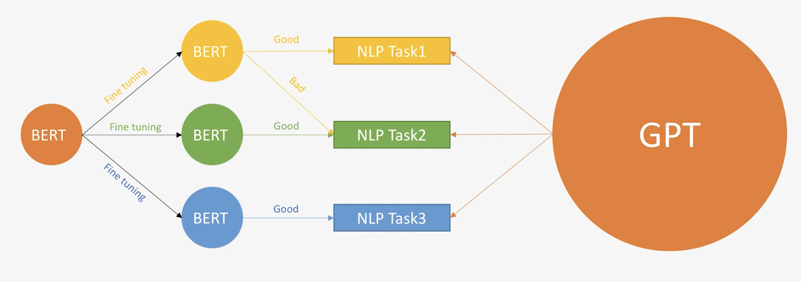
Recap – GPT
GPT is a general-purpose model
Trained with single objective: next-token prediction
Performs well on many tasks with zero-shot or few-shot prompting
Radford et al. “Language models are unsupervised multitask learners”, 2019

Slide 15

Recap – GPT
Input = Task + Context
Output → predict the most probable next token
GPT-2’s improved performance enables it to handle multiple tasks without fine-tuning — using just prompts.
GPT
Radford et al. “Language models are unsupervised multitask learners”, 2019

Slide 16
Emergent of Large Language Models

Slide 17
In-Context Learning

Slide 18
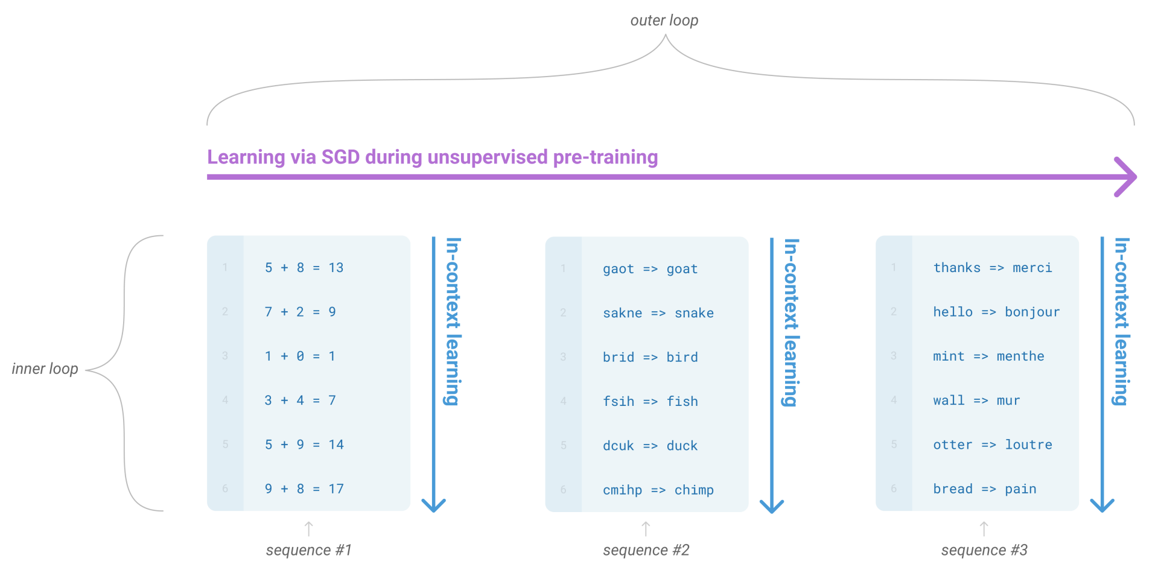
In-Context Learning
Task Learning via Context, not Parameters
Language models can learn from few-shot demonstrations (Without parameter update)
Previous: Fine-tuning (Difficult and expensive to collect training datasets)
Emergent phenomenon in LLMs
Brown et al. “Language Models are Few-Shot Learners”, NeurIPS 2020

Slide 19
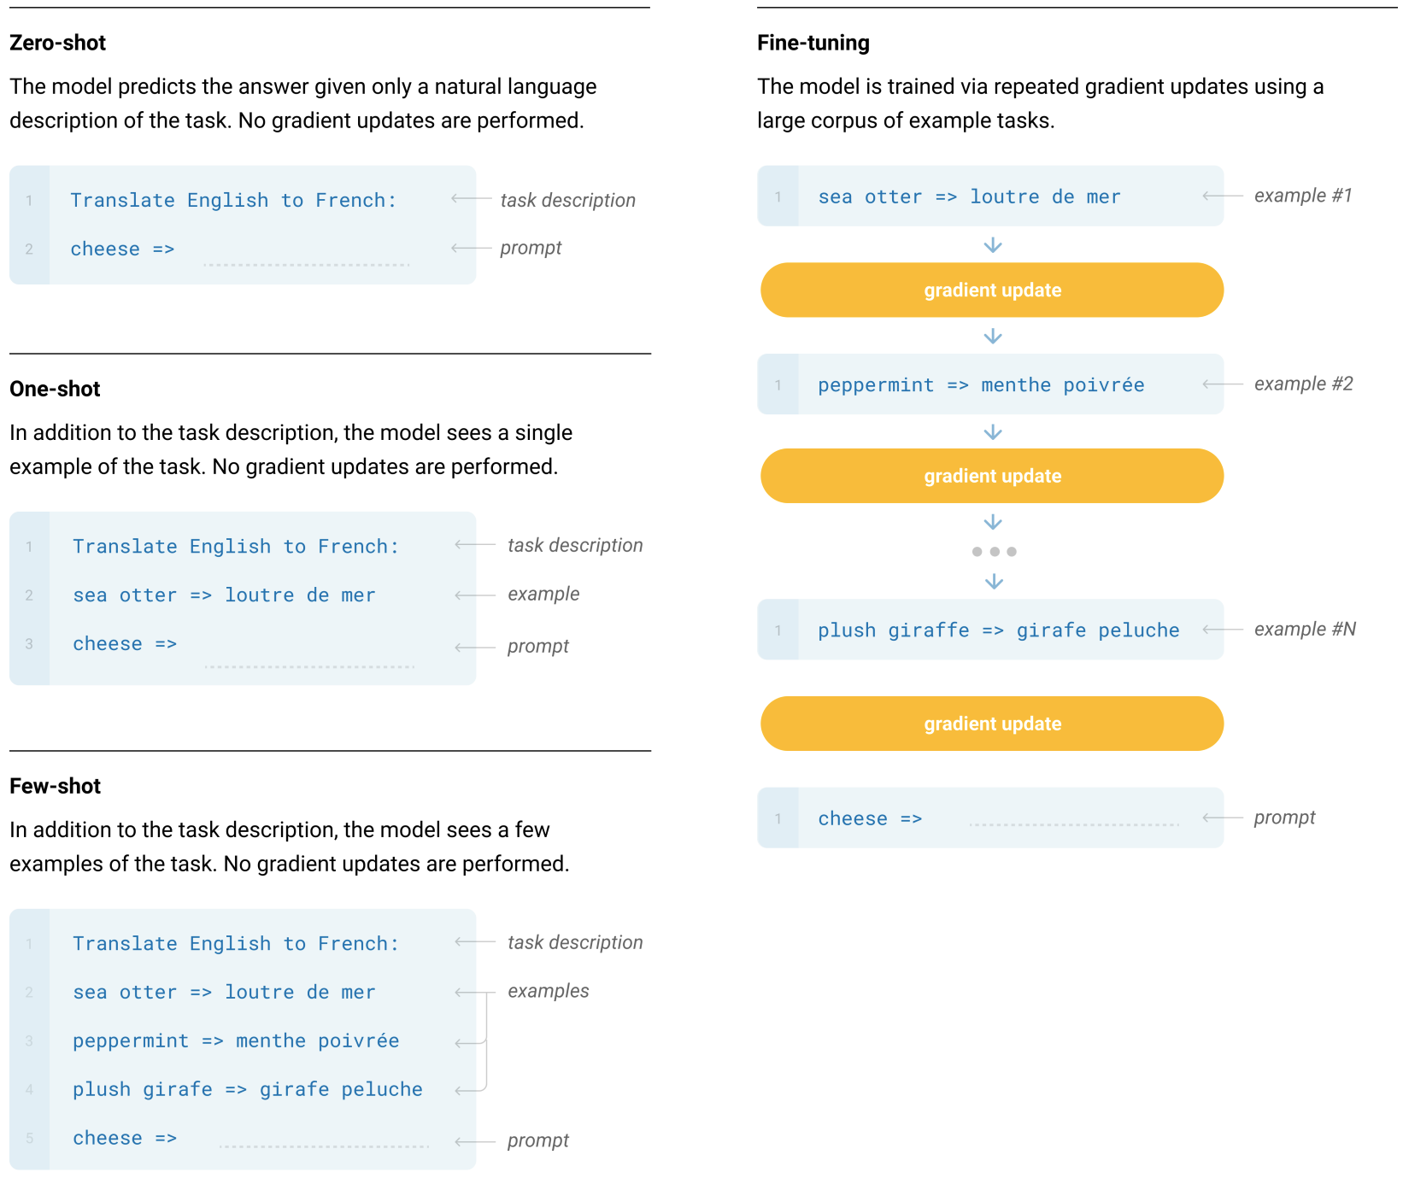
In-Context Learning
Learning “how to learn”
Brown et al. “Language Models are Few-Shot Learners”, NeurIPS 2020

Slide 20
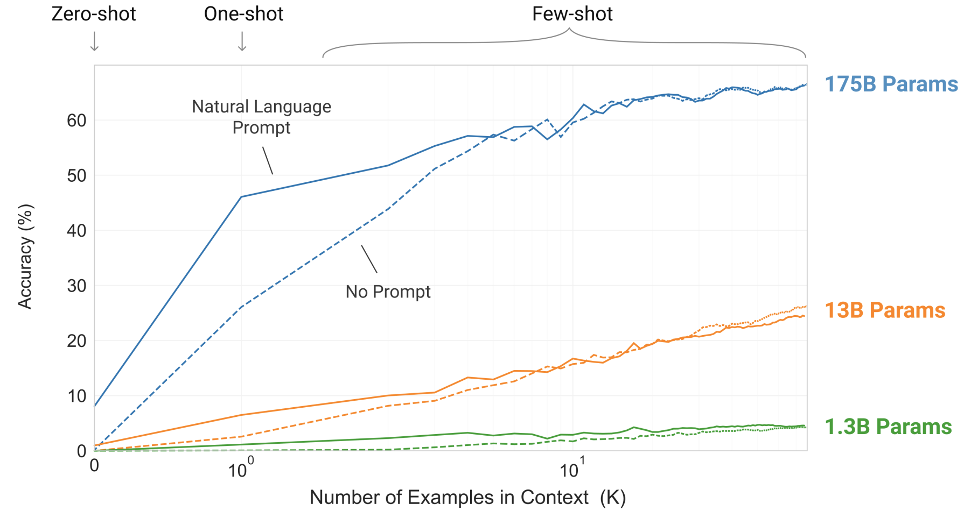
In-Context Learning
The larger the model is, the better the accuracy is
Brown et al. “Language Models are Few-Shot Learners”, NeurIPS 2020

Slide 21
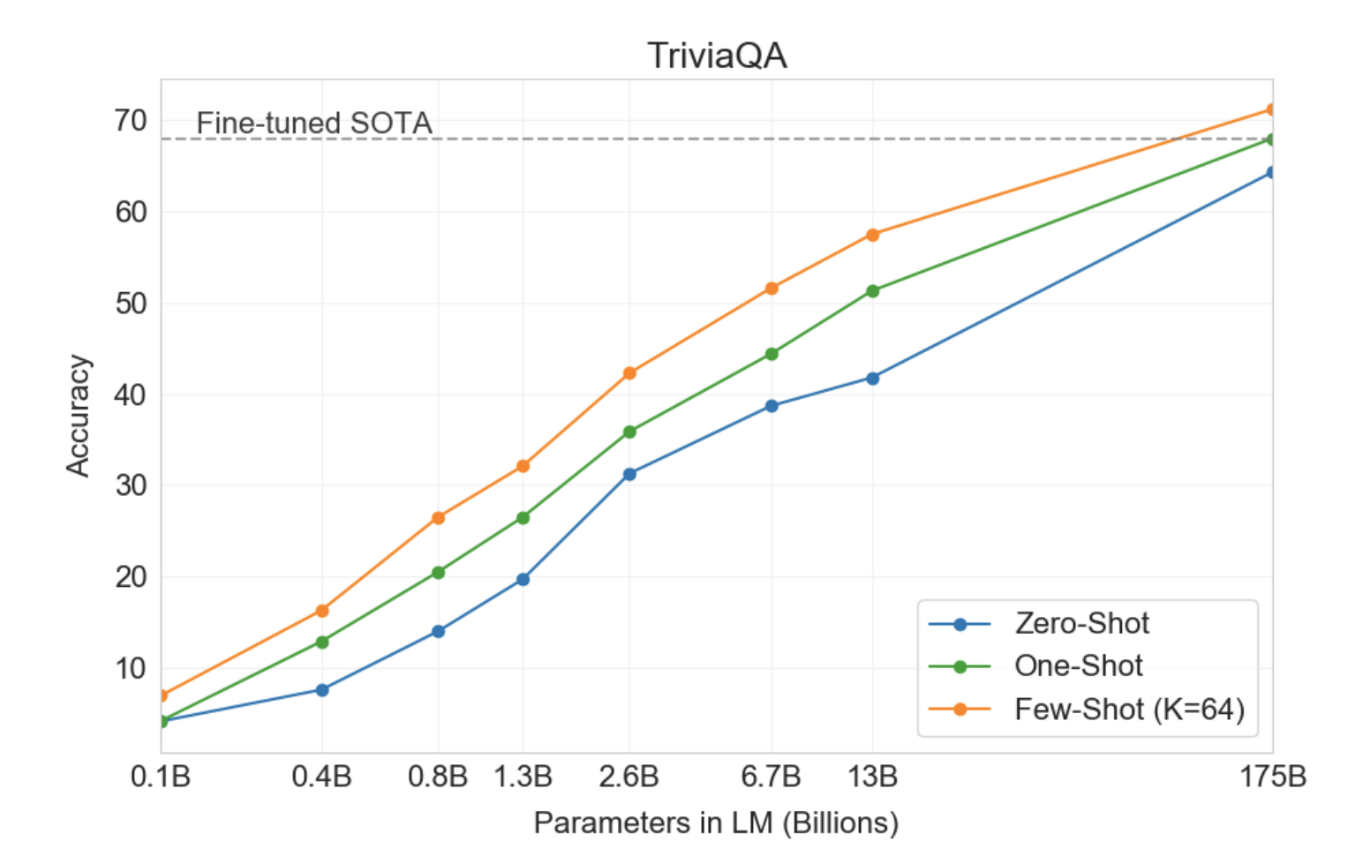
In-Context Learning
Few-shot > One-shot > Zero-shot
Brown et al. “Language Models are Few-Shot Learners”, NeurIPS 2020

Slide 22
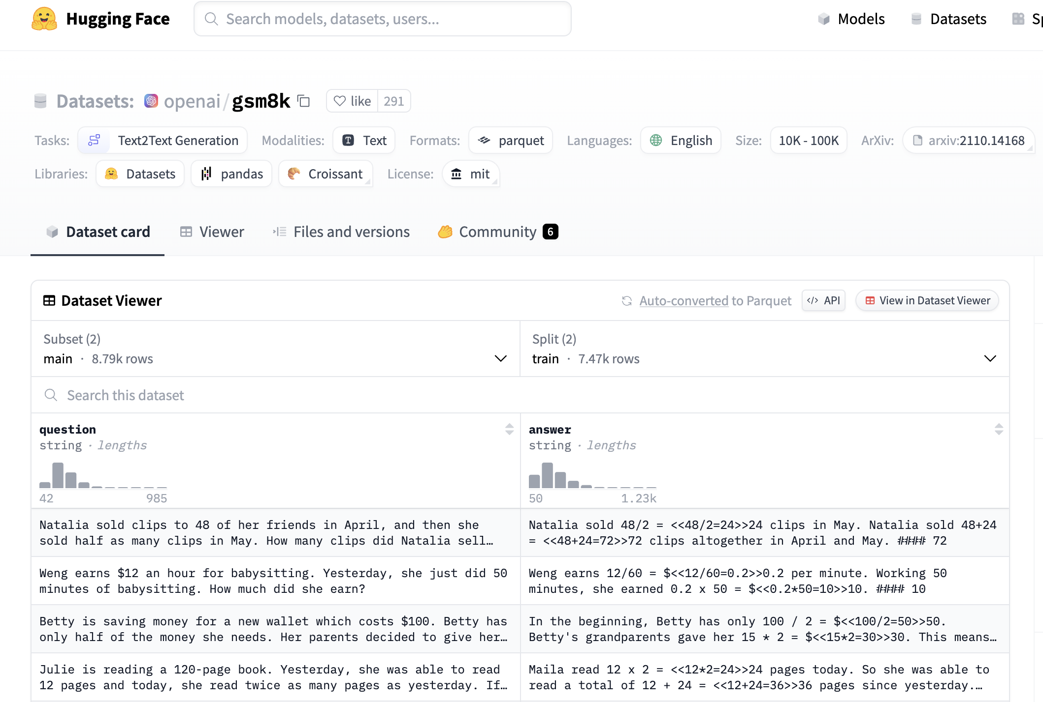
Task 1-1: In-Context Learning
Task: Mathematical Reasoning (GSM8K)
https://huggingface.co/datasets/openai/gsm8k

Slide 23
Task 1-1: In-Context Learning
Examples
Question: Natalia sold clips to 48 of her friends in April, and then she sold half as many clips in May. How many clips did Natalia sell altogether in April and May?
Answer: Natalia sold 48/2 = <<48/2=24>>24 clips in May. Natalia sold 48+24 = <<48+24=72>>72 clips altogether in April and May. #### 72
https://huggingface.co/datasets/openai/gsm8k

Slide 24
Task 1-1: In-Context Learning
In-context demonstration construction
[Example 1]
Input:
~~~
Output:
~~~
…
[Example 4]
Input:
~~~
Output:
https://huggingface.co/datasets/openai/gsm8k

Slide 25
Task 1-1: In-Context Learning
In-context demonstration construction
[Example 1]
Input:
~~~
Output:
~~~
…
[Example 4]
Input:
~~~
Output: LLM will generate output after this identifier!
https://huggingface.co/datasets/openai/gsm8k

Slide 26
Grok API
Through Grok API, you can get generation results of various chat models.

Slide 27
Instruction Tuning

Slide 28
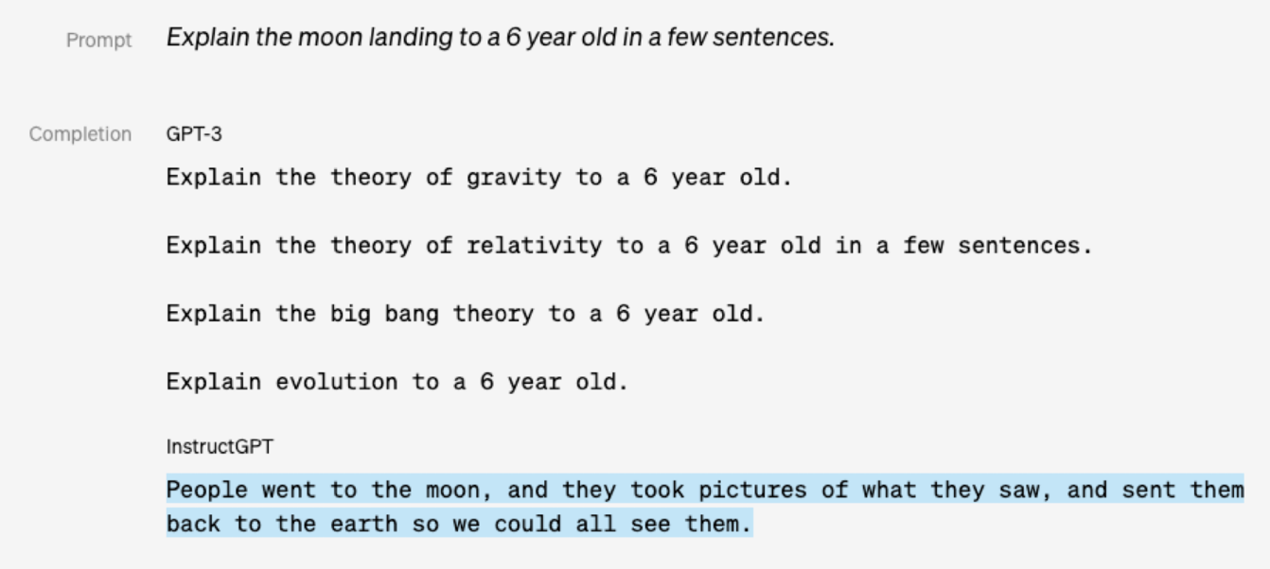
Challenges of Pre-trained LLMs
Even LLMs suffer to understand human’s intention and value
LLM’s are trained to predict next token
Low-quality data in web
Ouyang et al., “Training Language Models to Follow Instructions with Human Feedback”, NeurIPS 2022
https://openai.com/index/instruction-following/

Slide 29
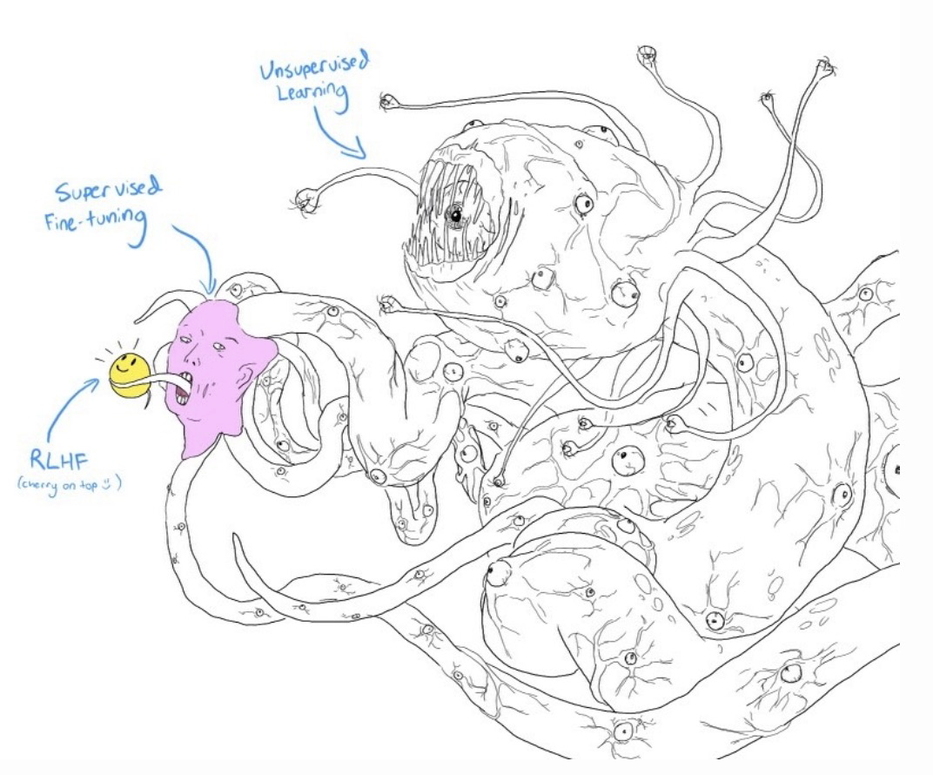
Challenges of Pre-trained LLMs
https://openai.com/index/instruction-following/

Slide 30
Instruction Tuning
Previous: Learning mapping from input to output without instruction

Slide 31
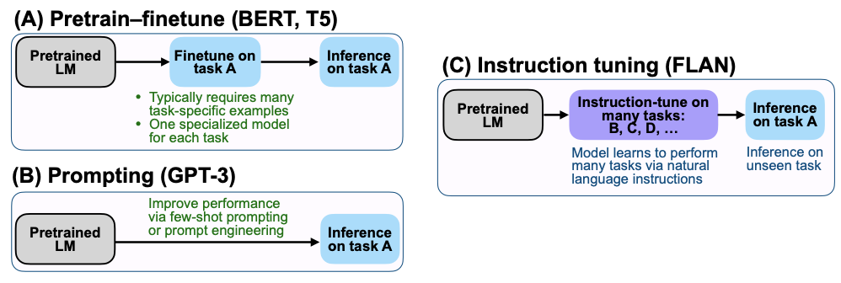
Instruction Tuning
Previous: Learning mapping from input to output without instruction
Now: Training LMs to follow instructions that describe the tasks asked for LMs to complete
Wei et al., “Finetuned Language Models are Zero-shot Learners”, ICLR 2022

Slide 32
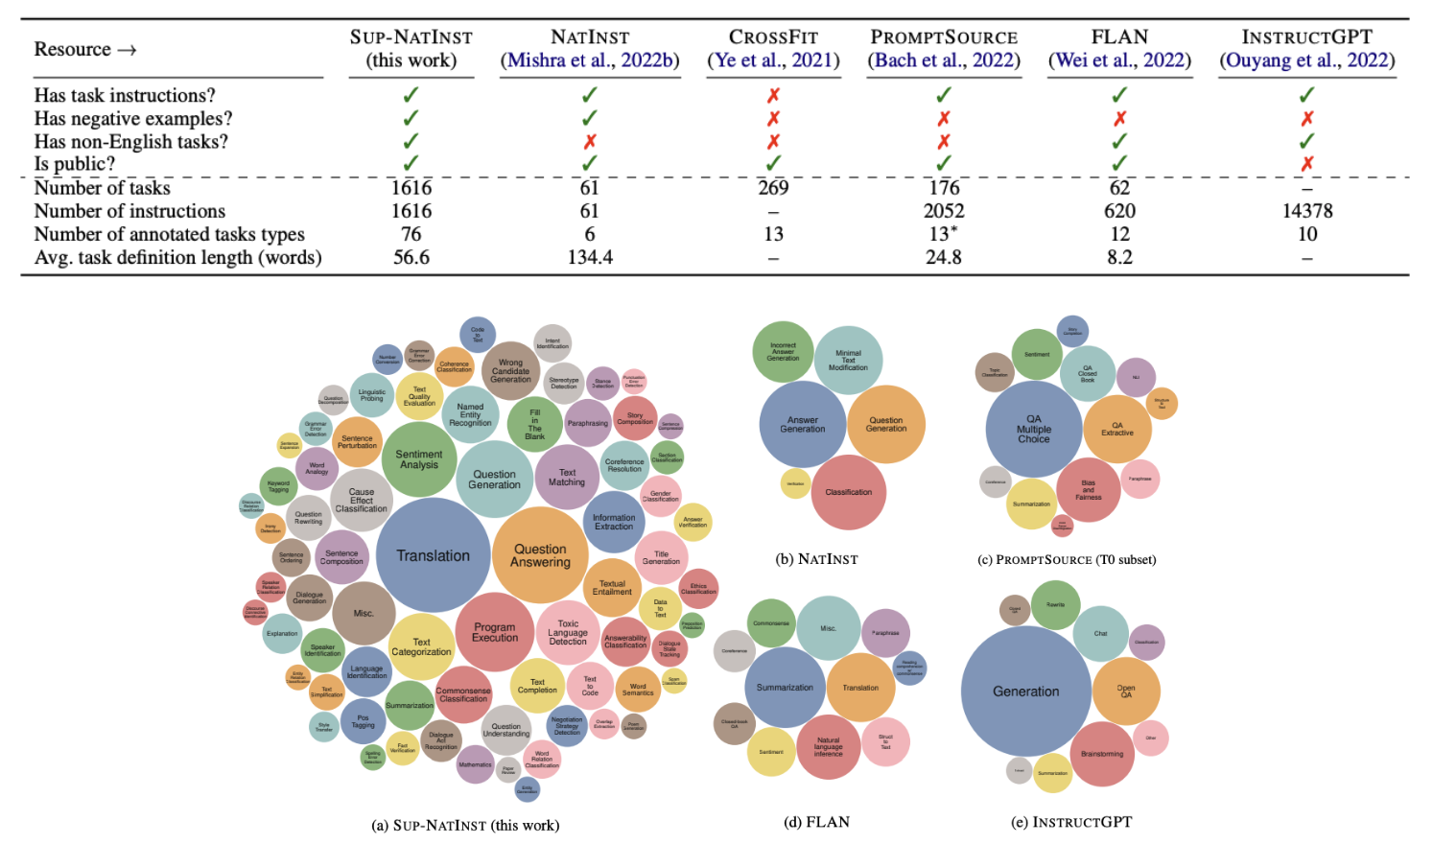
Instruction Tuning
Instruction following capabilities are generalized to unseen tasks
Wang et al., “Super-NaturalInstructions: Generalization via Declarative Instructions on 1600+ NLP Tasks”, EMNLP 2022

Slide 33
Task 1-2: Instruction following LMs
Task: Add instruction and also see the zero-shot performance!
### Instruction: ~~~
[Example 1]
Input:
~~~
Output:
~~~
…
[Example 4]
Input:
~~~
Output:

Slide 34
Task 1-2: Instruction following LMs
Task: Add instruction and also see the zero-shot performance!
### Instruction: ~~~
[Example 1]
Input:
~~~
Output:
Zero shot!

Slide 35
How can we better use LLMs?

Slide 36
Chain-of-Thought Prompting

Slide 37
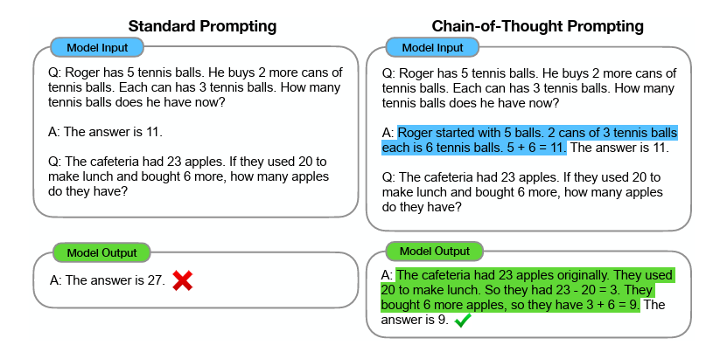
Chain-of-Thought Prompting
LLMs can improve their reasoning capabilities through intermediate natural language reasoning steps before generating answer
Emergent phenomenon in LLMs
Wei et al. “Chain-of-Thought Prompting Elicits Reasoning in Large Language Models”, NeurIPS 2022

Slide 38
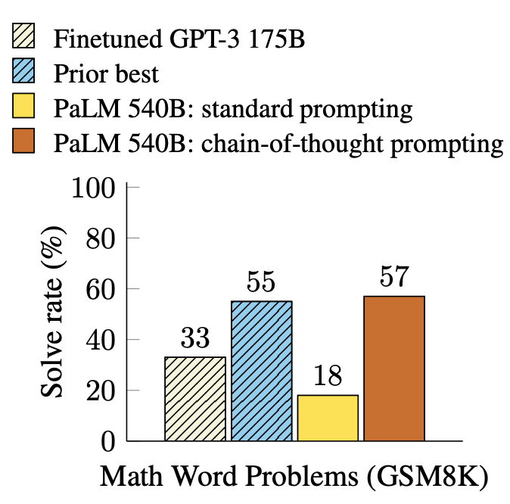
Chain-of-Thought Prompting
CoT outperforms standard prompting by a large margin and achieves new state-of-the-art performance.
Even better performance than fine-tuned LLMs.
Wei et al. “Chain-of-Thought Prompting Elicits Reasoning in Large Language Models”, NeurIPS 2022

Slide 39
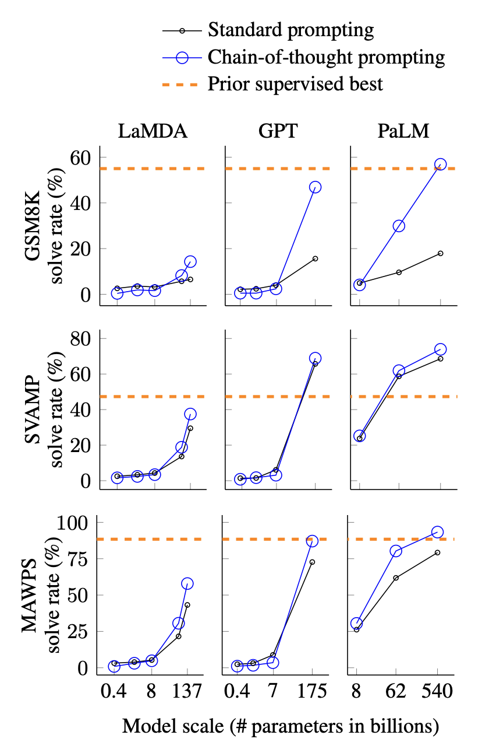
Chain-of-Thought Prompting
CoT is an emergent phenomenon of the LLMs
Model scale
Wei et al. “Chain-of-Thought Prompting Elicits Reasoning in Large Language Models”, NeurIPS 2022

Slide 40
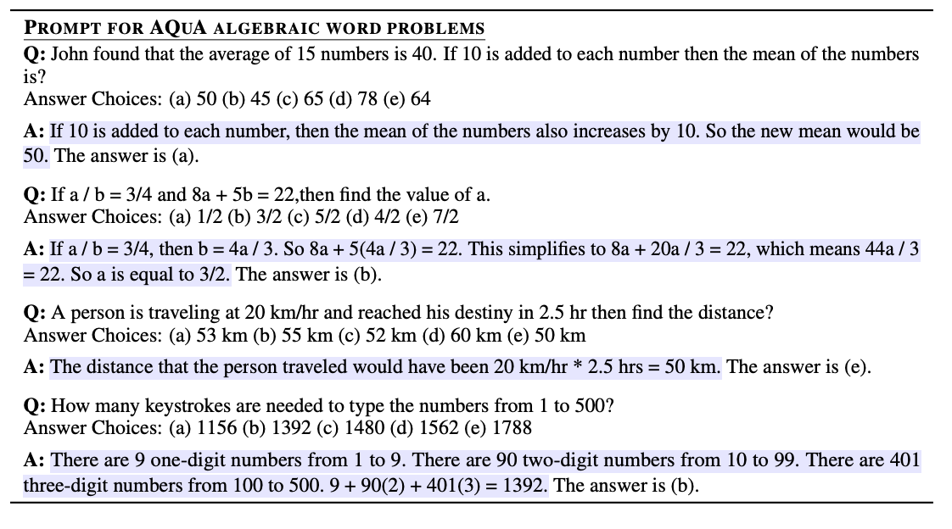
Chain-of-Thought Prompting
How to generate intermediate reasoning steps?
Few shot demonstrations!!!
Wei et al. “Chain-of-Thought Prompting Elicits Reasoning in Large Language Models”, NeurIPS 2022

Slide 41
Task 2-1: CoT Prompting
Solve GSM8K with Chain-of-Thought!!
Better with instruction??
[Example 1]
Input:
~~~
Output:
In the beginning, Betty has only 100 / 2 = $<<100/2=50>>50.
Betty's grandparents gave her 15 * 2 = $<<15*2=30>>30.
This means, Betty needs 100 - 50 - 30 - 15 = $<<100-50-30-15=5>>5 more.
#### 5
…
[Example 4]
Input:
~~~
Output:

Slide 42
Task 2-1: CoT Prompting
How about Zero-shot CoT??
Add the instruction?
### Instruction: Generate the answer with rationale~~~
[Example 1]
Input:
~~~
Output:

Slide 43
Zero-shot
Chain-of-Thought Prompting

Slide 44
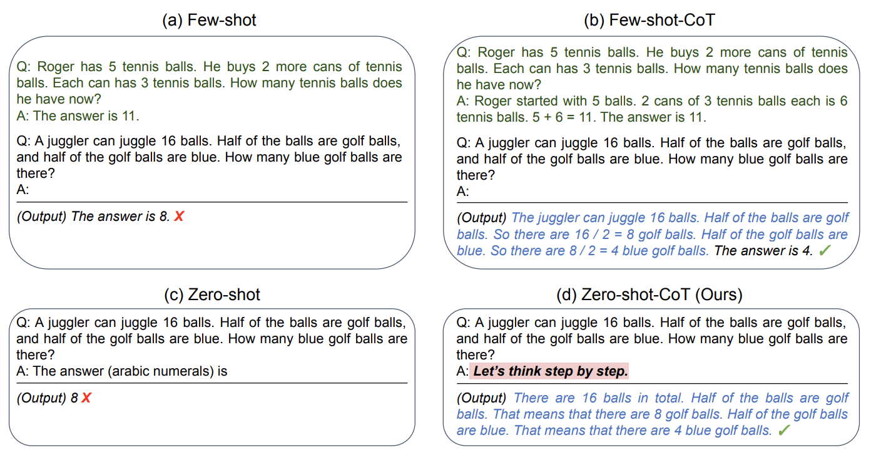
Zero-shot CoT
How can we generate reasoning steps without any demonstrations?
Kojima et al. “Large language models are zero-shot reasoners.”, NeurIPS 2022

Slide 45
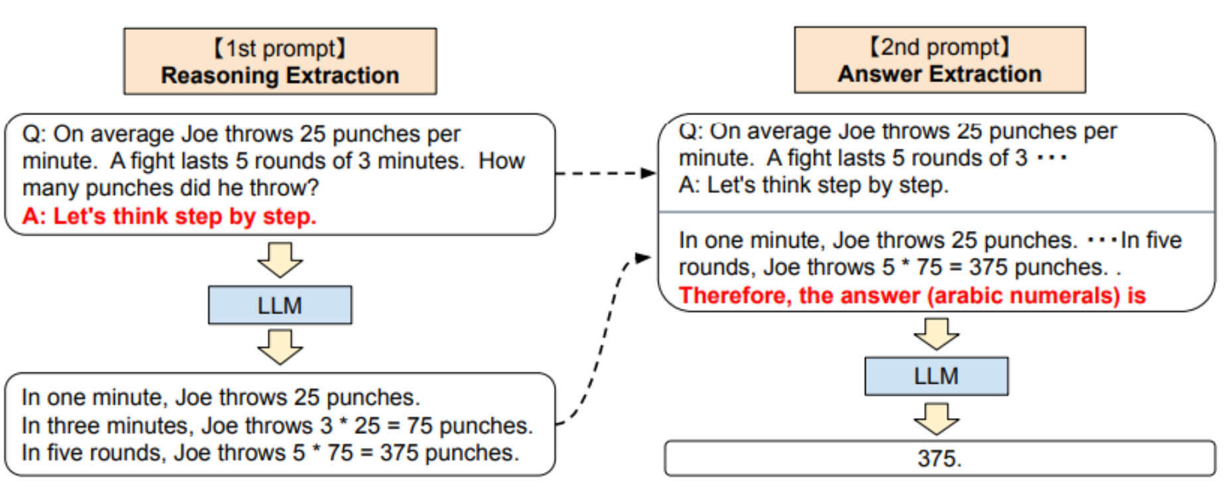
Zero-shot CoT
Two stage prompting
Reasoning extraction and answer extraction
Kojima et al. “Large language models are zero-shot reasoners.”, NeurIPS 2022

Slide 46
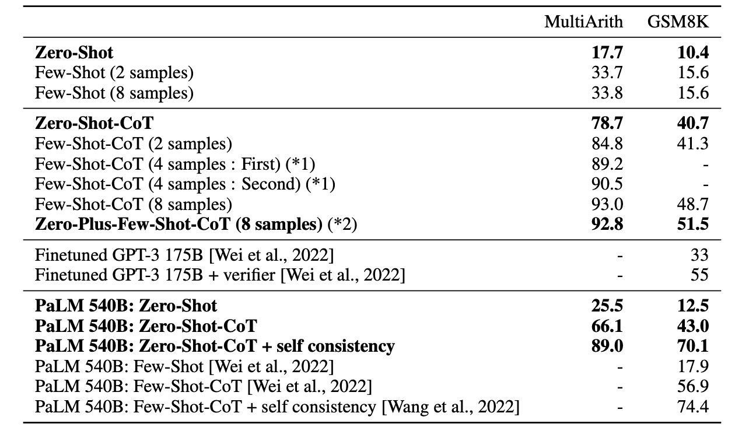
Zero-shot CoT
Two stage prompting
Reasoning extraction and answer extraction
Kojima et al. “Large language models are zero-shot reasoners.”, NeurIPS 2022

Slide 47
Task 2-1: CoT Prompting
Zero-shot CoT with reasoning extraction!
[Example 1]
Input:
~~~
Output:
[Answer]
Let’s think step by step.

Slide 48
Self-Consistency

Slide 49
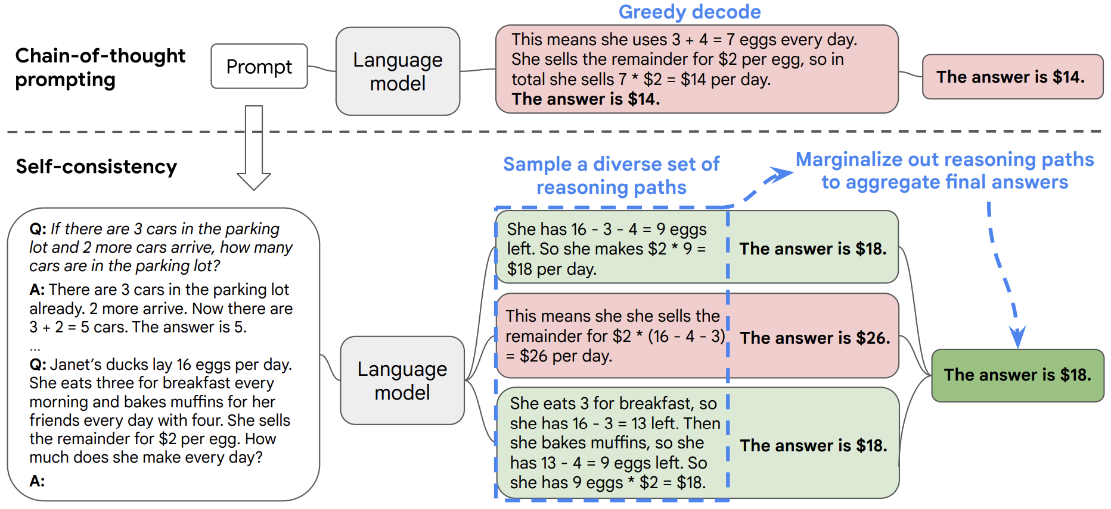
Self-Consistency
CoT decoding strategy: Greedy decoding
Wang et al. “Self-Consistency Improves Chain of Thought Reasoning in Language Models.”, ICLR 2023

Slide 50
Self-Consistency
Complex reasoning tasks admit multiple reasoning paths
The more deliberate thinking is required, the greater the diversity of reasoning path is.
Wang et al. “Self-Consistency Improves Chain of Thought Reasoning in Language Models.”, ICLR 2023

Slide 51
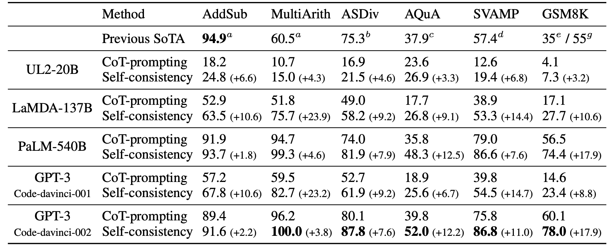
Self-Consistency
Self-consistency significantly improves the reasoning performance
Mathematical reasoning
Wang et al. “Self-Consistency Improves Chain of Thought Reasoning in Language Models.”, ICLR 2023

Slide 52
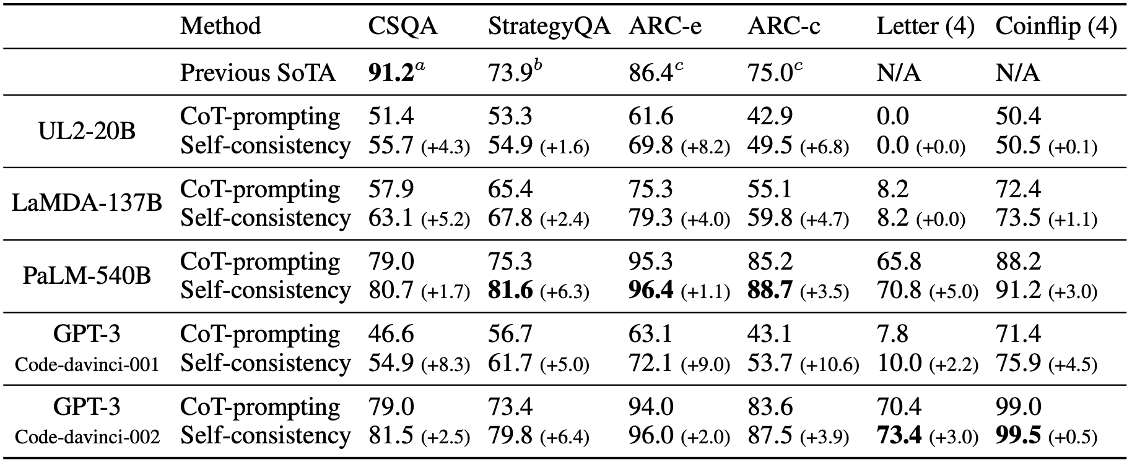
Self-Consistency
Self-consistency significantly improves the reasoning performance
Commonsense reasoning
Wang et al. “Self-Consistency Improves Chain of Thought Reasoning in Language Models.”, ICLR 2023

Slide 53
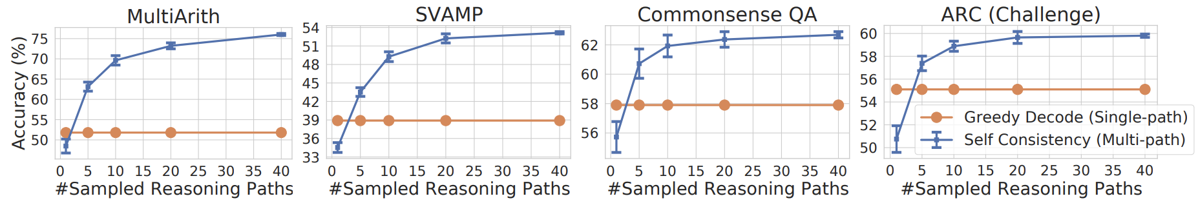
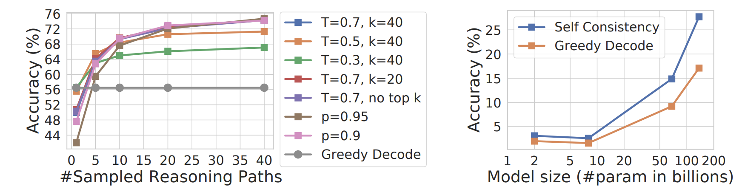
Self-Consistency
Self-consistency significantly improves the reasoning performance
Robust to the number of reasoning paths, sampling strategy and scaling
Wang et al. “Self-Consistency Improves Chain of Thought Reasoning in Language Models.”, ICLR 2023

Slide 54
Task 2-2: Self-consistency
Let’s apply self-consistency!
How? Sample the examples multiple times!
[Example 1]
Input:
~~~
Output:
~~~
…
[Example 4]
Input:
~~~
Output:
[Example 1*]
Input:
~~~
Output:
~~~
…
[Example 4*]
Input:
~~~
Output:

Slide 55
Task 2-2: Self-consistency
Let’s plot the result
1~5 times

Slide 56
ReAct

Slide 57
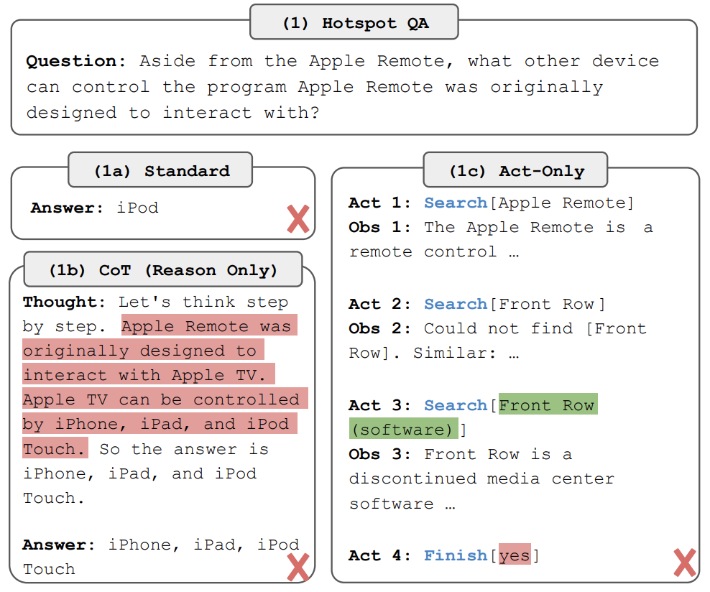
ReAct
Recent approaches
Reasoning only: Internal representation only, not grounded in external world -> hallucination, error propagation
Actions: generate domain-specific actions or plans, and then use a controller to choose or execute them -> No reasoning abstractly about high-level goals
Yao et al. “ReAct: Synergizing Reasoning and Acting in Language Models”, ICLR 2023

Slide 58
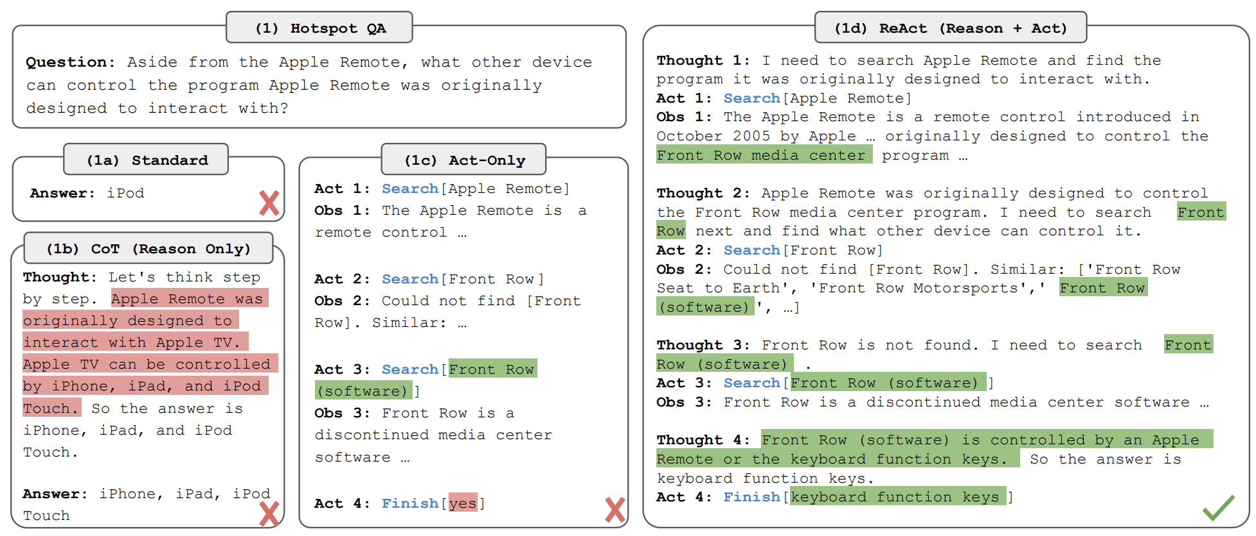
ReAct
Reasoning + Acting
Prompt LLMs to generate both verbal reasoning traces and actions pertaining to a task
Yao et al. “ReAct: Synergizing Reasoning and Acting in Language Models”, ICLR 2023

Slide 59
ReAct
Yao et al. “ReAct: Synergizing Reasoning and Acting in Language Models”, ICLR 2023

Slide 60
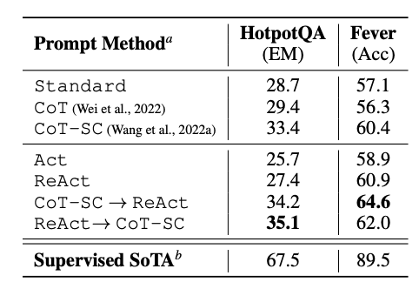
ReAct
Results
HotpotQA: CoT outperforms
Fever: Fact verification -> ReAct outperforms
SC: Self-consistency
Yao et al. “ReAct: Synergizing Reasoning and Acting in Language Models”, ICLR 2023

Slide 61
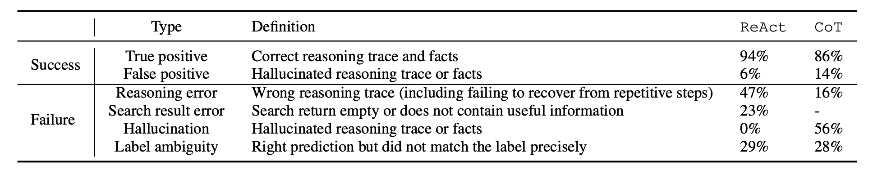
ReAct
ReAct significantly mitigates the hallucination issue of CoT
Yao et al. “ReAct: Synergizing Reasoning and Acting in Language Models”, ICLR 2023

Slide 62
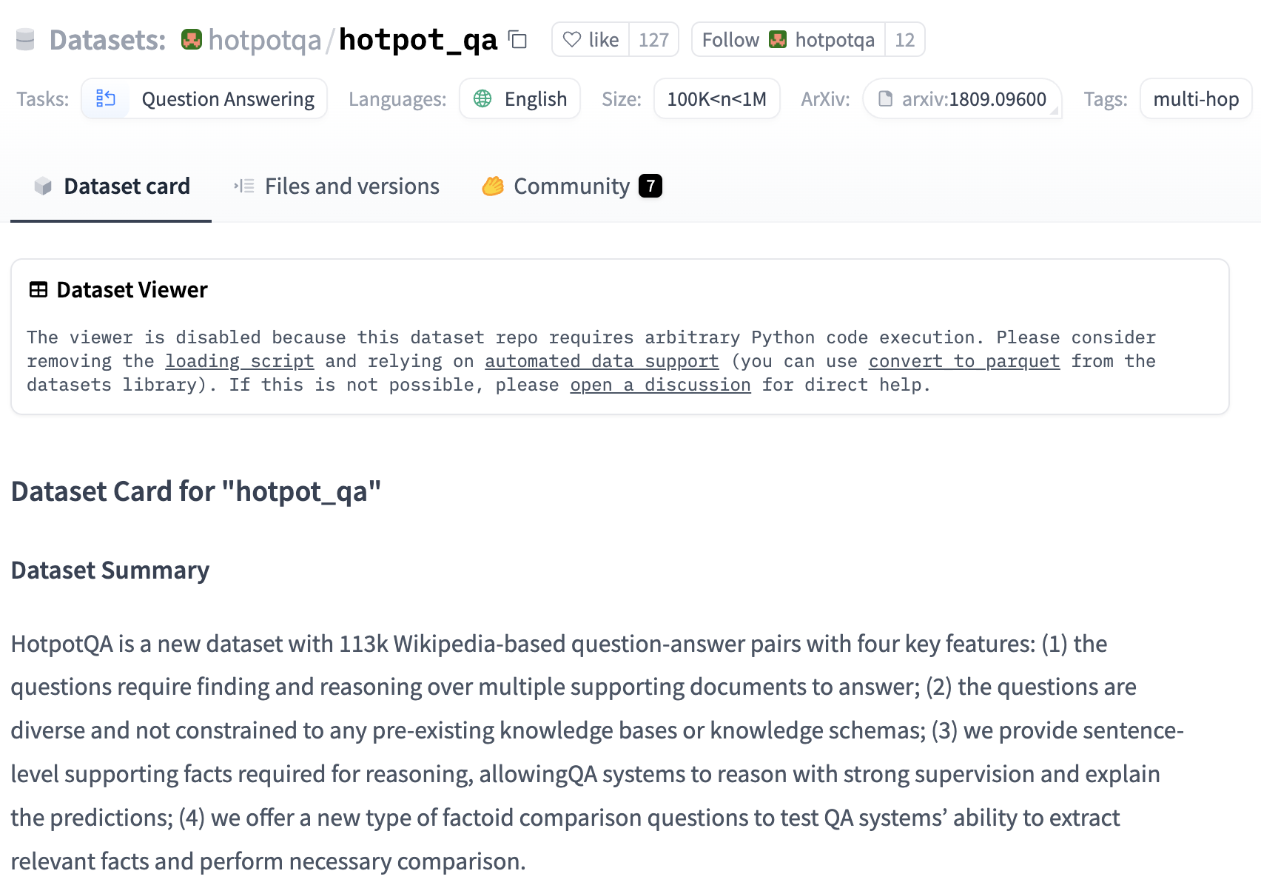
Task 2-3: ReAct
Task: Wikipedia-based question answering task
HotpotQA

Slide 63
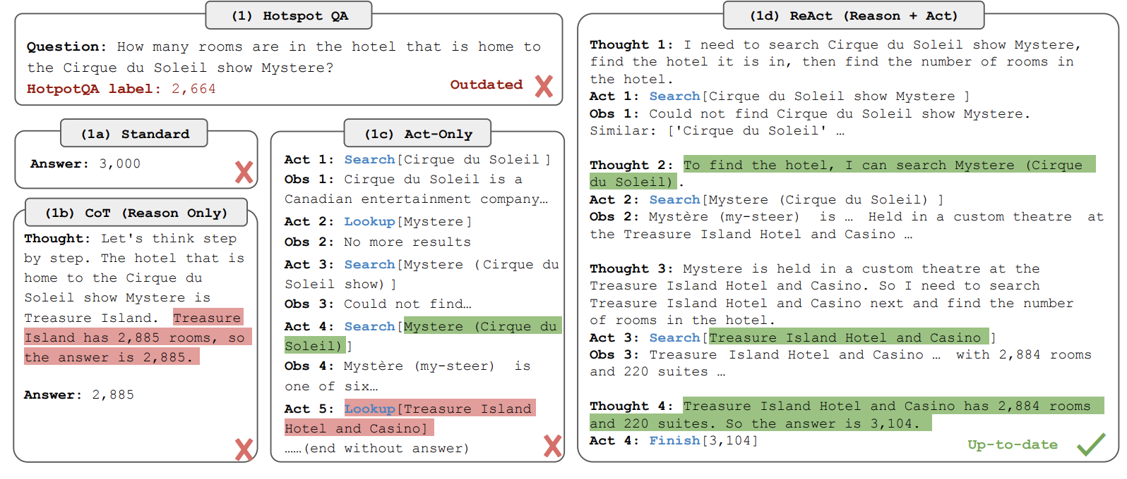
Task 2-3: ReAct
What to do
Let’s compare the performance of CoT / Act / ReAct

