Slide 1
Retrieval Augmented Generation (RAG) &
Agent System
Taeyoon Kwon
LangAGI Lab, Yonsei University

Slide 2
Contents
Build a simple AI chatbot
Retrieval Augmented Generation (RAG)
LLM Agents

Slide 3
Goal of this lecture
Learn how to use langchain and to build an AI chatbot
Understand the basics of retrieval augmented generation (RAG) and learn how to build a RAG system
Understand the basic concepts of LLM agents

Slide 4
Build a simple AI chatbot

Slide 5
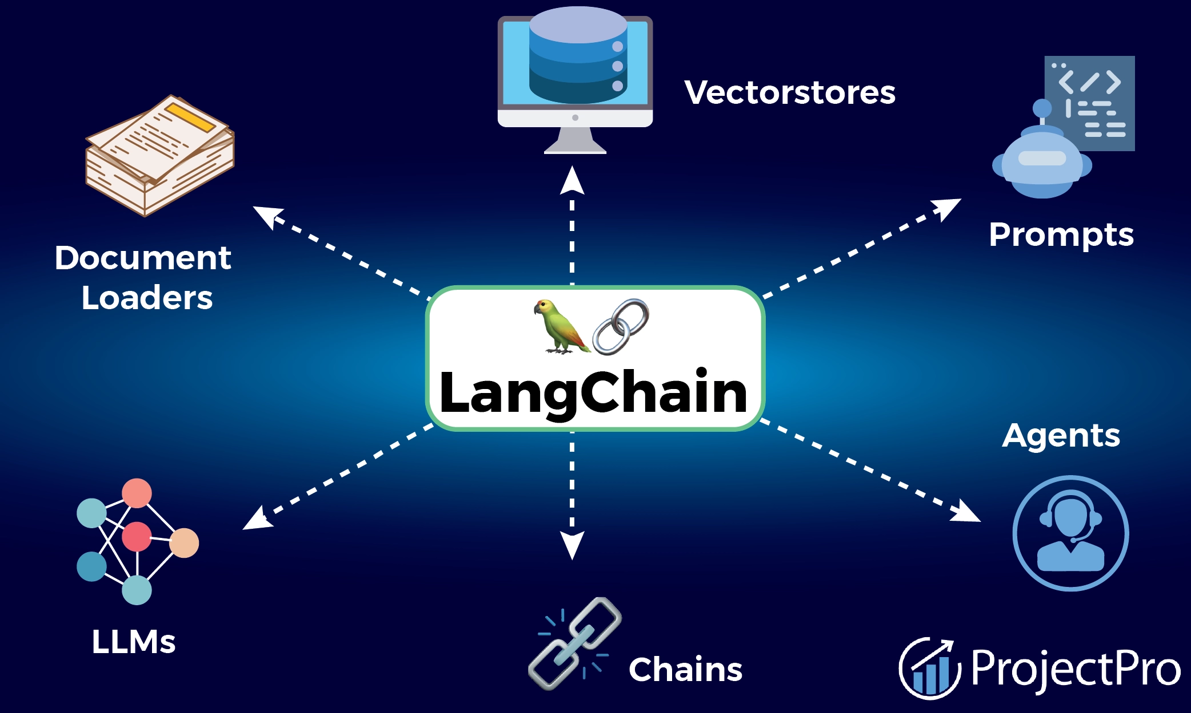
Part 1. Build a simple AI chatbot
What is Langchain?
LangChain is a framework for developing applications powered by frontier AI models
https://python.langchain.com/docs/introduction/
내용을
입력하세요

Slide 6
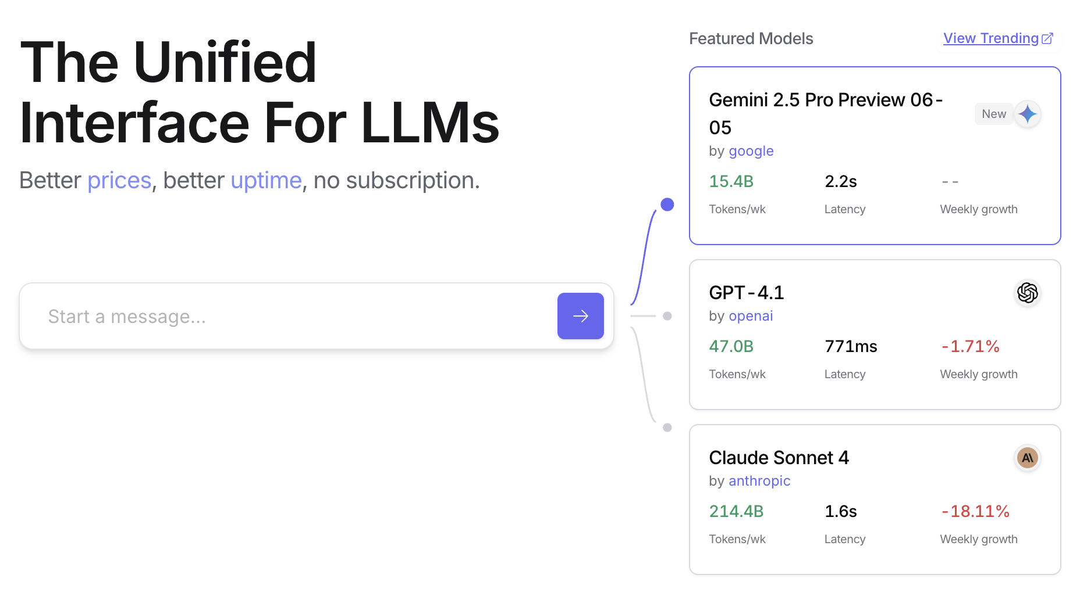
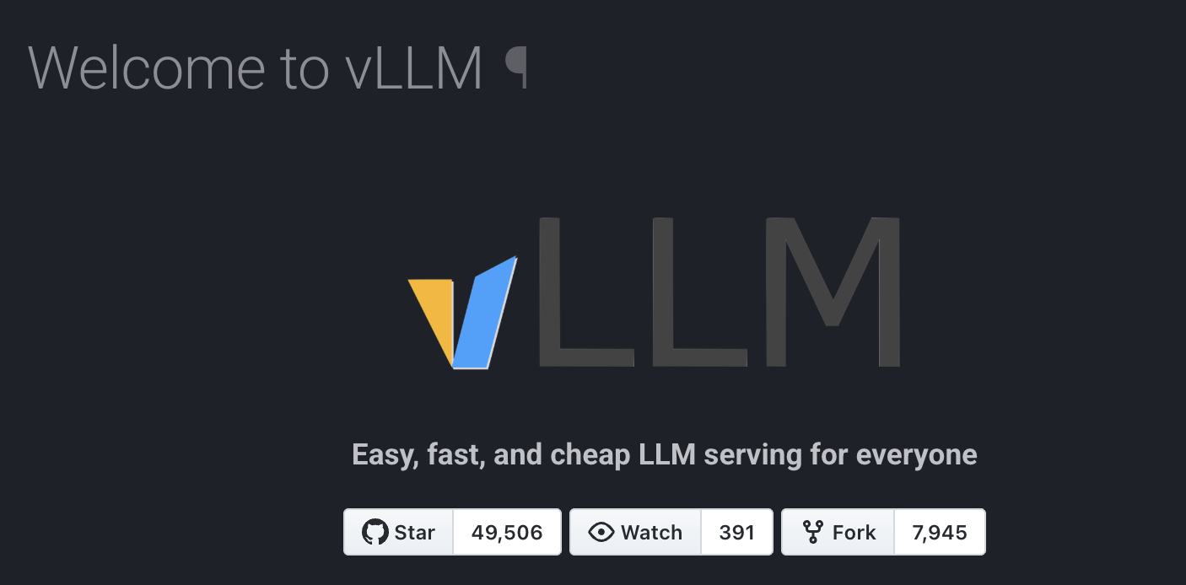
Part 1. Build a simple AI chatbot
Model inference
API inference
Groq (https://groq.com/) , Openrouter (https://openrouter.ai/), etc
Local server inference
vLLM (https://docs.vllm.ai/en/latest/)
내용을
입력하세요

Slide 7
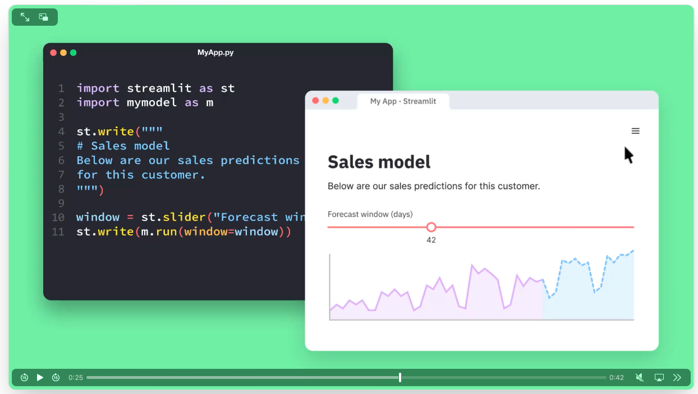
Part 1. Build a simple AI chatbot
Streamlit
https://streamlit.io/
내용을
입력하세요

Slide 8
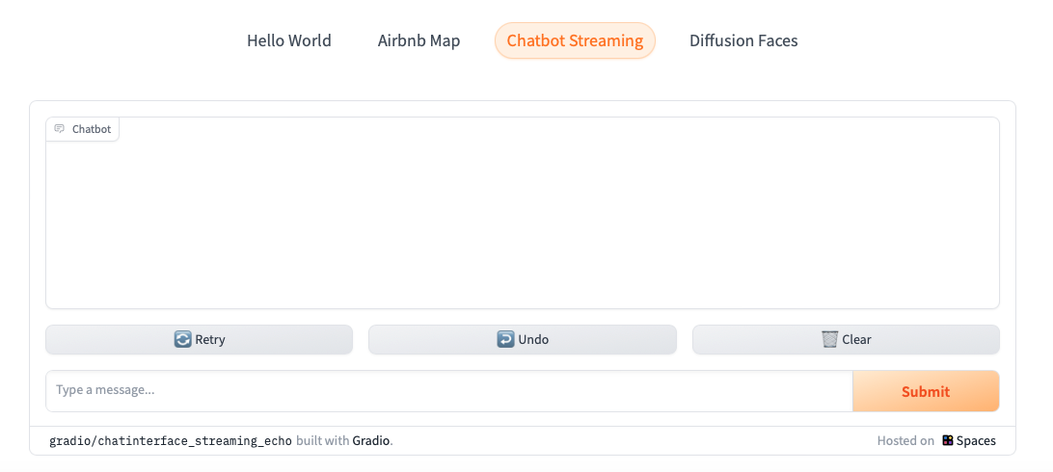
Part 1. Build a simple AI chatbot
Gradio
https://www.gradio.app/
내용을
입력하세요

Slide 9

Part 1. Build a simple AI chatbot
Tips for prompt engineering
Terminologies
Instruction - a specific task or instruction you want the model to perform
Context - external information or additional context that can steer the model to better responses
Input data - the input or question that we are interested to find a response for
Output indicator - the type or format of the output
Use some clear separator like “###” or “[]”
It’s often better to be specific and direct
Avoid saying what not to do but say what to do instead
내용을
입력하세요
Notes:
2. Use some clear separator like "###"

Slide 10
Part 1. Build a simple AI chatbot
Hands On
Chatbot with Visualization
AI Tutor Chatbot
영어 문법 교정을 잡아주는 AI Tutor
Scenario: 유저는 틀린 영어 문장을 input으로 넣음
Requirements: AI Tutor는 (1) 수정된 문과 (2) paraphrase 한 문장 두개를 유저에게 제공해야함
Twenty Questions Game AI Chatbot
스무고개 게임을 하는 AI Chatbot
Scenario: AI가 예상하는 동물을 유저가 맞추는 게임을 진행하는 Chatbot, 유저의 질문에 따라 예, 아니요로 답해야 함
Requirements: 유저가 답이 뭔지 물어도 (20번이 되도) 절대 답을 알려주면 안됨
내용을
입력하세요

Slide 11
Retrieval Augmented Generation (RAG)

Slide 12

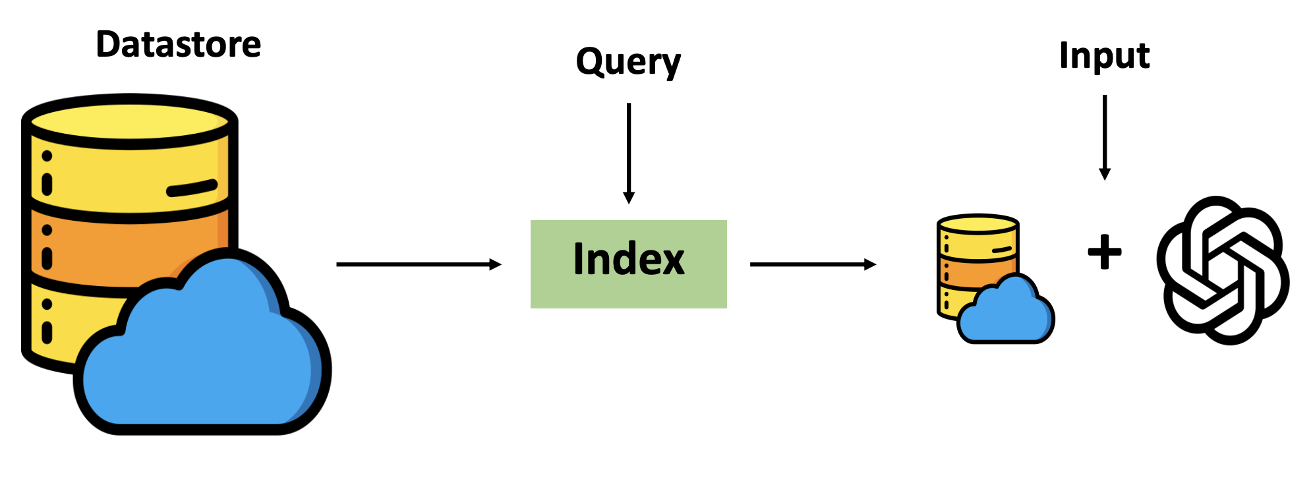
Part 2. Retrieval Augmented Generation (RAG)
Retrieval-based language models
Information Retrieval + Language Models
Retrieve information from external datastore (at least during inference time)
내용을
입력하세요

Slide 13
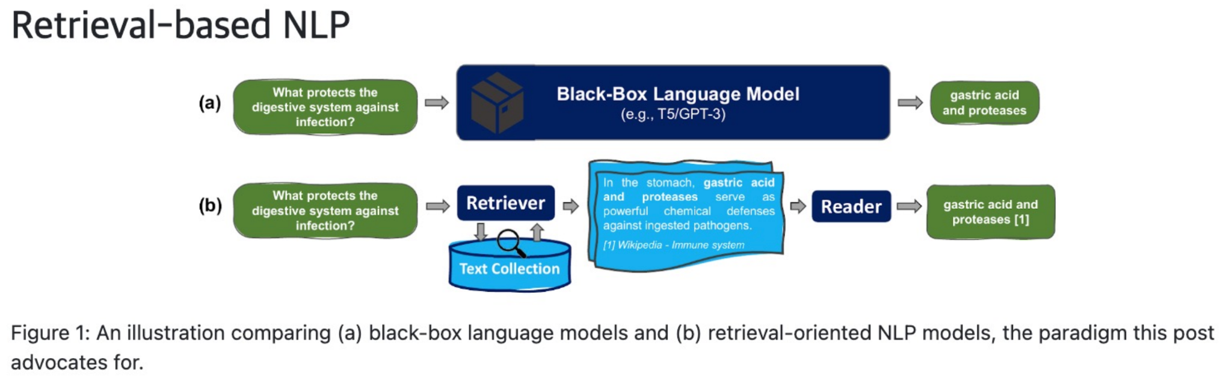
Part 2. Retrieval Augmented Generation (RAG)
Retrieval-based language models
내용을
입력하세요

Slide 14
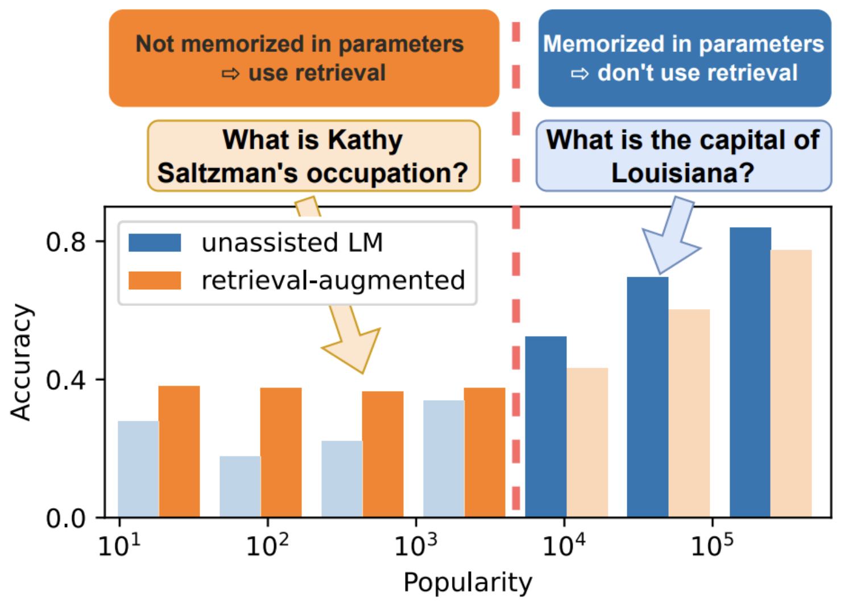
Part 2. Retrieval Augmented Generation (RAG)
Why retrieval-based language models?
LLMs cannot memorize all (long-tail) knowledge in their parameters
내용을
입력하세요
Notes:
It retrieves from an external datastore (at least during inference time)

Slide 15
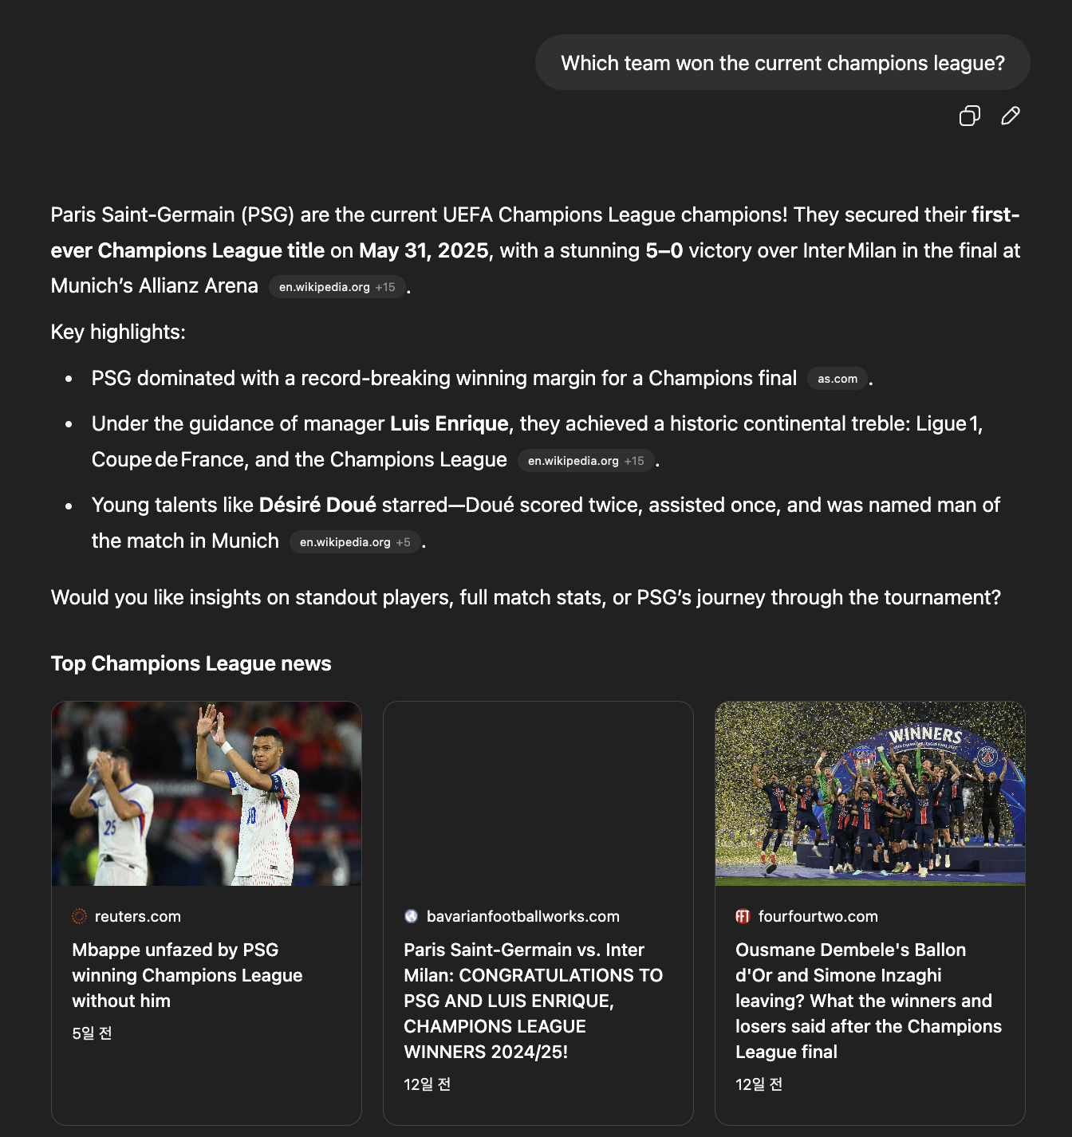
Part 2. Retrieval Augmented Generation (RAG)
Why retrieval-based language models?
LLMs’ knowledge is easily outdated and hard to update
내용을
입력하세요

Slide 16
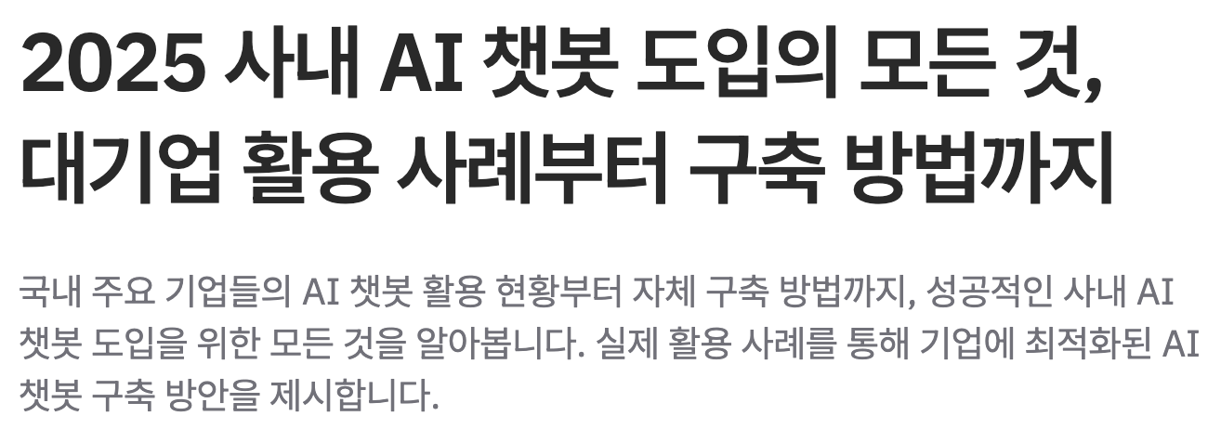

Part 2. Retrieval Augmented Generation (RAG)
Why retrieval-based language models?
Private issues
내용을
입력하세요

Slide 17
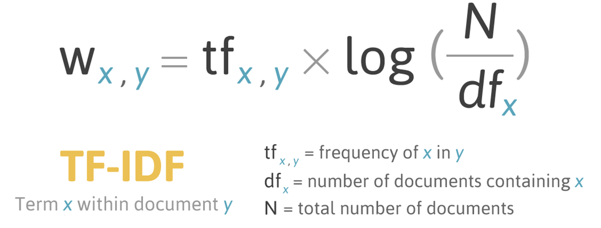
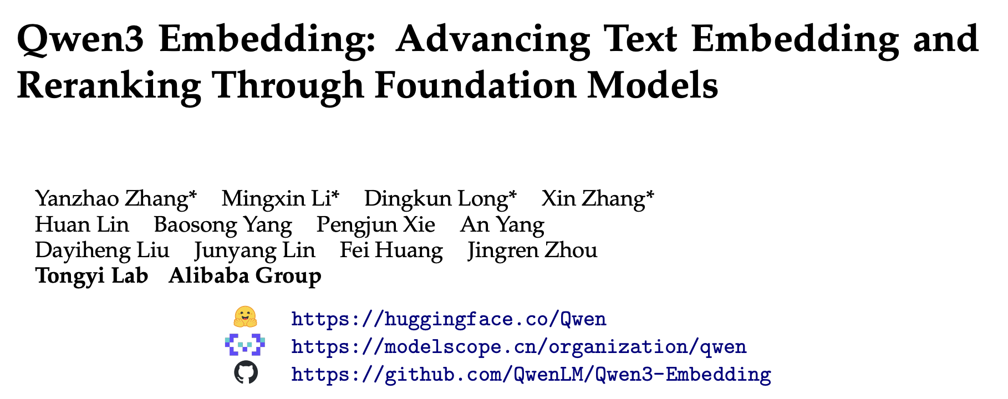
Part 2. Retrieval Augmented Generation (RAG)
Retriever
Sparse retriever
TF-IDF, BM-25
Basis - Lexical (word-level matching)
Dense retriever (embedding based retriever)
DPR, contriever, openai-embeddings, etc
Basis - Semantic similarity (mean-based matching)
내용을
입력하세요

Slide 18
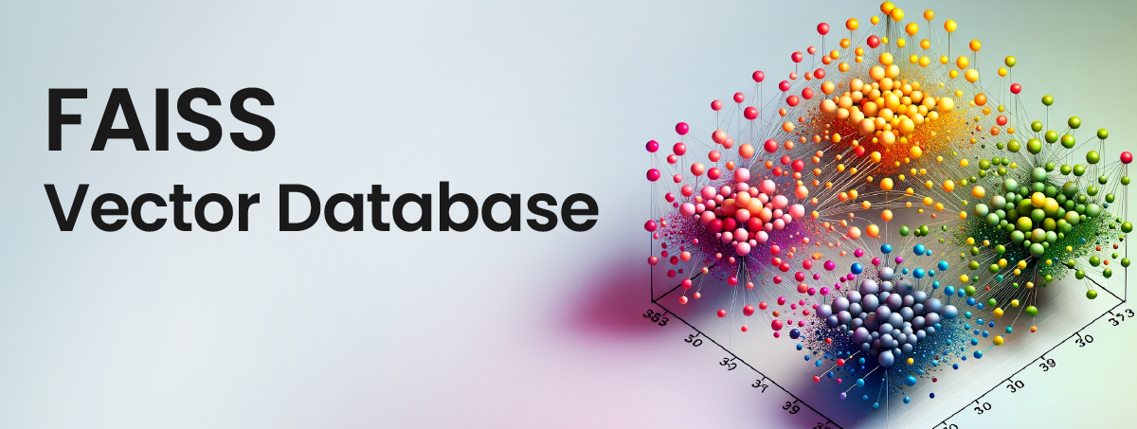
Part 2. Retrieval Augmented Generation (RAG)
Vector store
Database optimized for storing and searching high-dimensional embeddings
Chroma, FAISS
내용을
입력하세요

Slide 19
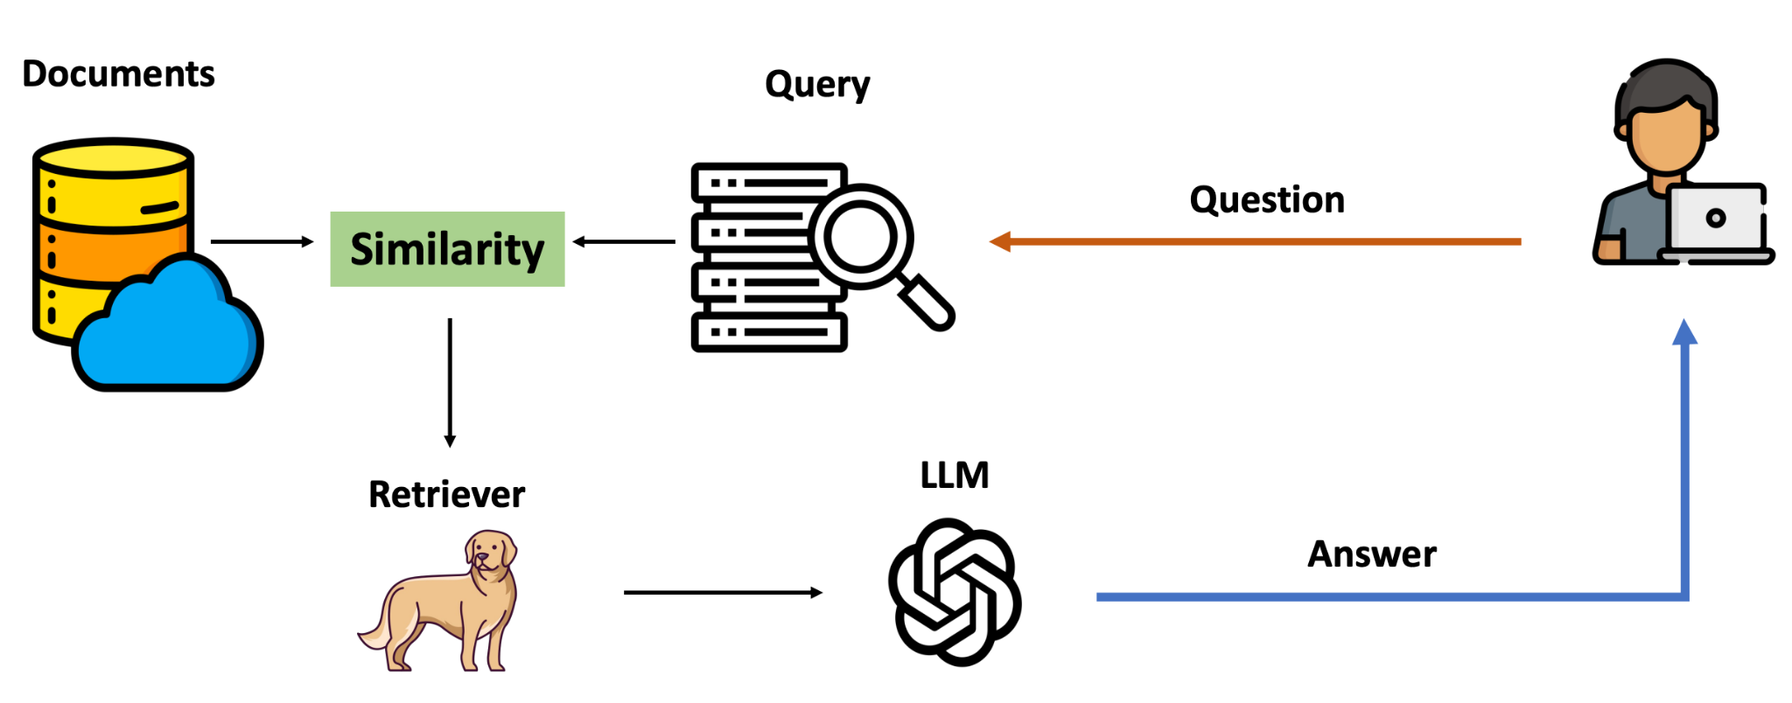
Part 2. Retrieval Augmented Generation (RAG)
Retrieval Augmented Generation (RAG)
내용을
입력하세요

Slide 20
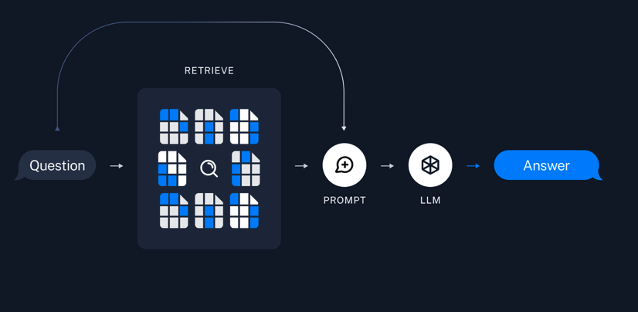
Part 2. Retrieval Augmented Generation (RAG)
Retrieval Augmented Generation (RAG)
내용을
입력하세요

Slide 21
Part 2. Retrieval Augmented Generation (RAG)
Build a RAG system
Basic RAG application
Build a Samsung Chatbot
2024 삼성 지속가능경영보고서 기반의 chatbot
(https://www.samsung.com/sec/sustainability/media/pdf/Samsung_Electronics_Sustainability_Report_2024_KOR.pdf)
Build a Debate workflow system
Agent 1 - 특정 주제에 대해 찬성
Agent 2 - 특정 주제에 대해 반대
내용을
입력하세요

Slide 22
LLM Agents

Slide 23
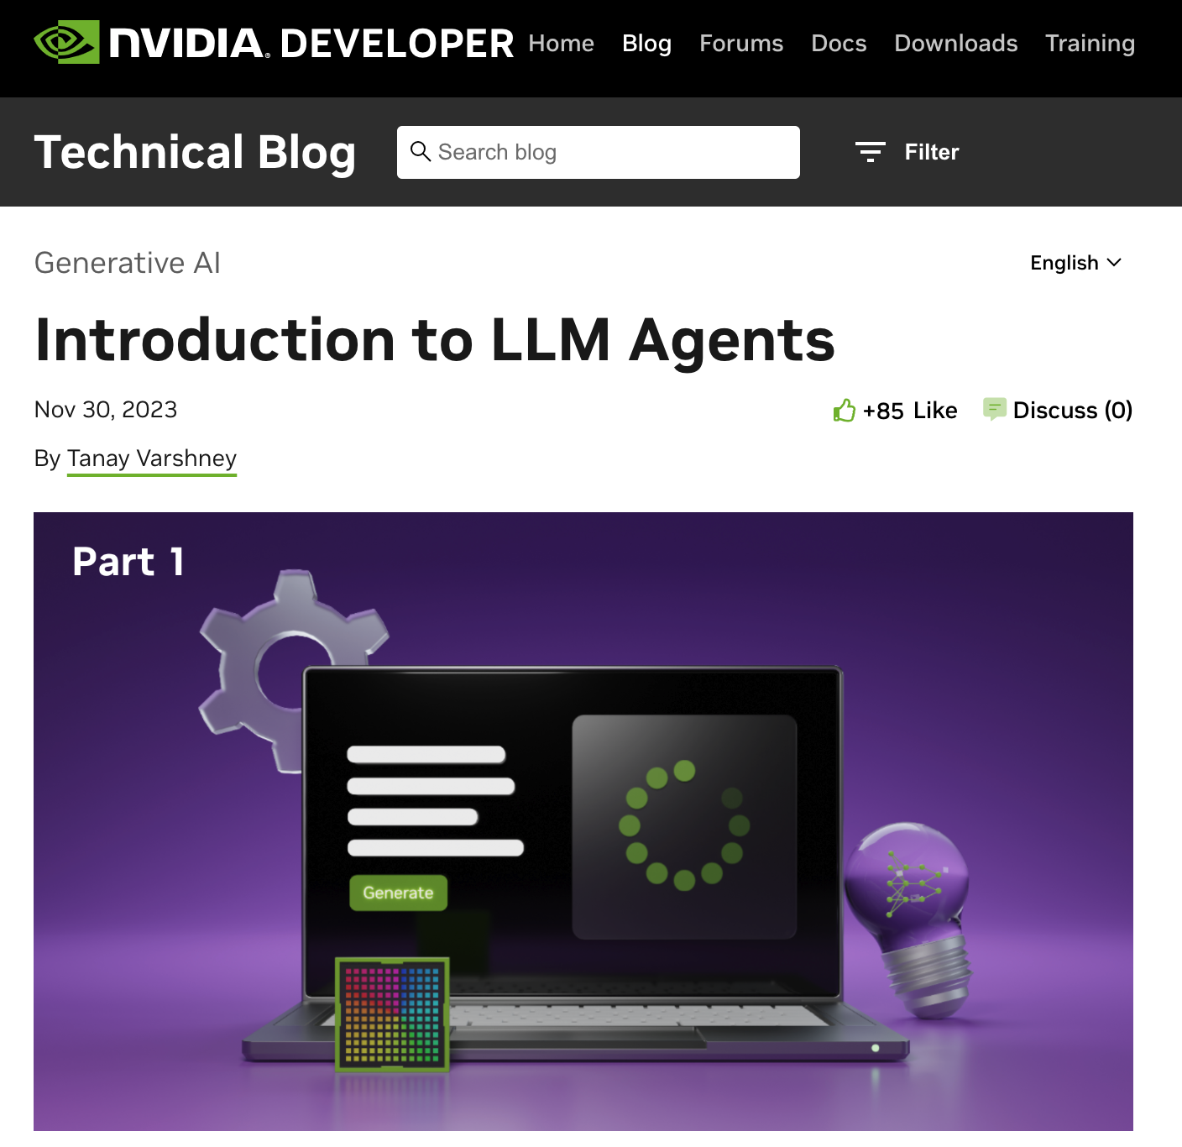
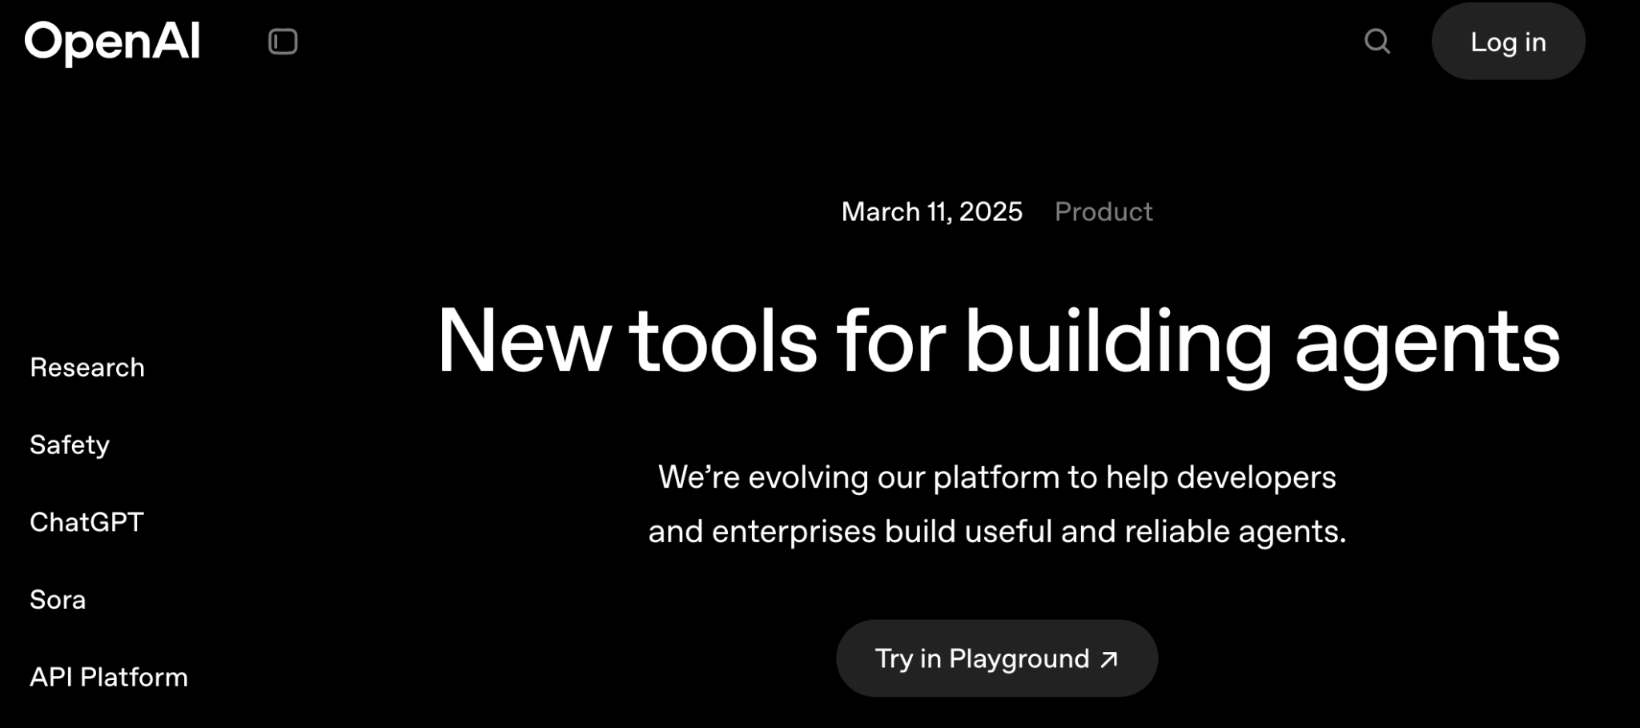
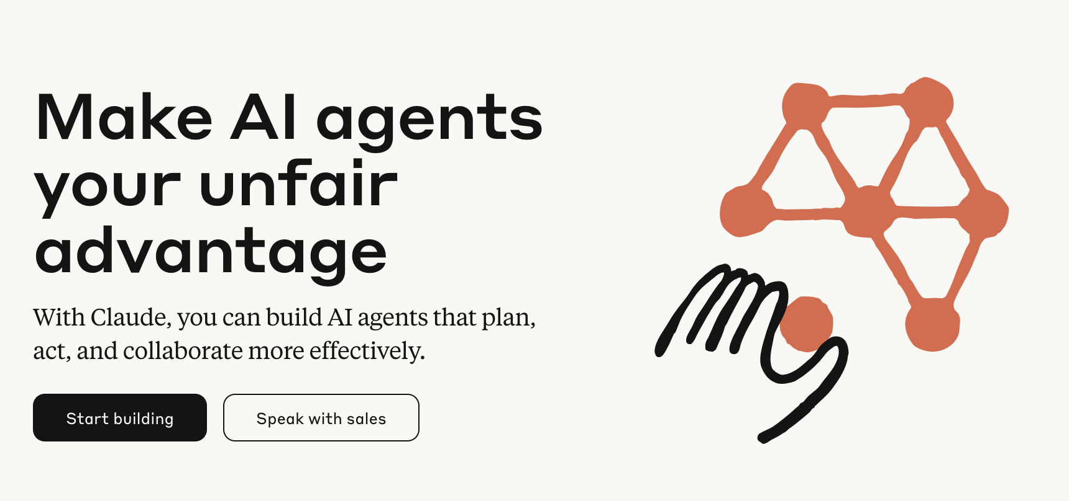
Part 3. LLM Agents
AI Agents
Recently AI/LLM agents are getting a lot of attention
내용을
입력하세요

Slide 24
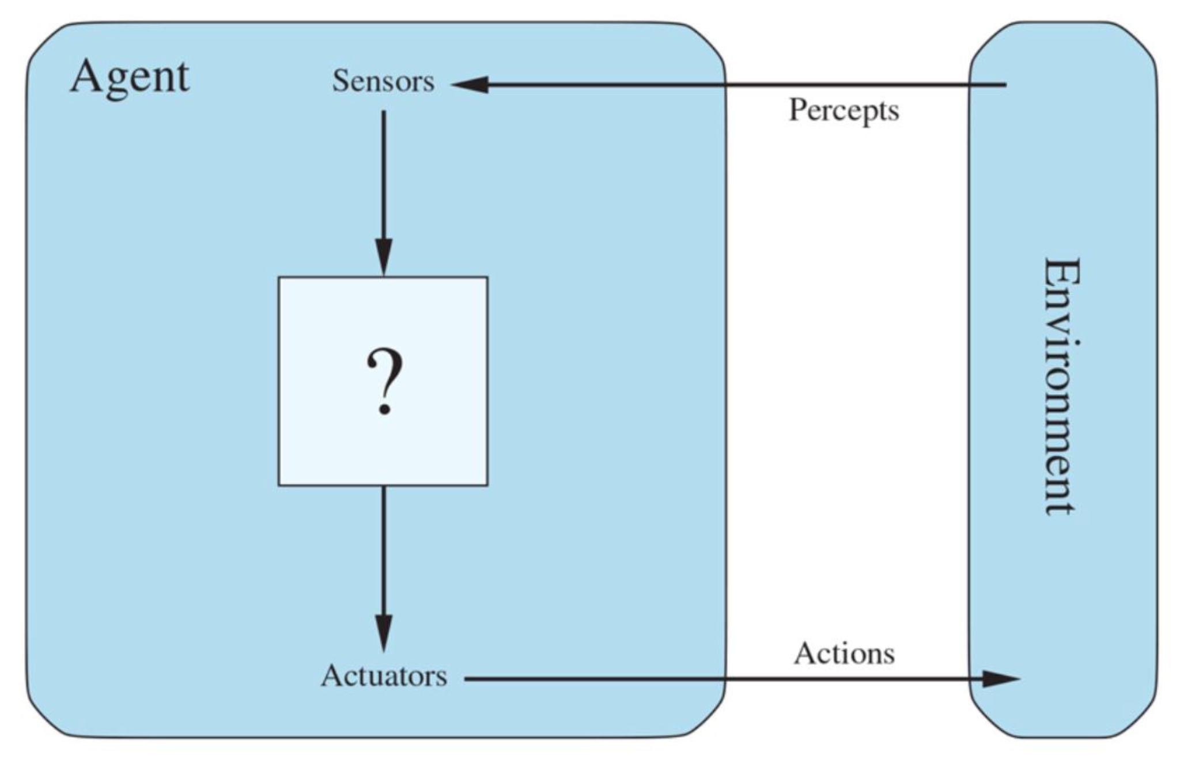
Part 3. LLM Agents
Agent
What is the Agent?
Anything that can be viewed as perceiving its environment through sensors and acting upon that environment through actuators – Russell & Norvig, AI: A Modern Approach (2020)

Slide 25
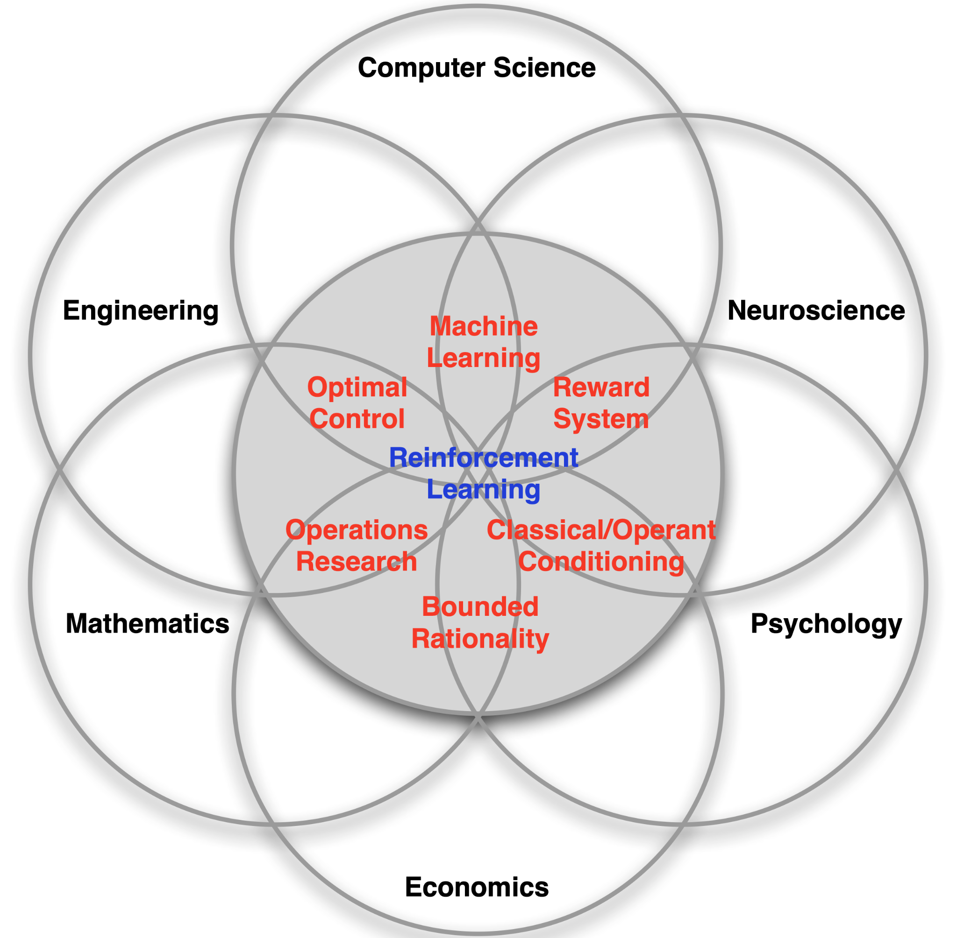
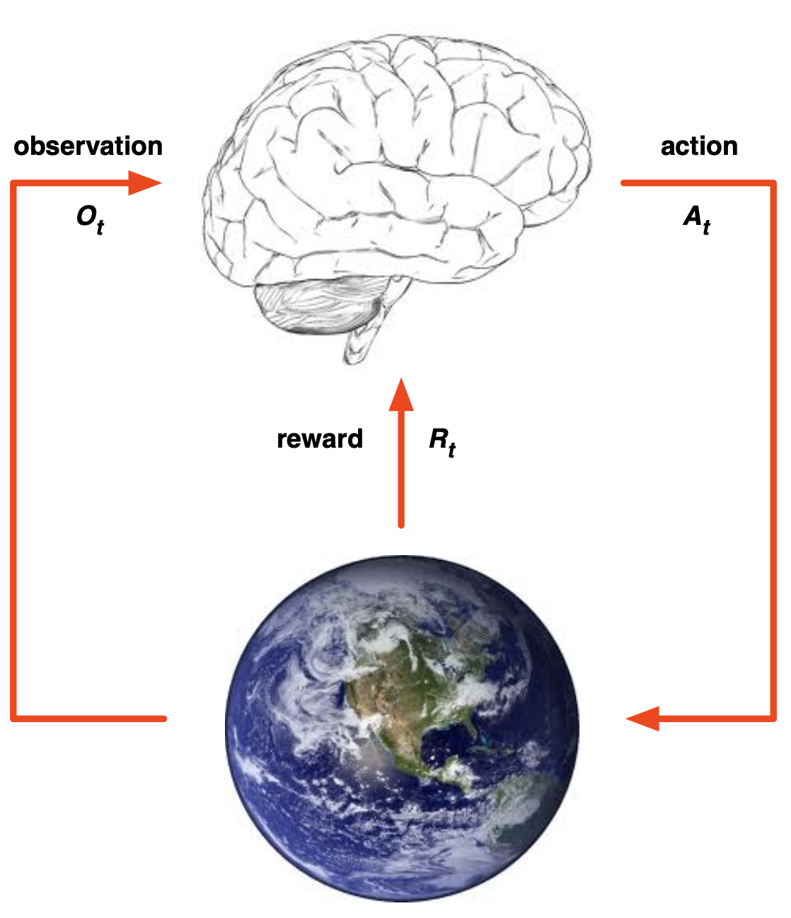
Part 3. LLM Agents
Agent
Reinforcement Learning - Science of Decision Making

Slide 26
Part 3. LLM Agents
LLM Agent (or Language Agent)
What is the LLM Agent?
LLM-first view: make LLM into an agent
e.g., RAG system -> RAG agent, Counselor agent
Agent-first view: integrate LLMs into AI agents so they can use language for reasoning and communication
e.g., Embodied agent, GUI agent, Web agent, Code agent, etc
EMNLP 2024 Language Agent Tutorial

Slide 27
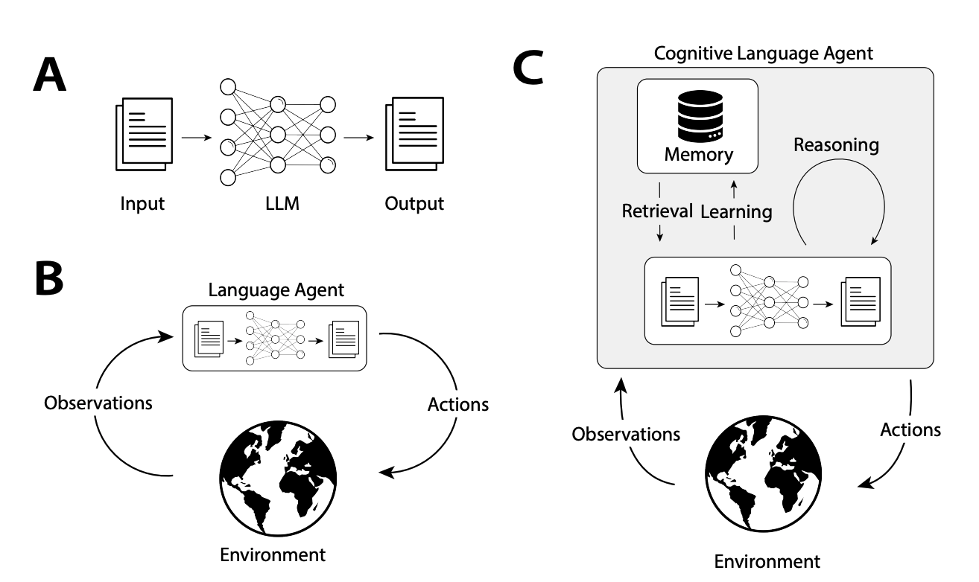
Part 3. LLM Agents
LLM Agent
Key concepts for LLM agents
Reasoning, Memory, Planning
Cognitive Architectures for Language Agents (2023)

Slide 28

Part 3. LLM Agents
Agent Design
How can we design an agent?
https://www.anthropic.com/engineering/building-effective-agents
내용을
입력하세요

Slide 29
Part 3. LLM Agents
Workflow vs Agent
Agentic systems
Workflows: systems where LLMs and tools are orchestrated through predefined code paths
Agents: systems where LLMs dynamically direct their own processes and tool usage, maintaining control over how they accomplish tasks
내용을
입력하세요

Slide 30
Part 3. LLM Agents
Workflow vs Agent
Agentic systems
Workflows: systems where LLMs and tools are orchestrated through predefined code paths
Predictability and consistency for well-defined tasks
Agents: systems where LLMs dynamically direct their own processes and tool usage, maintaining control over how they accomplish tasks
Flexibility and model-driven decision-making are needed at scale
Note
For many applications, optimizing single LLM with retrieval and in-context examples is usually enough
내용을
입력하세요

Slide 31
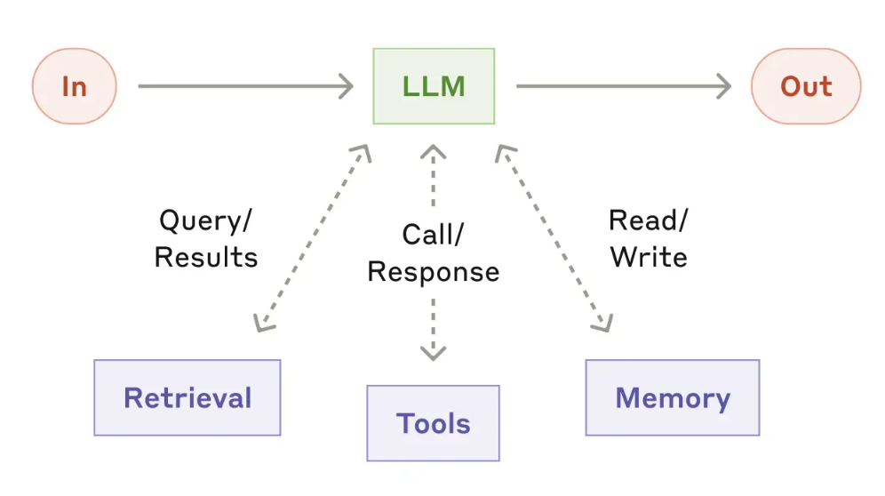
Part 3. LLM Agents
Agent Design
Building block: The augmented LLM
one way to implement this: Model Context Protocol (MCP)
내용을
입력하세요

Slide 32
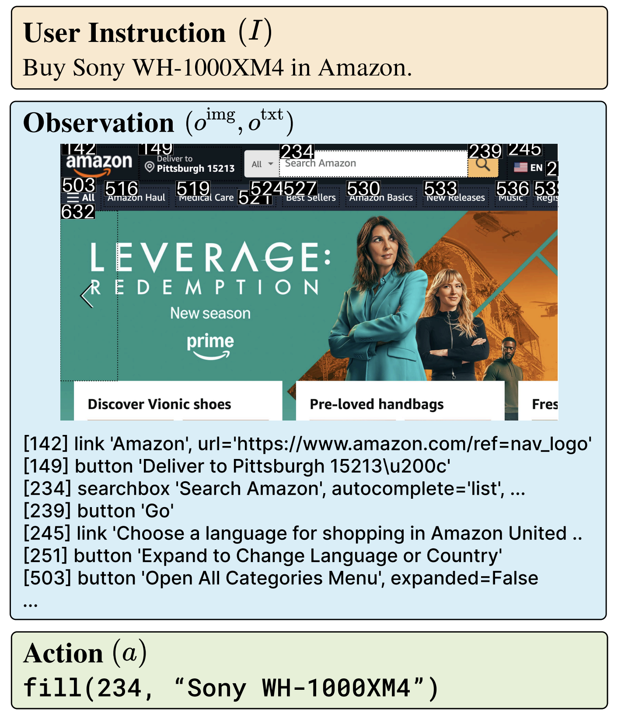
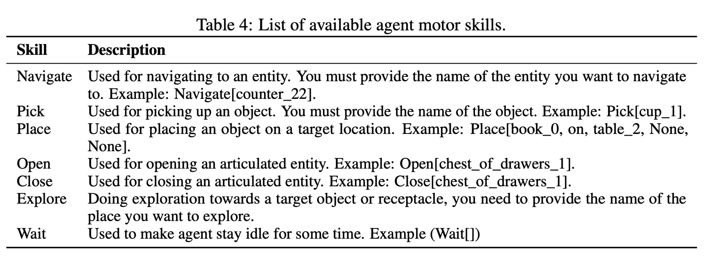
Part 3. LLM Agents
Agent Design
Tools
An agent can choose its actions (response) based on the tools it has access to
It is important to define the available tools that the agent can utilize for the target task
내용을
입력하세요

Slide 33
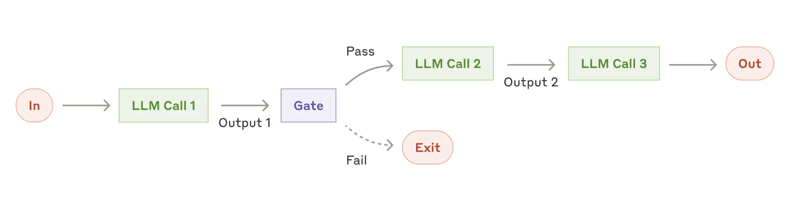
Part 3. LLM Agents
Workflow
Workflow 1: Prompt Chaining
Decomposes a task into sequence of steps
when to use?
tasks that can be easily and clearly decomposed into fixed subtasks
e.g., writing an outline of a document, checklist
내용을
입력하세요

Slide 34
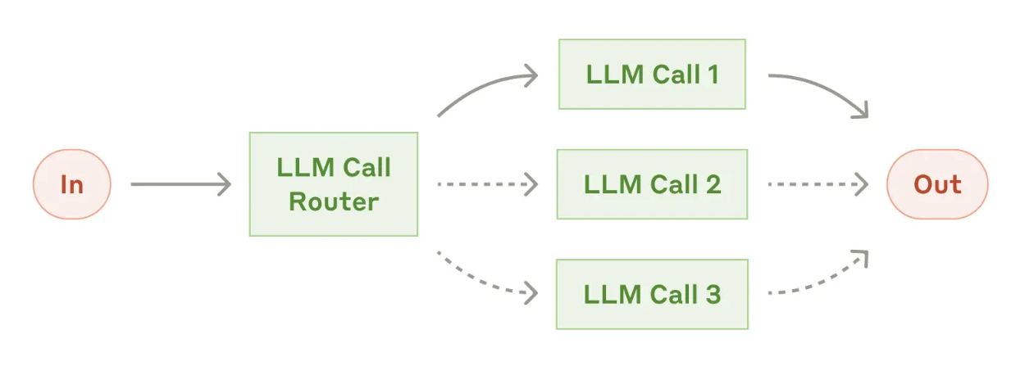
Part 3. LLM Agents
Workflow
Workflow 2: Routing
Classifies an input and directs it to a specialized follow-up task
This allows building more specialized prompts
When to use?
Customer service queries
내용을
입력하세요

Slide 35
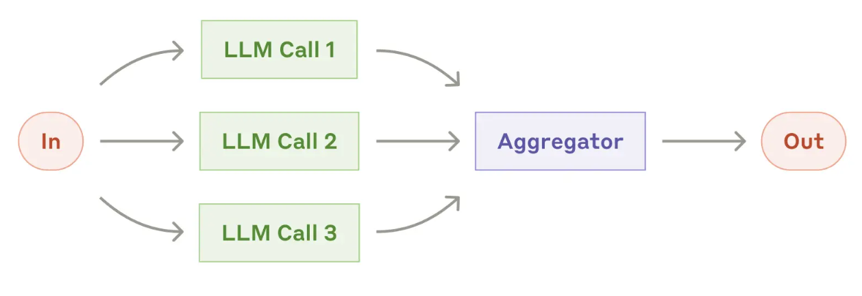
Part 3. LLM Agents
Workflow
Workflow 3: Parallelization
Work simultaneously on a task with output aggregation
Sectioning: breaking a task into independent subtasks run in parallel
Voting: Running the same task multiple times to get diverse outputs
When to use?
Sectioning -> when divided subtasks can be parallelized for speed
Voting -> complex tasks with multiple consideration
내용을
입력하세요

Slide 36
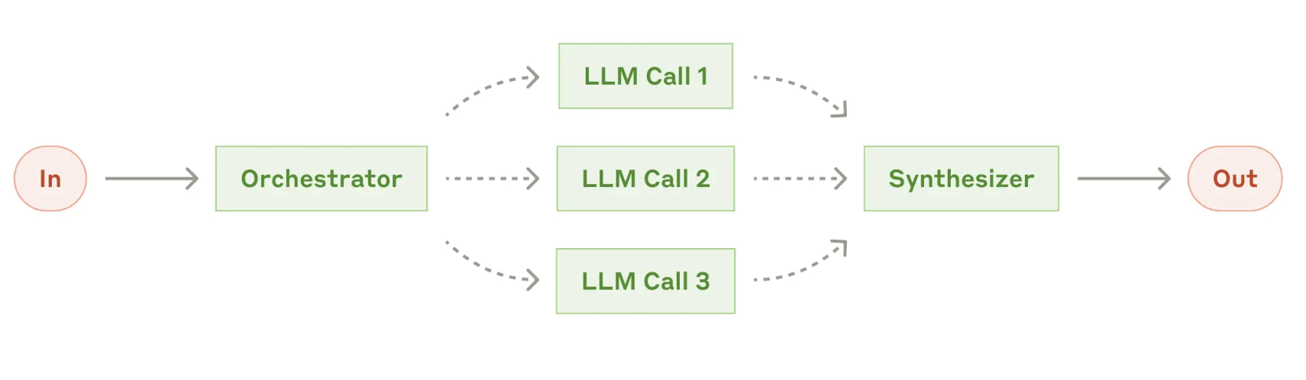
Part 3. LLM Agents
Workflow
Workflow 4: Orchestrator-workers
Central LLM dynamically breaks down tasks, delegates them to worker LLMs, and synthesizes their results
When to use?
complex tasks where you can’t predict the subtasks needed
Difference between ‘parallelization’
Flexibility
내용을
입력하세요

Slide 37
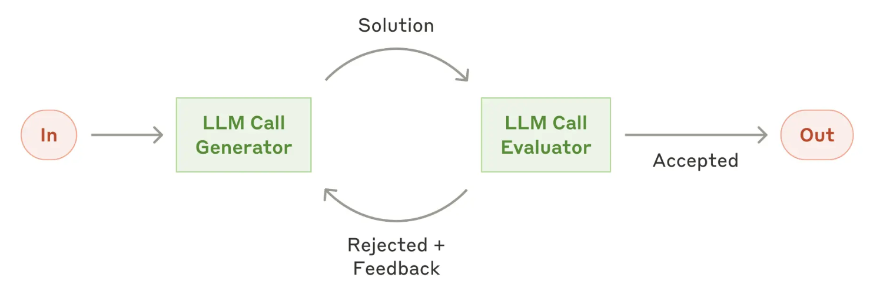
Part 3. LLM Agents
Workflow
Workflow 5: Evaluator-optimizer
One LLM call generates a response while another provides evaluation and feedback in a loop
When to use?
when we have clear evaluation criteria
when iterative refinement provides measurable values
내용을
입력하세요

Slide 38
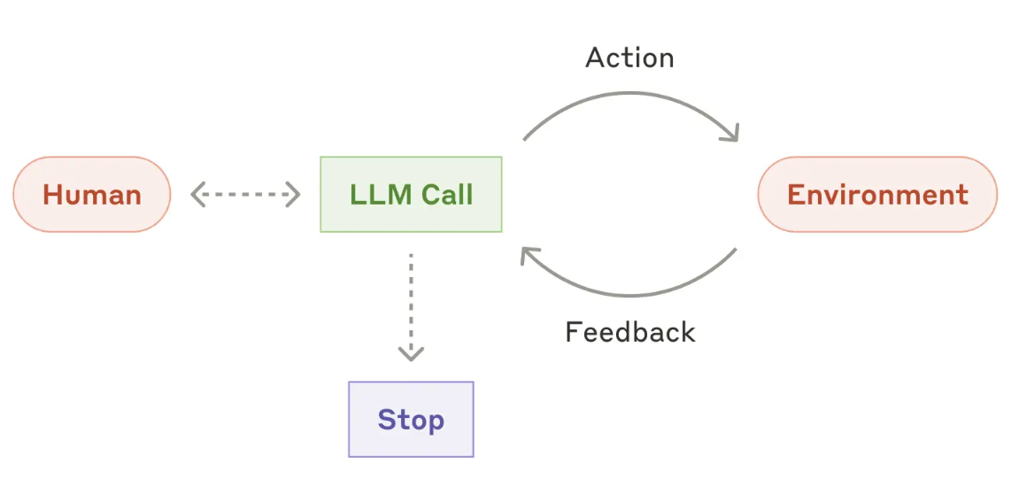
Part 3. LLM Agents
Agent
Autonomous agent
Key capabilities
Understanding complex inputs
Engaging in reasoning and planning
Using tools reliably
Recover from errors
내용을
입력하세요

Slide 39
Part 3. LLM Agents
Agent
Autonomous agent
It’s important for the agents to gain “ground truth” from the environment at each step
When to use?
For open-ended problems
When you have trust in LLMs’ decision-making ability
내용을
입력하세요

Slide 40
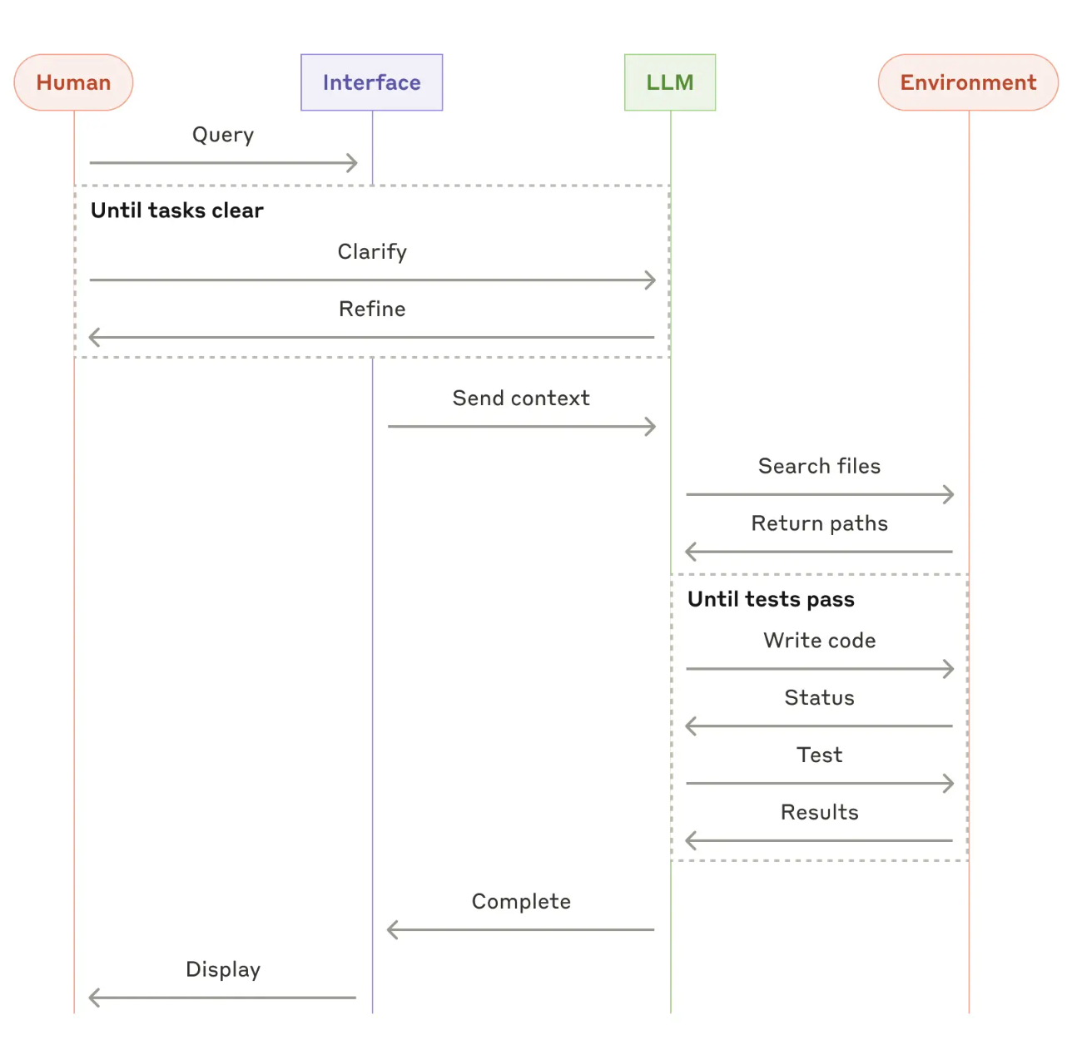
Part 3. LLM Agents
Agent
Coding agent high-level flow
SWE-bench (https://www.swebench.com/)
내용을
입력하세요

Slide 41
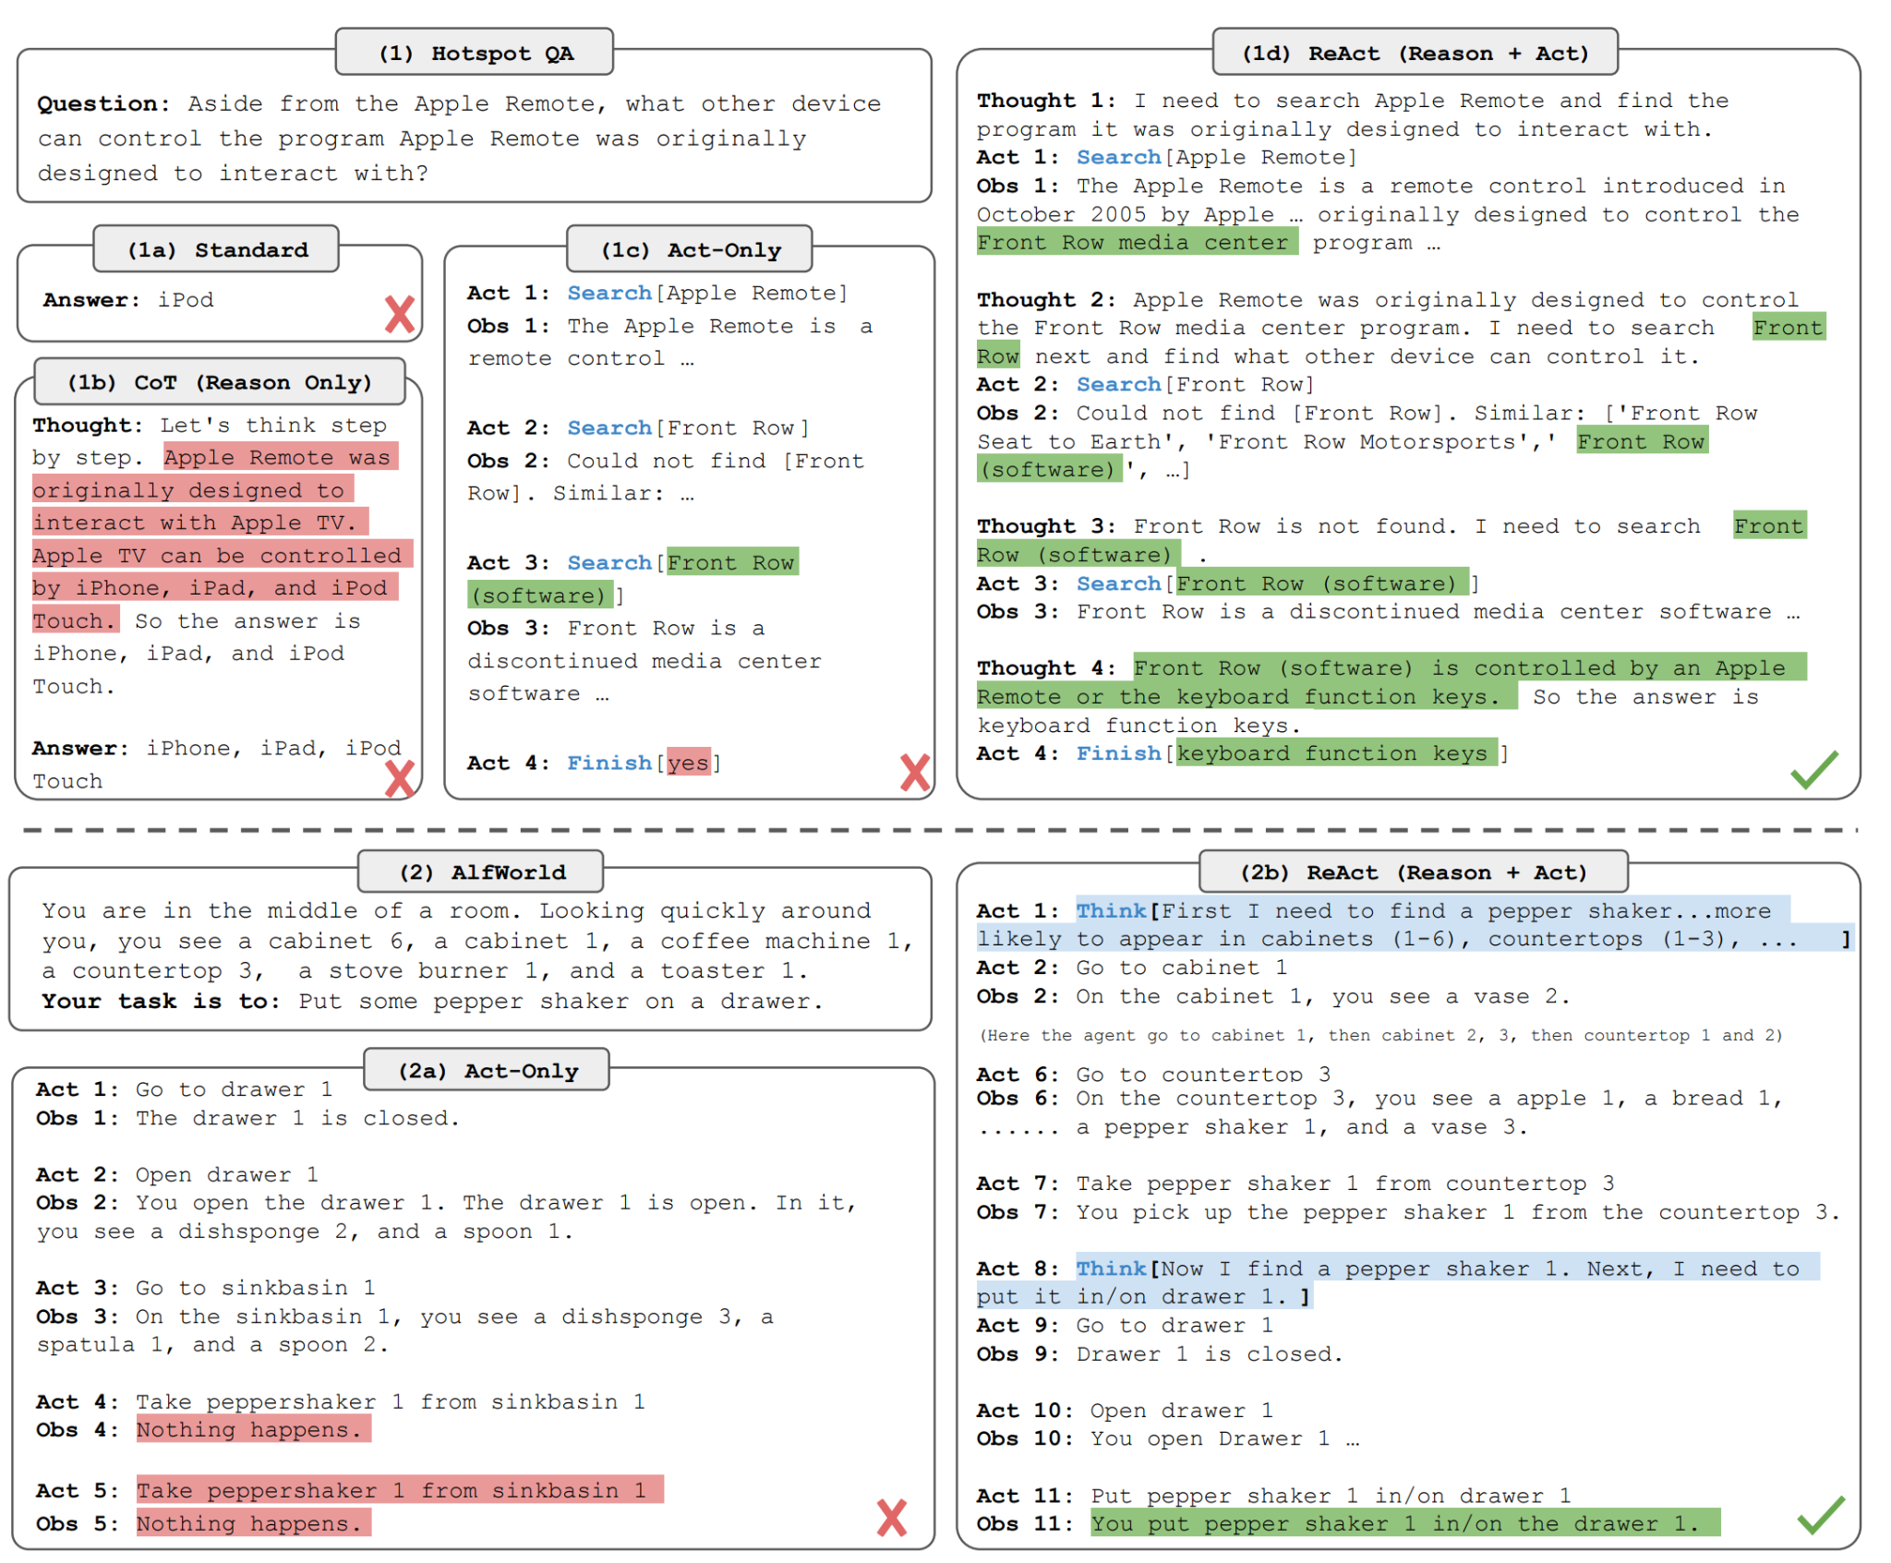
Part 3. LLM Agents
ReACT
ReACT: Reason + Act
(https://arxiv.org/abs/2210.03629)
Base prompt format for current LLM agent
내용을
입력하세요

Slide 42
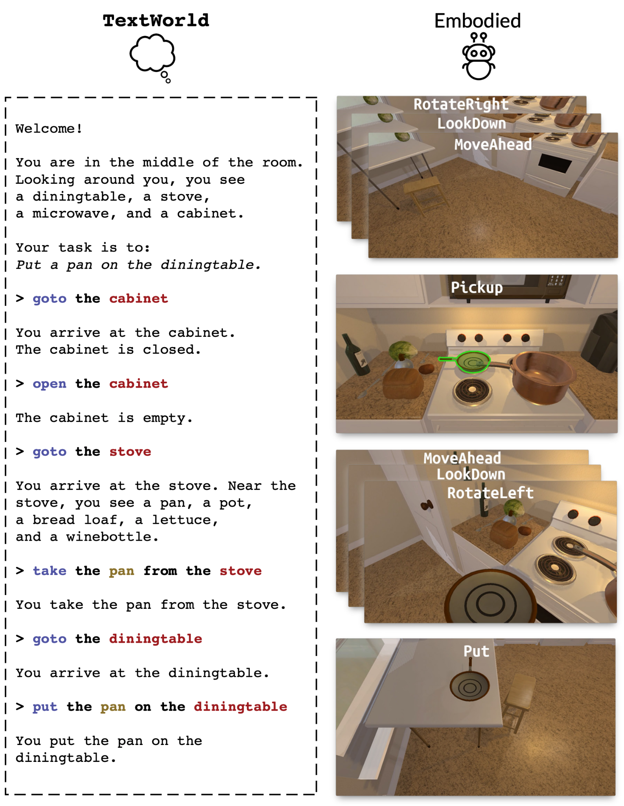
Part 3. LLM Agents
Alfworld
Alfworld - TextWorld based embodied agent simulator (https://alfworld.github.io/)
내용을
입력하세요

Slide 43
Part 3. LLM Agents
Hands On
w/ ReACT format prompting
QA agent (with access to wikipedia)
내용을
입력하세요

