Slide 1
Convolutional Neural Networks
’25년 Samsung AI Expert 7기

Slide 2
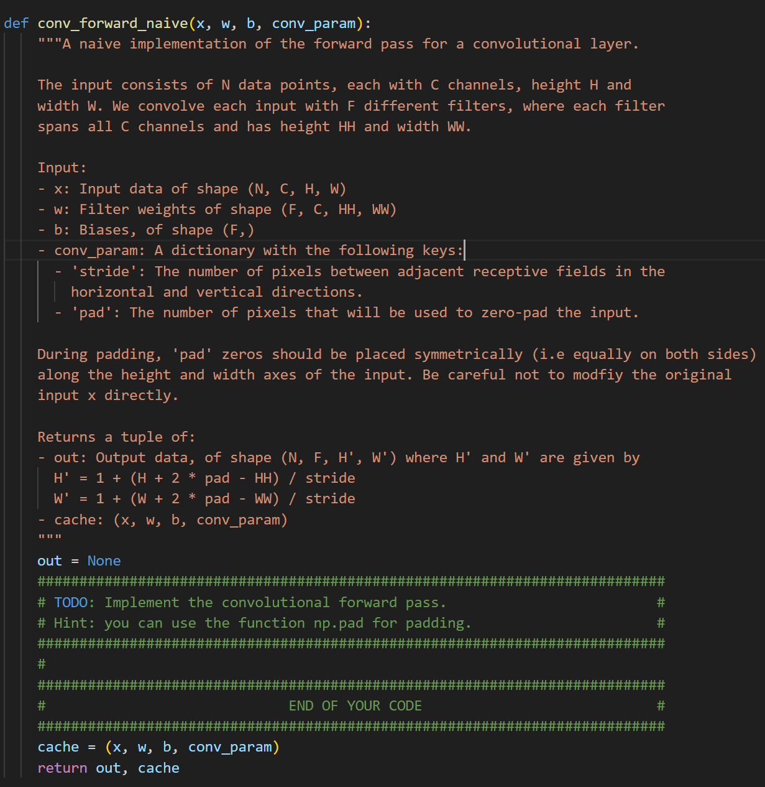
Objective
Let’s implement convolution forward on your own
Part of CS231n assignment2 from Stanford
https://cs231n.github.io/assignments2025/assignment2/

Slide 3
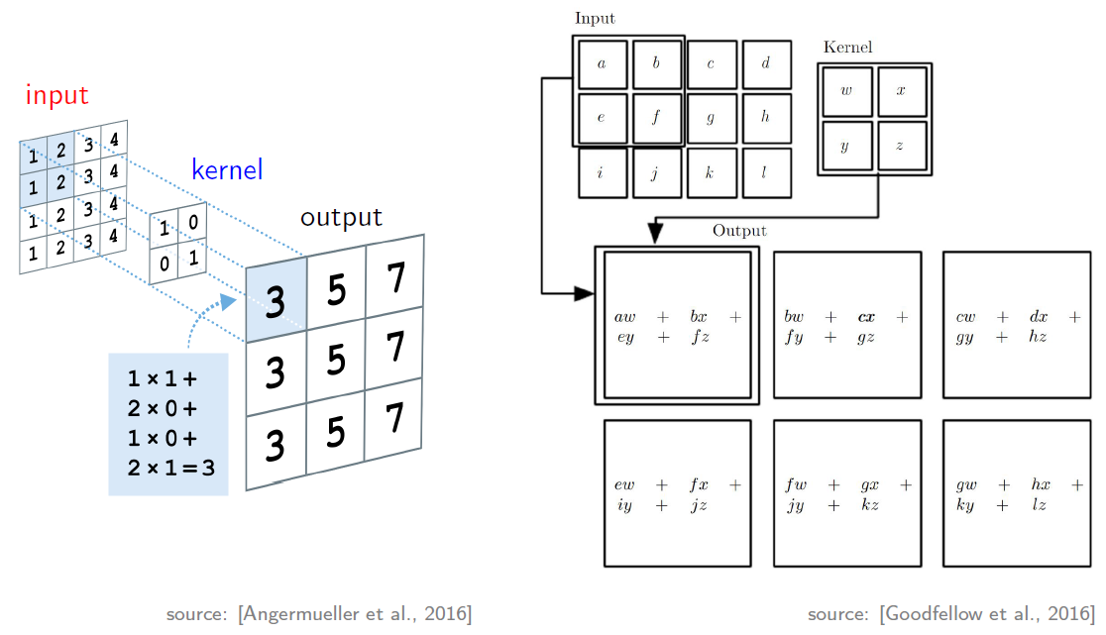
Convolution

Slide 4
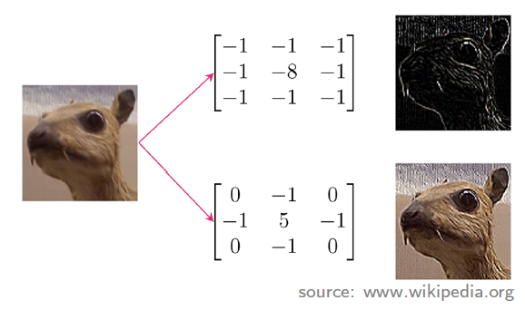
Convolution: Filter
Filter (aka kernel or convolution matrix)
Different filters extract different features (e.g. edges)
Filter weights: trained with data

Slide 5
Convolution: Stride
7x7 input
3x3 filter w/ stride=1
→ 5x5 output
7x7 input
3x3 filter w/ stride=2
→ 3x3 output
The number of pixels between adjacent receptive fields
down-sampling the output of full convolution function

Slide 6
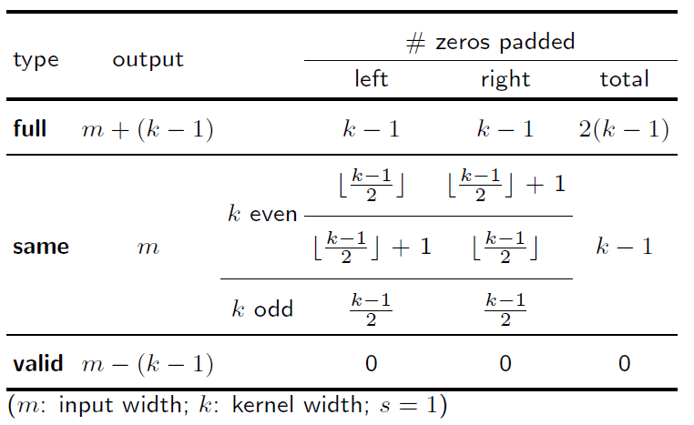
Convolution: Padding

Slide 7
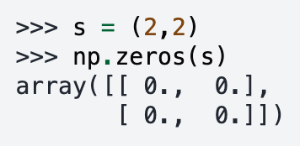
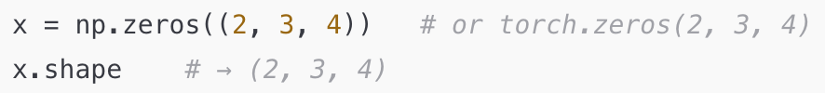
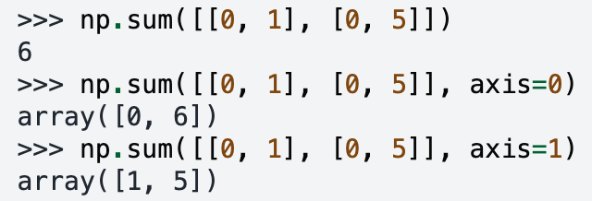
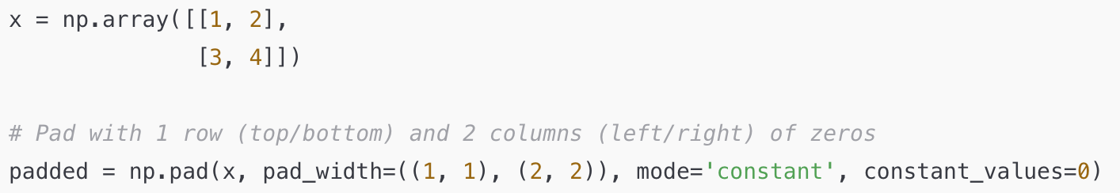
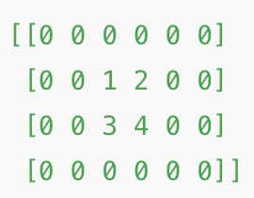
Appendix: Numpy Operations
zeros
summation
pad
shape

Slide 8
Tutorial
Let's move on to CNN_forward.ipynb

