Slide 1
Recurrent Neural Networks
’25년 Samsung AI Expert 7기

Slide 2
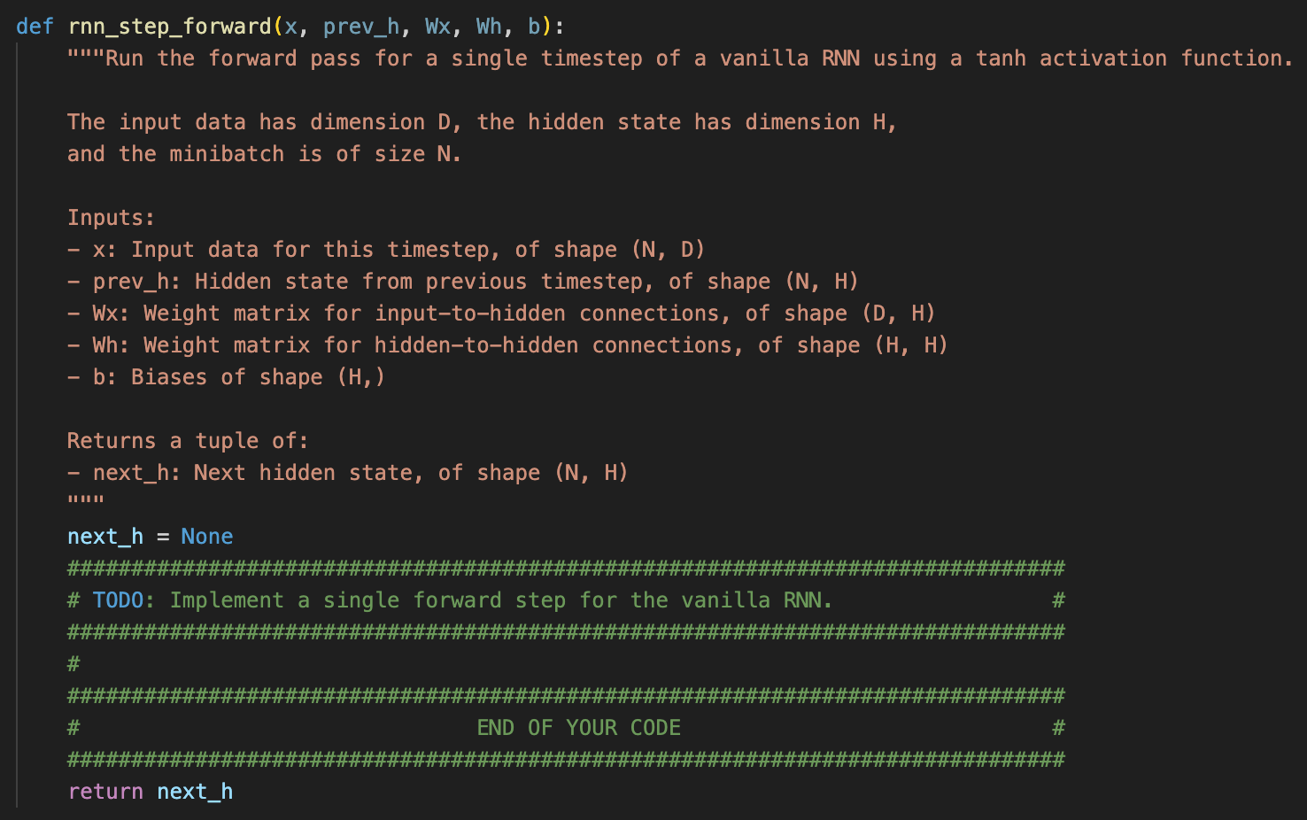
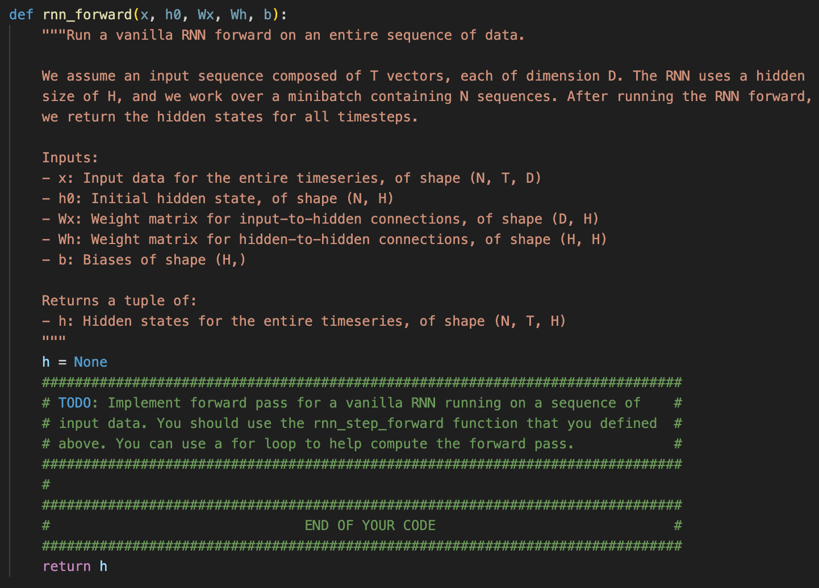
Objective
Let’s implement RNN forward on your own
Part of CS231n assignment2 from Stanford
https://cs231n.github.io/assignments2025/assignment2/

Slide 3
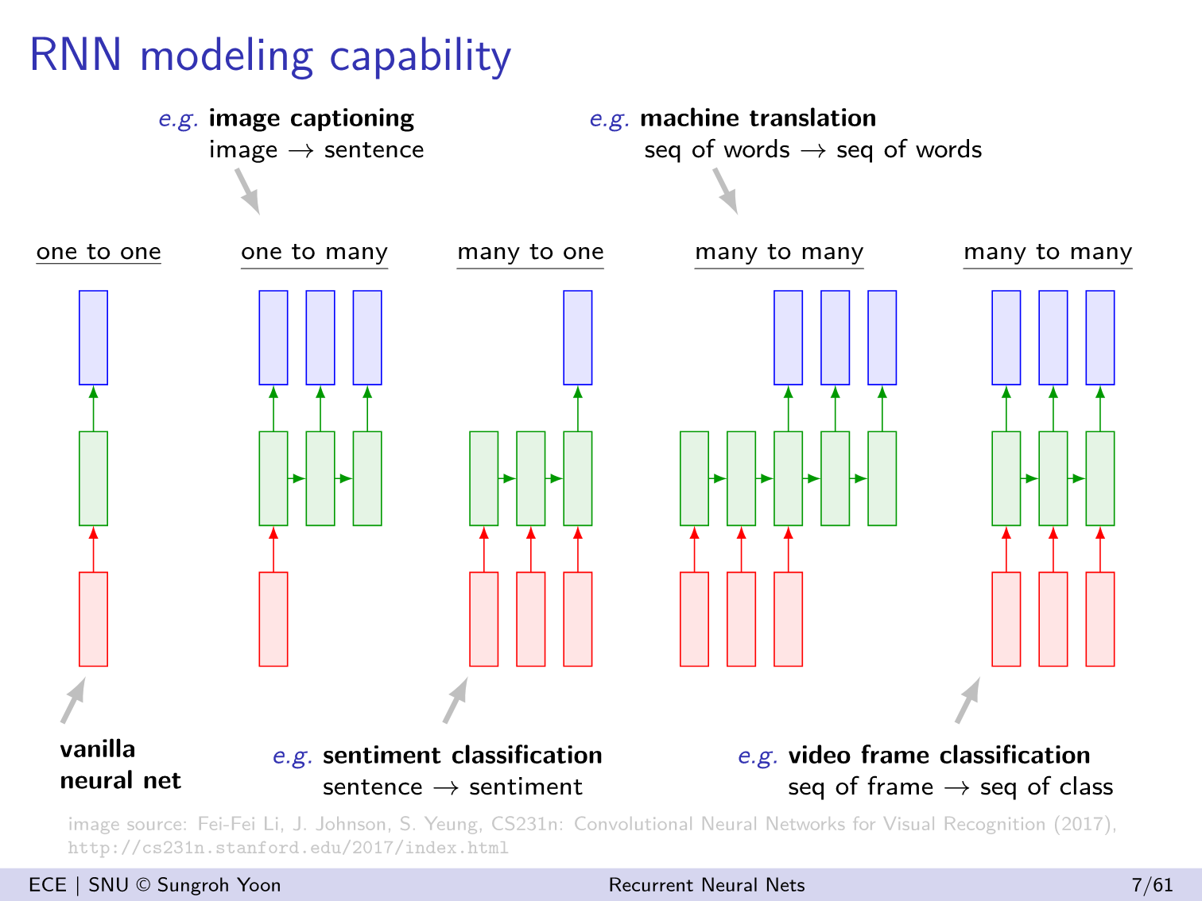
Recurrent

Slide 4
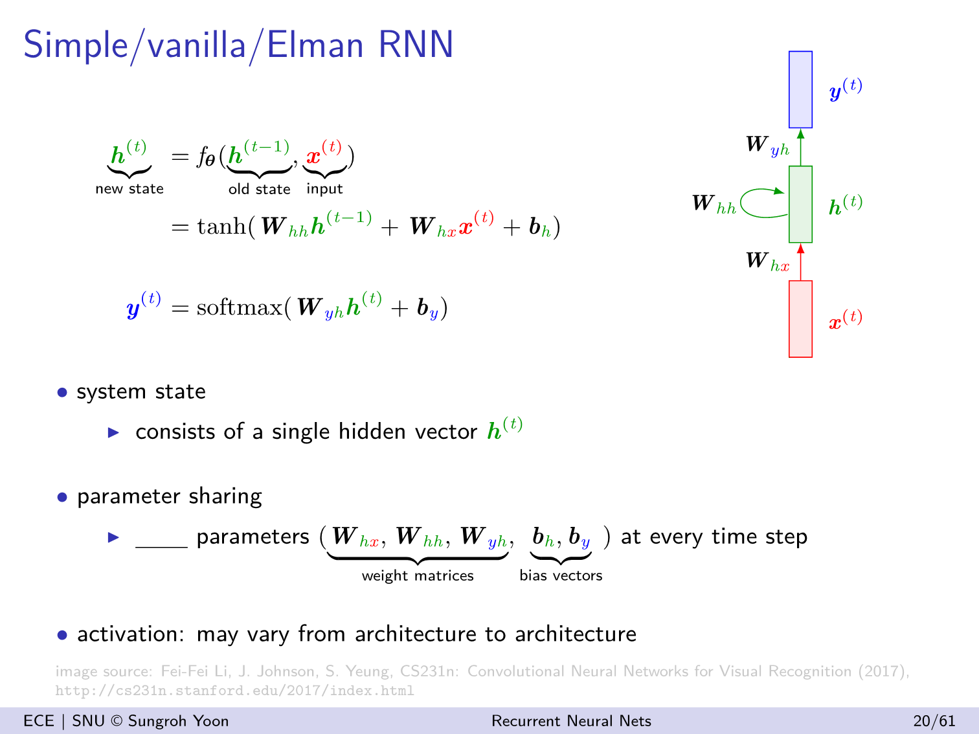

Slide 5
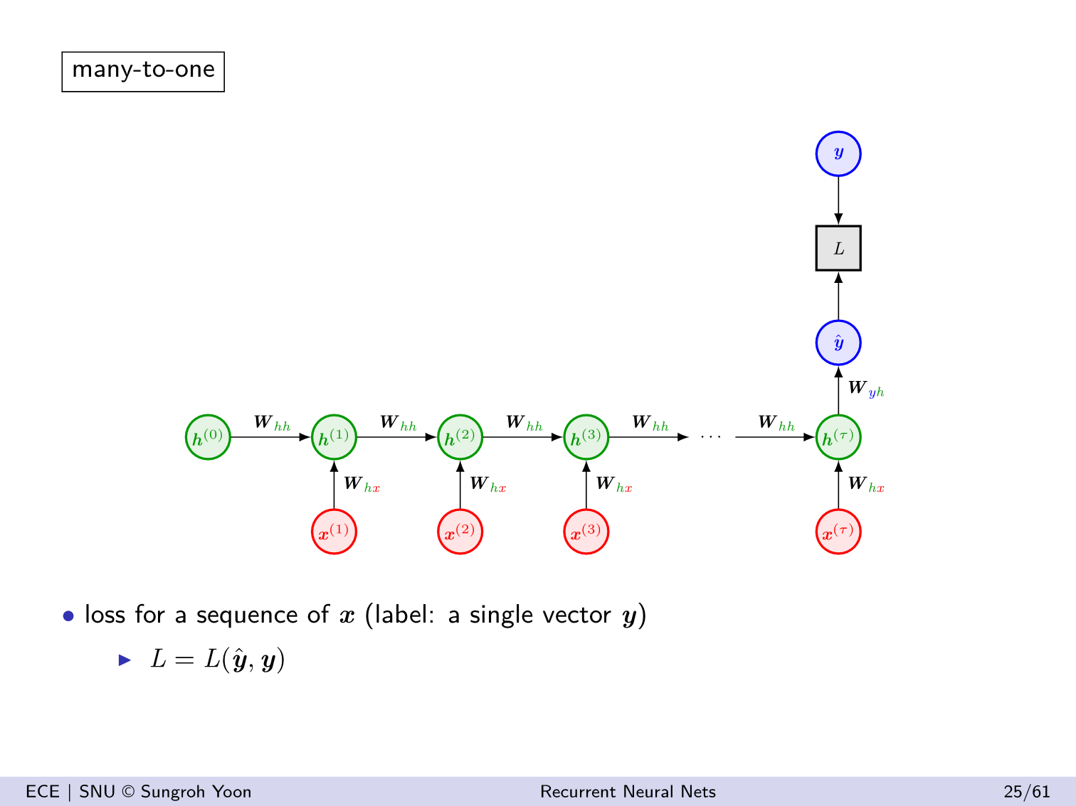

Slide 6
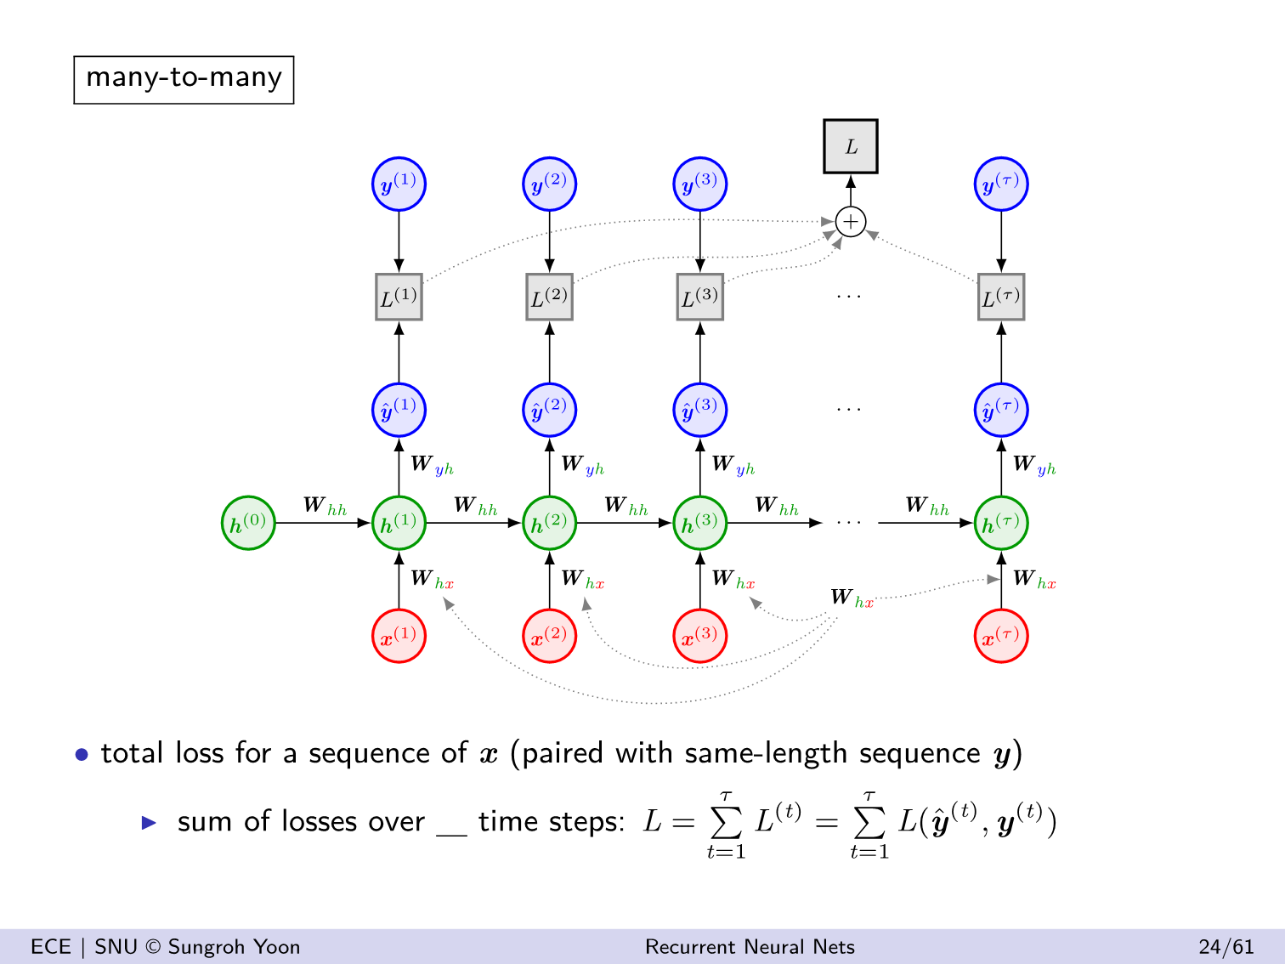

Slide 7
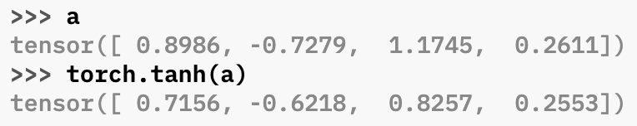
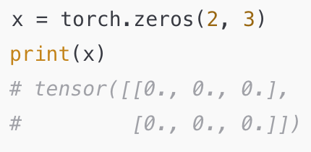
Appendix: PyTorch Operations
@ Operator
In PyTorch, the @ operator performs matrix multiplication (like torch.matmul()).
Multiplying 2D matrices
A @ B is equivalent to torch.matmul(A, B)
Also works with batched tensors (e.g. 3D or higher), applying matrix multiplication over the last two dimensions.
tanh
Returns a new tensor with the hyperbolic tangent of the elementsof input.
zeros

Slide 8
Appendix: Broadcasting
Broadcasting allows arrays/tensors with different shapes to be used in arithmetic operations as if they had the same shape—without copying data.
Broadcasting Logic: Step-by-Step
Align shapes from the right (trailing dimensions).
Prepend 1s to the shorter shape to match the number of dimensions.
Compare each dimension:
If equal → OK
If one is 1 → OK (will be stretched)
Else → Error
Resulting shape is the element-wise maximum along each dimension.

Slide 9
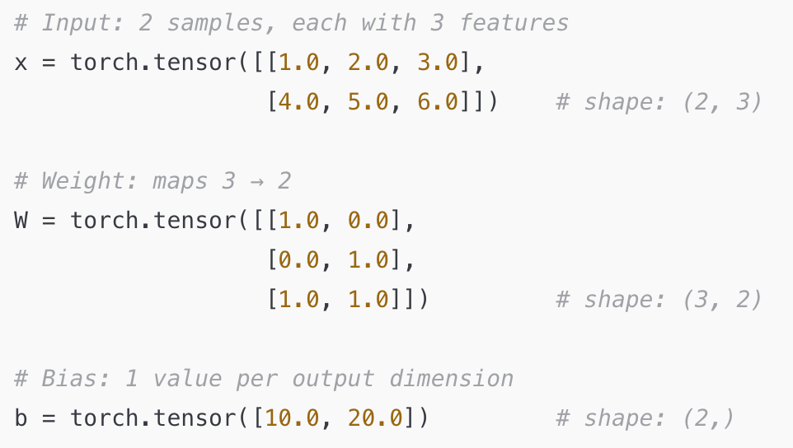
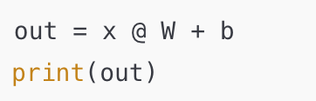
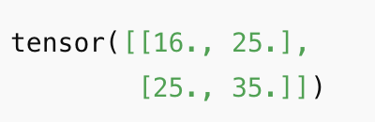
Appendix: Broadcasting

Slide 10
Tutorial
Let's move on to RNN_forward.ipynb

