Slide 1
Long Short-Term Memory
’25년 Samsung AI Expert 7기

Slide 2
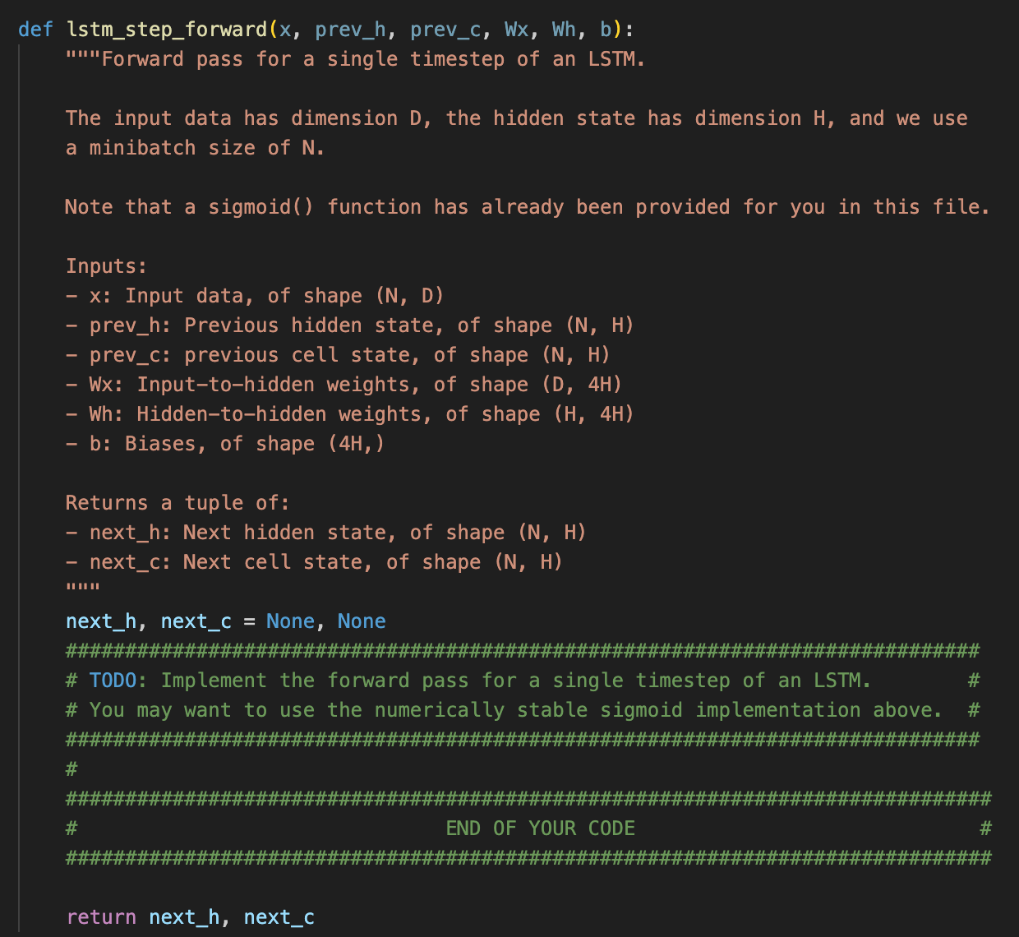
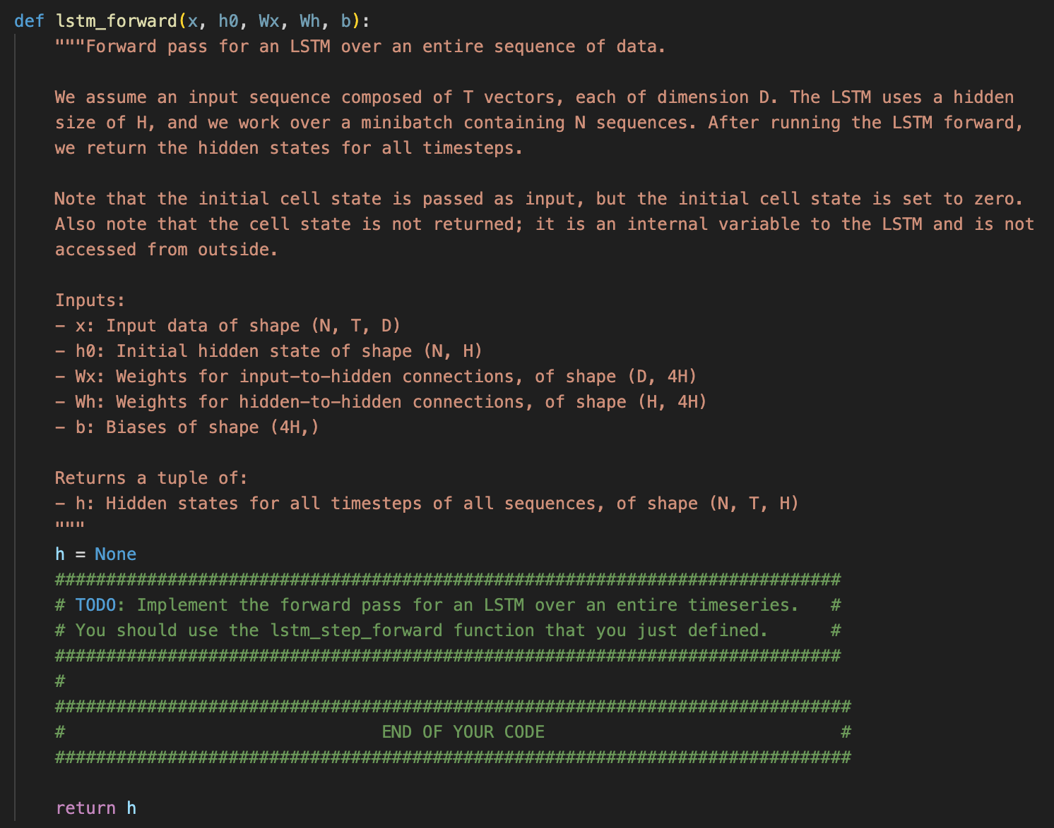
Objective
Let’s implement LSTM forward on your own
Part of CS231n assignment3 from Stanford
https://cs231n.github.io/assignments2024/assignment3/

Slide 3
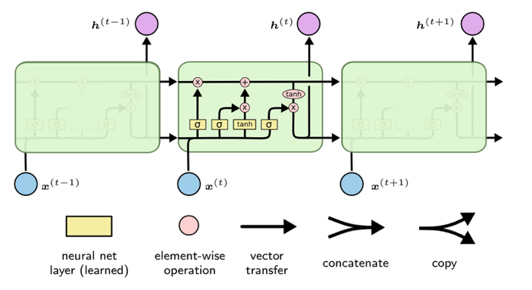
LSTM
https://web.stanford.edu/class/cs379c/archive/2018/class_messages_listing/content/Artificial_Neural_Network_Technology_Tutorials/OlahLSTM-NEURAL-NETWORK-TUTORIAL-15.pdf

Slide 4
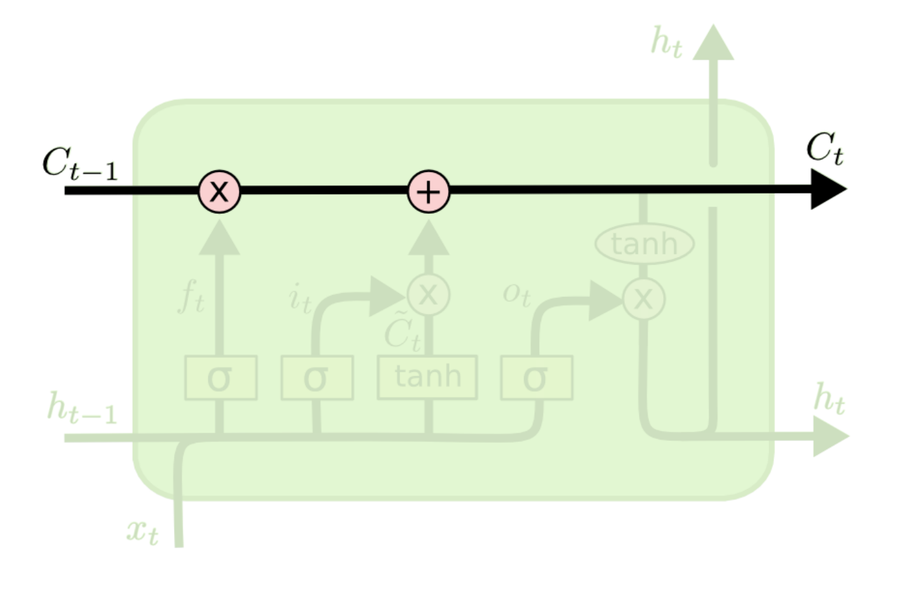
LSTM
Cell state
The key to LSTMs is the cell state, the horizontal line running through the top of the diagram.
https://web.stanford.edu/class/cs379c/archive/2018/class_messages_listing/content/Artificial_Neural_Network_Technology_Tutorials/OlahLSTM-NEURAL-NETWORK-TUTORIAL-15.pdf

Slide 5
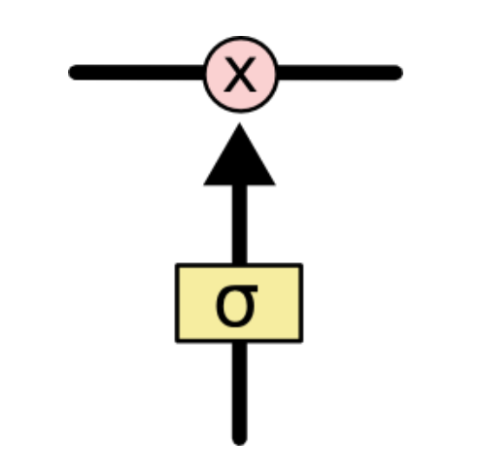
LSTM
Gate
Gates are a way to optionally let information through. They are composed out of a sigmoid neural net layer and a pointwise multiplication operation.
https://web.stanford.edu/class/cs379c/archive/2018/class_messages_listing/content/Artificial_Neural_Network_Technology_Tutorials/OlahLSTM-NEURAL-NETWORK-TUTORIAL-15.pdf

Slide 6
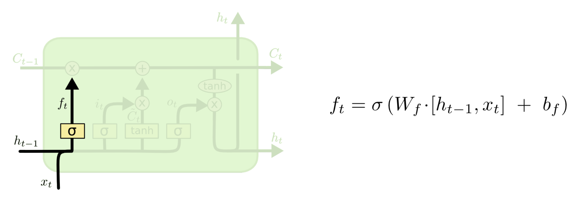
LSTM
Forget Gate
https://web.stanford.edu/class/cs379c/archive/2018/class_messages_listing/content/Artificial_Neural_Network_Technology_Tutorials/OlahLSTM-NEURAL-NETWORK-TUTORIAL-15.pdf

Slide 7
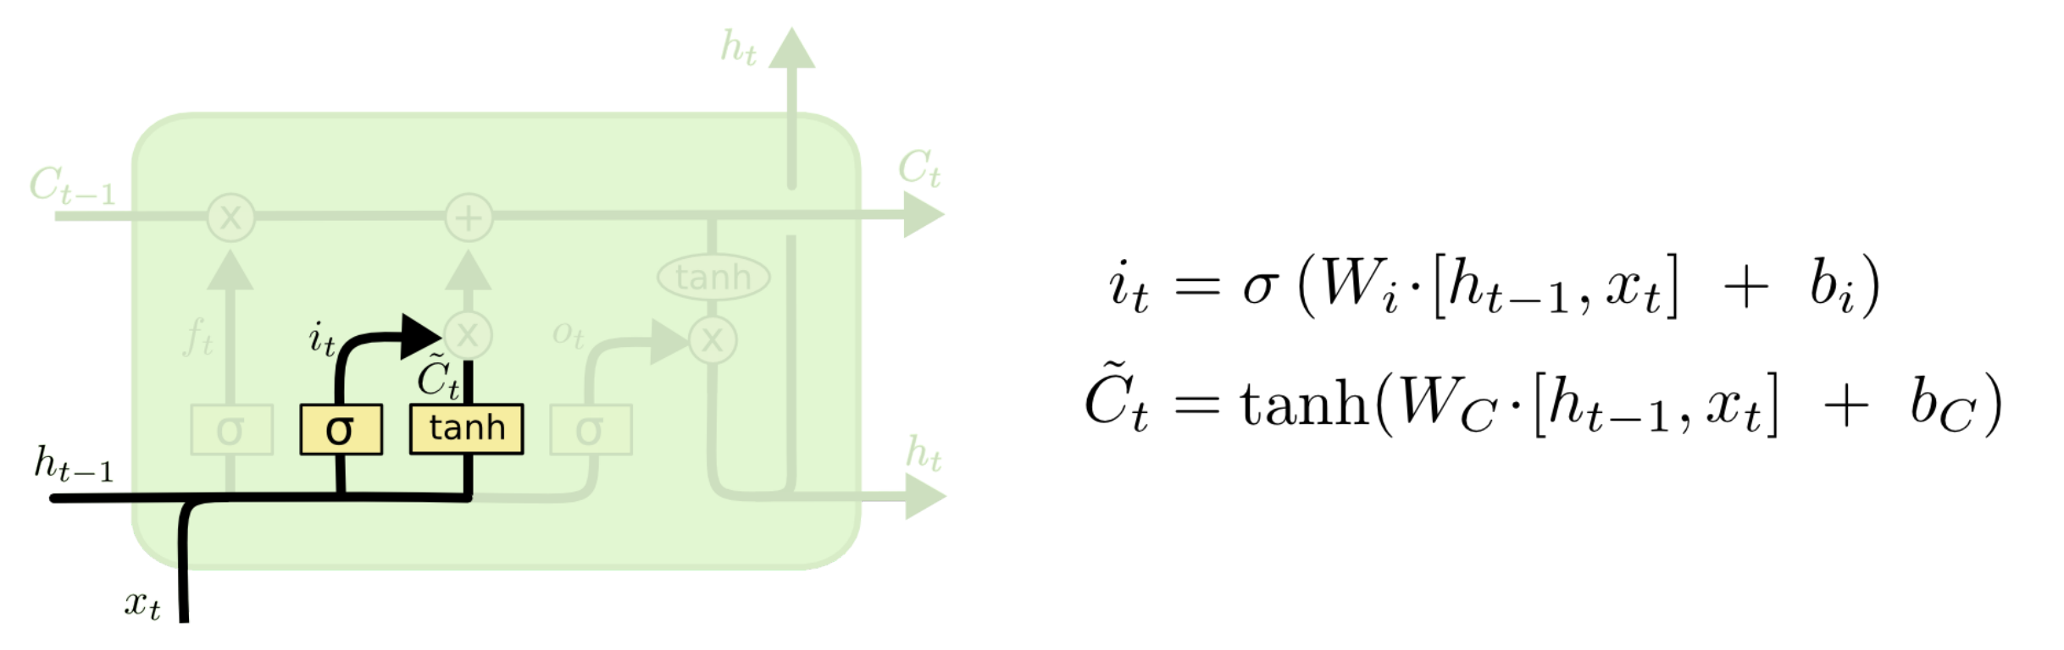
LSTM
Input Gate
https://web.stanford.edu/class/cs379c/archive/2018/class_messages_listing/content/Artificial_Neural_Network_Technology_Tutorials/OlahLSTM-NEURAL-NETWORK-TUTORIAL-15.pdf

Slide 8
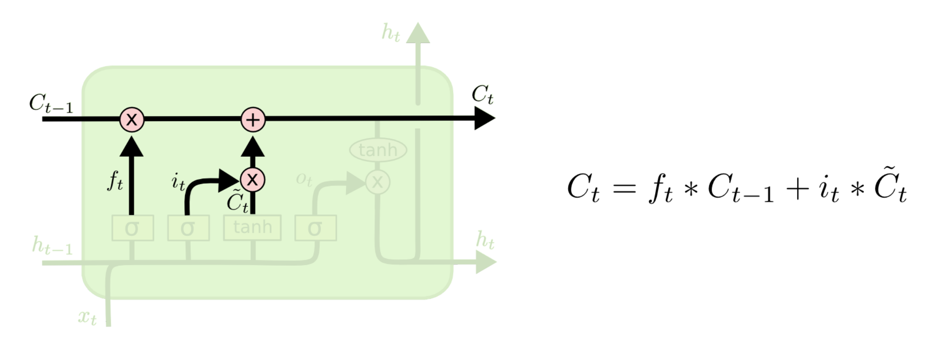
LSTM
Cell State Update
https://web.stanford.edu/class/cs379c/archive/2018/class_messages_listing/content/Artificial_Neural_Network_Technology_Tutorials/OlahLSTM-NEURAL-NETWORK-TUTORIAL-15.pdf

Slide 9
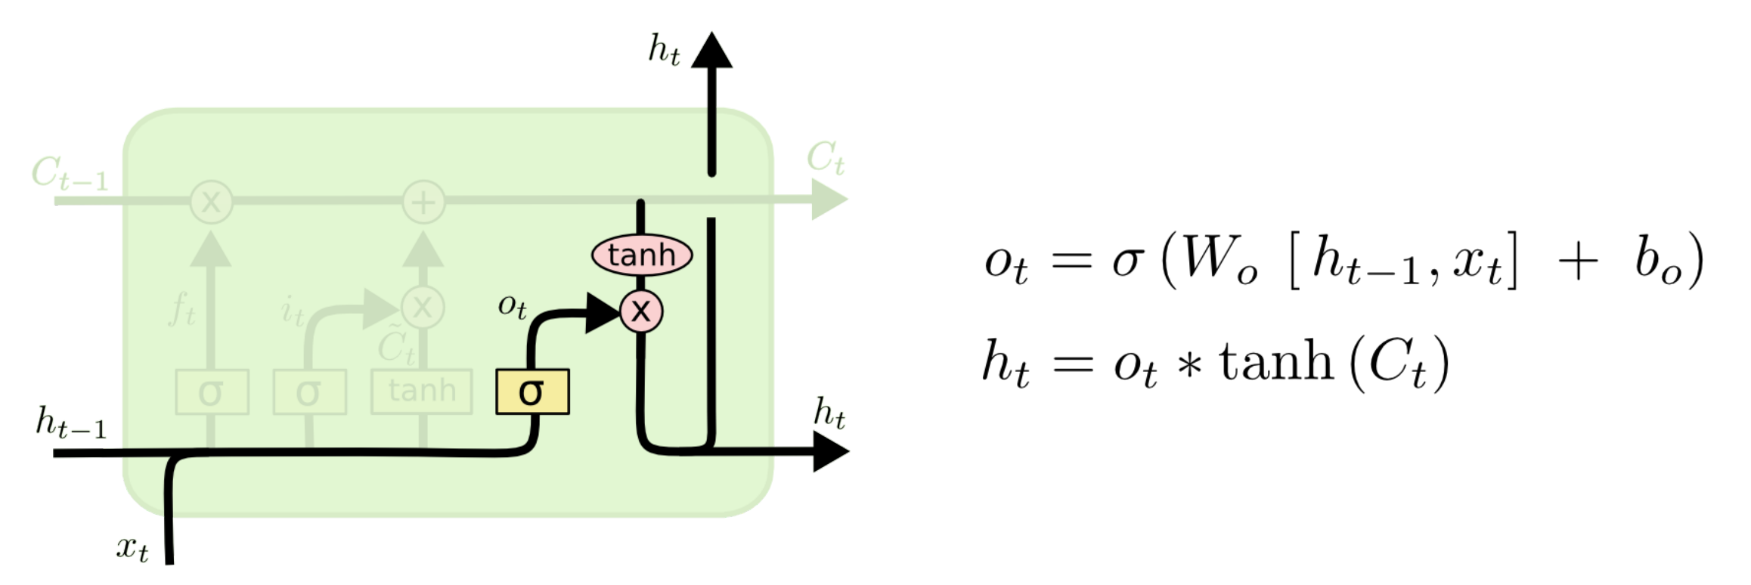
LSTM
Output Gate
https://web.stanford.edu/class/cs379c/archive/2018/class_messages_listing/content/Artificial_Neural_Network_Technology_Tutorials/OlahLSTM-NEURAL-NETWORK-TUTORIAL-15.pdf

Slide 10
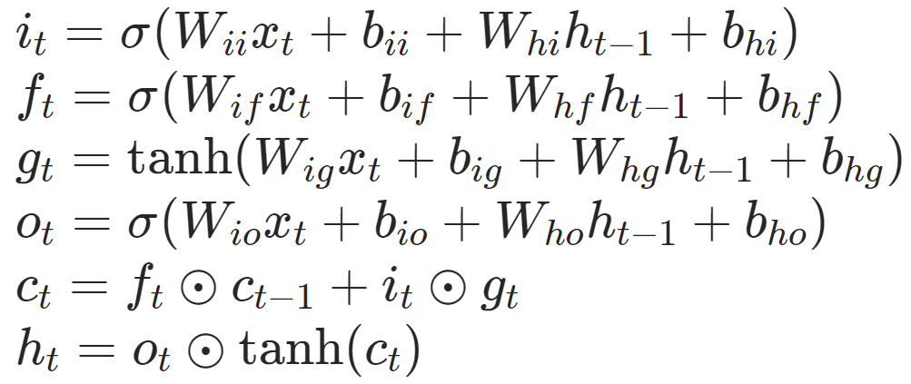
LSTM
Forward Propagation
Both are fine…

Slide 11
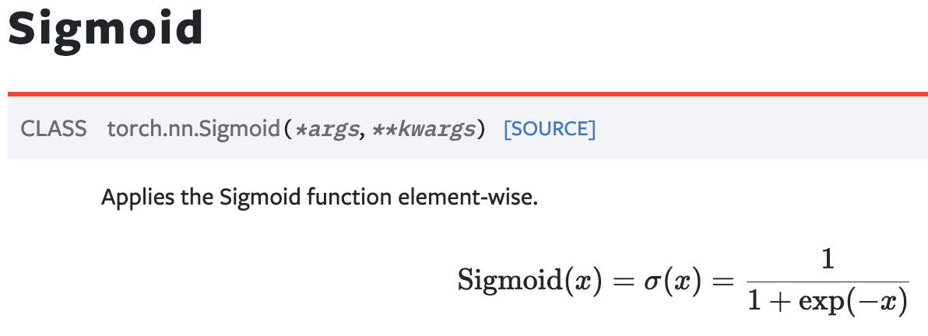
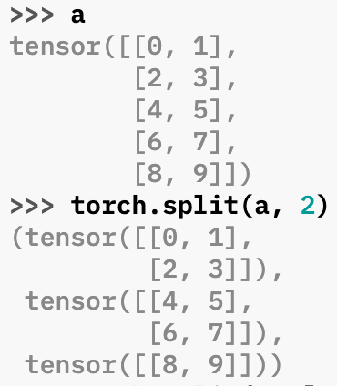
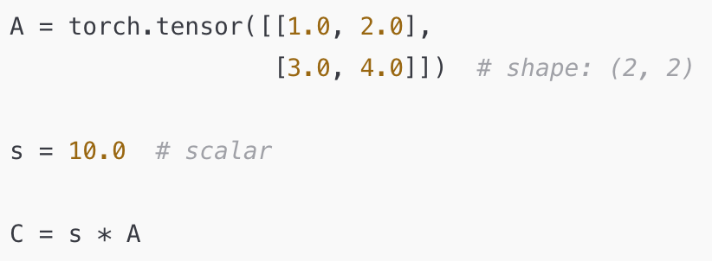
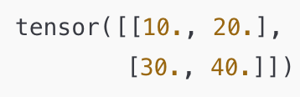
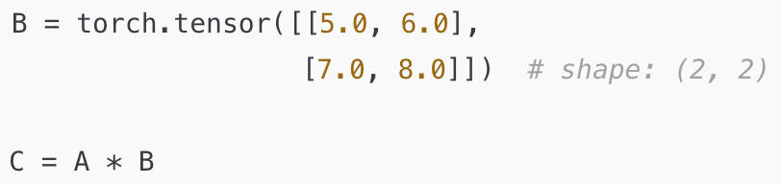
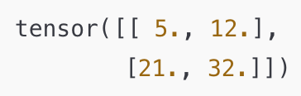
Appendix: PyTorch Operations
sigmoid
split * (element-wise multiplication)

Slide 12
Tutorial
Let's move on to LSTM_forward.ipynb

