Slide 1
Interference from Non-Target Items in Change-Detection Task
Hsuan-Yu Lin/Klaus Oberauer

Slide 2
Working Memory Capacity
Working memory capacity as hard limit:
Slot model
Resource model
Interference explanation without hard limit:
The limitation comes from the interference between items.
The more items in the memory -> more interference.
Interference Model (Oberauer & Lin, 2017)

Slide 3
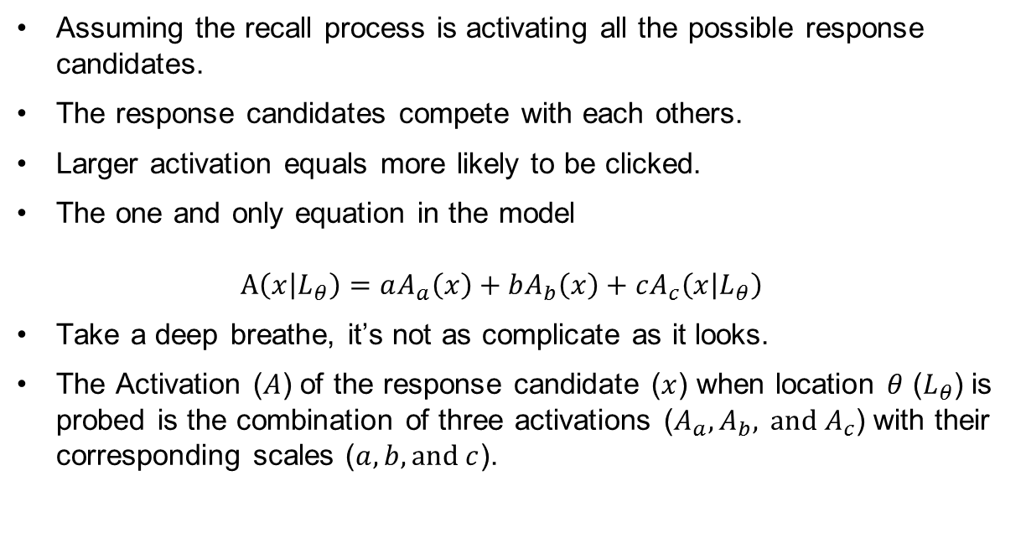
Interference Model
Assuming the recall process is activating all the possible response candidates.
The response candidates compete with each others.
Larger activation equals more likely to be clicked.
The one and only equation in the model $A\left(x | L_{θ}\right)=aA_{a}\left(x\right)+bA_{b}\left(x\right)+cA_{c}\left(x | L_{θ}\right)$
Take a deep breathe, it’s not as complicate as it looks.
The Activation ($A$) of the response candidate ($x$) when location $θ$ ($L_{θ}$) is probed is the combination of three activations ($A_{a}, A_{b}, \text{and}{ A}_{c}$) with their corresponding scales ($a, b,\text{and} c$).

Slide 4

Interference model
$$A\left(x | L_{θ}\right)=aA_{a}\left(x\right)+bA_{b}\left(x\right)+cA_{c}\left(x | L_{θ}\right)$$
Activation from context-independent source.
Activated by recently experienced items regardless the location of probe and the location of items.

Slide 5

Interference model
$$A\left(x | L_{θ}\right)=aA_{a}\left(x\right)+bA_{b}\left(x\right)+cA_{c}\left(x | L_{θ}\right)$$
Background-noise activation.
By product of the encoding process.

Slide 6

Interference model
$$A\left(x | L_{θ}\right)=aA_{a}\left(x\right)+bA_{b}\left(x\right)+cA_{c}\left(x | L_{θ}\right)$$
Cued-retrieval activation.
Activated by reactive the location-color binding formed during the encoding process.

Slide 7

Interference model
$$A\left(x | L_{θ}\right)=aA_{a}\left(x\right)+bA_{b}\left(x\right)+cA_{c}\left(x | L_{θ}\right)$$
Activation from cued retrieval.
Activated by reactive the location-color binding formed during the encoding process.

Slide 8
Interference model
And that’s the model!
Interference comes from:
Cued retrieval.
Competition between response candidates.
Previously, we implemented IM to continuous reproduction task.

Slide 9
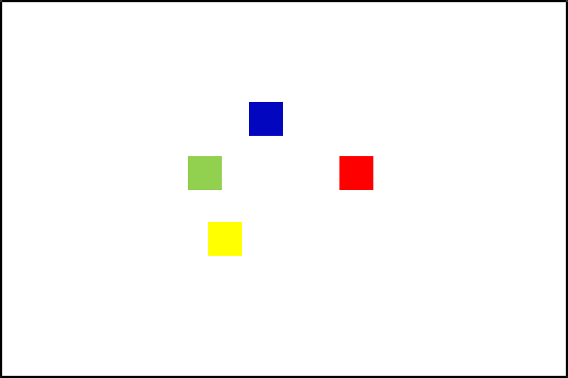
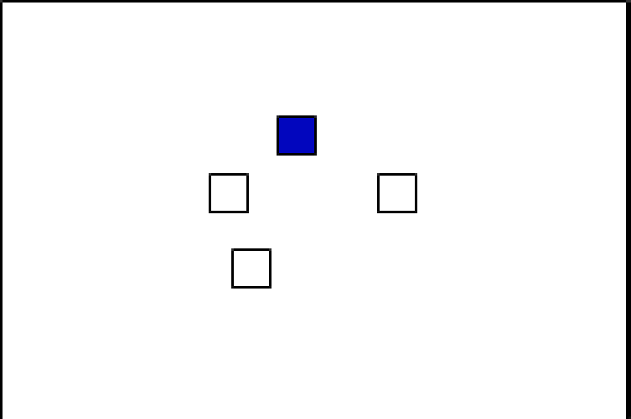
Change-Detection Task

Slide 10
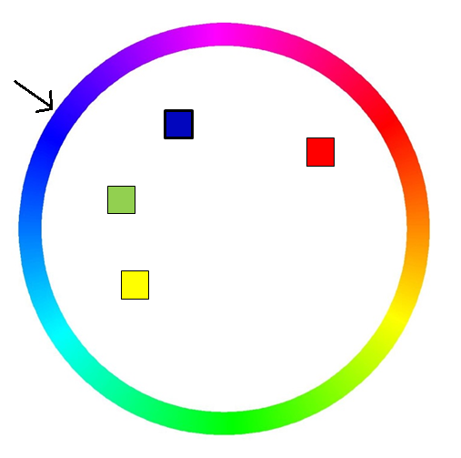
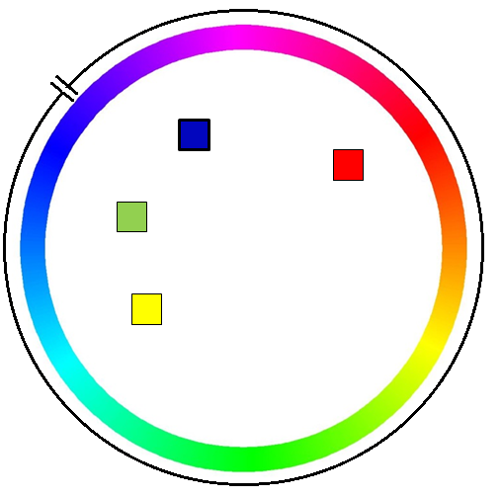
Change-Detection Task
20 participants from UZH
2400 trials per participants.
Material:
Colors from a continuous colorwheel.
Manipulates:
Set sizes: 1-6.
Probe type: change, no change
No Change
Change

Slide 11
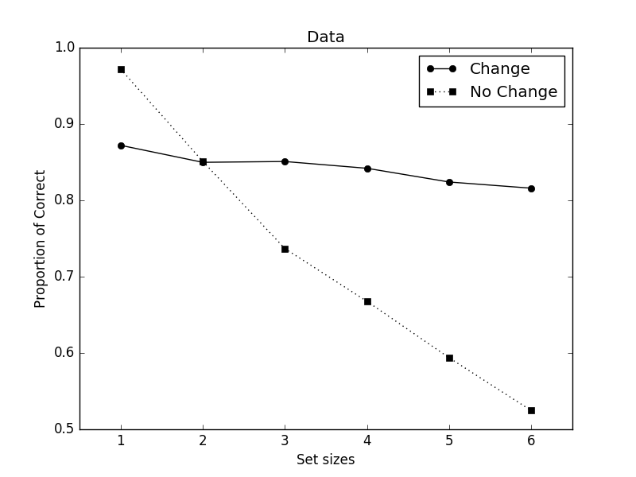
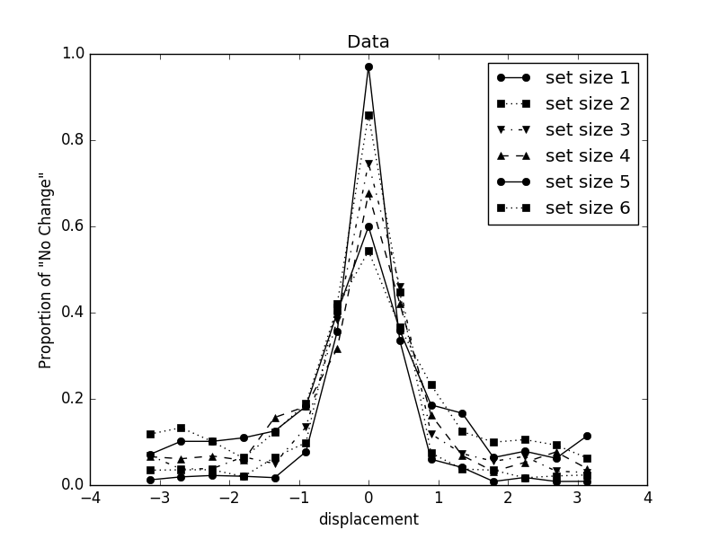
Results
Set-size effect
Response distribution

Slide 12
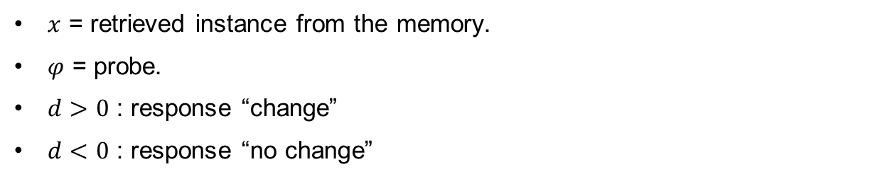
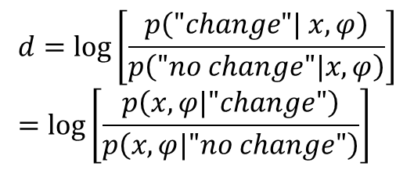
Bayes Inference (Keshvari, van den Berg, & Ma, 2013)
$$d=\log\left[\frac{p\left("change"| x, φ\right)}{p\left("no change"|x, φ\right)}\right] \\ =\log\left[\frac{p\left(x, φ|"change"\right)}{p\left(x, φ|"no change"\right)}\right]$$
$x$ = retrieved instance from the memory.
$φ$ = probe.
$d>0$ : response “change”
$d<0$ : response “no change”
Notes:
In layman’s term, given the probe and the retrieved instance, is the probe more likely to come from the “change’” condition or the no-change condition.

Slide 13
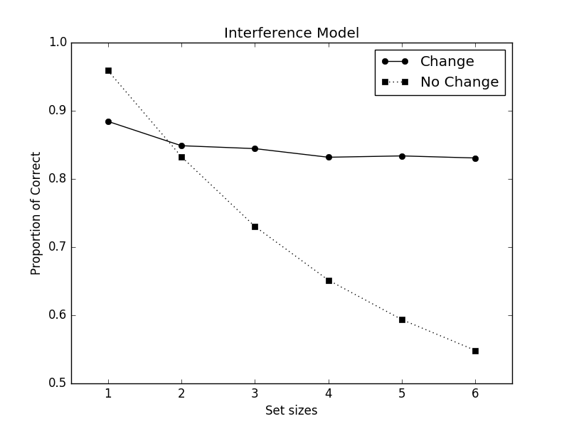
Set-size effect (models prediction)
Data
Interference Model

Slide 14
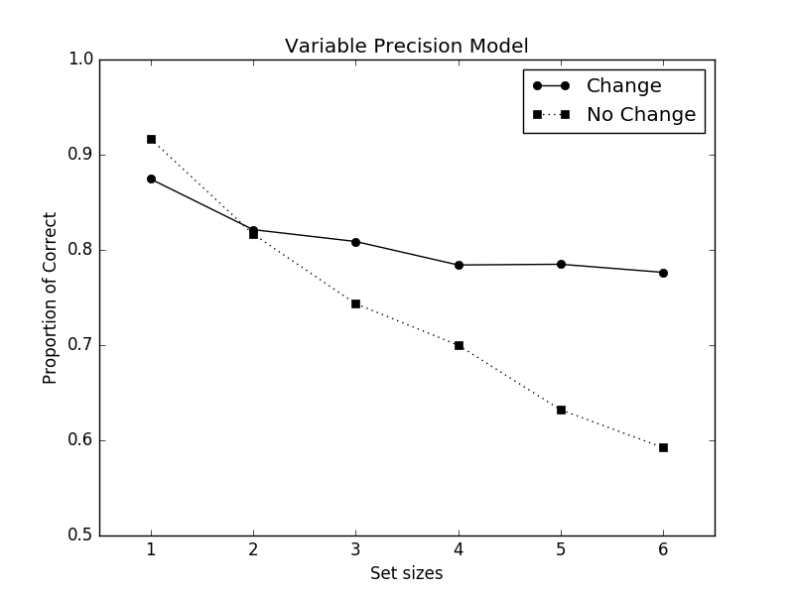
Set-size effect (models prediction)
Data
Variable Precision

Slide 15
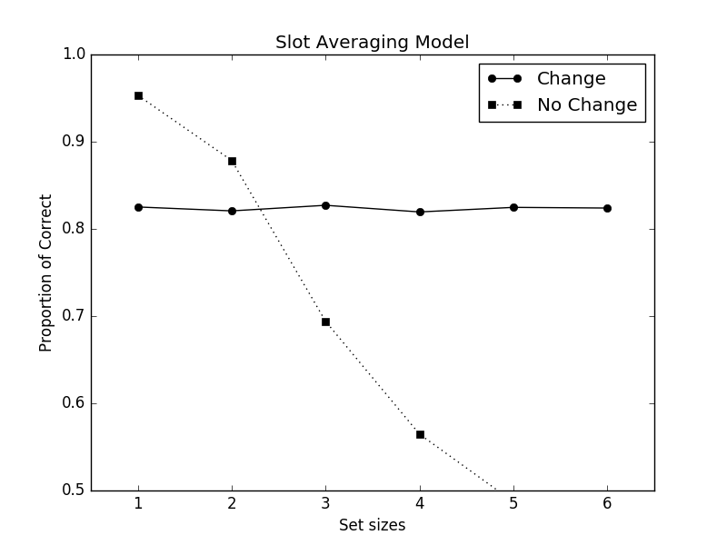
Set-size effect (models prediction)
Data
Slot-averaging

Slide 16

Response Distribution (models predictions)
Data
Interference Model

Slide 17
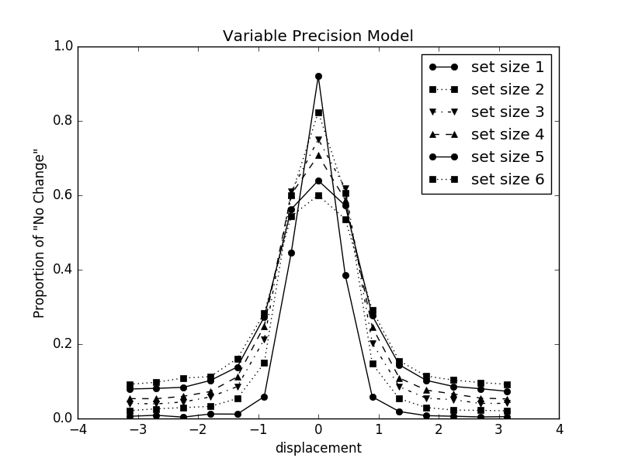
Response Distribution (models predictions)
Data
Variable Precision

Slide 18
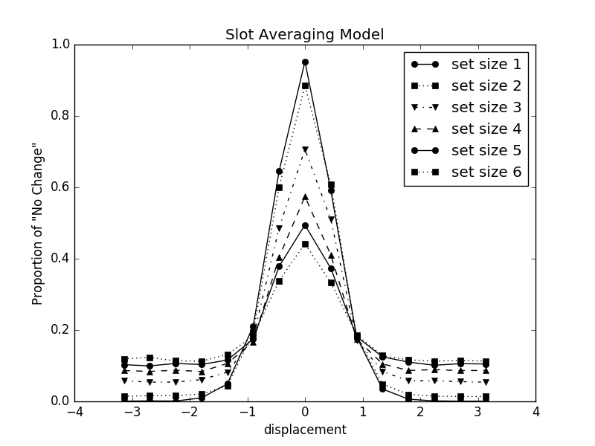
Response Distribution (models predictions)
Data
Slot-averaging

Slide 19
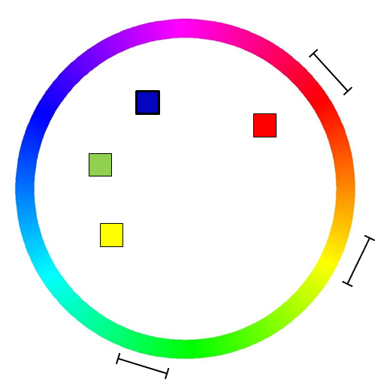
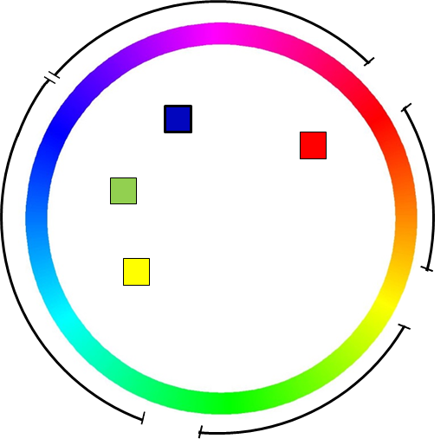

Interference from Non-target Items
Non-target items response:
Activation from context-independent activation ($A_{a}$)
Activation from cue-based retrieval ($A_{c}$)
Re-categorized the probes:
same
intrusion
new

Slide 20
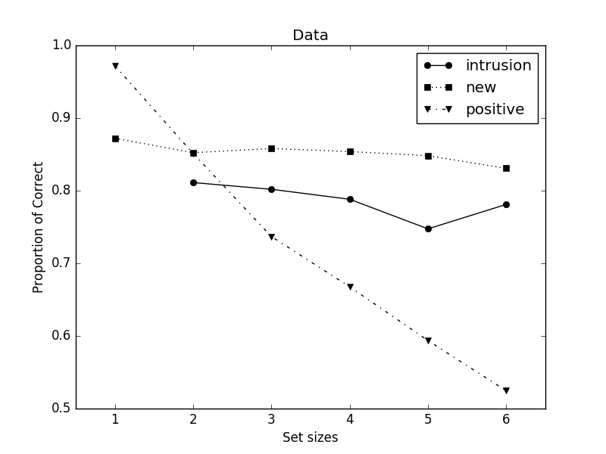
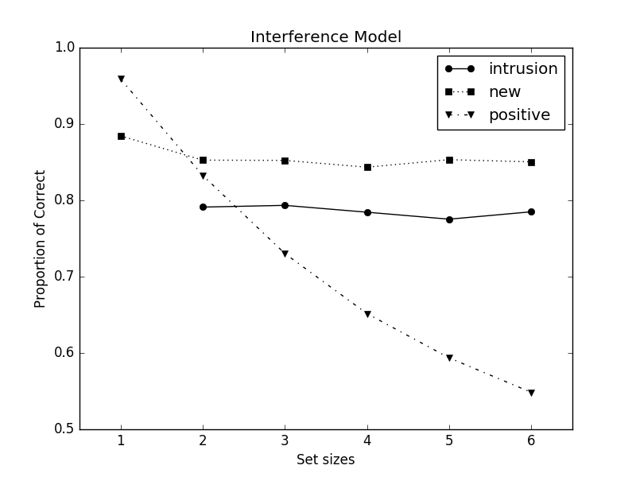
Intrusion probes (models predictions)
Data
Interference Model

Slide 21
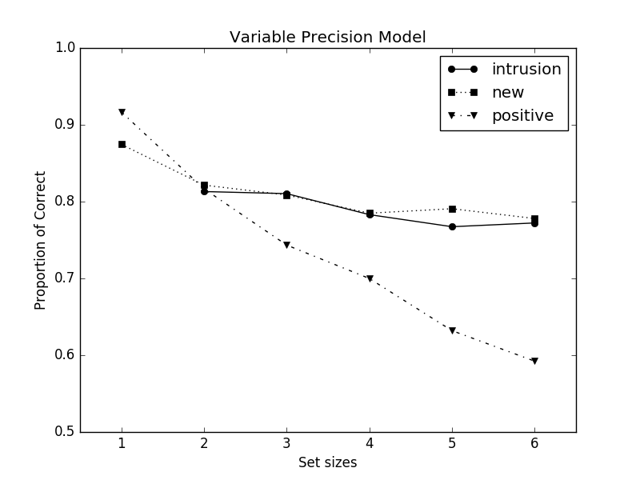
Intrusion probes (models predictions)
Data
Variable Precision

Slide 22
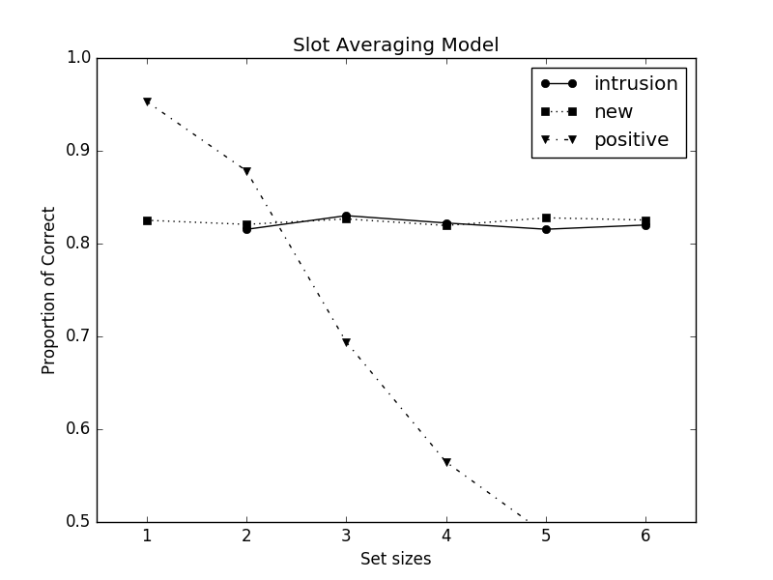
Intrusion probes (models predictions)
Data
Slot-averaging

Slide 23
Conclusion
Interference Model is the only model able to predict the intrusion cost without additional assumptions.
Maybe we don’t need a hard limit to explain working memory capacity.

Slide 24
Caveat
The set-size effect of the intrusion cost
IM can not predict any the effect of set size on intrusion cost
However, there might be a set size effect.
Bayes factor is 0.39 in favor of no set-size effect in the presented experiment.

Slide 25
Thank you for you attention. Please don’t ask mean questions.

Slide 26
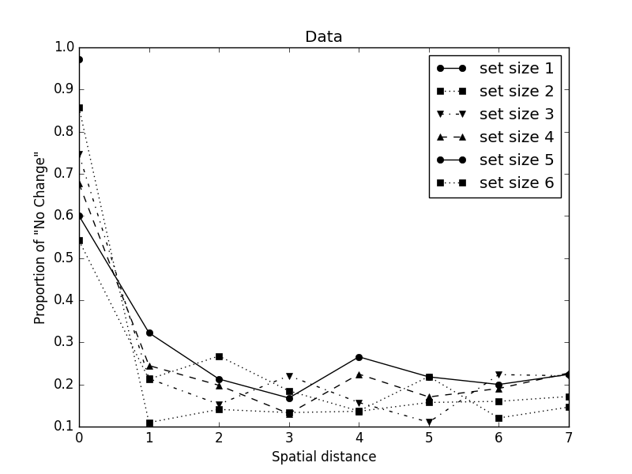
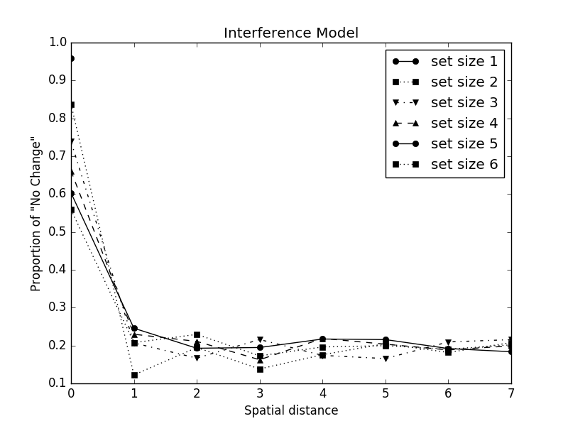
Spatial Gradient Effect
Data
Interference Model

Slide 27
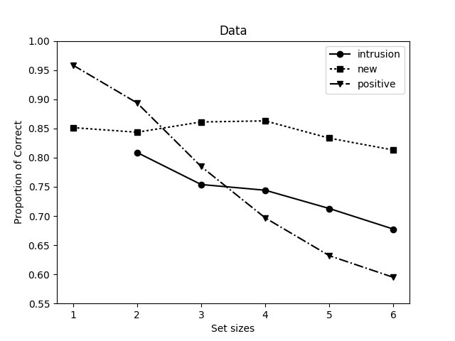
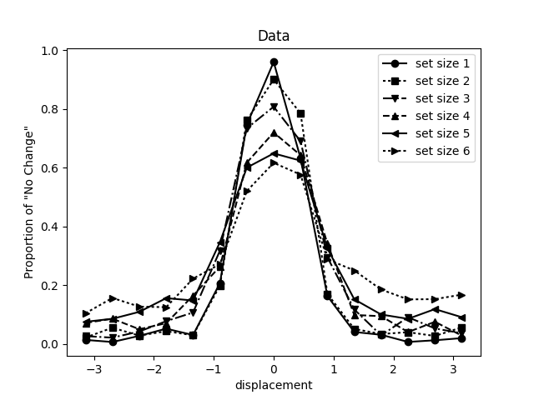
Results- Experiment 0
Set-size effect
Response distribution

