Slide 1
Hello World

Slide 2
Adding PsychoPy interpreter to VSCode
Install Python extension.
Press f1 (or ctrl+shift+p) to open command palette.
Type in: Python select interpreter.
Choose the psychopy interpreter.
See this link:
https://code.visualstudio.com/docs/python/environments

Slide 3
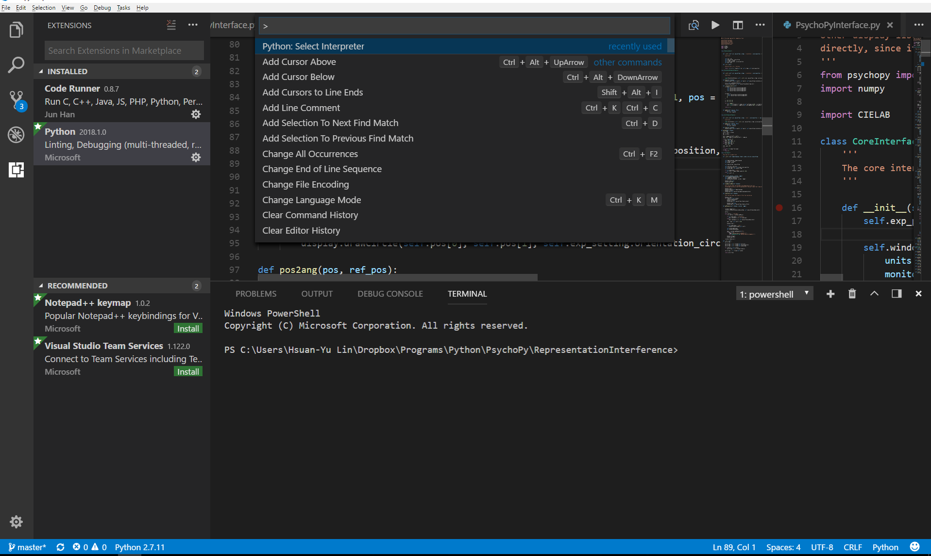
Press f1 (or ctrl+shift+p) to open command palette.

Slide 4
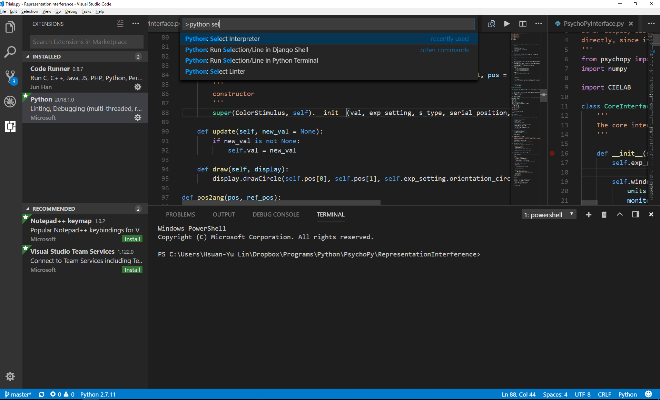
Type in: Python select interpreter.

Slide 5
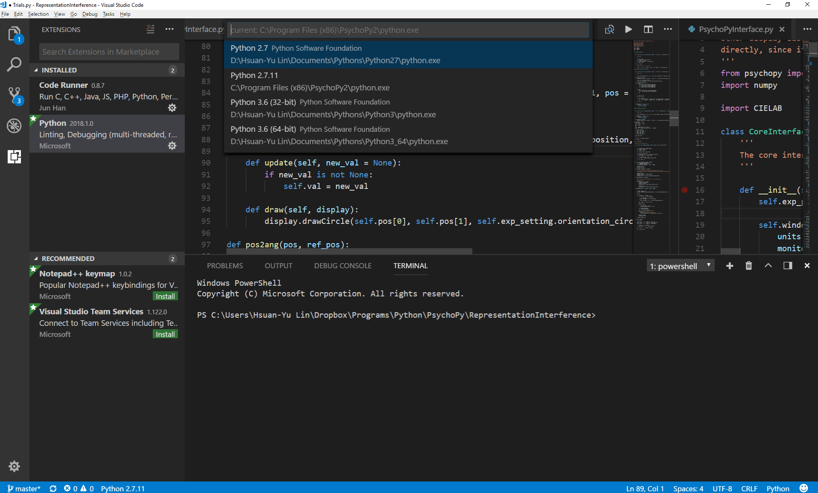
Choose the psychopy interpreter.

Slide 6
Using PsychoPy
Import

