Slide 1

Multi-finger Motion Inference Using M1 Neural Decoding
ICOIN 2018
Dept. of Electronic Engineering, Soongsil Univ.
Neuro-Engineering and Neural Signal Processing Lab.
Hwayoung Choi, Kyung-Jin You and Hyun-Chool Shin

Slide 2
CONTENTS
01
Introduction
02
Method
Data Collection
Neural correlation
Maximum Likelihood
Stochastic modeling
Semi-blind Decoding
03
Experimental Results
Estimated Models
Decoding Accuracy
04
Conclusion

Slide 3
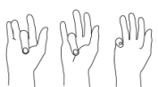
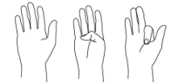
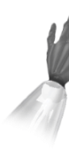
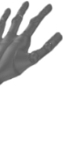
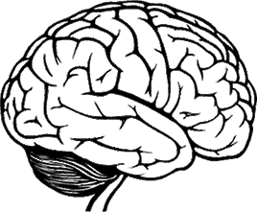
Introduction (1)
What is the neural decoding ?
Neurons encode information in the form of an electrical signal (e.g. spike train)
Inferring information about motion/ sensory signal in the spike train is called neural decoding
Applications
Prosthetic hand / robot arm control by inferring motion intention
Detection using animal sensory perception
Motion decoding
Environmental stimuli
M1
S1
olfaction, temperature , pressure…
Record signals
from motor
neural structure
Record signals
from sensory
neural structure
Decode stimulus source/level
Decode motor intent
Notes:
M1 primary motor cortex
S1 somatosensory cortex

Slide 4









Introduction (2)
Among the motion decoding, decoding finger is developed for safe and convenient life
In previous research, to estimate multi-finger motion, it is necessary to model various finger combinations
Need decoding technology that does not require the training process of multi-finger motion
Thus, we proposed the novel decoding method that estimates multi-finger motions requiring only single finger motion data
Motion intention
Training process
Control
Conventional method
Proposed method
$$…$$

Slide 5
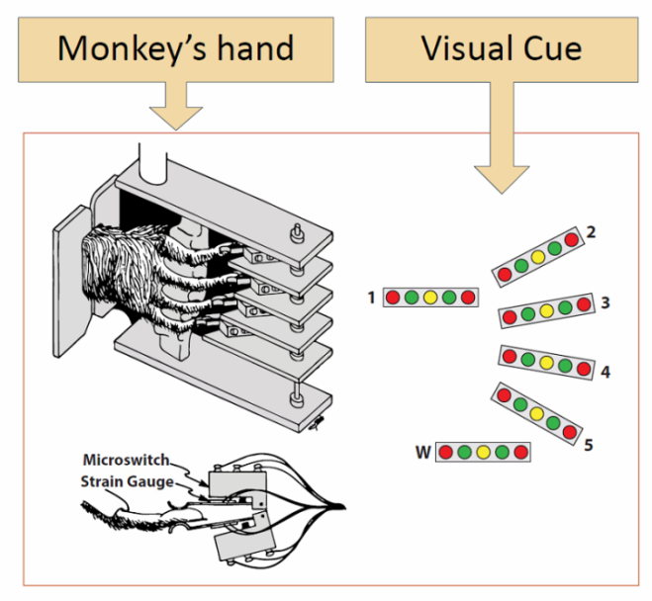
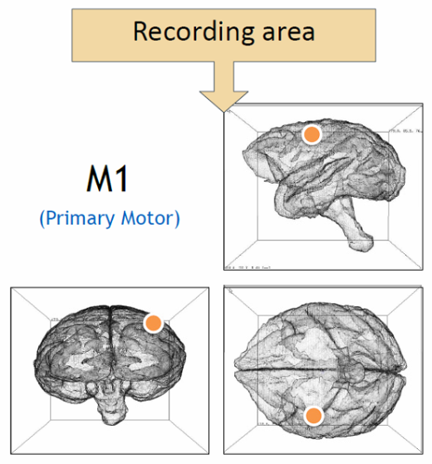
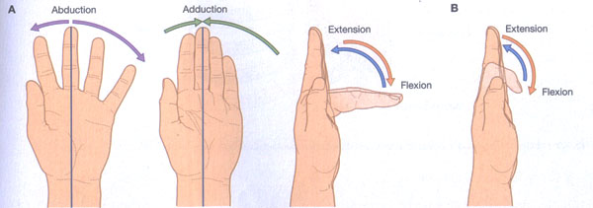
Data Collection (1)
Experimental Protocol
Subject: A male rhesus monkey (training to perform visually cued individuated finger motions)
Recording area: 115 task-related neurons in primary motor cortex (M1)
Motion (total of 16 motions) : 10 single finger motions, 6 multi-finger motions (flexion and extension of the right five fingers)
↑ Motion e.g. 2f : flexion of 2nd finger
2+3e: extension of 2nd and 3rd finger
Notes:
Monkeys thus can move one or more digits to some degree
independent of the movement or posture of the others.

Slide 6

Data Collection (2)
Neural Activations of Finger motions
Using Peri-event time histogram (PETH) to identify neural activity in each motions
The neurons responsive to single finger motions are also participating in corresponding multi-finger motions
* Recording interval
Base(0.0s to 0.7s), Onset(0.7s to 1.4s), After(1.4s to 2.0s)

Slide 7

Neural correlation (1)
Using Pearson’s correlation coefficient to quantitatively analyze the neural correlation
When PETH of motion m is vector $P\left(m\right)=\left[P_{1}\left(m\right),P_{2}\left(m\right),…\right]$ Pearson’s correlation coefficient : $ρ_{k,l}=\frac{\sum_{t}{\left(\left(P_{t}\left(k\right)−\overline{P(k)}\right)\left(P_{t}\left(l\right)−\overline{P(l)}\right)\right)}}{\sqrt{\sum_{t}{{\left(P_{t}\left(k\right)−\overline{P(k)}\right)}^{2}}}\sqrt{\sum_{t}{{\left(P_{t}\left(k\right)−\overline{P(k)}\right)}^{2}}}}$
Some neurons are not responsive to certain finger motions
Neuron-averaged correlation of all 115 neurons
Each circle represents the correlation
The size of circle is proportional to the correlation coefficient
Relevance can be verified, but the correlation coefficient value is small
Notes:
(e.g. ‘1+2f’ multi-finger motion has the highest correlation coefficient with ‘2f’)

Slide 8
Neural correlation (2)
Collecting the high responding neurons
The Pearson’s correlation coefficient for the physically related motion pairs are greater than others
e.g. ‘1+2f’ multi-finger motion has the greatest correlation coefficient with ‘1f’ and the second greatest value with ‘2f’
Neuron-averaged correlation of high responding 10 neurons

Slide 9


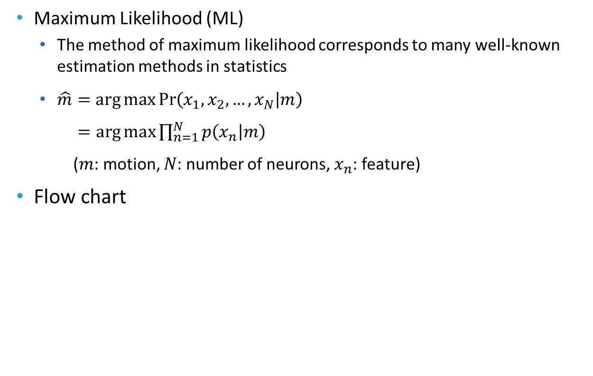







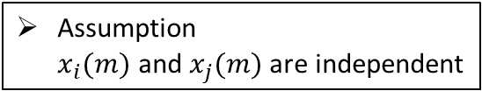
ML neural decoding
Maximum Likelihood (ML)
The method of maximum likelihood corresponds to many well-known estimation methods in statistics
$\hat{m}=\arg{\max{\operatorname{Pr}\left(x_{1},x_{2},…,x_{N} | m\right)}}$ $=\arg{\max{\prod_{n=1}^{N}{p\left(x_{n} | m\right)}}}$ ($m$: motion, $N$: number of neurons, $x_{n}$: feature)
Flow chart
$$m$$
Assumption $x_{i}(m)$ and $x_{j}(m)$ are independent
$$m$$
start
$$p{(x_{n}|m=1)}$$
Feature $x_{n}$
($n=1\sim N)$
$$p{(x_{n}|m=2)}$$
$$\hat{m}=\arg{\max{p\left(x_{n} | m\right)}}$$
$$x_{n}∈\hat{m}$$
$$⋮$$
m
$$p{(x_{n}|m=6)}$$
end

Slide 10

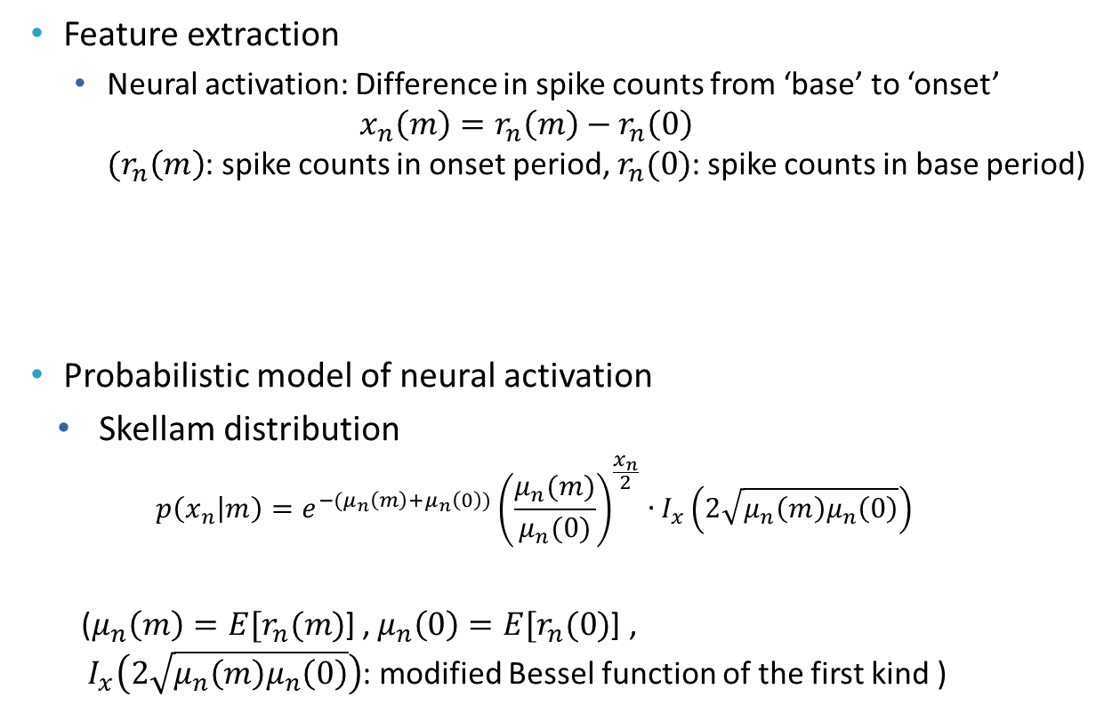


Stochastic Modeling
Feature extraction
Neural activation: Difference in spike counts from ‘base’ to ‘onset’ $x_{n}\left(m\right)=r_{n}\left(m\right)−r_{n}\left(0\right)$ $(r_{n}\left(m\right)$: spike counts in onset period, $r_{n}(0)$: spike counts in base period)
Probabilistic model of neural activation
Skellam distribution $p\left(x_{n} | m\right)=e^{−(μ_{n}\left(m\right)+μ_{n}\left(0\right))}{\left(\frac{μ_{n}(m)}{μ_{n}(0)}\right)}^{\frac{x_{n}}{2}}∙I_{x}\left(2\sqrt{μ_{n}\left(m\right)μ_{n}\left(0\right)}\right)$
($μ_{n}\left(m\right)=E[r_{n}(m)$] , $μ_{n}\left(0\right)=E[r_{n}(0)$] , $I_{x}\left(2\sqrt{μ_{n}\left(m\right)μ_{n}\left(0\right)}\right)$: modified Bessel function of the first kind )
base
onset
→ $x_{n}\left(m\right)=12−4=8$
$$r_{n}\left(0\right)=4$$
$$r_{n}\left(m\right)=12$$

Slide 11



Semi-blind Decoding (1)
Semi-blind decoding
Exploiting the relationship between single and multi-finger motion
Inferring multi-finger motions trained by the neural activities acquired in single finger motions
Training data (single finger motion) | Prosthetics Motion (multi-finger motion)
flexion of 4th finger
flexion of 5th finger
flexion of 4&5th fingers

Slide 12
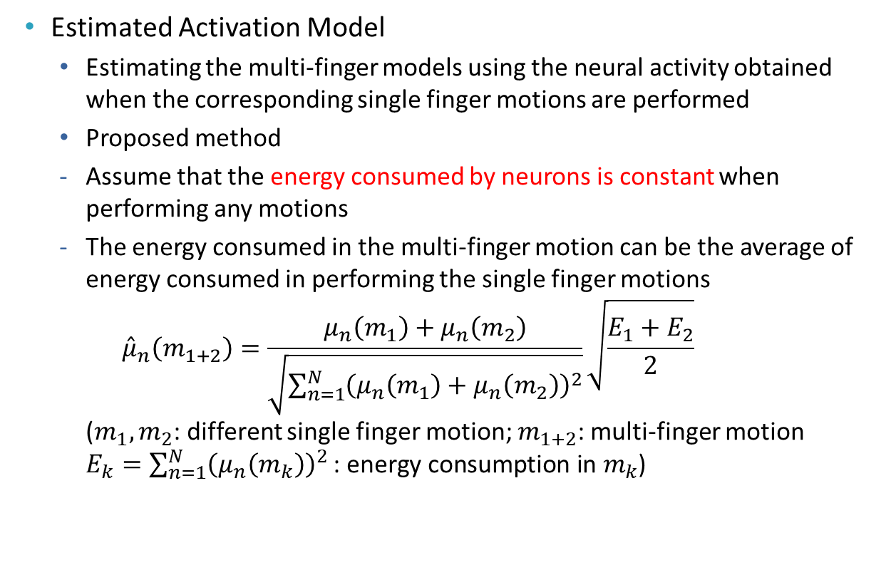
Semi-blind Decoding (2)
Estimated Activation Model
Estimating the multi-finger models using the neural activity obtained when the corresponding single finger motions are performed
Proposed method
Assume that the energy consumed by neurons is constant when performing any motions
The energy consumed in the multi-finger motion can be the average of energy consumed in performing the single finger motions ${\hat{μ}}_{n}\left(m_{1+2}\right)=\frac{μ_{n}\left(m_{1}\right)+μ_{n}\left(m_{2}\right)}{\sqrt{\sum_{n=1}^{N}{{\left(μ_{n}\left(m_{1}\right)+μ_{n}\left(m_{2}\right)\right)}^{2}}}}\sqrt{\frac{E_{1}+E_{2}}{2}}$ $\text{(}m_{1}, m_{2}$: different single finger motion; $m_{1+2}$: multi-finger motion $E_{k}=\sum_{n=1}^{N}{{\left(μ_{n}\left(m_{k}\right)\right)}^{2}} \text{: }\text{energy} \text{consumption} \text{in} m_{k}$)

Slide 13
Estimated Models
Accuracy of estimated mean: comparison of actual mean(black) and estimated mean (white)
Comparison of actual model (line) and estimated model (line with marker) in two motions, 4+5f and 2+3e

Slide 14
Decoding Accuracy (1)
Decoding accuracy by number of neurons used for decoding
Average decoding accuracy
Semi-blind decoding accuracy for six multi-finger motions
* Non-blind Decoding : Decoding technique that requires training process of multi-finger motion

Slide 15
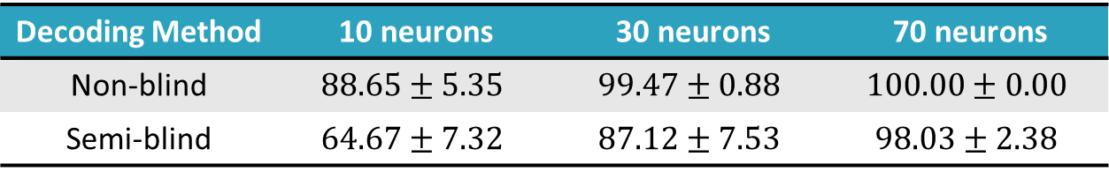
Decoding Accuracy (2)
Decoding Method | 10 neurons | 30 neurons | 70 neurons
Non-blind | $$88.65±5.35$$ | $$99.47±0.88$$ | $$100.00±0.00$$
Semi-blind | $$64.67±7.32$$ | $$87.12±7.53$$ | $$98.03±2.38$$
Summary of decoding results (%, average $±$ std)
Considering the feature of semi-blind decoding, which does not require a priori training data for multi-finger motion, the decoding accuracy is not so low compared with non-blind decoding
The result show that the possibility of semi-blind decoding

Slide 16
Conclusion
Quantifying the neurological correlations between single finger motions and their combined motion
Propose the semi-blind neural decoding which can discriminate multi-finger motions based on independent and elementary finger motions
So, prosthetic hand users can expect to skip the boring training process of multi-finger motions
Confirmed six results of multi-finger motions for decoding, the further verification of the proposed decoding is required from experiments that perform more various motions
Notes:
We confirmed the results using the neural activity of the monkey with six multi-finger motions.
The proposed method is innovative in that it can overcome the common limitations of existing methods, which require the training procedure for the number of detectable motions

Slide 17
Q & A
Hwayoung choi, M.S. Student
E-mail : chy2207@soongsil.ac.kr

