Slide 1
Robust Registration to a template brain for the Drosophila larva
Learning based approach – Voxelmorph

Slide 2
Contents
Registration Setup.
Registration result with Voxelmorph.
Registration result with Larvalign.
Conclusion.
Comparison between Larvalign and Voxelmorph.

Slide 3
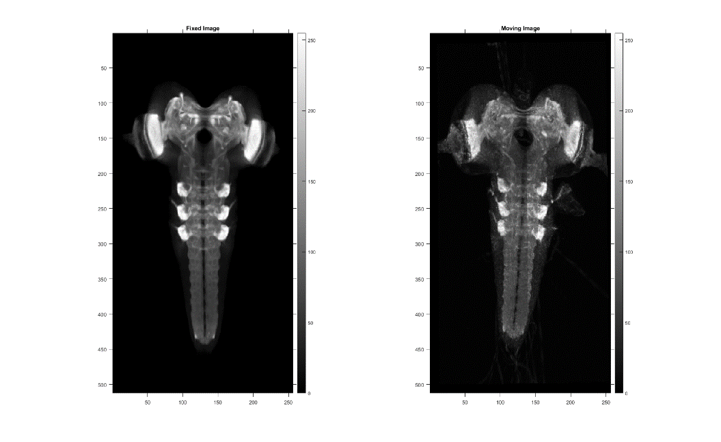
Registration Setup
Full-scale version:
993 x 1449 x 99 (w x h x d).
Downsampled version:
256 x 512 x 64 (w x h x d).

Slide 4
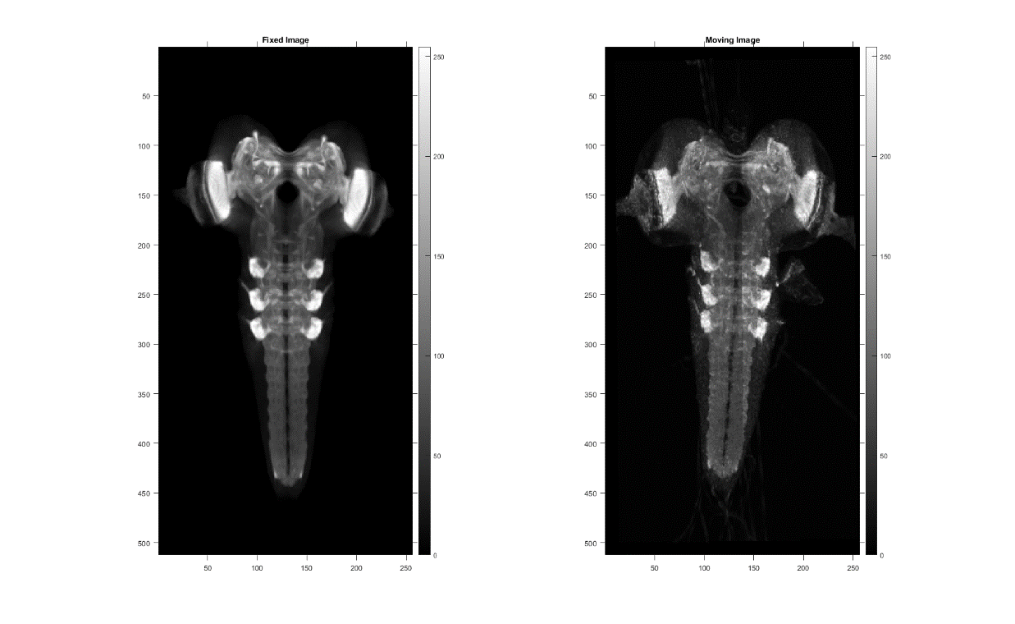
Registration result with Voxelmorph (1/3)
„Fixed“ image (atlas/template/target) on the left hand side and „moving“ image (subject) on the right hand side.

Slide 5
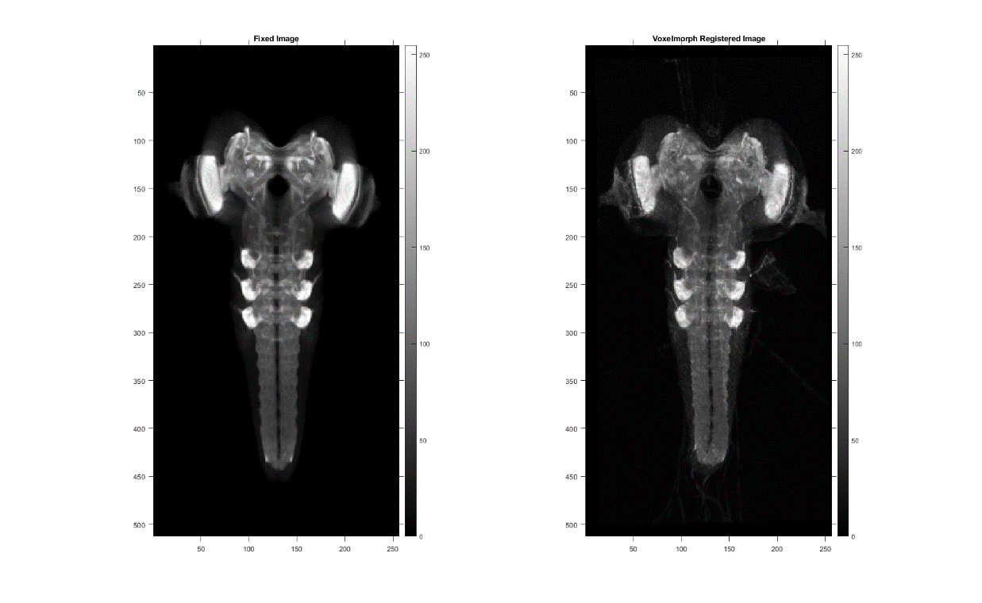
Registration result with Voxelmorph (2/3)
„Fixed“ image (atlas/template/target) on the left hand side and „registered“ image (moved) on the right hand side.

Slide 6
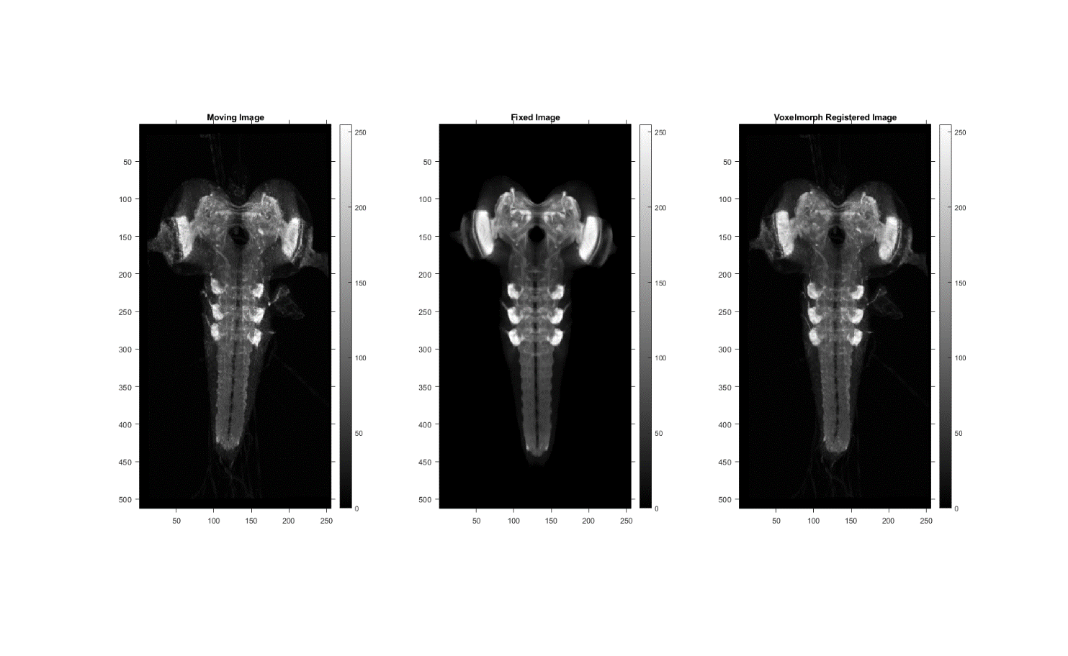
Registration result with Voxelmorph (3/3)
„Moving“ image on the left hand side, „fixed“ image at the center, and „moved“ image on the right hand side.
„Voxelmorph“

Slide 7
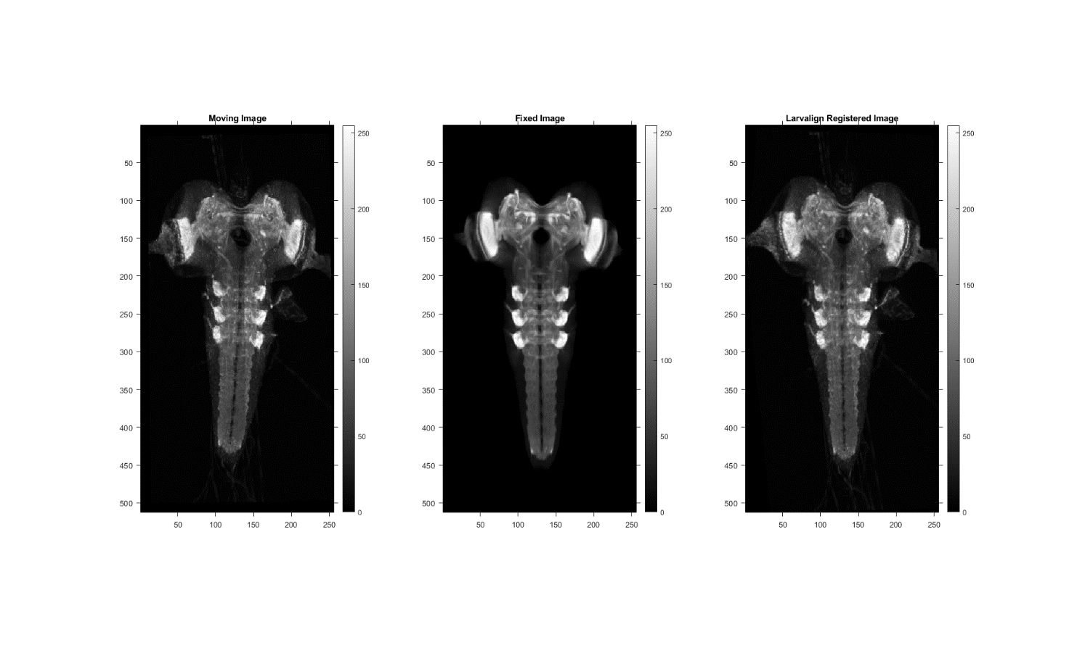
Registration result with Larvalign
„Moving“ image on the left hand side, „fixed“ image at the center, and „moved“ image on the right hand side.
„Larvalign“

Slide 8
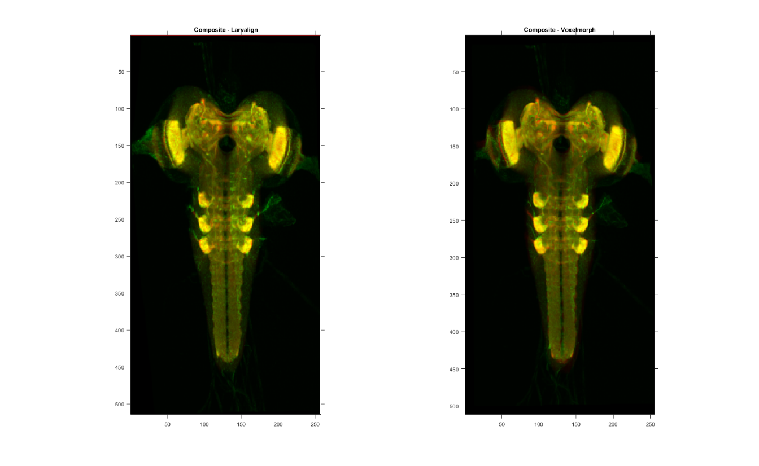
Comparison between Larvalign and Voxelmorph
Composite image for larvalign on the left hand side and composite image for voxelmorph on the right hand side.

Slide 9
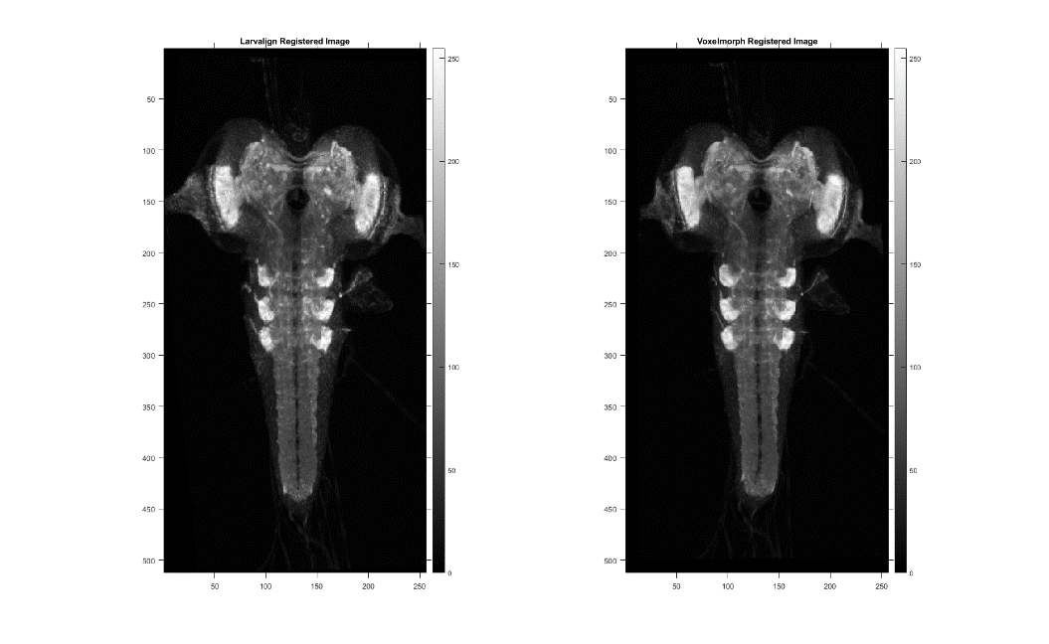

Comparison between Larvalign and Voxelmorph
Time for registration
CPU Configuration:
AMD Ryzen 9 5950X 16-Core Processor, 4.00 GHz.
128 GB RAM
GPU Configuration:
NVIDIA RTX A5000
24 GB Dedicated GPU memory.
Registration settings:
Single channel registration (NP Channel).
Downsampled version: 256 x 512 x 64 (w x h x d).
Full-scale version: 993 x 1449 x 99 (w x h x d).

