Slide 2
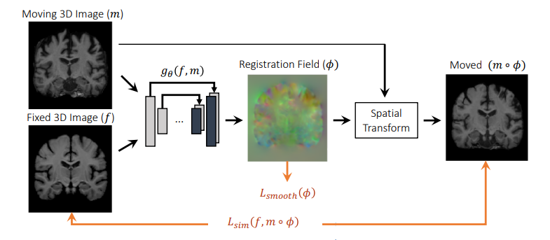






Auxiliary Information (Optional)
-ϕ
Fixed Image Landmarks ($l_{f}$)
Moving Image Landmarks ($l_{m}$)
Moved Image Landmarks ($l_{m}$)
$$ℒ_{ldm}(l_{f}, l_{m}∘φ)$$

