Slide 1
Robust Registration to a template brain for the Drosophila larva
Interim presentation
- Harsha Yogeshappa
Supervisor: Dr.rer.nat. Martin Strauch
Notes:
Hello all,
Welcome to the interim presentation of my master thesis.
The title of my master thesis is "Robust Registration to a template brain for the Drosophila larva", done under the supervision of Dr. Martin Strauch.

Slide 2
Contents
Model organism – Drosophila larva.
Motivation.
Datasets.
Concepts.
Voxelmorph.
Experimental Setup.
Assessment and Results.
Work to do.
Notes:
Before I begin to present the thesis and its current status, I would like to show you a brief overview of the sections I will be discussing.
And these are they.

Slide 3
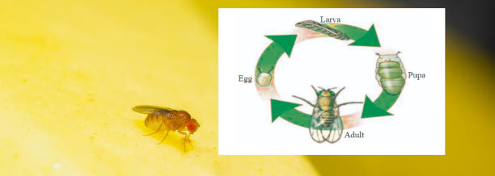
Model organism – Drosophila larva
Image: https://www.istockphoto.com/de/fotos/drosophila-melanogaster
Image: Learn About Metamorphosis In Drosophila | Chegg.com
Notes:
The Drosophila, commonly known as the fruit fly, has been used in scientific research and the study of neuroscience for about a century. As you can see from the picture, and as most of you know, the fruit fly goes through different stages in its growth before becoming an adult: Egg - Larva - Pupa - Adult. In this thesis we are working on 3D scans of the central nervous system of the Drosophila in its larval stage.

Slide 4
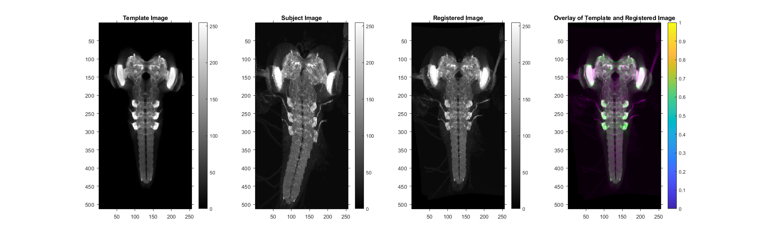

Motivation
Thesis work is an extension of the work done in larvalign: Aligning Gene Expression Patterns from the Larval Brain of Drosophila melanogaster.
Muenzing, Sascha E A et al. Neuroinformatics vol. 16,1 (2018): 65-80.
Notes:
My thesis is an extension of the work done in the Larvalign paper, co-authored by Dr. Martin Strauch and Professor Dorit Mehrof.
<pause!>
Larvalign is in itself a standard volume template and is also a registration method to register other 3D volumes to it.
So, the next question is what is Image registration? - Image registration is the process of transforming different sets of images into a common coordinate system for e.g., transforming into template’s coordinate system.
The following figure is an example of a Larvalign registration.
While the registration itself is performed on the 3D volume, for visualization purposes, the figures shown here are the maximum intensity projection in the z-direction.
On the left side you can see the template image against which the registration is performed and the subject image that needs to be registered.
In the image registration field, the images against which the registration is done are called fixed images and the subject images are called moving images. So, from now on, the template image will be referred to as a fixed image and the subject image will be referred to as a moving image.
On the right side you can see the registered image, which is nothing but the subject image in the template’s coordinate system. And an overlay of the registered image and the fixed image. The green represents the fixed image and the magenta represents the registered image. And wherever there is a perfect overlap, you see gray (or the original intensity values).Based on this overlap, we can visually inspect where the registration result has failed.

Slide 5
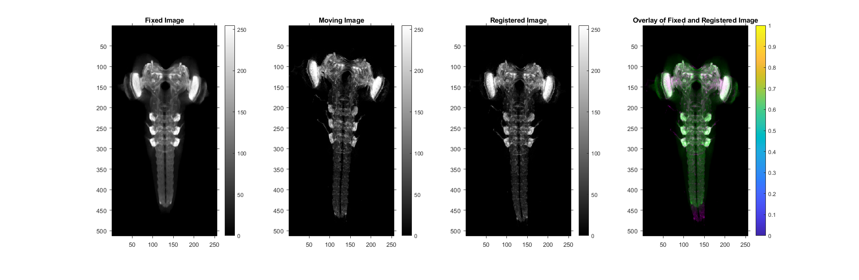
Motivation
Thesis work is an extension of the work done in larvalign: Aligning Gene Expression Patterns from the Larval Brain of Drosophila melanogaster.
Muenzing, Sascha E A et al. Neuroinformatics vol. 16,1 (2018): 65-80.
Notes:
Though the larvalign showed promising results, it however, for a few volume scans, the registration was not perfect. This can be seen at the tip of the ventral nerve cord, as shown in this example.
By definition, Larvalign is non-learning method of registration i.e., to be more specific - is a parametric method. The success or failure of registration depends largely on the choice of parameters and the values selected for each of them. And there are several such parameters. Since larvalign is a non-learning, it repeats the same errors each time it performs a registration and starts from scratch each time it registers new image pairs.
We hope to address these problems by moving from a non-learning style of registration to a learning style, in the hope that the network can learn to solve such registration problems through experience.

Slide 6
Motivation
Goal of the thesis
Analyze if the following is achievable with a learning-based approach.
Robust registration.
Overcome the failed registrations in larvalign.
Improve the registration time.
Investigate how landmark points can be inserted into the training as auxiliary information.
At the end of the thesis, we hope to have a faster and more robust larvalign called larvalign 2.0
Notes:
So, the goal of this thesis is
to make the registration process more robust,
to solve the problems that Larvalign could not solve,
to improve the registration time, which is now about 7 minutes on a 64 GB GPU machine,
and most importantly to try to include the landmark points as auxiliary information to assist the network during the training.
(in the upcoming slides, I will talk about what landmark points are.)
At the end of the thesis, as mentioned in the slide, we hope to have larvalign 2.0 which is faster and more robust.
03:30

Slide 7
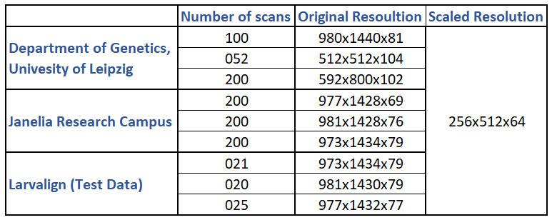
Datasets
In total, 1 template scan and ~1000 larval brain scans from
Department of Genetics, University of Leipzig, Leipzig, Germany.
Janelia Research Campus, Howard Hughes Medical Institute, Ashburn, VA, USA.
Evaluation performed on test data and compared with larvalign.
Notes:
We have received about 1000 3D scans from the University of Leipzig and the Janelia Research Campus. Thanks to them!
<pause!>
Each of these images varies in resolution. However, for development purposes, the images are scaled to 256x512x64.
For my model’s architecture, this is by far the largest resolution that can fit on a machine with a GPU capacity between 20GB and 30GB, even with a batch size of 1. Any larger resolution would cause OOM errors. However, the problem of the batch size being limited to 1 is mitigated by the gradient accumulation technique.
The third dataset we see here is a subset of the dataset that was used in the larvalign work. This will now be used as a test dataset to evaluate the performance of our network against larvalign.

Slide 8
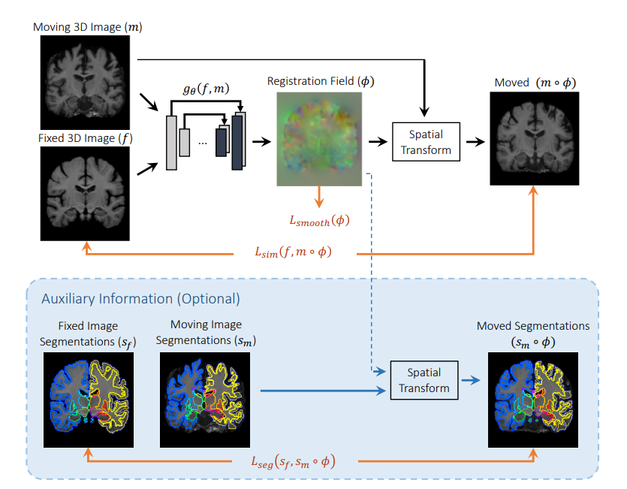
Concepts
Unsupervised method.
Feed auxiliary information to the network to guide it in the right direction of learning.
Base model: Voxelmorph
A learning framework for deformable medical image registration.
It is proven to work: Comparable performance to state-of-the-art medical image registration.
Can be combined with auxiliary information to improve the accuracy (e.g., segmentation map).
Voxelmorph: Balakrishnan et al., IEEE Transactions on Medical Imaging, 2019.
Notes:
We chose to use an unsupervised learning method because it is difficult to find a ground truth for all training images – be it a registered image or a deformation field that maps the transformation from a fixed image to a moving image.
And, any information that could help steer the network in the right direction of learning is beneficial. And we would like to be able to provide such additional information that could help us train the model better.
We found that the model that meets these two requirements is Voxelmorph model. It has proven to be functional and offers the possibility to introduce additional information. In the voxelmorph paper, segmentation maps were used as auxiliary information, and it was found that this improved the accuracy of the registration.
<pause!>
To briefly explain the Voxelmorph model: The two images - one fixed and one moving - are concatenated at the input and fed into the network, which has an encoder-decoder UNet architecture with skip connections. The output of the network is a deformation field with three channels and in the size of the input images. 3 channeled because each entry in the deformation field is a 3d displacement vector. To calculate the unsupervised loss, the moving image is warped by the predicted deformation field using a spatial transformer network, and a similarity measurement is made between the warped image and the fixed image. The supervised loss is the dice score between the ground truth segmentation map and the warped segmentation map.

Slide 9

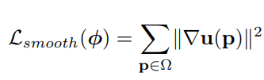
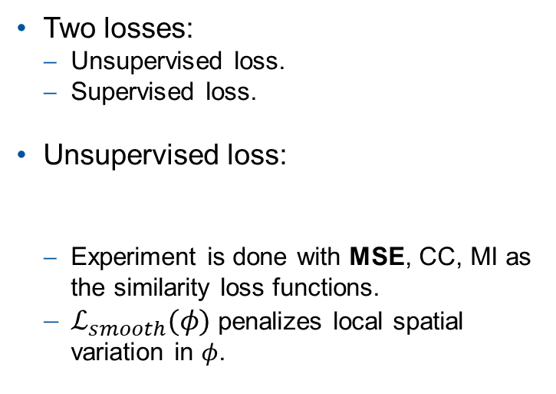
Voxelmorph: Loss Functions
Two losses:
Unsupervised loss.
Supervised loss.
Unsupervised loss:
Experiment is done with MSE, CC, MI as the similarity loss functions.
$ℒ_{smooth}(φ)$ penalizes local spatial variation in $φ$.
Voxelmorph: Balakrishnan et al., IEEE Transactions on Medical Imaging, 2019.
Notes:
As explained in the previous slide, unsupervised loss is nothing more than a measure of similarity between the fixed and registered images. The similarity measure can be a mean square error, a normalized cross correlation, or mutual information. However, it was empirically found that for our case the mean squared error performs better.

Slide 10
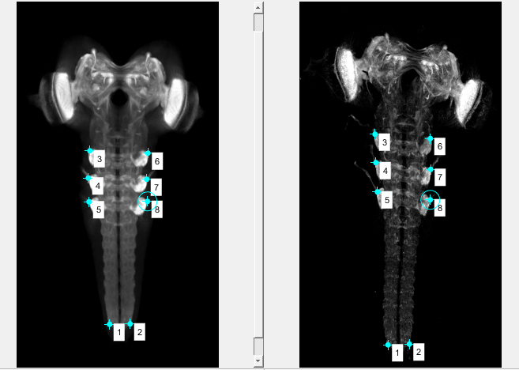
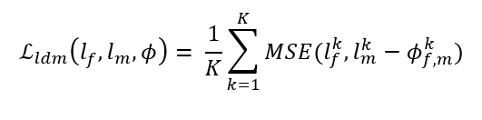
Concepts: Auxiliary Information
Landmark points, spatial correspondences between f and m.
commonly known as the gold standard in the field of image registration.
We quantify perfect registration of landmark points using mean squared error function.
Notes:
Just as segmentation maps were used in the Voxelmorph paper, we want to introduce our own auxiliary information. Here, we are trying a novel method of incorporating landmark points into the training.
So what exactly are landmarks?
A landmark is a spatial correspondence between f and m marked in the same place in both images, as shown in the figure.
<pause!>
In the field of image registration, these spatial correspondences are called gold standards.
We term perfect registration when the distance between them in the registered image and in the fixed image is zero.
The following mathematical equation describes the same for K number of landmarks, where phi represents the displacement or deformation field. This loss from now on will be referred to as landmark registration error.
<pause!>
The terms in the equation will be explained in the second slide from now.

Slide 11
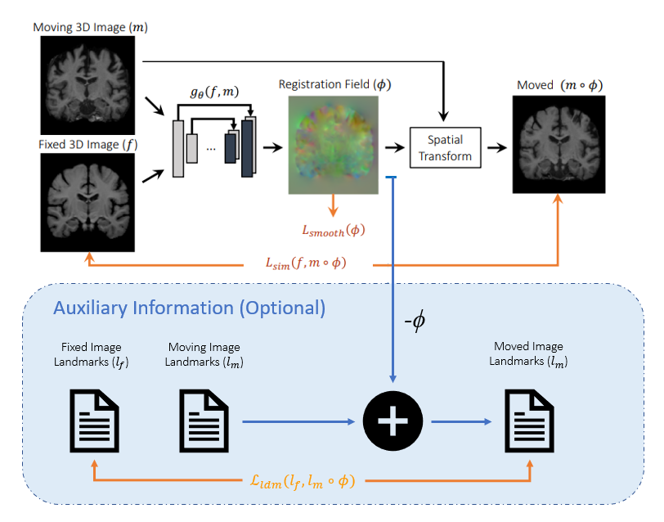
Voxelmorph: Loss Functions
Two losses:
Unsupervised loss.
Supervised loss.
Supervised loss:
If landmark points are available, then for K landmark points.
Voxelmorph: Balakrishnan et al., IEEE Transactions on Medical Imaging, 2019.
Notes:
So, how it is done?
The deformation field is nothing more than a displacement vector field that specifies by how many units a given pixel in the moving image must move in 3D space. Thus, the landmarks in the fixed and moving image are related to the displacement field by a simple addition, subtraction operation.
And that is what is described in this mathematical equation. To reach the landmark in the fixed image, the landmark in the moving image must be subtracted by the vector given in the deformation field.

Slide 12
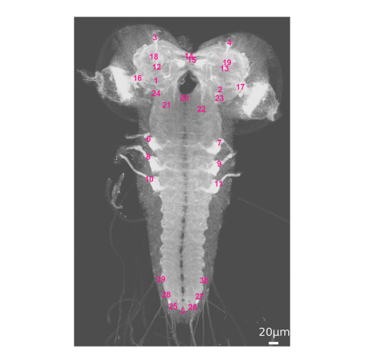
Experimental Setup
Registration is always done against the fixed template image – the larvalign template.
7 nerve entry points in the inferior ventral nerve cord are chosen.
More such landmarks can be added to further assist the network.
Image: Muenzing, Sascha E A et al. Neuroinformatics vol. 16,1 (2018): 65-80.
Notes:
Experimental setup.
<pause!>
The first and foremost: we always keep the fixed image constant, i.e., the registration is always done against the same image – the larvalign template.
As for the selection of landmarks,
1. Number one, the landmark needs to be clearly identifiable anatomical positions. And the Larvalign paper suggests 30 such possible locations, as shown here in the figure.
For training, not all of these 30 landmarks need to be provided as auxiliary information, but only a subset of them can be used (even 0). However, for the evaluation, the error in registering all 30 landmarks will be taken into account.
As shown in the first slides, we know that larvalign had problems registering the lower tip of the ventral nerve cord. For this reason, we decided to annotate only these 7 lower-end nerve inputs in those training examples where we thought the network might need help.
Adding more landmarks should not hurt either.

Slide 13
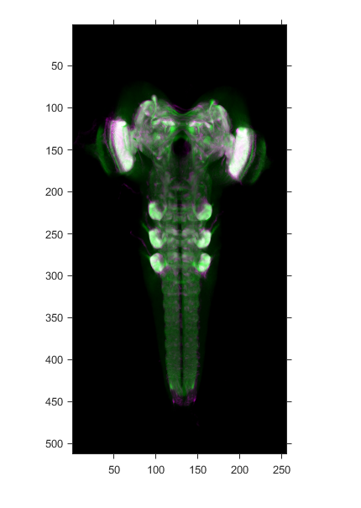
Assessment
Qualitative assessment.
The registered scans are merged with the template in different colors (green and magenta) to then visually inspect deviations.
Quantitative assessment.
Global Registration Error.
VNC Terminal Error Indicator (VI).
Thoracic Nerve Error Indicator (TI).
Landmark Registration Error (LRE).
Notes:
We plan to do two types of assessments.
One is a qualitative assessment, where we overlay the registered image with the fixed image and look for areas where the registration failed.
The second is quantitative, where we derive some numbers out of the registered image in correspondence with the fixed image.
The global registration error is the correlation between the fixed image and the registered image as a whole. It is obvious that such a global measure may not be able to capture local errors. Therefore, we consider two additional error values, the VNC error indicator and Thoracic error indicator, as proposed in larvalign paper.
We choose a small spherical volume at few of the landmarks in VNC and Thoraci nerve entry points, as defined in the template image and compute a mmi score between fixed and registered image.
VNC: On spherical regions with a radius of 10 μm at two terminal positions of the VNC landmarks defined in the template image, a mutual information score is calculated between the fixed image and the registered image.
Thoracic: Similarly, for spherical regions with a radius of 15 μm at all six entry points of the thoracic nerve defined in the template image, a mutual information value between the fixed image and the registered image is calculated.
LRE: Finally, LRE is the average of all eucledian distances between the 30 landmarks in the registered image and the fixed image.
G, V, T := Higher the better.
LRE := Lower the better.

Slide 14
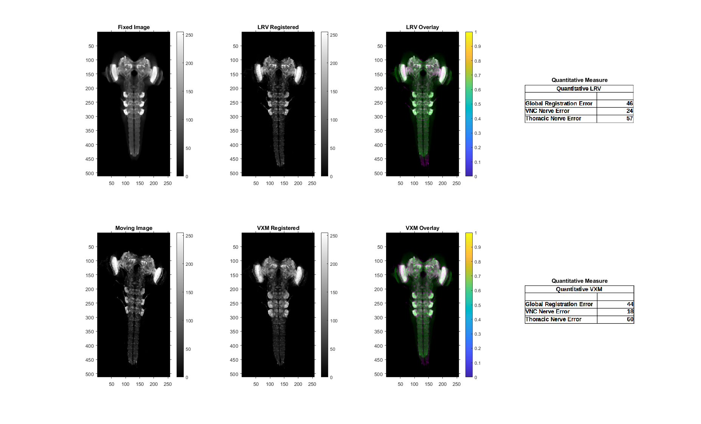
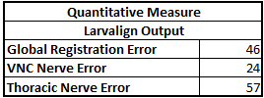
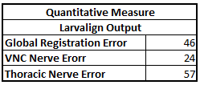
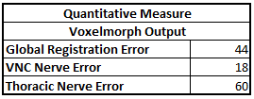
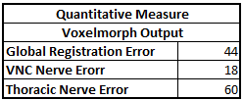
Results | Voxelmorph registration without auxiliary information
Notes:
In the current slide and in the next slide, I want to show that a voxel morph trained with auxiliary information performs better.
Here, we do a comparative analysis between the registered results of larvalign, vxm-without-aux information, and vxm-with-aux information. Here, you can see in the first column the fixed image and the moving image. In the second column, you can see the registered results with larvalign and voxelmorph without auxiliary information. In the third column, you can see the respective overlay. In the fourth column you see the quantitative results. In this scenario of training without landmark information, voxelmorph actually performed almost as well as larvalign - both the visual inspection and the numbers are in agreement with it.
On the next slide, I show the result obtained with a network trained with landmark information.

Slide 15
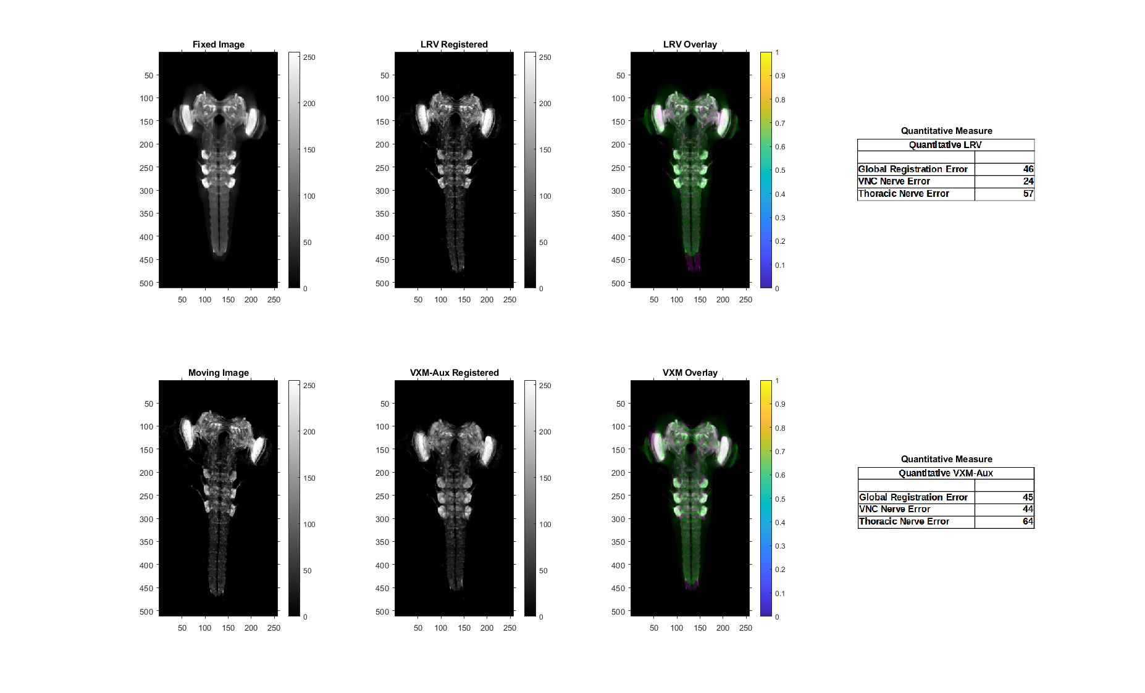


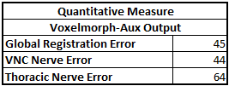
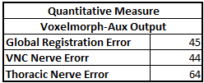
Results | Voxelmorph registration with auxiliary information
Notes:
As we can see, there is a significant correction at the VNC tip and mutual information scores also shows an improved result.

Slide 16
Results
Generalizability
To evaluate the generalization capability of the network, the following test was performed.
Experimental configuration_1:
Train on larvalign dataset
Test on larvalgin dataset
Experimental configuration_2:
Train on janelia_dataset.
Test on larvalign_dataset
The qualitative and quantitative assessment of configuration_1 is comparable with configuration_2 in both the respective scenarios of with and without auxiliary information.
Notes:
This is a nice feature to have and gives that additional confidence that the network would perform alright when deployed into the real world and sees new data.

Slide 17
Work to do
Data augmentation: flipping in horizontal direction.
Work with large scale images.
Include more landmark points.
Full empirical evaluation on different datasets, different losses etc.,
Notes:
Flipping in horizontal direction because, we want the network to be able to correct VNC bend in both the directions and not just limited to left bend or right bend as seen in the training samples.

Slide 18
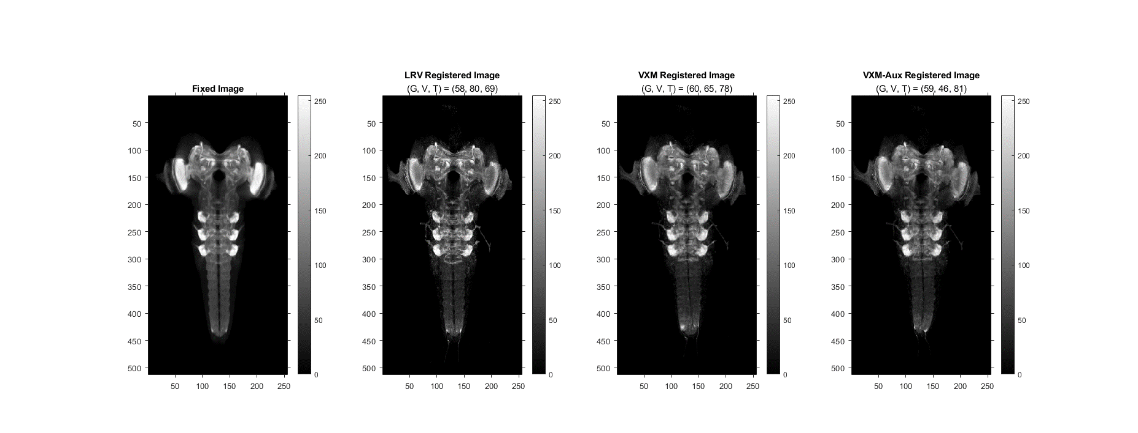
Work to do - Appendix

Slide 19
Notes:
Thank you for your attention. I will be happy to answer any questions and will be very happy to hear any suggestions or insights.

Slide 20
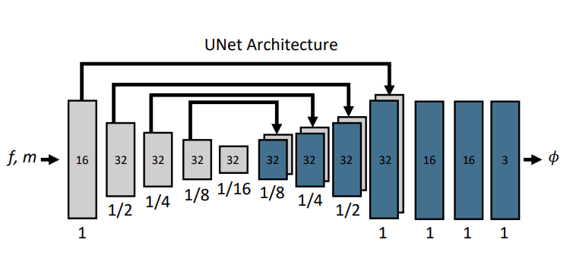
Model Architecture: Voxelmorph | Appendix
Model description
The fixed image (f) and the moving image (m) is concatenated as two input channels and fed to the Unet.
Number of features in each layer is mentioned in the figure.
Output has 3 channels representing the amount of displacement that in each of 3 directions (u,v,w).
Image: Balakrishnan et al., IEEE Transactions on Medical Imaging, 2019.
Notes:
Architectural constraint: Keep an eye on anisotropic nature of the image and make sure that smallest volume captures the maximum displacement expected in all 3 directions.

Slide 21
Model Architecture: Voxelmorph | Appendix
Unet architecture
3D Convolutions (Kernel=3, Stride=1, and ‚SAME‘ padding) with LeakyReLU activation function.
Explicit MaxPooling to downsize the images in the encoder layer.
Upsampling, 3D Convolution, and concatenating skip connections in the decoder layer.
Image: Balakrishnan et al., IEEE Transactions on Medical Imaging, 2019.

Slide 22
Model Architecture: Voxelmorph | Appendix
Architectural constraint
„The receptive fields of the convolutional kernels of the smallest layer should be at least as large as the maximum expected displacement between corresponding voxels in f and m.“
Balakrishnan et al., IEEE Transactions on Medical Imaging, 2019.
Image: Balakrishnan et al., IEEE Transactions on Medical Imaging, 2019.
Notes:
Therefore, the pooling in z-direction is controlled.
- Give proof in the next slides.

Slide 23
Results | Appendix
Experimental Setup
Registration is always done against a fixed template image.
The dimensions of the scans used are 256x512x64, grayscale images.
The batch size for training could not be >1 (OOM error).
Gradient Accumulation technique alleviates this issue.
Number of epochs is 100 (with early stopping).
Dataset split:
janelia_dataset
leipzig_dataset_1.0
leipzig_dataset_2.0
Notes:
leipzig_dataset_1.0 is the subset of data that larvalign was tested.
leipzig_dataset_2.0 is the new data recorded in the same laboratory but with a different microscope and registration is not good i.e., not robust.

