Slide 1
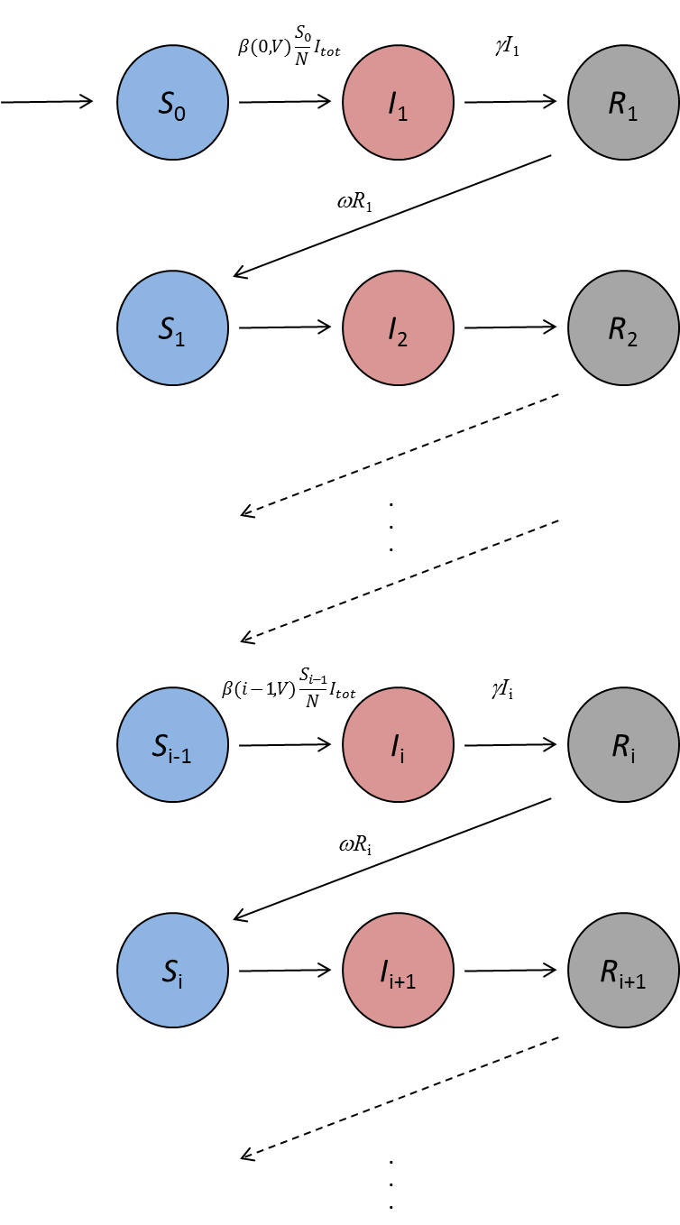

Slide 2

Age group1
S₁
(<1:10)
Infection
S₂
(1:10)
I₁
I₁
Susceptible
I₁
I₁
S₃
(1:20)
I₂
I₂
I₂
I₂
S₄
(1:40)
I₃
I₃
Antibody
decay
I₃
I₃
S₅
(1:80)
I₄
I₄
I₄
I₄
S₆
(1:160)
Age group1
Age group2
Age group1
Age group2
Immune
protection
S₇
(1:80)
2nd Strain
1st Strain
S₈
(1:160)
Immune boosting

Slide 3
S₁
(<1:10)
S₁
(<1:10)
S₂
(1:10)
S₂
(1:10)
S₃
(1:20)
S₃
(1:20)
S₄
(1:40)
S₄
(1:40)
S₅
(1:80)
S₅
(1:80)
S₆
(1:160)
S₆
(1:160)
S₇
(1:80)
S₇
(1:80)
S₈
(1:160)
S₈
(1:160)

Slide 4
S₁
(<1:10)
I₁
S₂
(1:10)
I₂
R₂
(1:10)
S₃
(1:20)
I₃
R₃
(1:20)
S_{k}
I_{k}
R_{k}

Slide 5




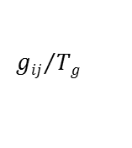

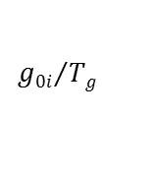

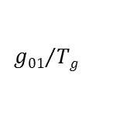
S₀
(<1:10)
$$ρ\left(0\right)λ$$
I₀
$${g01}/{Tg}$$
S₁
(1:10)
$$ρ\left(1\right)λ$$
I₁
R₁
(1:10)
$${g0i}/{Tg}$$
S_{i}
$$ρ\left(i\right)λ$$
I_{i}
R_{i}
$${gij}/{Tg}$$
$$w$$
S_{k}
$$\sim 0$$
I_{k}
R_{k}
$$w$$

Slide 6
S
(<1:40)
I
R
(>1:40)

Slide 7
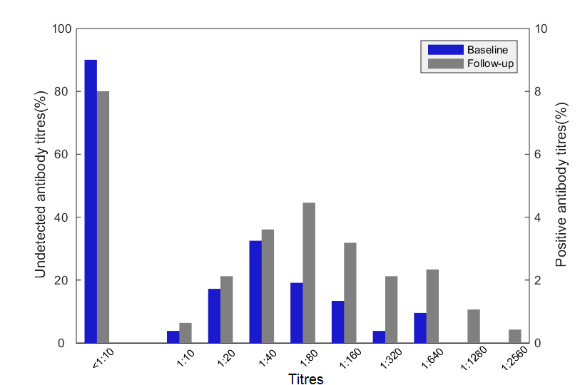

Slide 8
