Slide 1

10/30 2025
Protease Simulation
Prof. Dong-Sik Shin
Hye-Won Kim

Slide 2
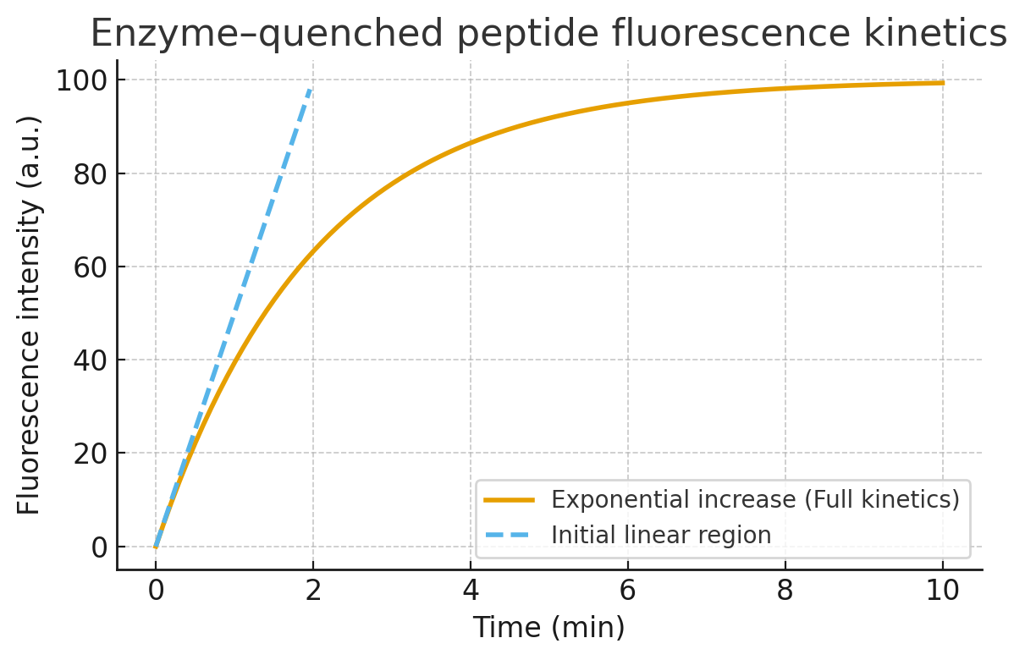
Background
Sookmyung Women’s University
Biomaterials Synthesis Laboratory
소광된 펩타이드의 효소 분해에 따른 형광 방출 Kinetics
Regardless
[E] constant, [S] excess
[S] constant, [E] excess
Initial Phase (1-2 min)
Pseudo-first-order kinetics
Linear curve
[E] constant, [S] excess
F(t)=kcat​[E0​]t
F(t): 누적 형광 세기
kcat: turnover number
[E0]: 효소 농도
[S] constant, [E] excess
Pseudo-first-order kinetics
Linear curve
실험적으로는 구할 때는 초기 선형 구간으로 기울기로 v0 구함

Slide 3

Background
Sookmyung Women’s University
Biomaterials Synthesis Laboratory
소광된 펩타이드의 효소 분해에 따른 형광 방출 Kinetics
Intermediate Phase
Exponential curve (asymptotic)
[E] constant, [S] excess
Michaelis-Menten eq. 적분식
F(t)=Fmax​(1−e−kobs​t)
[S] constant, [E] excess
Pseudo-first-order kinetics
Linear curve

Slide 4
Background
Sookmyung Women’s University
Biomaterials Synthesis Laboratory
소광된 펩타이드의 효소 분해에 따른 형광 방출 Kinetics
Final Phase
Steady-state
Plateau (saturation)
Why?
Lack of [S] [S]>>[E] (FL increase ratio ≈ 0)
Deactivation of E E-S complex
Physical limitation of FL signal 1) FL limitation 2) detector saturation
Photobleaching
Internal filter
Self-quenching
→ plateau 이후 신호 증가 둔화
구분 | Photobleaching | Internal Filter | Self-quenching
원인 | 광화학적 분해 | 빛의 재흡수 | 형광체 간 에너지 소실
의존성 | 시간 | 농도(광경로) | 농도(분자간 거리)
복원 가능성 | X | O | O
대표 상황 | 장시간 측정 | 고농도 시료 | 고농도·응집상

Slide 5
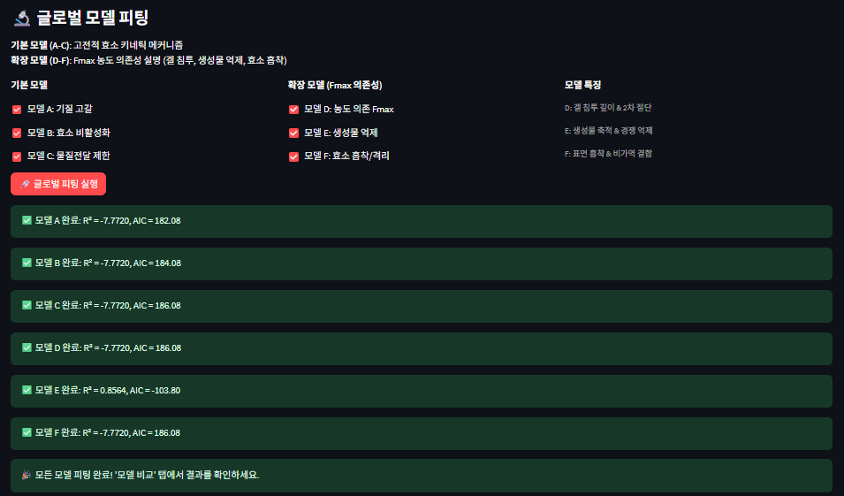
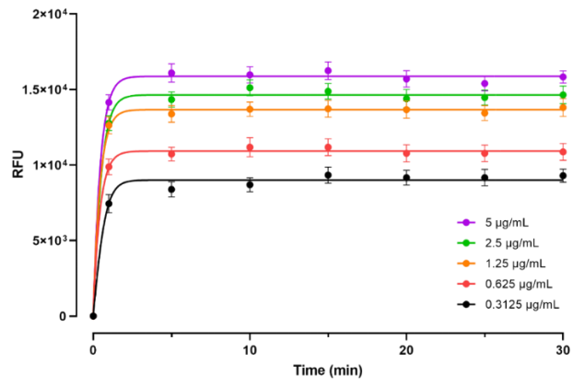
Introduction
Sookmyung Women’s University
Biomaterials Synthesis Laboratory
시뮬레이션 결과와 실제 펩타이드 분해 형광 방출 사이의 간극
접착성 전도성 하이드로겔의 제작
 | Peptide | Enzyme
Name | Dabcyl-His-Gly-Lys-Lys(FITC)-Cys | Kgp (Lys-gingipain)
MW |  | 56.6k Da
Hydrogel Immobilization | O | -
Concentration | 2 mM | 0.3125, 0.625, 1.25, 2.5, 5 µg/mL
Volume | 100 uL (PBS) | 100 uL (PBS)
너무 빨리 saturation
Plateau 이후 약간씩 형광 감소
Photobleaching
Internal filter
Self-quenching
→ plateau 이후 신호 증가 둔화
Lee, Yul, et al. Sookmyung Women’s University (2025)
https://dcollection.sookmyung.ac.kr/srch/srchDetail/000000072892

Slide 6
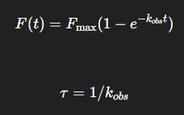
Method
Sookmyung Women’s University
Biomaterials Synthesis Laboratory
Temporary Normalization
Model-free threshold → F0 = (0,0) & Fmax = max(F)
“초기 선형 → 지수 증가 → plateau” 구분하기
Model-free threshold
Slope, data 값으로 구간 나누기
Noise, baseline drift 에 취약
0
10
90
100
linear
exponential
plateau
전체 형광 normalization [%]
Exponential fit using τ = 1/k_obs
τ : time constant
t≲0.1τ: 초기 선형 구간
0.1𝜏≲𝑡≲3𝜏: 지수 증가
𝑡≳3𝜏: plateau 근처
초기 구간 noise 에 따라 fitting 흔들림
최소 2회
최종 선형구간 kinetics
Plateau 시작 시간
Shape model 특이점
Re-normalization
구간 구분
…
Final normalization
Final 구간 구분

Slide 7
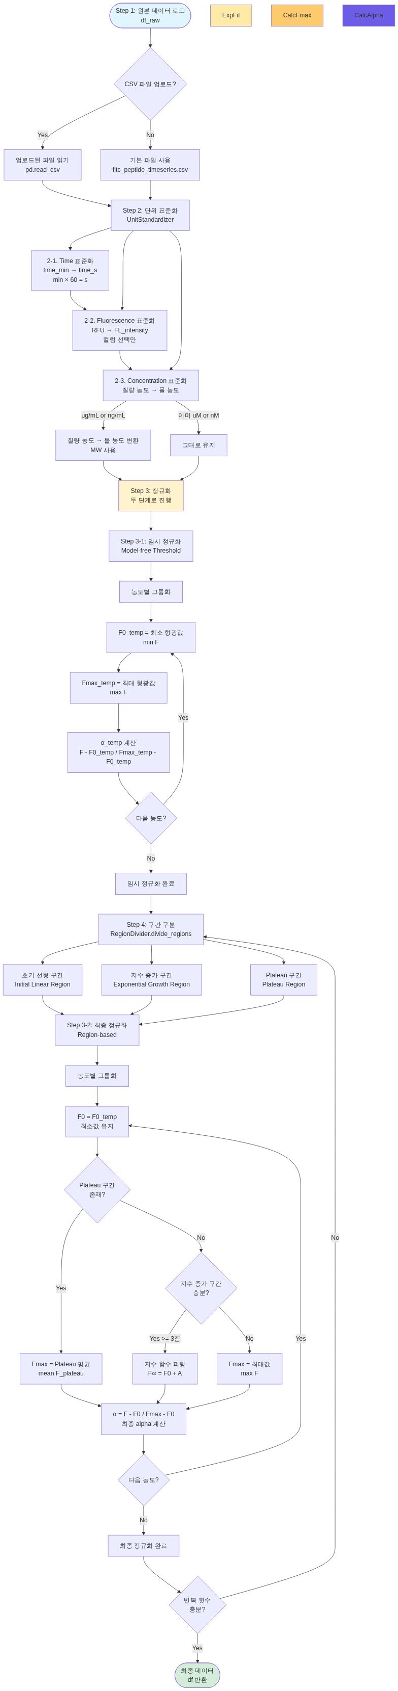
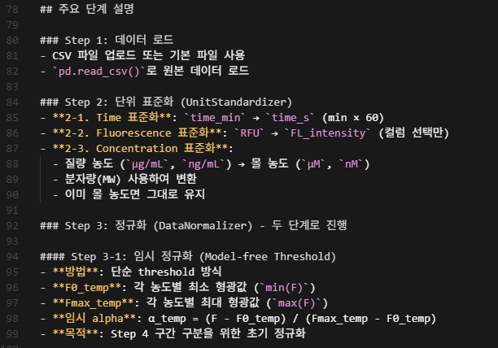
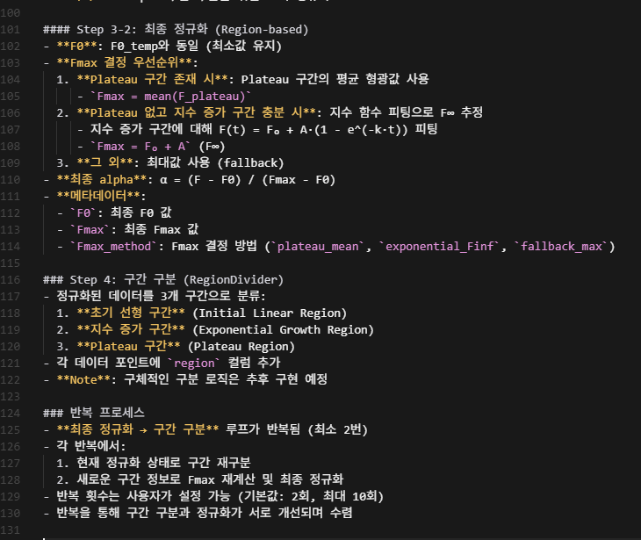
Method
Sookmyung Women’s University
Biomaterials Synthesis Laboratory
https://protease-simulation-2.streamlit.app/

Slide 8
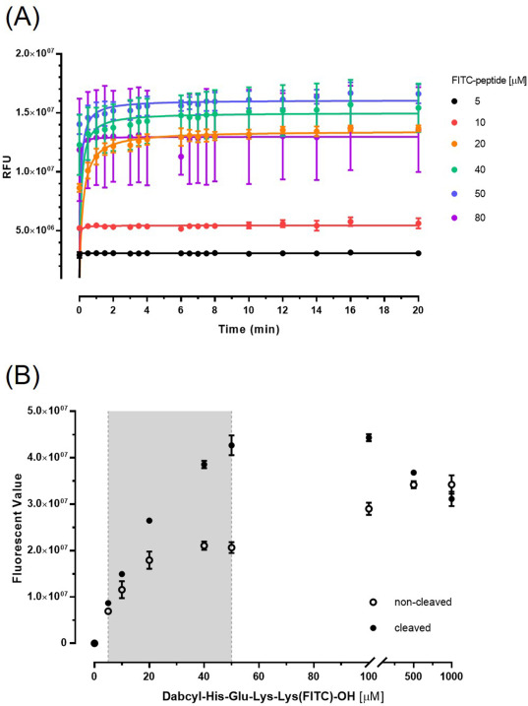
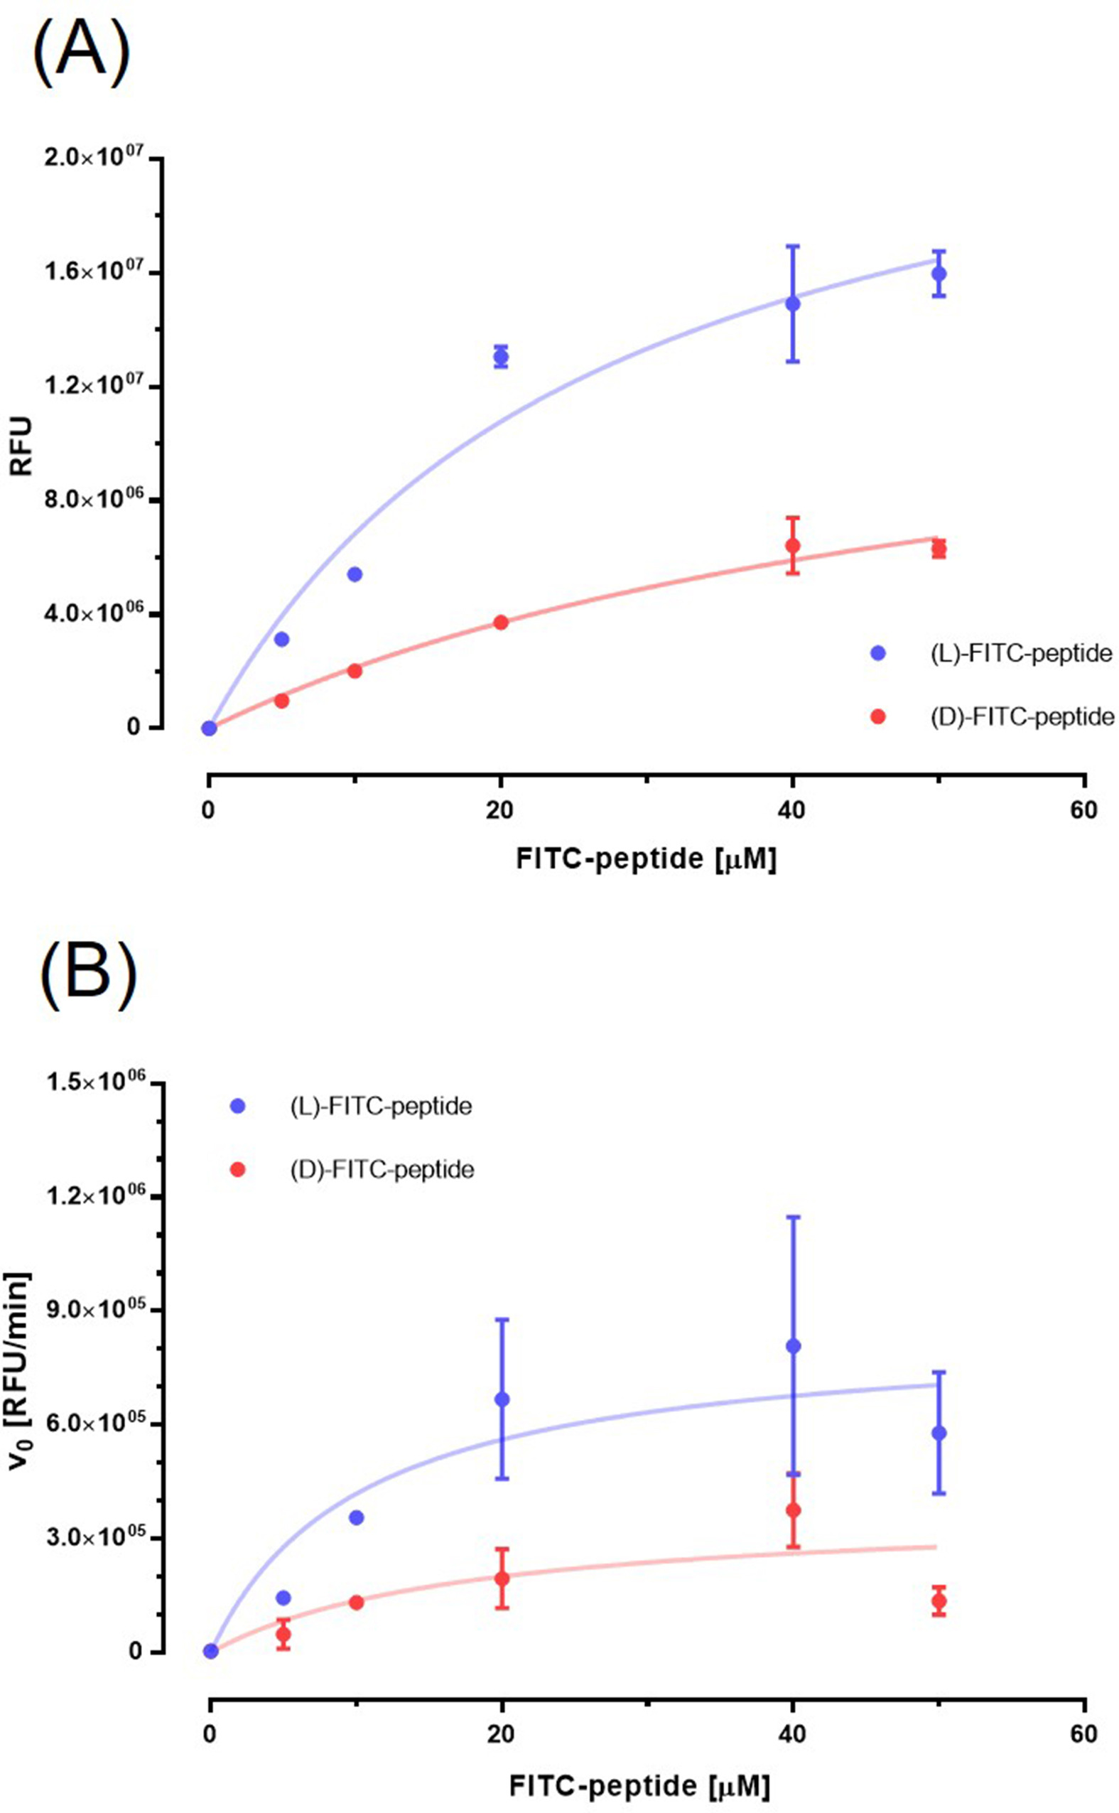
Introduction
Sookmyung Women’s University
Biomaterials Synthesis Laboratory
시뮬레이션 결과와 실제 펩타이드 분해 형광 방출 사이의 간극
Kgp 와 Dabcyl-HEKK(FITC)-OH 의 Kinetics
 | Peptide | Enzyme
Name | Dabcyl-His-Glu-Lys-Lys(FITC)-OH | Kgp (Lys-gingipain)
MW |  | 56.6k Da
Hydrogel Immobilization | X | -
Concentration | 0, 5, 10, 20, 40, 50, 100, 500, 1000 µM | 90.88 nM
Volume | 100 uL (PBS) | 100 uL (PBS)
 | Peptide | Enzyme
Name | Dabcyl-His-Gly-Lys-Lys(FITC)-OH | Kgp (Lys-gingipain)
MW |  | 56.6k Da
Hydrogel Immobilization | X | -
Concentration | 50 µM | 0, 0.097, 0.19, 1.56, 3.25, 5, 12.5, 25 µg/mL
Volume | - | -
3.5 min
8 min
V_{max} = 8.50E+5 units/min
K_{m} = 10.32 µM
Park, Jeeyeon, et al. Journal of Dental Sciences 20.2 (2025): 802-810.
DOI: https://www.sciencedirect.com/science/article/pii/S1991790224003362?via%3Dihub

Slide 9
Introduction
Sookmyung Women’s University
Biomaterials Synthesis Laboratory
시뮬레이션 결과와 실제 펩타이드 분해 형광 방출 사이의 간극
Kgp 와 Dabcyl-HEKK(FITC)-OH 의 Kinetics
 | Peptide | Enzyme
Name | Dabcyl-His-Glu-Lys-Lys(FITC)-OH | Kgp (Lys-gingipain)
MW |  | 56.6k Da
Hydrogel Immobilization | X | -
Concentration | 0, 5, 10, 20, 40, 50, 100, 500, 1000 µM | 90.88 nM
Volume | 100 uL (PBS) | 100 uL (PBS)
고농도에서 형광 감소
Photobleaching
Internal filter
Self-quenching
Park, Jeeyeon, et al. Journal of Dental Sciences 20.2 (2025): 802-810.
DOI: https://www.sciencedirect.com/science/article/pii/S1991790224003362?via%3Dihub

Slide 10
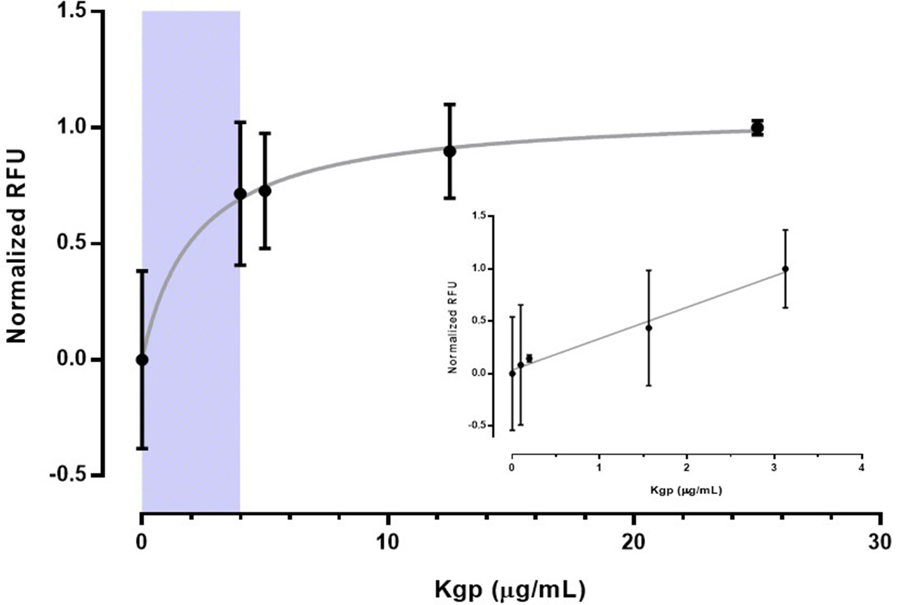
Introduction
Sookmyung Women’s University
Biomaterials Synthesis Laboratory
시뮬레이션 결과와 실제 펩타이드 분해 형광 방출 사이의 간극
Kgp 와 Dabcyl-HEKK(FITC)-OH 의 Kinetics
 | Peptide | Enzyme
Name | Dabcyl-His-Gly-Lys-Lys(FITC)-OH | Kgp (Lys-gingipain)
MW |  | 56.6k Da
Hydrogel Immobilization | X | -
Concentration | 50 µM | 0, 0.097, 0.19, 1.56, 3.25, 5, 12.5, 25 µg/mL
Volume | - | -
R²=0.9854
Park, Jeeyeon, et al. Journal of Dental Sciences 20.2 (2025): 802-810.
DOI: https://www.sciencedirect.com/science/article/pii/S1991790224003362?via%3Dihub

Slide 11
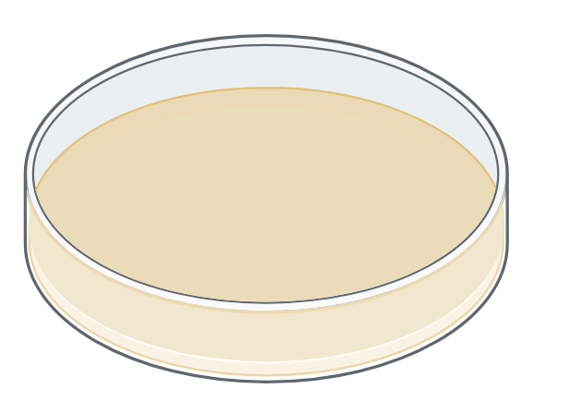
Experimental
Sookmyung Women’s University
Biomaterials Synthesis Laboratory
Ideal Cleavage Reaction
F_{max}
F₀

Slide 12
Experimental – Hypothesis (Hydrogel Non-immobilization)
Sookmyung Women’s University
Biomaterials Synthesis Laboratory
Hypothesis 1: Substrate depletion ([E]>>[S])
Hypothesis 2: Mass-transfer Limitation (Early burst effect → Diffusion)
convection

Slide 13
Experimental – Hypothesis (Hydrogel Non-immobilization)
Sookmyung Women’s University
Biomaterials Synthesis Laboratory
Hypothesis 3: Enzyme deactivation/adsorption
>>
<<

Slide 14
Experimental – Hypothesis (Hydrogel Non-immobilization)
Sookmyung Women’s University
Biomaterials Synthesis Laboratory
Hypothesis 4: Photobleaching/Internal filter/Self-quenching
Photobleaching
Internal filter
Self-quenching
Long-time
동일시간 반응 비교 시, 고농도에서 형광 다시 감소하는 양상
구분 | Photobleaching | Internal Filter | Self-quenching
원인 | 광화학적 분해 | 빛의 재흡수 | 형광체 간 에너지 소실
의존성 | 시간 | 농도(광경로) | 농도(분자간 거리)
복원 가능성 | X | O | O
대표 상황 | 장시간 측정 | 고농도 시료 | 고농도·응집상
Park, Jeeyeon, et al. Journal of Dental Sciences 20.2 (2025): 802-810.
DOI: https://www.sciencedirect.com/science/article/pii/S1991790224003362?via%3Dihub

Slide 15
Future Works
Sookmyung Women’s University
Biomaterials Synthesis Laboratory
Hypothesis for Hydrogel Immobilization
 | Peptide | Enzyme
Name | Dabcyl-His-Glu-Lys-Lys(FITC)-OH | Kgp (Lys-gingipain)
MW |  | 56.6k Da
Hydrogel Immobilization | X | -
Concentration | 0, 5, 10, 20, 40, 50, 100, 500, 1000 µM | 90.88 nM
Volume | 100 uL (PBS) | 100 uL (PBS)
 | Peptide | Enzyme
Name | Dabcyl-His-Gly-Lys-Lys(FITC)-Cys | Kgp (Lys-gingipain)
MW |  | 56.6k Da
Hydrogel Immobilization | O | -
Concentration | 2 mM | 0.3125, 0.625, 1.25, 2.5, 5 µg/mL
Volume | 10 uL (PBS) | 10 uL (PBS)

Slide 16
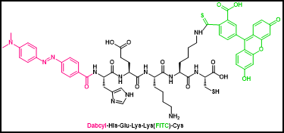
min | 0.3125ug/ml |  | 0.625 ug/mL |  | 1.25 ug/mL |  | 2.5 ug/mL |  | 5 ug/mL
 | RFU | SD | RFU | SD | RFU | SD | RFU | SD | RFU | SD
0 | 0 |  | 0 |  | 0 |  | 0 |  | 0
1 | 7445.16 | 100.496 | 9881.38 | 118.798 | 12628.2 | 157.84505 | 12772.3 | 194.578 | 14144.1 | 202.368
5 | 8383.01 | 102.692 | 10728.6 | 156.341 | 13384 | 148.01309 | 14331.8 | 212.436 | 16100 | 206.877
10 | 8692.2 | 163.541 | 11184.8 | 132.565 | 13696 | 171.55884 | 15121.7 | 231.322 | 15978.1 | 239.443
15 | 9333.98 | 127.057 | 11177.6 | 162.774 | 13723.1 | 160.5641 | 14880.4 | 218.857 | 16245.9 | 188.897
20 | 9165.91 | 151.964 | 10773.7 | 163.252 | 13672.3 | 167.952 | 14392.1 | 209.78 | 15697.6 | 253.965
25 | 9165.72 | 149.793 | 10773.5 | 151.47 | 13439.5 | 206.781 | 14470.3 | 192.144 | 15398.7 | 191.192
30 | 9301.82 | 135.79 | 10874.5 | 156.121 | 13812.7 | 183.112 | 14647.4 | 187.78 | 15834.8 | 210.288
 |  |  |  | - Peptide solution: 2 mM peptide + 4 mM DIPEA in DMF
 |  |  |  | - Add the peptide solution to the hydrogel and incubate for 2 h.
 |  |  |  | - Protease solution: Kgp + PBS
 |  |  |  | - Add the sample to the hydrogel, cover it with a cover glass, and then measure the RFU.
 |  |  |  | - FITC filter, n= 50

Slide 17


Slide 18
Thank you ☺

