Slide 1

12/01 2025
Protease Simulation
Prof. Dong-Sik Shin
Hye-Won Kim

Slide 2
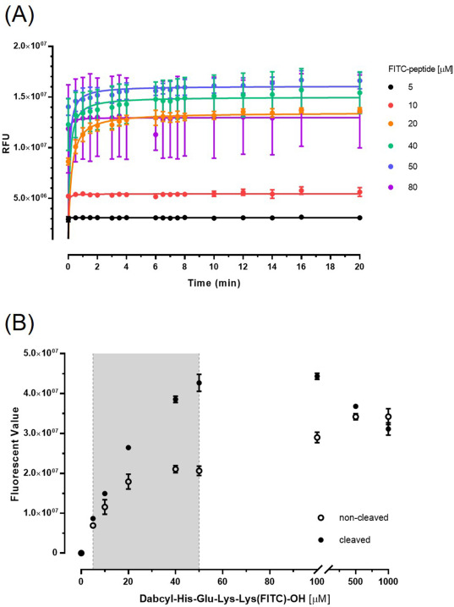
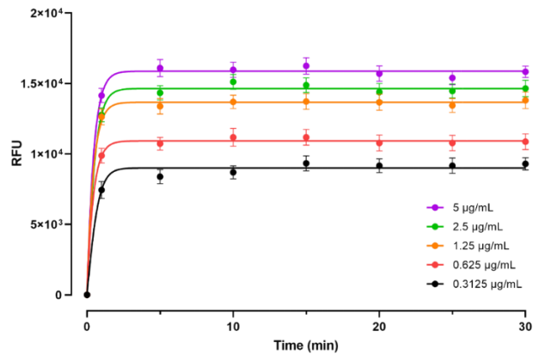
Introduction
Sookmyung Women’s University
Biomaterials Synthesis Laboratory
Kinetics of cleaved peptide by enzyme
 | Peptide | Enzyme
Name | Dabcyl-His-Glu-Lys-Lys(FITC)-OH | Kgp (Lys-gingipain)
MW | 1166.26 g/mol | 56.6k Da
Hydrogel Immobilization | X | -
Concentration (mol) | 0, 5, 10, 20, 40, 50, 80, 100, 500, 1000 µM | 90.88 nM
Concentration (mass) | 0, 5.83, 11.66, 23.32, 46.65, 58.31, 93.29, 116.62, 583.08, 1,166.16 ug/mL | 51.43 ug/mL
Volume | 100 uL (PBS) | 100 uL (PBS)
 | Peptide | Enzyme
Name | Dabcyl-His-Gly-Lys-Lys(FITC)-Cys | Kgp (Lys-gingipain)
MW | 1269.42 g/mol | 56.6k Da
Hydrogel Immobilization | O | -
Concentration (mol) | 2 mM | 5.57, 11.16, 22.32, 44.4, 89.29 nM
Concentration (mass) | 2.53 mg/mL | 0.3125, 0.625, 1.25, 2.5, 5 µg/mL
Volume | 10 uL (PBS) | 10 uL (PBS)

Slide 3
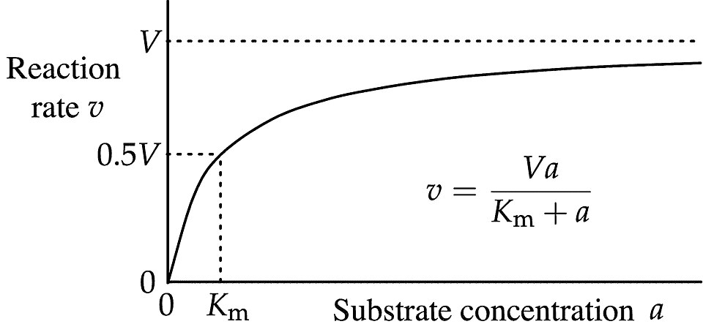
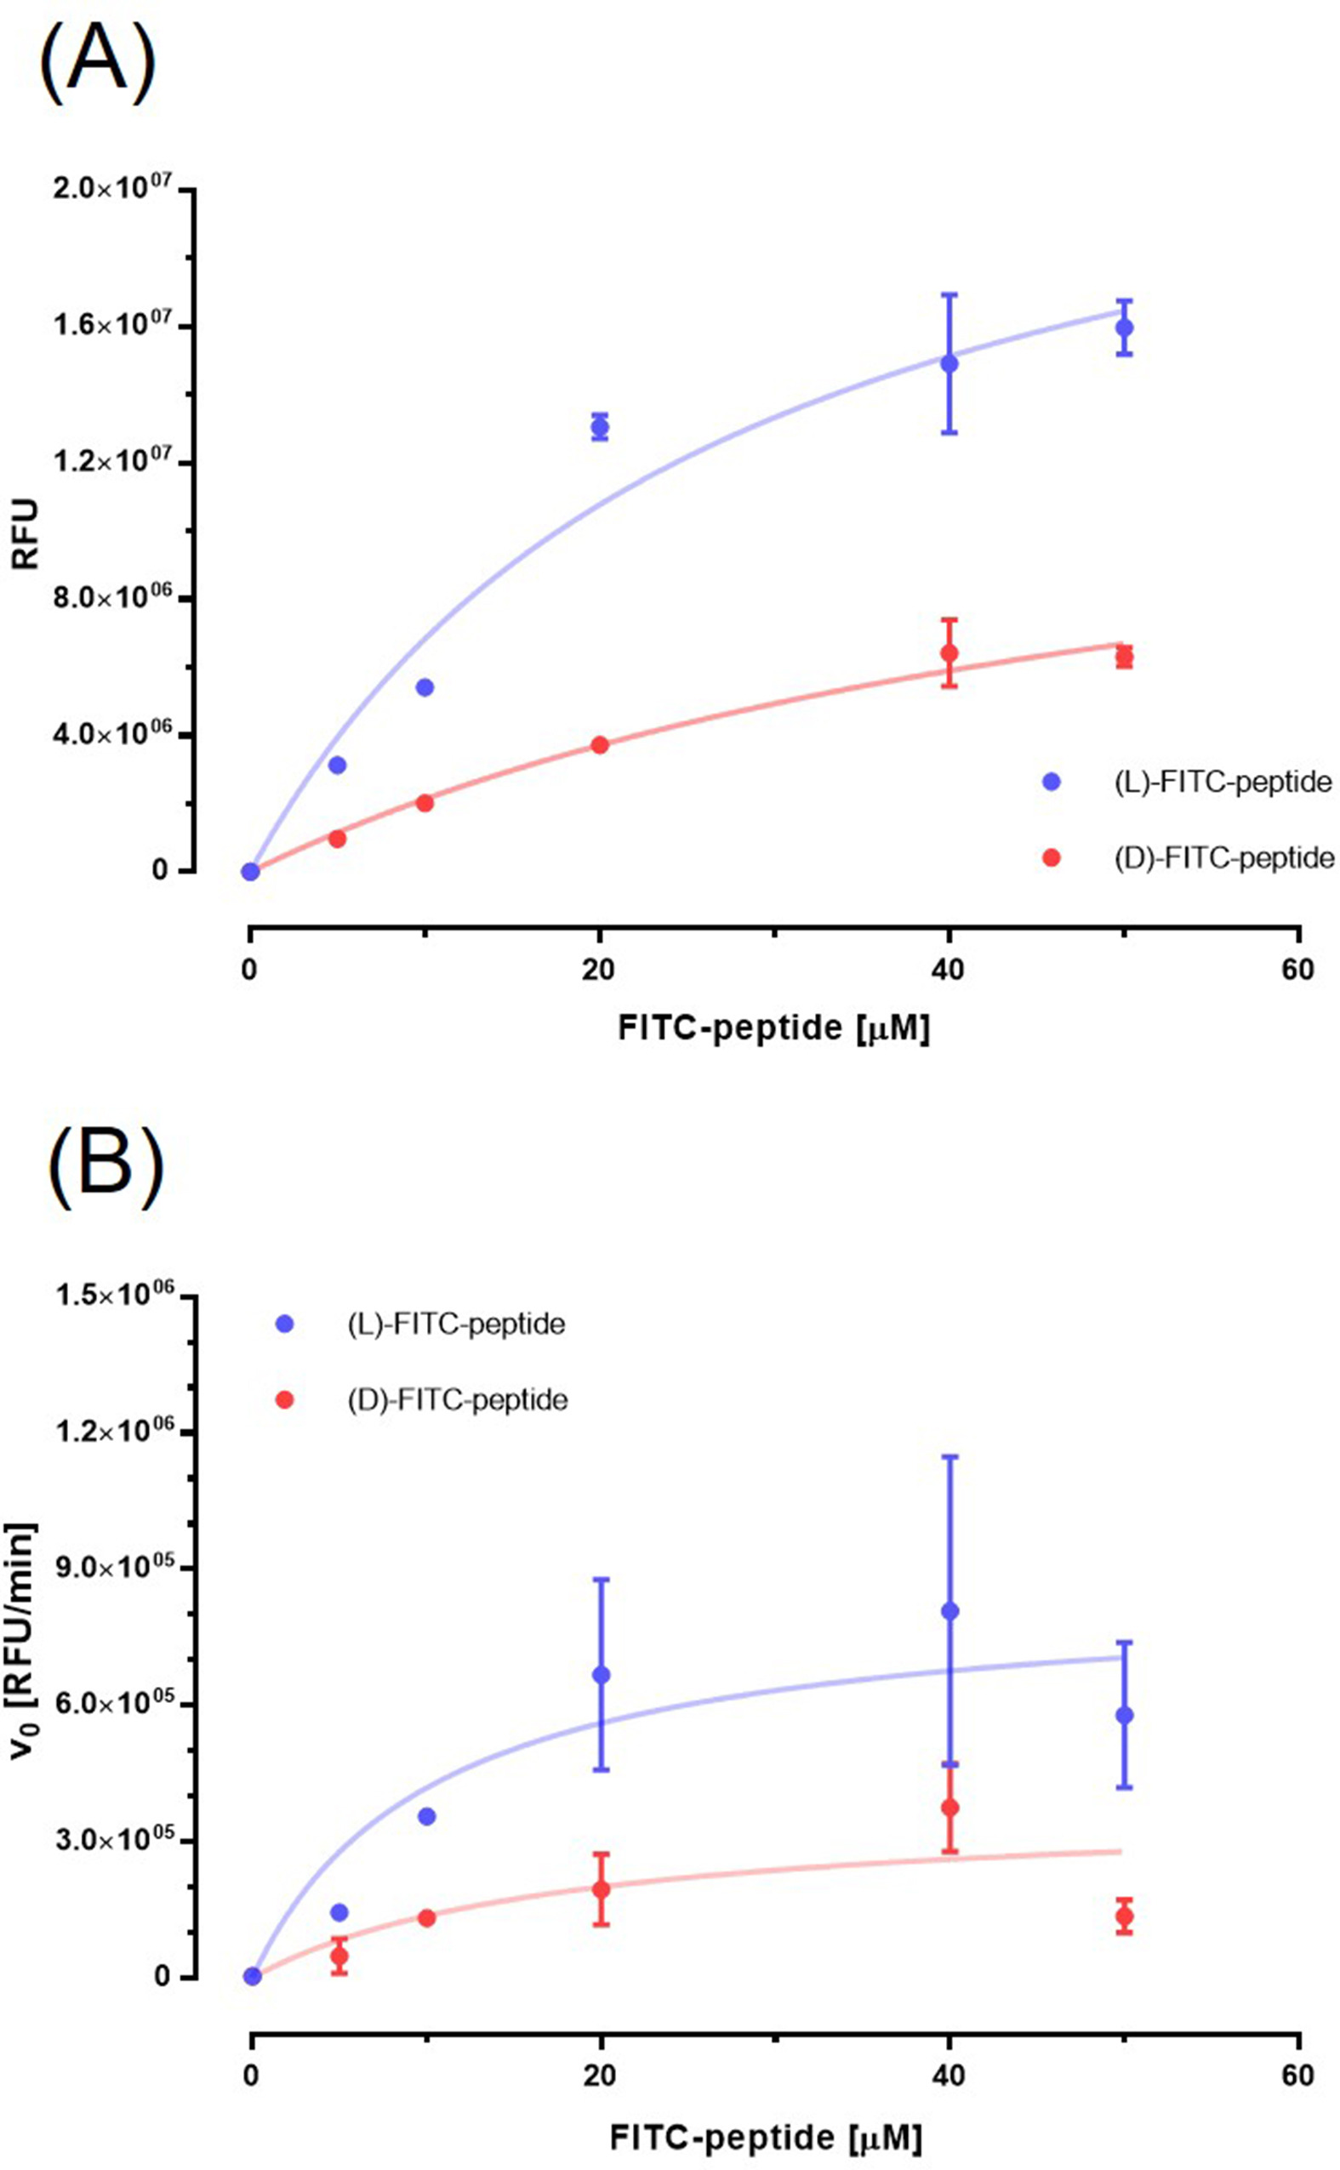
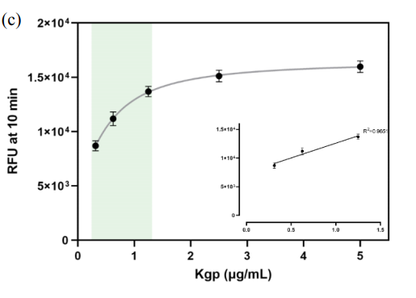
Introduction
Sookmyung Women’s University
Biomaterials Synthesis Laboratory
Kinetics of cleaved peptide by enzyme
Michaelis-Menten equation
Y = Vmax*X/(Km + X)
Vmax: maximum enzyme velocity (almost always higher than any velocity measured in your experiment)
Km: Michaelis-Menten constant (substrate concentration needed to achieve a half-maximum enzyme velocity)

Slide 4
Introduction
Sookmyung Women’s University
Biomaterials Synthesis Laboratory
Kinetics of cleaved peptide by enzyme
1
Experiment: Time-RFU plot
Michaelis-Menten equation
2
Experiment: Time-RFU plot
RFU with various conc. after 8min rxn
Michaelis-Menten equation
3
Experiment: Time-RFU plot
Initial velocity (v0) with various conc. at 3.5 min
Michaelis-Menten equation
1
2
3

Slide 5
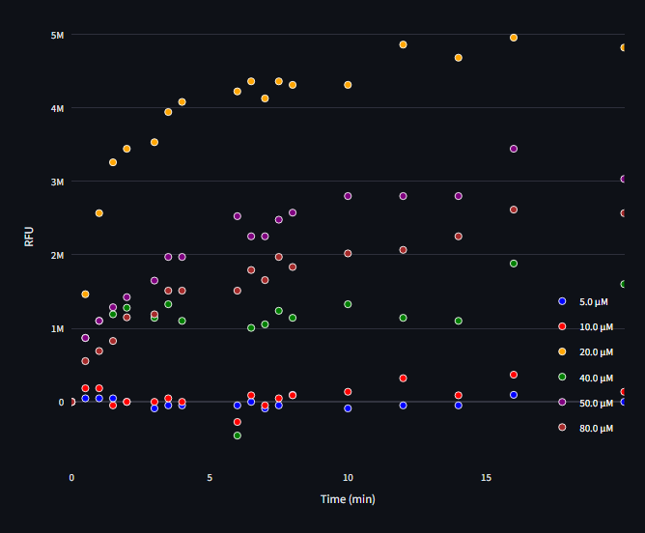
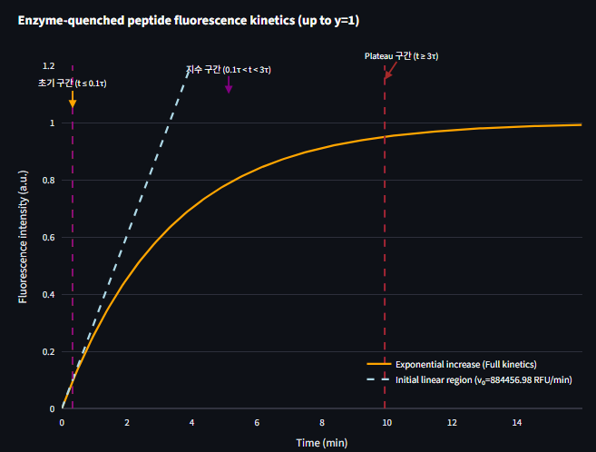
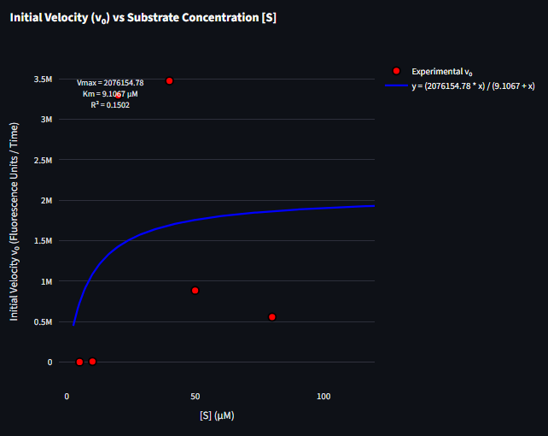
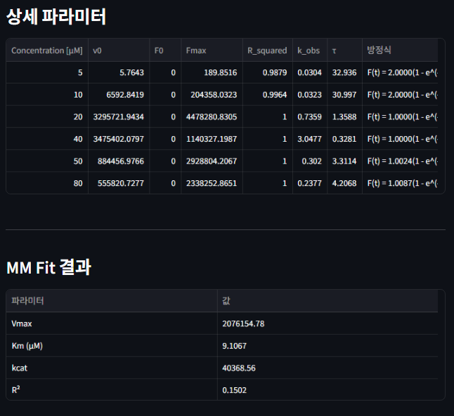
Experimental
Sookmyung Women’s University
Biomaterials Synthesis Laboratory
Kinetics of cleaved peptide by enzyme
1
2
3
4
Experiment: Time-RFU plot
Initial velocity by conc.
v0 – [S] Michaelis-Menten equation
Model simulation
Data Interpolation
Normalization (0-1)
Get parameters
: Km, kcat, Vmax…
Blank/Background subtraction
Segmented into initial, exponential, and plateau phases
Linear fit of initial phase
https://protease-simulator-3.streamlit.app/
1
2
3

Slide 6
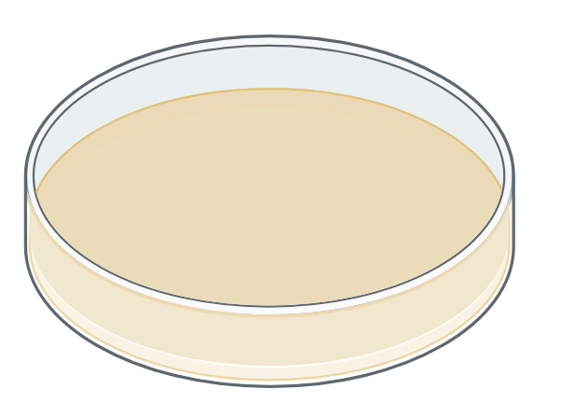
Experimental
Sookmyung Women’s University
Biomaterials Synthesis Laboratory
Ideal Cleavage Reaction
F_{max}
F₀

Slide 7
Experimental – Hypothesis (Hydrogel Non-immobilization)
Sookmyung Women’s University
Biomaterials Synthesis Laboratory
Hypothesis 1: Substrate depletion ([E]>>[S])
Hypothesis 2: Mass-transfer Limitation (Early burst effect → Diffusion)
convection

Slide 8
Experimental – Hypothesis (Hydrogel Non-immobilization)
Sookmyung Women’s University
Biomaterials Synthesis Laboratory
Hypothesis 3: Enzyme deactivation/adsorption
>>
<<

Slide 9
Experimental – Hypothesis (Hydrogel Non-immobilization)
Sookmyung Women’s University
Biomaterials Synthesis Laboratory
Hypothesis 4: Photobleaching/Internal filter/Self-quenching
Photobleaching
Internal filter
Self-quenching
Long-time
동일시간 반응 비교 시, 고농도에서 형광 다시 감소하는 양상
구분 | Photobleaching | Internal Filter | Self-quenching
원인 | 광화학적 분해 | 빛의 재흡수 | 형광체 간 에너지 소실
의존성 | 시간 | 농도(광경로) | 농도(분자간 거리)
복원 가능성 | X | O | O
대표 상황 | 장시간 측정 | 고농도 시료 | 고농도·응집상
Park, Jeeyeon, et al. Journal of Dental Sciences 20.2 (2025): 802-810.
DOI: https://www.sciencedirect.com/science/article/pii/S1991790224003362?via%3Dihub

Slide 10
Thank you ☺

Slide 11
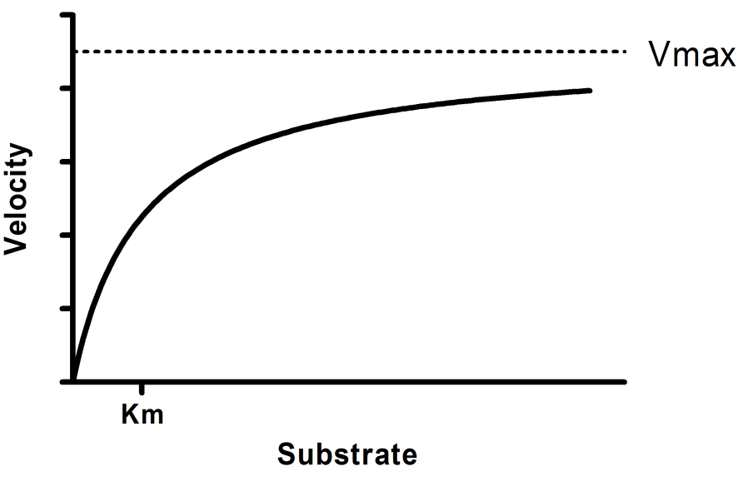
Background
Sookmyung Women’s University
Biomaterials Synthesis Laboratory
Kinetics of cleavage peptide by enzyme

Slide 13
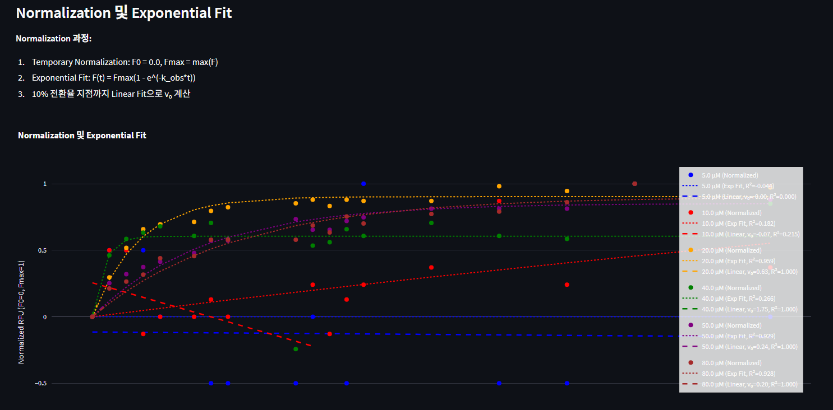
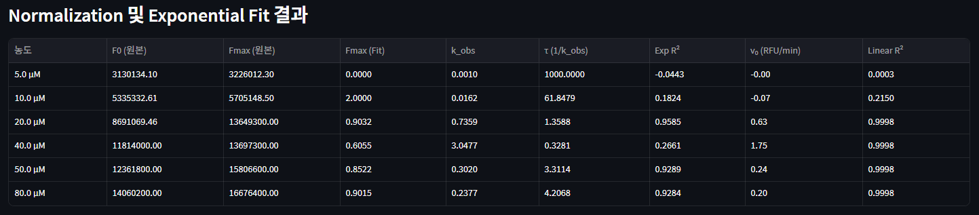
Normalization 방식 정립
단순히 F max 로 설정

Slide 14
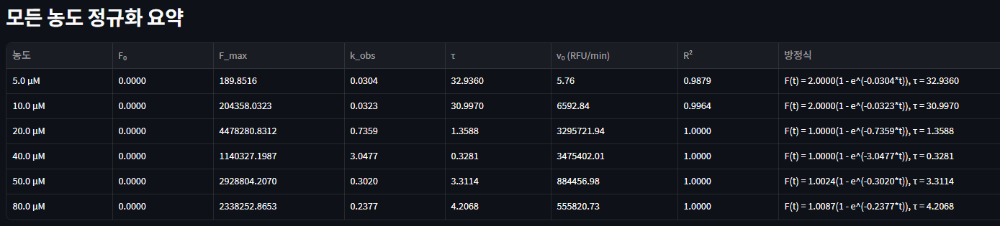
단순히 F max 로 설정

Slide 15
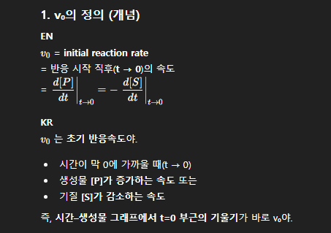
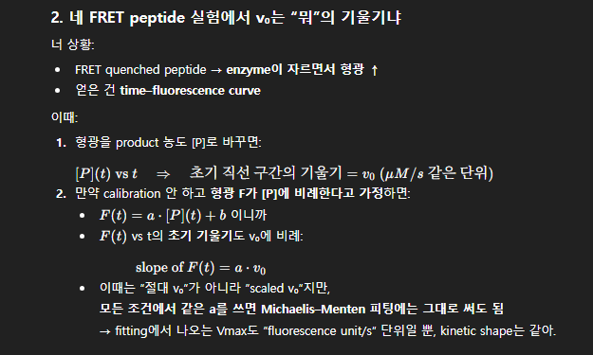

Slide 16
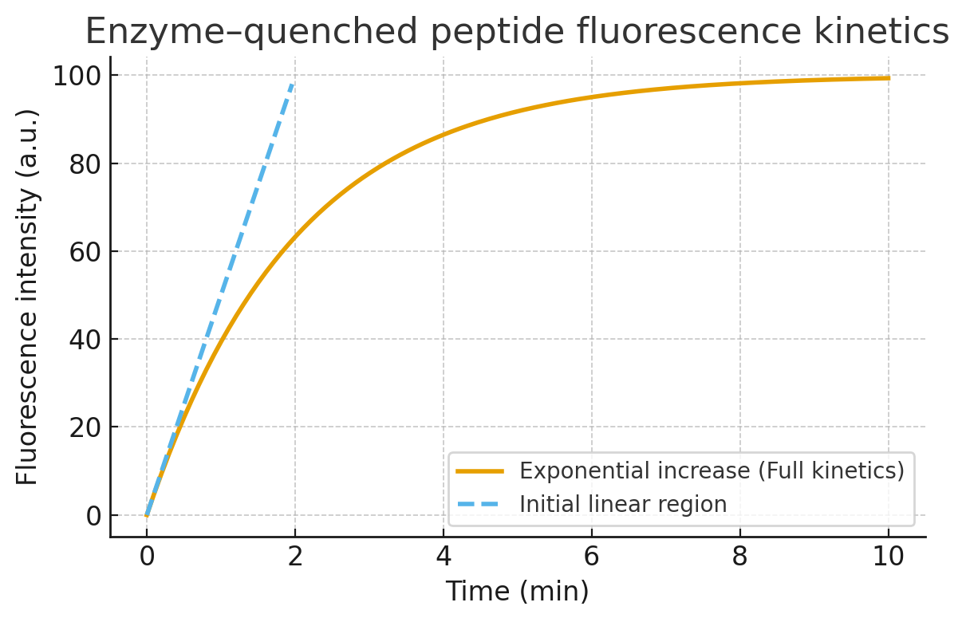
Background
Sookmyung Women’s University
Biomaterials Synthesis Laboratory
소광된 펩타이드의 효소 분해에 따른 형광 방출 Kinetics
Regardless
[E] constant, [S] excess
[S] constant, [E] excess
Initial Phase (1-2 min)
Pseudo-first-order kinetics
Linear curve
[E] constant, [S] excess
F(t)=kcat​[E0​]t
F(t): 누적 형광 세기
kcat: turnover number
[E0]: 효소 농도
[S] constant, [E] excess
Pseudo-first-order kinetics
Linear curve
실험적으로는 구할 때는 초기 선형 구간으로 기울기로 v0 구함

Slide 17

Background
Sookmyung Women’s University
Biomaterials Synthesis Laboratory
소광된 펩타이드의 효소 분해에 따른 형광 방출 Kinetics
Intermediate Phase
Exponential curve (asymptotic)
[E] constant, [S] excess
Michaelis-Menten eq. 적분식
F(t)=Fmax​(1−e−kobs​t)
[S] constant, [E] excess
Pseudo-first-order kinetics
Linear curve

Slide 18
Background
Sookmyung Women’s University
Biomaterials Synthesis Laboratory
소광된 펩타이드의 효소 분해에 따른 형광 방출 Kinetics
Final Phase
Steady-state
Plateau (saturation)
Why?
Lack of [S] [S]>>[E] (FL increase ratio ≈ 0)
Deactivation of E E-S complex
Physical limitation of FL signal 1) FL limitation 2) detector saturation
Photobleaching
Internal filter
Self-quenching
→ plateau 이후 신호 증가 둔화
구분 | Photobleaching | Internal Filter | Self-quenching
원인 | 광화학적 분해 | 빛의 재흡수 | 형광체 간 에너지 소실
의존성 | 시간 | 농도(광경로) | 농도(분자간 거리)
복원 가능성 | X | O | O
대표 상황 | 장시간 측정 | 고농도 시료 | 고농도·응집상

Slide 19
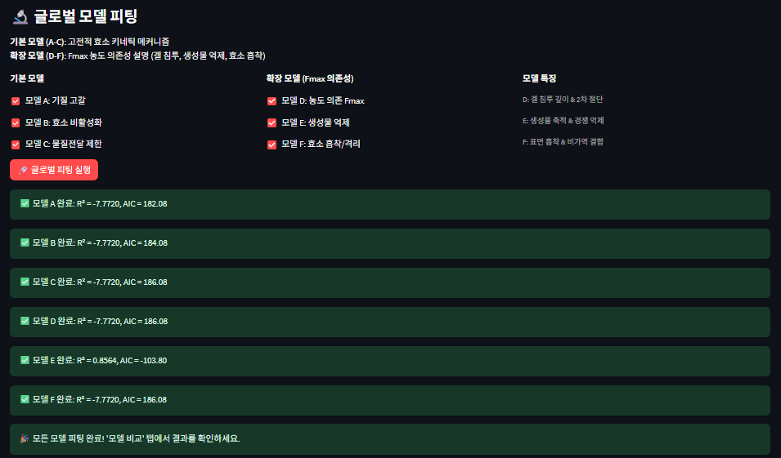
Introduction
Sookmyung Women’s University
Biomaterials Synthesis Laboratory
시뮬레이션 결과와 실제 펩타이드 분해 형광 방출 사이의 간극
접착성 전도성 하이드로겔의 제작
 | Peptide | Enzyme
Name | Dabcyl-His-Gly-Lys-Lys(FITC)-Cys | Kgp (Lys-gingipain)
MW |  | 56.6k Da
Hydrogel Immobilization | O | -
Concentration | 2 mM | 0.3125, 0.625, 1.25, 2.5, 5 µg/mL
Volume | 100 uL (PBS) | 100 uL (PBS)
너무 빨리 saturation
Plateau 이후 약간씩 형광 감소
Photobleaching
Internal filter
Self-quenching
→ plateau 이후 신호 증가 둔화
Lee, Yul, et al. Sookmyung Women’s University (2025)
https://dcollection.sookmyung.ac.kr/srch/srchDetail/000000072892

Slide 20
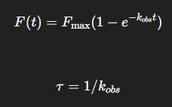
Method
Sookmyung Women’s University
Biomaterials Synthesis Laboratory
Temporary Normalization
Model-free threshold → F0 = (0,0) & Fmax = max(F)
“초기 선형 → 지수 증가 → plateau” 구분하기
Model-free threshold
Slope, data 값으로 구간 나누기
Noise, baseline drift 에 취약
0
10
90
100
linear
exponential
plateau
전체 형광 normalization [%]
Exponential fit using τ = 1/k_obs
τ : time constant
t≲0.1τ: 초기 선형 구간
0.1𝜏≲𝑡≲3𝜏: 지수 증가
𝑡≳3𝜏: plateau 근처
초기 구간 noise 에 따라 fitting 흔들림
최소 2회
최종 선형구간 kinetics
Plateau 시작 시간
Shape model 특이점
Re-normalization
구간 구분
…
Final normalization
Final 구간 구분

Slide 21
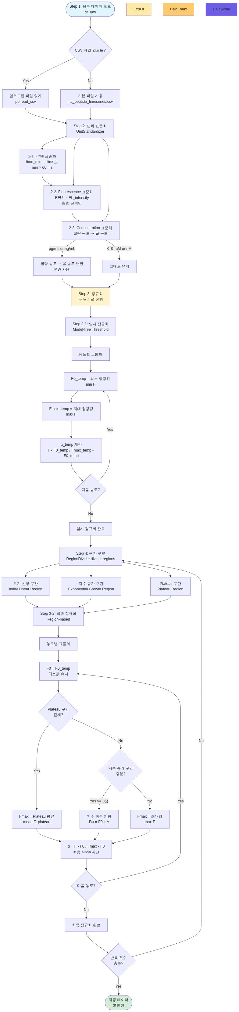
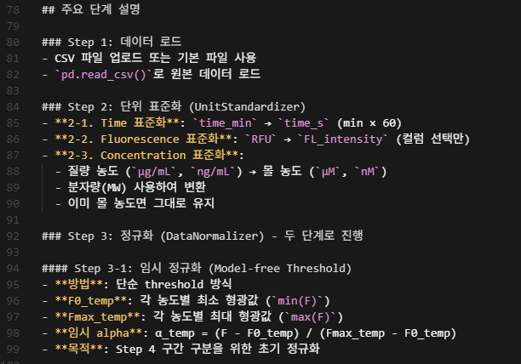
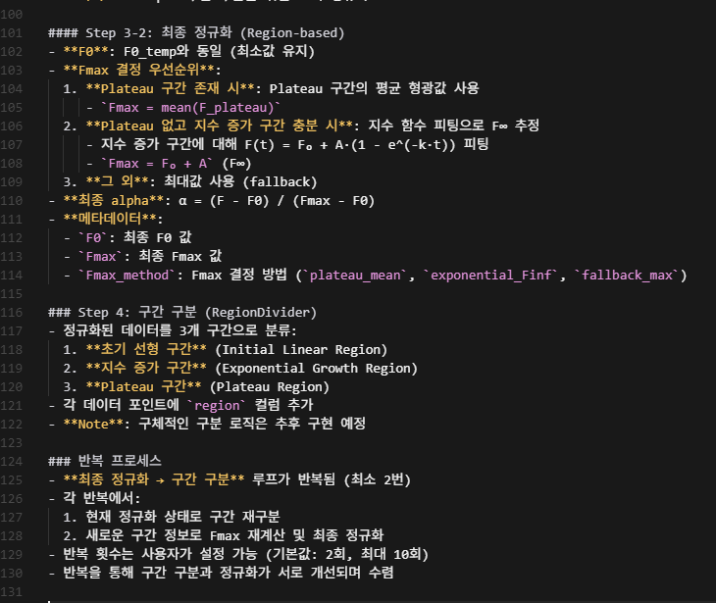
Method
Sookmyung Women’s University
Biomaterials Synthesis Laboratory
https://protease-simulation-2.streamlit.app/

Slide 22
Introduction
Sookmyung Women’s University
Biomaterials Synthesis Laboratory
시뮬레이션 결과와 실제 펩타이드 분해 형광 방출 사이의 간극
Kgp 와 Dabcyl-HEKK(FITC)-OH 의 Kinetics
 | Peptide | Enzyme
Name | Dabcyl-His-Glu-Lys-Lys(FITC)-OH | Kgp (Lys-gingipain)
MW |  | 56.6k Da
Hydrogel Immobilization | X | -
Concentration | 0, 5, 10, 20, 40, 50, 100, 500, 1000 µM | 90.88 nM
Volume | 100 uL (PBS) | 100 uL (PBS)
 | Peptide | Enzyme
Name | Dabcyl-His-Gly-Lys-Lys(FITC)-OH | Kgp (Lys-gingipain)
MW |  | 56.6k Da
Hydrogel Immobilization | X | -
Concentration | 50 µM | 0, 0.097, 0.19, 1.56, 3.25, 5, 12.5, 25 µg/mL
Volume | - | -
3.5 min
8 min
V_{max} = 8.50E+5 units/min
K_{m} = 10.32 µM
Park, Jeeyeon, et al. Journal of Dental Sciences 20.2 (2025): 802-810.
DOI: https://www.sciencedirect.com/science/article/pii/S1991790224003362?via%3Dihub

Slide 23
Introduction
Sookmyung Women’s University
Biomaterials Synthesis Laboratory
시뮬레이션 결과와 실제 펩타이드 분해 형광 방출 사이의 간극
Kgp 와 Dabcyl-HEKK(FITC)-OH 의 Kinetics
 | Peptide | Enzyme
Name | Dabcyl-His-Glu-Lys-Lys(FITC)-OH | Kgp (Lys-gingipain)
MW |  | 56.6k Da
Hydrogel Immobilization | X | -
Concentration | 0, 5, 10, 20, 40, 50, 100, 500, 1000 µM | 90.88 nM
Volume | 100 uL (PBS) | 100 uL (PBS)
고농도에서 형광 감소
Photobleaching
Internal filter
Self-quenching
Park, Jeeyeon, et al. Journal of Dental Sciences 20.2 (2025): 802-810.
DOI: https://www.sciencedirect.com/science/article/pii/S1991790224003362?via%3Dihub

Slide 24
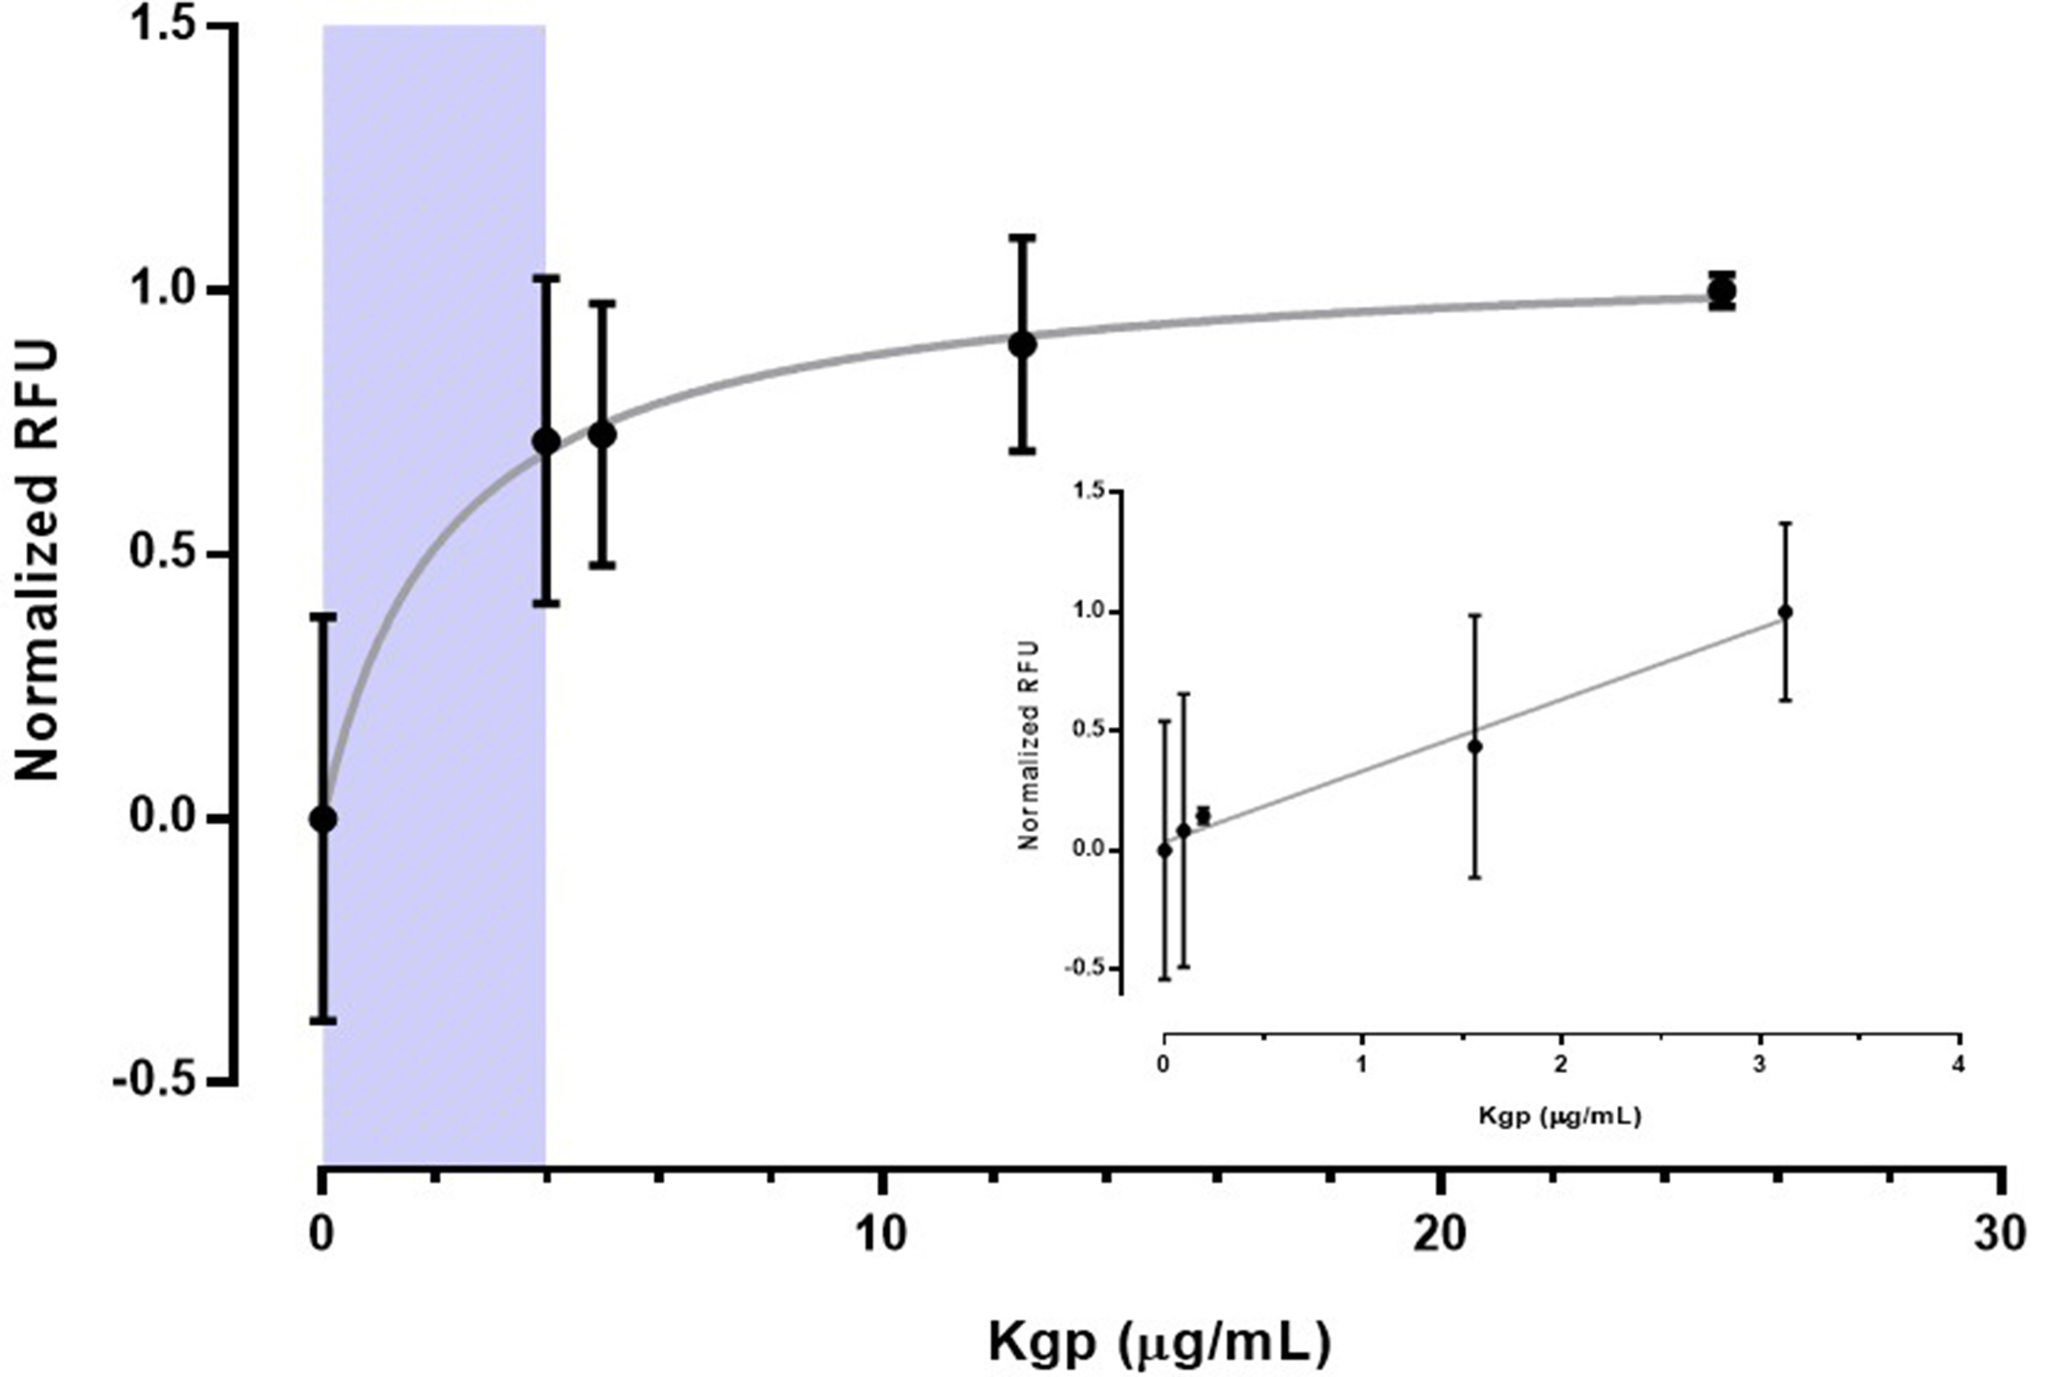
Introduction
Sookmyung Women’s University
Biomaterials Synthesis Laboratory
시뮬레이션 결과와 실제 펩타이드 분해 형광 방출 사이의 간극
Kgp 와 Dabcyl-HEKK(FITC)-OH 의 Kinetics
 | Peptide | Enzyme
Name | Dabcyl-His-Gly-Lys-Lys(FITC)-OH | Kgp (Lys-gingipain)
MW |  | 56.6k Da
Hydrogel Immobilization | X | -
Concentration | 50 µM | 0, 0.097, 0.19, 1.56, 3.25, 5, 12.5, 25 µg/mL
Volume | - | -
R²=0.9854
Park, Jeeyeon, et al. Journal of Dental Sciences 20.2 (2025): 802-810.
DOI: https://www.sciencedirect.com/science/article/pii/S1991790224003362?via%3Dihub

Slide 25
Experimental
Sookmyung Women’s University
Biomaterials Synthesis Laboratory
Ideal Cleavage Reaction
F_{max}
F₀

Slide 26
Experimental – Hypothesis (Hydrogel Non-immobilization)
Sookmyung Women’s University
Biomaterials Synthesis Laboratory
Hypothesis 1: Substrate depletion ([E]>>[S])
Hypothesis 2: Mass-transfer Limitation (Early burst effect → Diffusion)
convection

Slide 27
Experimental – Hypothesis (Hydrogel Non-immobilization)
Sookmyung Women’s University
Biomaterials Synthesis Laboratory
Hypothesis 3: Enzyme deactivation/adsorption
>>
<<

Slide 28
Experimental – Hypothesis (Hydrogel Non-immobilization)
Sookmyung Women’s University
Biomaterials Synthesis Laboratory
Hypothesis 4: Photobleaching/Internal filter/Self-quenching
Photobleaching
Internal filter
Self-quenching
Long-time
동일시간 반응 비교 시, 고농도에서 형광 다시 감소하는 양상
구분 | Photobleaching | Internal Filter | Self-quenching
원인 | 광화학적 분해 | 빛의 재흡수 | 형광체 간 에너지 소실
의존성 | 시간 | 농도(광경로) | 농도(분자간 거리)
복원 가능성 | X | O | O
대표 상황 | 장시간 측정 | 고농도 시료 | 고농도·응집상
Park, Jeeyeon, et al. Journal of Dental Sciences 20.2 (2025): 802-810.
DOI: https://www.sciencedirect.com/science/article/pii/S1991790224003362?via%3Dihub

Slide 29
Future Works
Sookmyung Women’s University
Biomaterials Synthesis Laboratory
Hypothesis for Hydrogel Immobilization
 | Peptide | Enzyme
Name | Dabcyl-His-Glu-Lys-Lys(FITC)-OH | Kgp (Lys-gingipain)
MW |  | 56.6k Da
Hydrogel Immobilization | X | -
Concentration | 0, 5, 10, 20, 40, 50, 100, 500, 1000 µM | 90.88 nM
Volume | 100 uL (PBS) | 100 uL (PBS)
 | Peptide | Enzyme
Name | Dabcyl-His-Gly-Lys-Lys(FITC)-Cys | Kgp (Lys-gingipain)
MW |  | 56.6k Da
Hydrogel Immobilization | O | -
Concentration | 2 mM | 0.3125, 0.625, 1.25, 2.5, 5 µg/mL
Volume | 10 uL (PBS) | 10 uL (PBS)

Slide 30
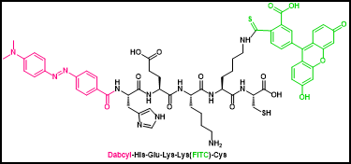
min | 0.3125ug/ml |  | 0.625 ug/mL |  | 1.25 ug/mL |  | 2.5 ug/mL |  | 5 ug/mL
 | RFU | SD | RFU | SD | RFU | SD | RFU | SD | RFU | SD
0 | 0 |  | 0 |  | 0 |  | 0 |  | 0
1 | 7445.16 | 100.496 | 9881.38 | 118.798 | 12628.2 | 157.84505 | 12772.3 | 194.578 | 14144.1 | 202.368
5 | 8383.01 | 102.692 | 10728.6 | 156.341 | 13384 | 148.01309 | 14331.8 | 212.436 | 16100 | 206.877
10 | 8692.2 | 163.541 | 11184.8 | 132.565 | 13696 | 171.55884 | 15121.7 | 231.322 | 15978.1 | 239.443
15 | 9333.98 | 127.057 | 11177.6 | 162.774 | 13723.1 | 160.5641 | 14880.4 | 218.857 | 16245.9 | 188.897
20 | 9165.91 | 151.964 | 10773.7 | 163.252 | 13672.3 | 167.952 | 14392.1 | 209.78 | 15697.6 | 253.965
25 | 9165.72 | 149.793 | 10773.5 | 151.47 | 13439.5 | 206.781 | 14470.3 | 192.144 | 15398.7 | 191.192
30 | 9301.82 | 135.79 | 10874.5 | 156.121 | 13812.7 | 183.112 | 14647.4 | 187.78 | 15834.8 | 210.288
 |  |  |  | - Peptide solution: 2 mM peptide + 4 mM DIPEA in DMF
 |  |  |  | - Add the peptide solution to the hydrogel and incubate for 2 h.
 |  |  |  | - Protease solution: Kgp + PBS
 |  |  |  | - Add the sample to the hydrogel, cover it with a cover glass, and then measure the RFU.
 |  |  |  | - FITC filter, n= 50

Slide 31


