Slide 1


श्री गणेश

Slide 2
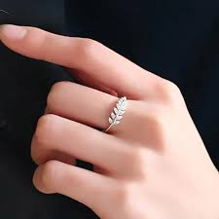
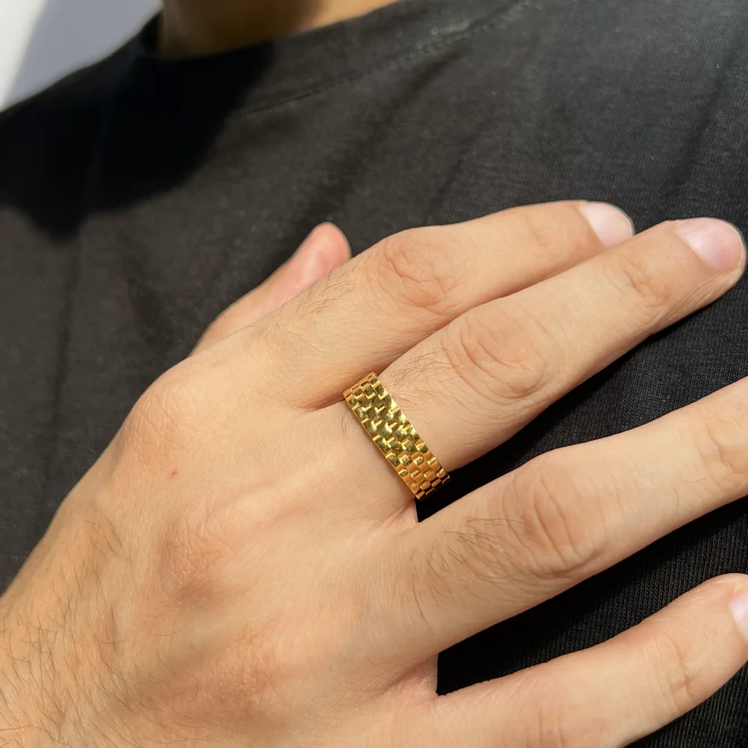
RING CEREMONY

Slide 3


