Slide 1
Objective
Find a more data-driven pricing strategy that enables our resort to select a better value for the ticket price
Study how important some facilities are compared to others, to develop a more data driven investment strategy.
Investigate into a number of possible changes that will either cut costs without undermining the ticket price or will support an even higher ticket price

Slide 2
Regression Based Modeling
Under our current market average pricing strategy, we would expect to estimate a ticket price about $19 or so off the real price
Regression based models provide much better estimation. With the linear model, on average we would expect to be about $10 or so off, whereas about $9 or so off under random forest modeling;
Random Forest Model provides better and more reliable predictions than the linear model.
Performance Comparison
Model | Train Data |  | Test Data
 | Mean Absolute Error | Standard Deviation of Error | Mean Absolute Error
Linear Regression | 10.50 | 1.62 | 14.11
Random Forest Regression | 9.58 | 1.37 | 9.54

Slide 3
Important Features Identified in Linear Regression
Linear Regression
Features (standardized) | Coefficients
vertical_drop | 10.767857
Snow Making_ac | 6.290074
total_chairs | 5.794156
fastQuads | 5.745626
Runs | 5.370555
LongestRun_mi | 0.181814
trams | -4.142024
SkiableTerrain_ac | -5.249780
Important features identified in Linear Regression
vertical drop, Snow Making Area
# of chairlifts, # of FastQuad
length of the longest run,
# of trams , skiable terrain Area
The larger the absolute value of a coefficient is, the more power the feature has to influence the ticket price.

Slide 4
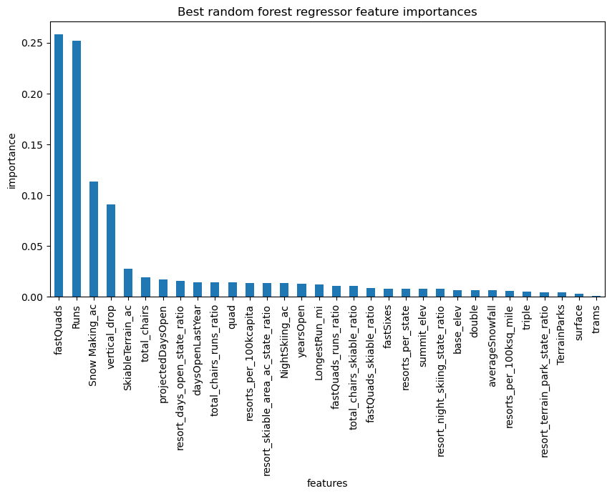
Feature Importance Rank in Random Forest Regression
four most important features
# of FastQuad,
# of runs,
Snow Making Area
vertical drops.
The importance of all features has a big drop/decline after the fourth one, vertical drop).

Slide 5
Big Mountain Standings in The League
Features | standing | Potential change & Expectation
runs | Compares well for the number of runs. There are some resorts with more, but not many | Closure of a few least used ones → cut own cost
vertical drop | Do well for vertical drop, but there are still quite a few resorts with a greater drop | adding vertical drop → price increase → revenue increase
snow making area | very high up in the league table. | adding the snow making area →make no much difference
Length of the longest run | Own one of the longest runs. Longer ones are rare. | Increasing the longest→ make no difference
Trams | The vast majority of resorts, such as Big Mountain, have no trams.
Skiable terrain area | Amongst the resorts with the largest amount of skiable terrain | Adding skiable terrain → make no difference
Total # of chairlifts | Amongst the highest number of total chairs, | Only make changes when required by changes in other features
Fast quads | Most resorts have no fast quads. Big Mountain has 3, which puts it high up that league table.

Slide 6
Experiment with Business Scenarios
Scenario Tested | Findings
· closing down up to 10 of the least used runs | · closing one run makes no difference · Closing 2 and 3 successively reduces support for ticket price · There is a plateau from closure of 3 runs till closure of 5 runs. · Ticket price drops rapidly when increasing the closure to 6 or more.
· Increase the vertical drop by adding a run to a point 150 feet lower down ; · Install an additional chair lift to bring skiers back up. | · support a ticket price increase by $9.13. · increase revenue by $15,978,514***
· The above, and · adding 2 acres of area covered with snow making equipment | · No difference from Scenario 2
· Increase the longest run by 0.2 mile · add an additional snow making coverage of 4 acres | · the ticket price stay unchanged.
***Assume 350,000 visitors over ski season and 5 ticket per customer

Slide 7
Recommendations
Recommendations | consideration
Increasing both types of ticket price immediately
Closure of 5 least used runs | Cut on cost would need to offset the loss in revenue. Need information such as · Operation costs of the 5 least used runs; · Projected number of visitors over the season; · added-on operational cost on the remaining runs and chairlifts.
Increase vertical drop & Install additional chairlifts | Increase in revenue (by ticket price) would need to offset the additional cost. Need information such as · Cost of adding vertical drop and installing new chairlifts · Projected number of visitors over the season; · Potential saving of operational cost on the other unchanged runs if visitors are more drawn to the new deeper run.

