Slide 1
A breif Look at Data Sceince Salary 2020-2023
By Hongling Yang

Slide 2
Objective
Data scientists are in high demand and can command a large salary. The average data scientist salary is annual $130,000 in 2022 with top earners making over $400,000. There are many factors that affect the amount of money a data scientist makes.
Here we look into 5 factors that are largely considered critical and rank their importance in determing salary earning.
Data Source:
https://www.kaggle.com/datasets/arnabchaki/data-science-salaries-2023?resource=download
experience level
employment type
job title
employee residence
company location
company size

Slide 3
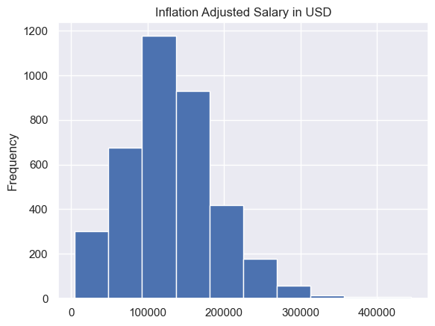
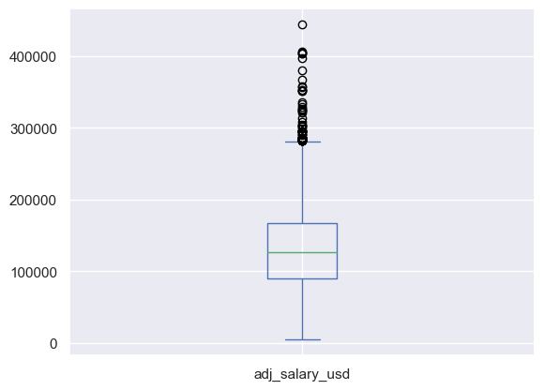
Overall Distribution of Salary 2020-2023
mean | $130,309
std | $59,822
min | $4,819
25% | $90,031
50% | $126,761
75% | $166,667
max | $444,664
skewness=0.56
kurtosis=0.92
Data Science Salary is slightly right skewed
There are outliers in large values

Slide 4
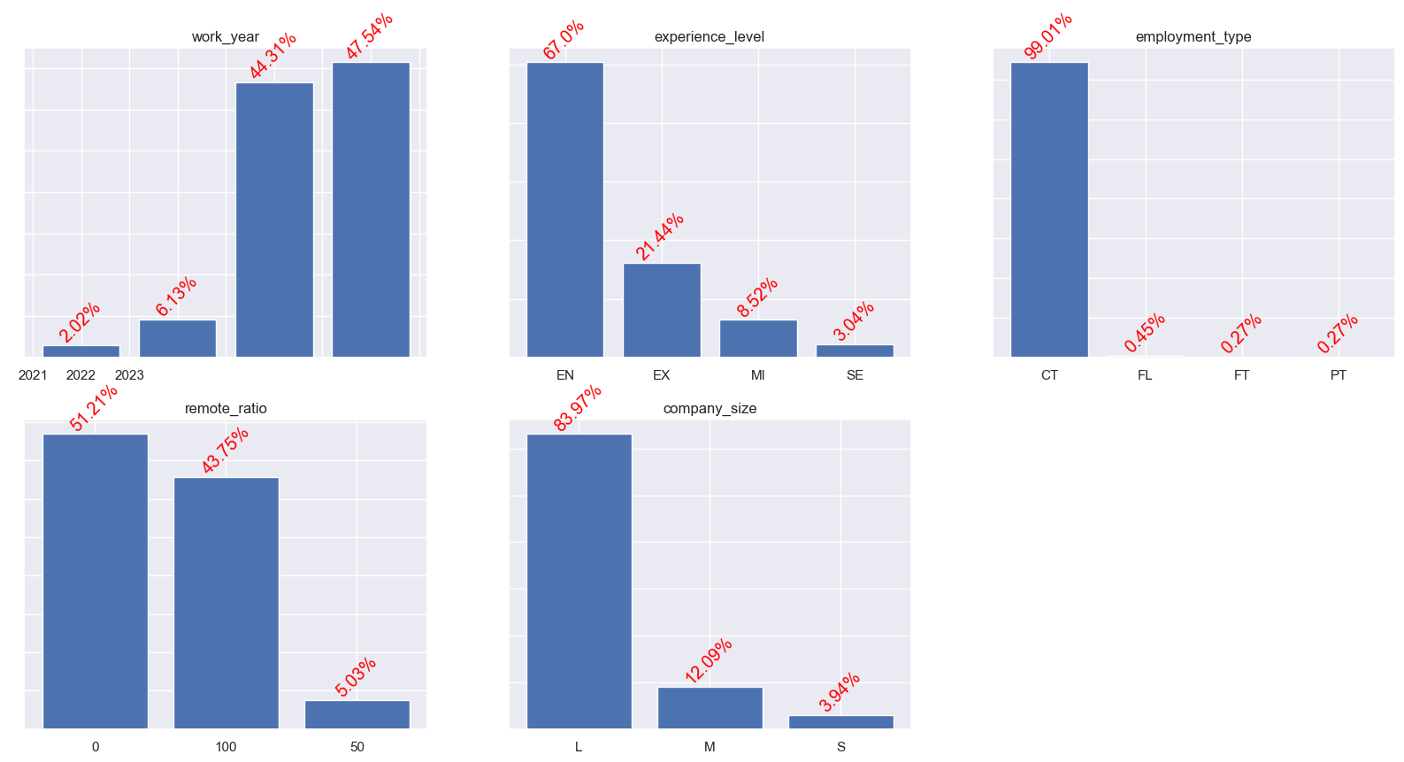
Examing Distribution of Factors

Slide 5
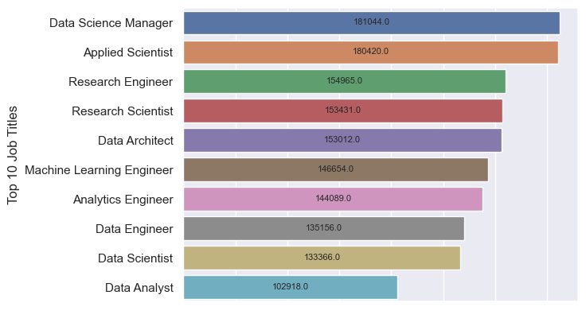
Means of Inflation Ajusted Salaries for Top 10 Most Popular Data Science Jobs
High
Medium
Low
Top 2 Winners: Data Science Managers & Applied Scientist
Among 10, Data Analysts make the least
Natrually aggregated into 3 groups

Slide 6
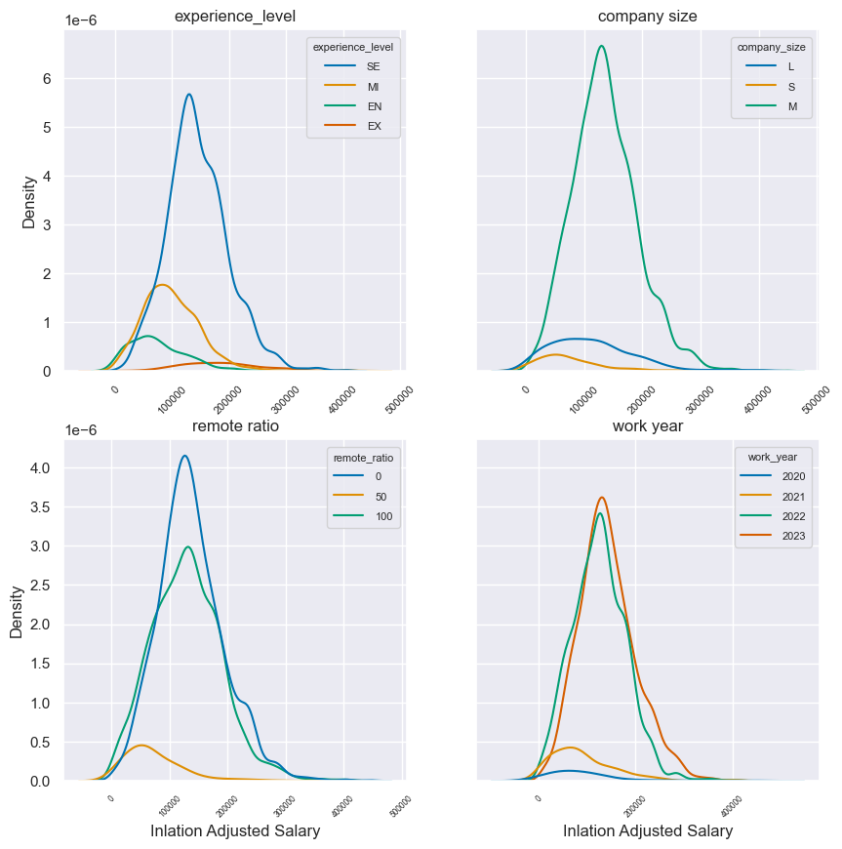
Influence of Experience, Company Size, Job Type, Working Year on Salary

Slide 7
Influence of Experience, Company Size, Job Type, Working Year on Salary
Arranged in Decreasing Order:
Experience Level:
Senior Level, Medium Level , Entry Level and Exective Level
Company Size:
Medium, Large, Samll
Remote Ratio:
On-site, 100% remote, hybrid (50-50)
Work Year:
2023, 2022, 2021, 2020.
There is a big leap from 2021 to 2022.

Slide 8
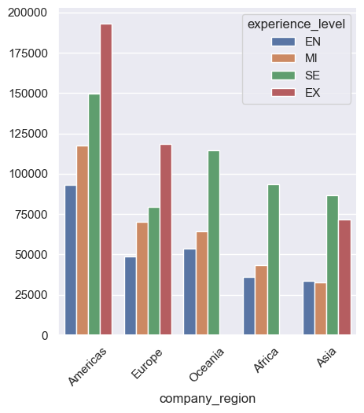
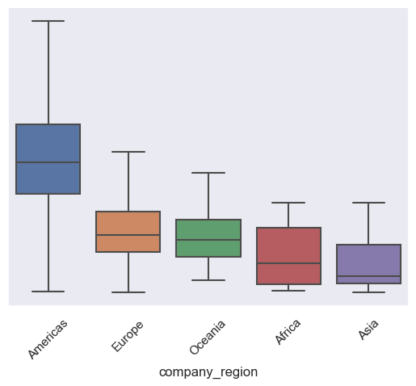
Influence of Company Region on Salary

Slide 9
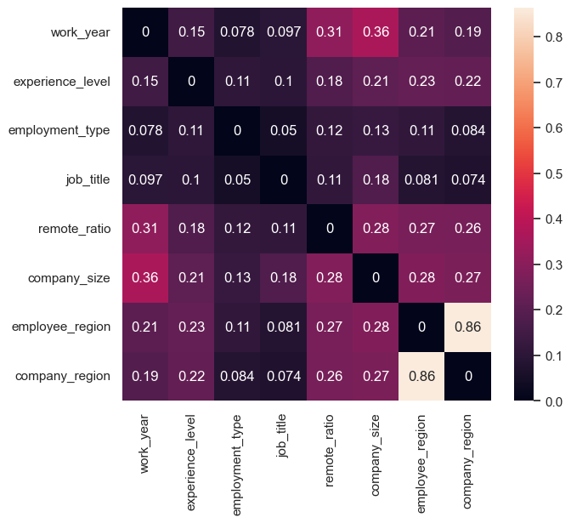
Cramer’s V Correlations among Factors
All Factors are not significantly correlated, except Company Region
& Employee Region
98.5% of data, Company Region & Employee Region are the same
Employee Region was dropped

Slide 10
Pre-Processing and Training
Pre-Processing on 90+ Job Titles:
Grouped into 6 categories,
Group 1-5: Top 5 most popular job titles
Group ‘Others’ : Jobs tiltes not in Group 1-5
Ordinal Categorical Factors: Comany Size, Experience Level
Dummy Categorical Factors: Company Region, Remote Ratio, Working Year
Random Forest regression
Hyperparameter Tuning: GridSearchCV
GridsearchCV best parameters :
{'max_depth': 5, 'n_estimators': 16}
Regression Results:
R² =0 .379, Adjusted R² =0.368
The 3 Most Important Factors:
Company Region, Experience Level, Job Title
ranked in descending order.

Slide 11
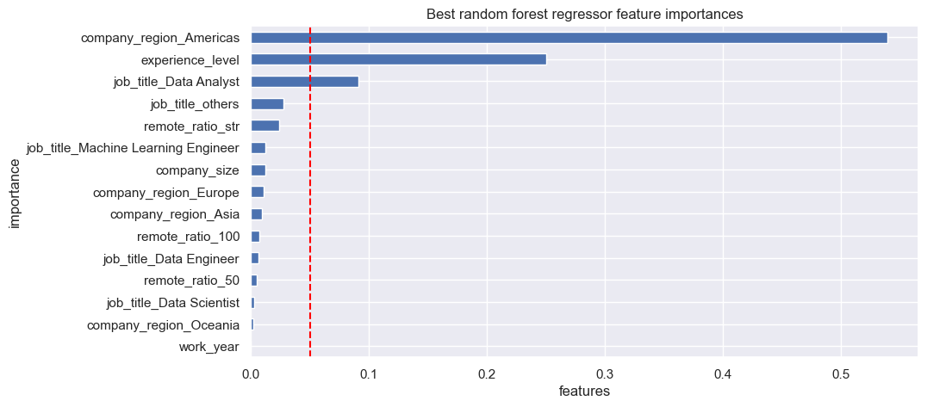
Importance of Factors in Determing Salary
0.05
The 3 Most Significantly Important Factors Ranked in Decreasing Order:
Company Region, Experience Level, Job Title

Slide 12
Modeling
Factors:
Comany Region (Americas vs Non-Americas),
Experience Level (Senior vs. Non-Senior)
Job Titles (Data Analyst vs Non-Analyst)
Regression Results:
R² =0 .365, Adjusted R² =0.363
Conclusion:
The three Factors considered is not adequate enough to predict data science job salary

Slide 13
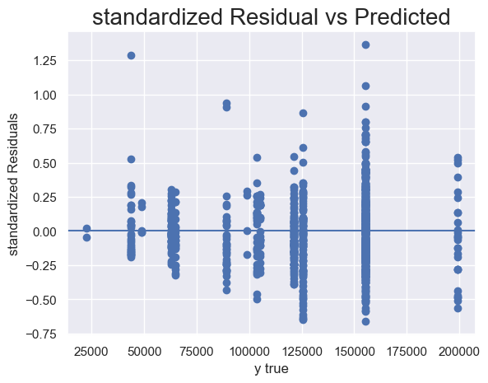
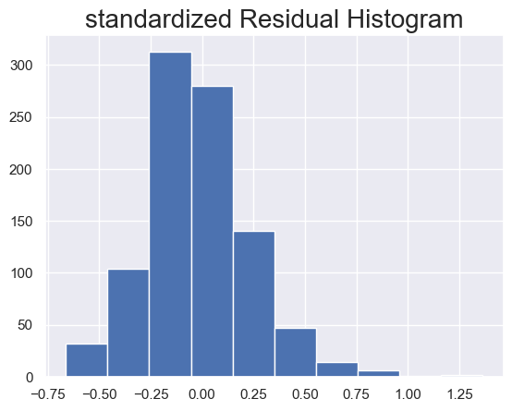
Model Diagnostic Plots

Slide 14
Discussion
Other Factors to be considered:
Education Level
The industry that data science job is in
Number and types of certifications
Additional skills besides Job Reqirements
Market price for benchmark jobs
Negotiation
Target Feature:
Hourly Pay Rate would be more appropriate

