Slide 1


BabyNutri: A Cost-Effective Baby Food Macronutrients Analyzer Based on Spectral Reconstruction Haiyan Hu, Qianyi Huang, Qian Zhang (IMWUT 2023)

Slide 2

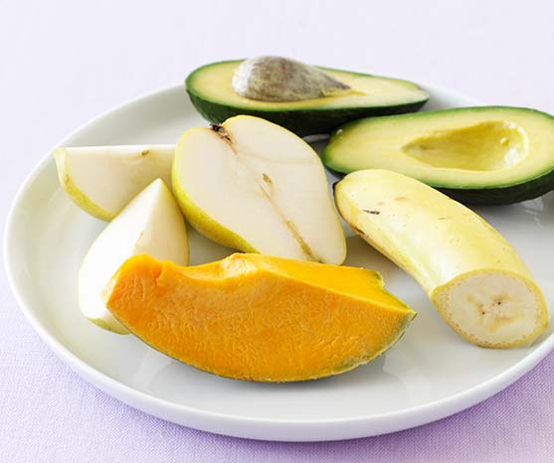
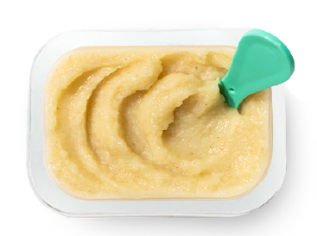




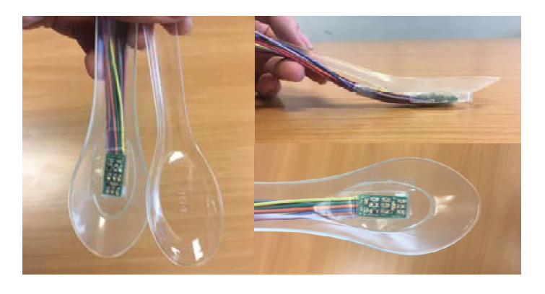
Introduction
Proper nutrient intake is essential for infants and toddlers to ensure children’s growth, health, and development to their full potential
There is no automated solution for baby food macronutrient estimation in daily usage.
Ingredients are mixed together and mill to pastes
Macronutrients for baby and toddler
Hand-record
Camera-based
Optical-based
cumbersome
No visual features
Limited resolution

Slide 3
Observation
Each photodiode (PD) can detect the light that are integrated over its spectral sensitive bandwidth (that typically range as wide as >100nm).
Spectral reconstruction can be utilized to restore a high-dimensional spectrum which contains the fine-grained light absorption characteristics from PD’s single output.
Reconstruct
High-dimensional Spectrum
And spectrometer’s Response Curve
Low-dimensional Spectrum
And PD’s Response Curve

Slide 4
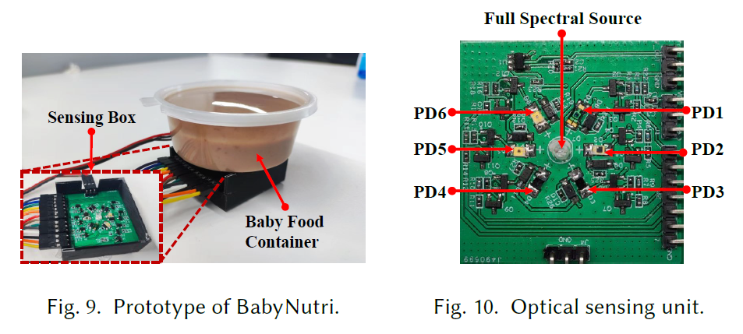
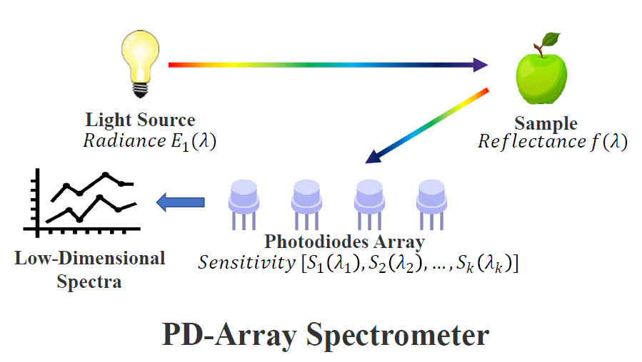
BabyNutri
We propose BabyNutri, a low-cost Baby Food Macronutrients Analyzer Based on Spectral Reconstruction.
BabyNutri takes unique photodiode array-based architecture to obtain low-dimensional spectra that can be reconstructed

Slide 5
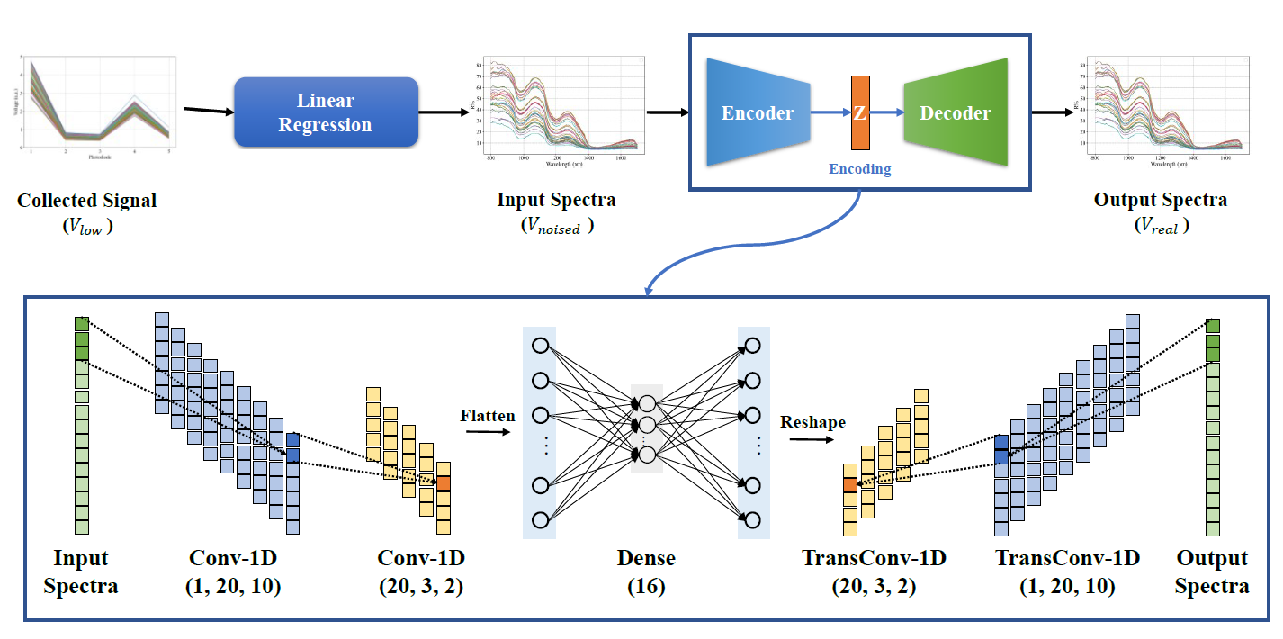
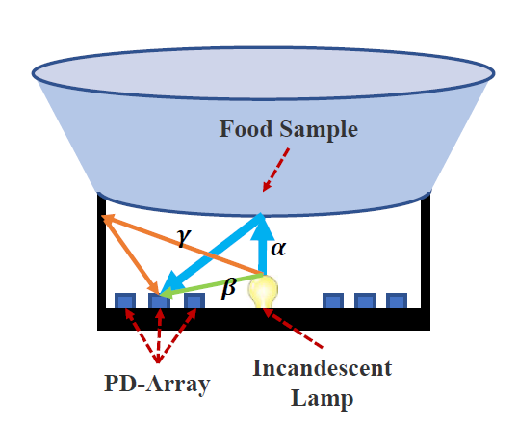

BabyNutri
The spectral reconstruction process is non-trivial:
Ambient light and surrounding objects scattering
We rephrase the problem of learning a stable reconstruction algorithm to the denoising problem of an unstable reconstruction algorithm and propose a novel autoencoder-based spectra reconstruction algorithm
The emitted light will travel through three light paths to reach the detector. Two of them are interfere items.

Slide 6
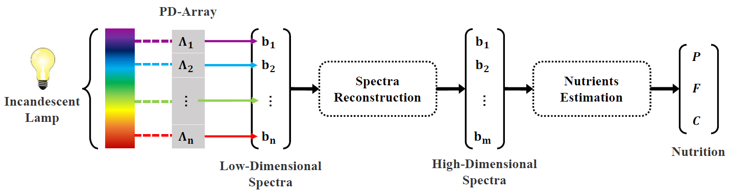
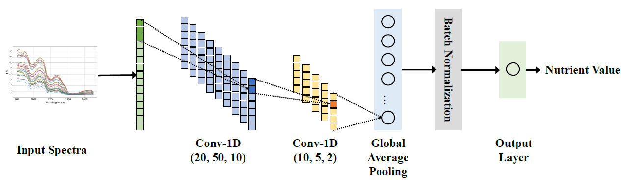
BabyNutri
BabyNutri exploits CNN-based model with several data augmentation methods to realize accurate estimations of different nutrients and foods.
§ 4.2 Nutrient Estimation

Slide 7
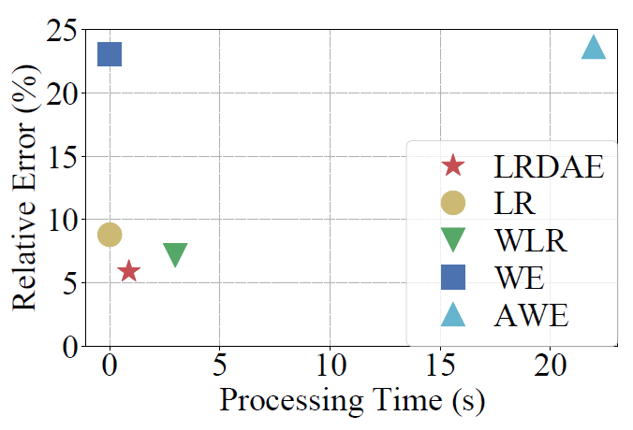
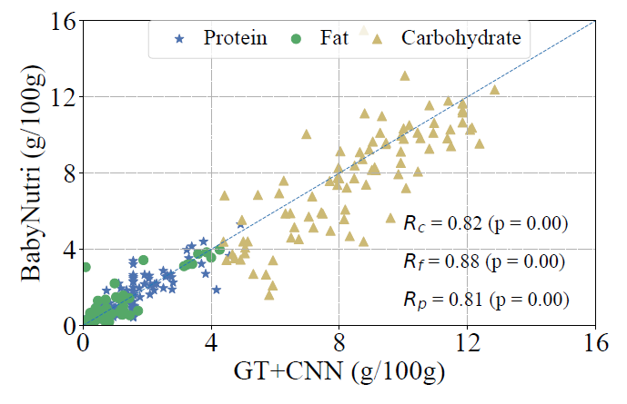
Evaluation
We evaluate the performance of BabyNutri on 88 types of baby food with various categories.
Spectral reconstruction
The spectral reconstruction error of BabyNutri is only 5.91%, reducing 33% than the state-of-the-art baseline with the same time complexity.
Macronutrients estimation
BabyNutri’s performance is highly correlated with the professional spectrometer.
While the price of our system is only one percent of the commercial spectrometer.

