Slide 1

NIRSCAM: A Mobile Near-Infrared Sensing System for Food Calorie Estimation Haiyan Hu, Qian Zhang, Yanjiao Chen (IOTJ 2022)

Slide 2
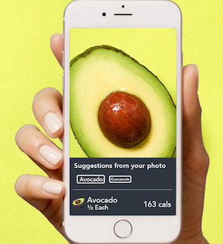
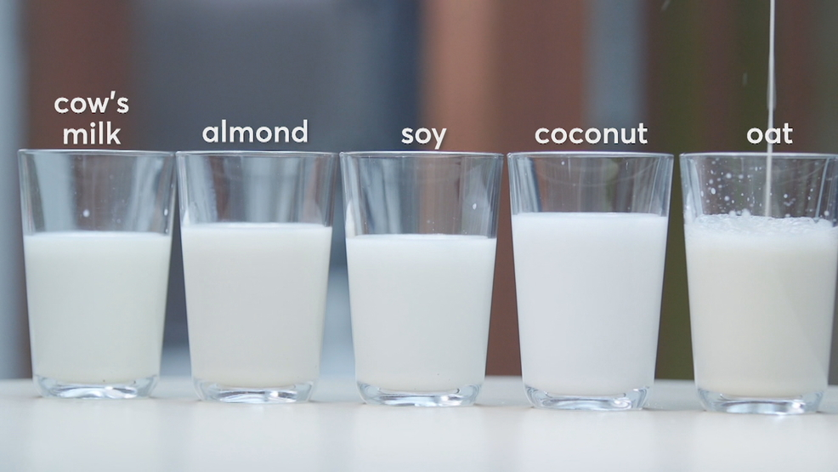
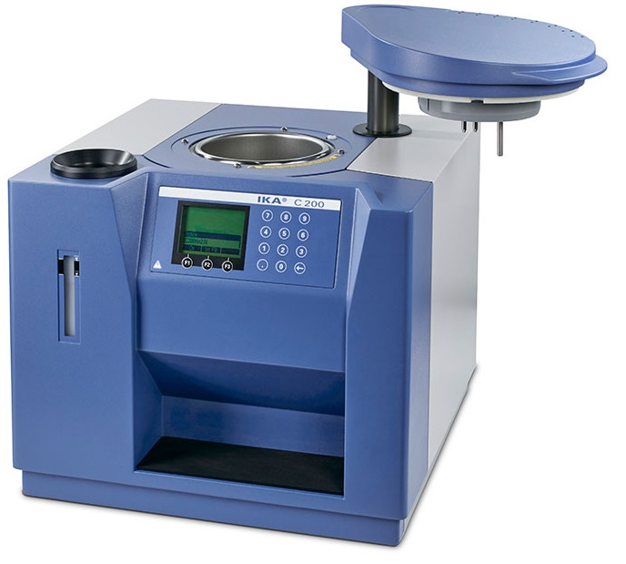
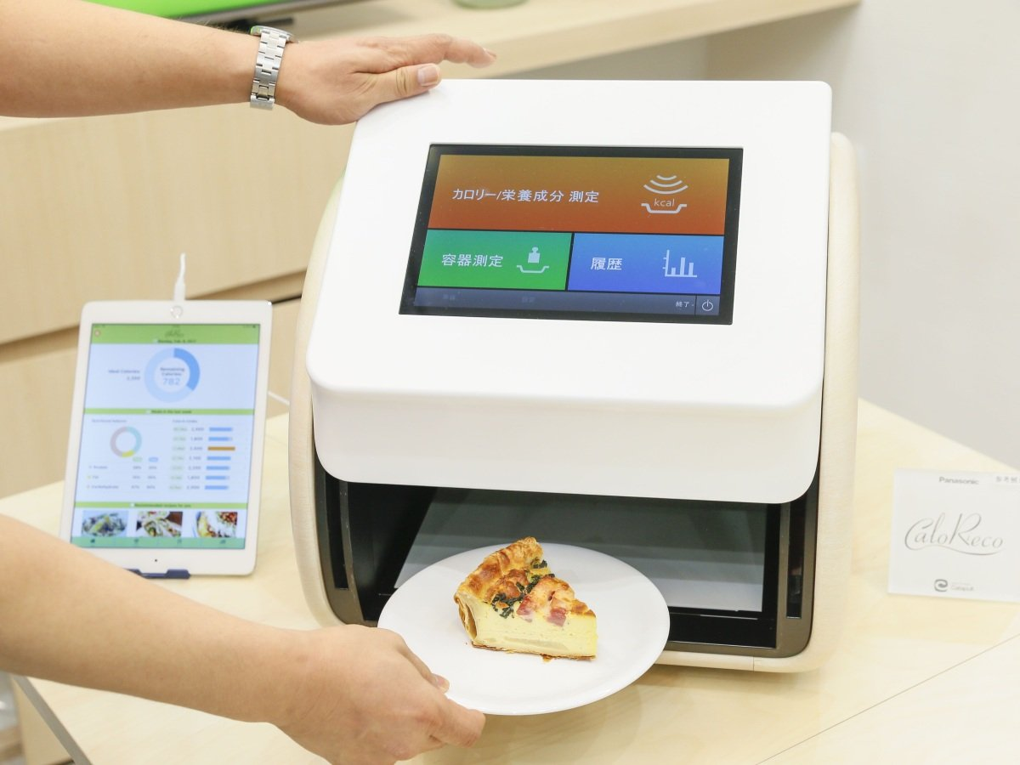

Introduction
There is a pressing demand for affordable and reliable food calorie estimation systems in daily diet.
Existing solutions are expensive, complicated or unreliable.
Food with similar appearances
Bomb Calorimeter
Spectrometer
Professional Solutions
Image-based Solutions
Can not distinguish
Give wrong calorie estimations
Complicated and Bulky
Expensive
Unreliable
Limited to superficial features
Ask for user operation

Slide 3
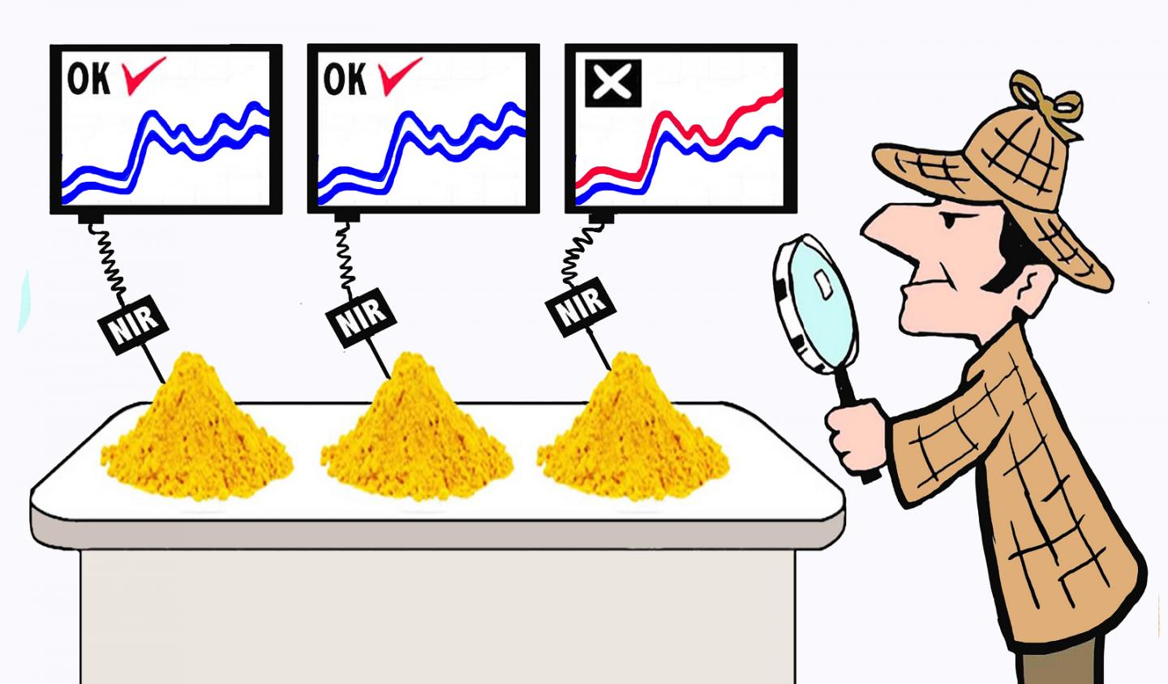
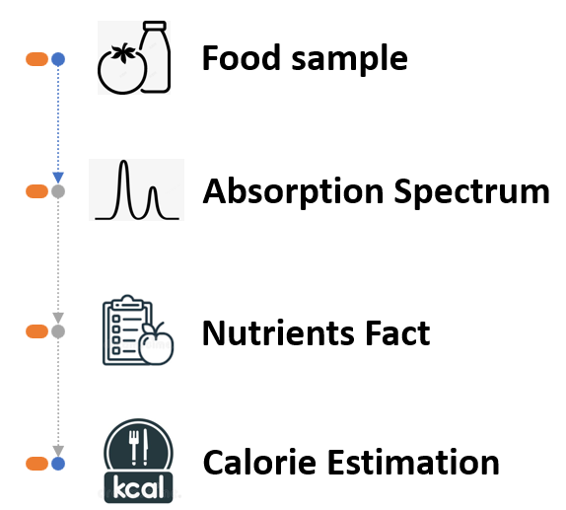
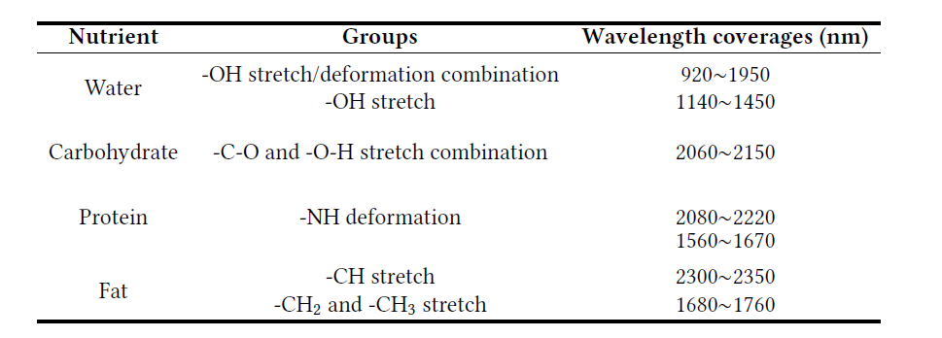
Observation
Near-infrared spectroscopy (NIRS) technology can detect underlying chemical characteristics of food, so that to provide reliable food nutrients and calories estimation.
Each nutrient has a distinctive near-infrared absorption spectrum

Slide 4
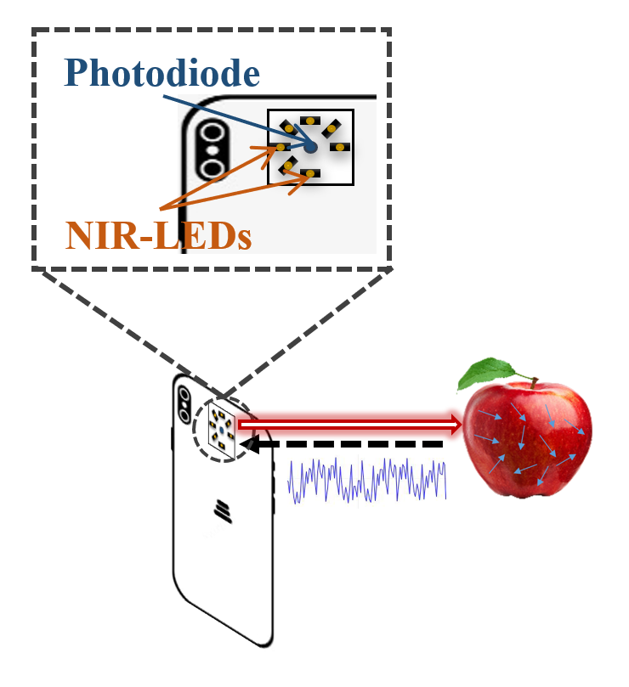
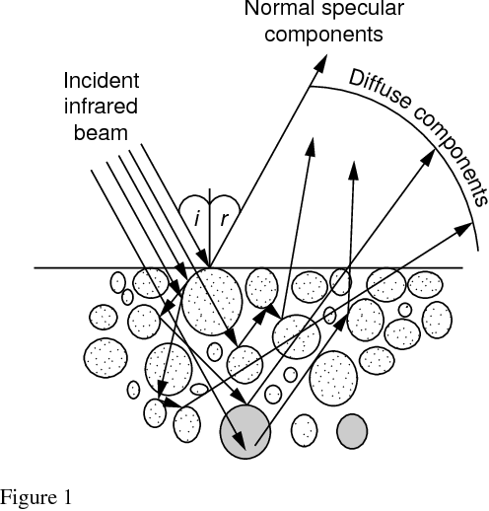

NIRSCAM
We propose a low-cost mobile near-infrared sensing system for reliable food calorie estimation, named NIRSCAM.
NIRCAM uses off-the-shelf cheap LEDs and photodiodes components to reduce the cost
Challenges:
Low emission power
Ambient light noise
C1: Low signal-to-noise ratio
C2: Heterogeneous of Foods
NIRSCAM

Slide 5
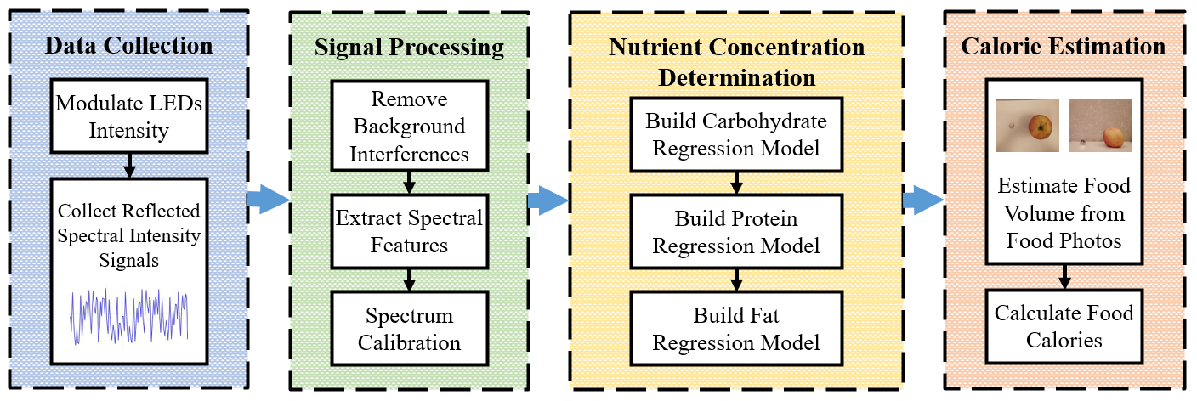
NIRSCAM
It improves the signal quality of the system by a series of schemes, including hardware modulation and denoising algorithms
It exploits non-linear machine learning model is used to realize accurate estimations of calories.
To fit the heterogeneous types of foods
To improve the signal quality of low-cost system

Slide 6
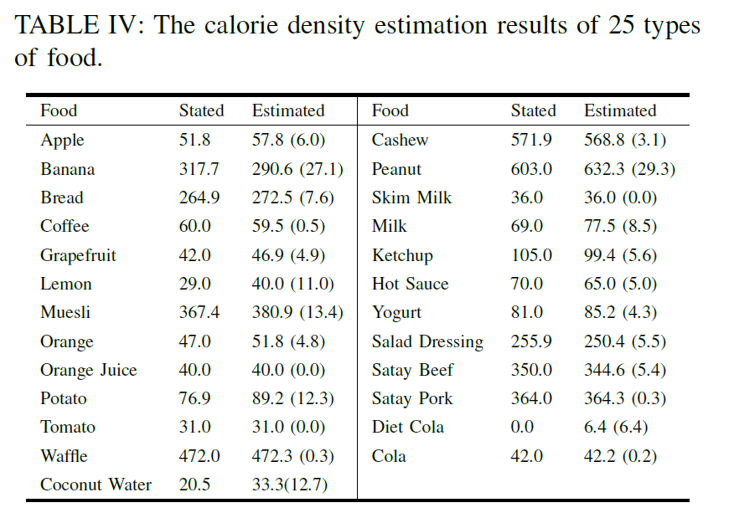
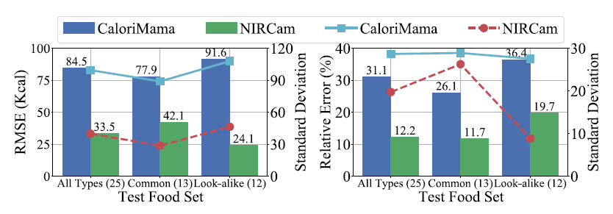
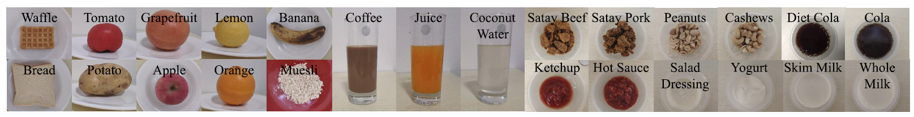
Evaluation
NIRSCAM is 15.32% more accurate in calorie estimation than the image-based baseline over 25 types of food.
NIRSCAM can differentiate foods with strong resemblance and gives accurate calorie estimation, like cola and diet cola.

