Slide 1




BabyNutri: A Cost-Effective Baby Food Macronutrients Analyzer Based on Spectral Reconstruction Haiyan Hu, Qianyi Huang, Qian Zhang (IMWUT 2023)
Notes:
第二份工作，我们在NIRSCAM的基础上，关注更特殊的一类人群：婴儿的营养饮食。提出了一种低成本的婴儿辅食宏量营养元素估计系统。并且在这份工作中我们探索了一种新的光谱处理技术：光谱重建来大幅度的提升系统的准确性。

Slide 2
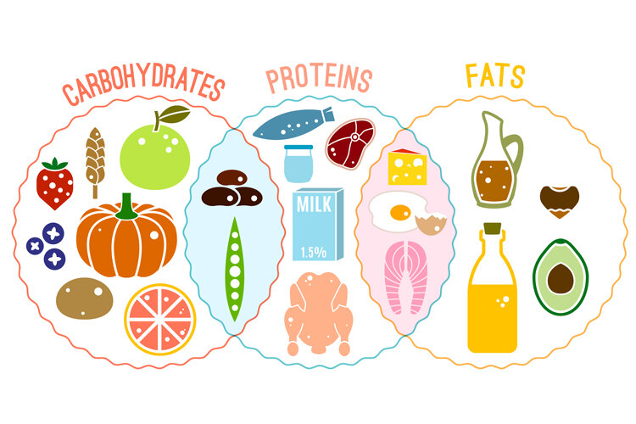
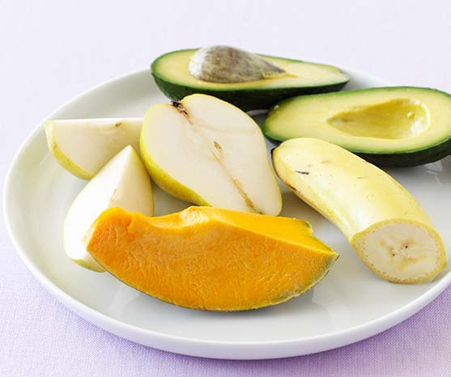
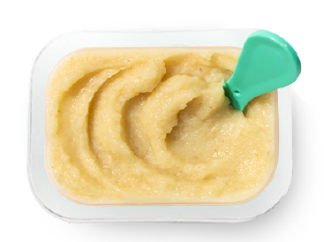




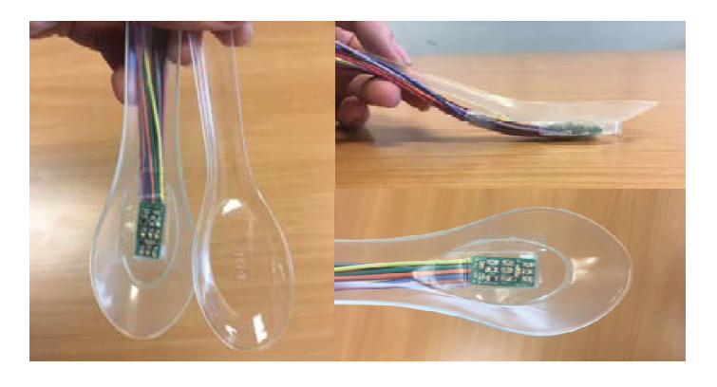
Motivation
Proper nutrient intake is essential for infants and toddlers to ensure children’s growth, health, and development to their full potential
There is no automated solution for baby food macronutrient estimation in daily usage.
Ingredients are mixed together and mill to pastes
Macronutrients for baby and toddler
Hand-record
Camera-based
Optical-based
cumbersome
No visual features
Limited resolution

Slide 3
Observation
Each photodiode (PD) can detect the light that are integrated over its spectral sensitive bandwidth (that typically range as wide as >100nm).
We can restore a high-dimensional spectrum which contains the fine-grained light absorption characteristics from PD’s single output.
Reconstruct
High-dimensional Spectrum
And spectrometer’s Response Curve
Low-dimensional Spectrum
And PD’s Response Curve

Slide 4
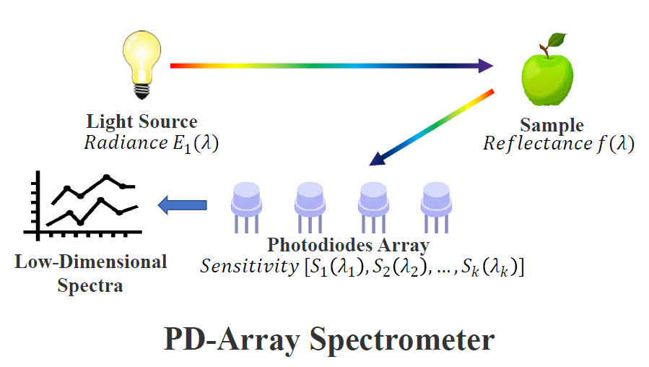
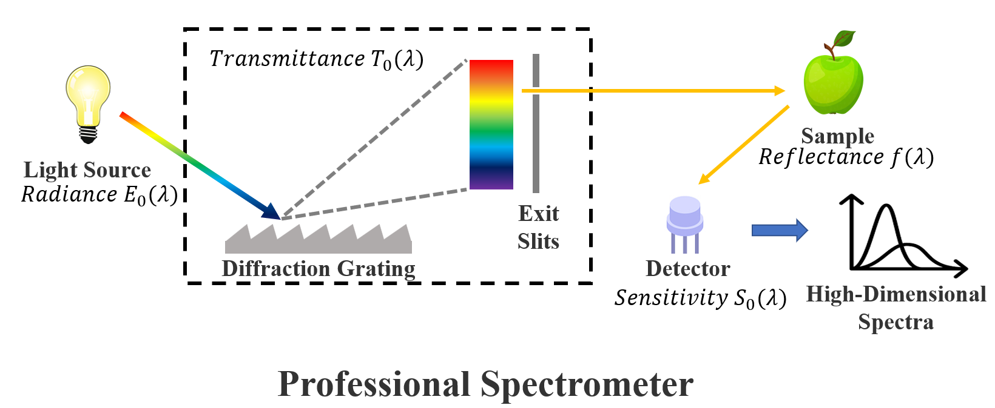




Rationale
Spectral reconstruction means to learn a mapping from Low-dimensional output to high dimensional one:
Reconstruct

Slide 5
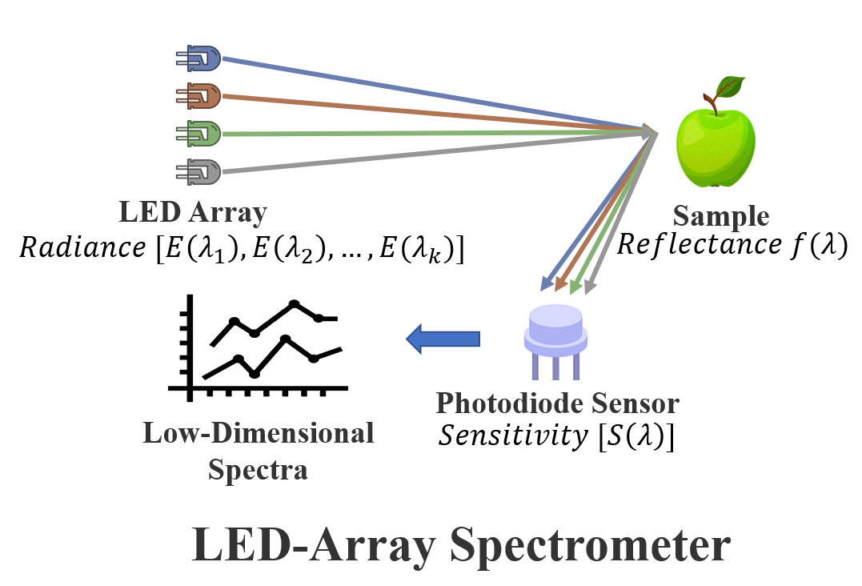


BabyNutri
We propose BabyNutri, a low-cost Baby Food Macronutrients Analyzer Based on Spectral Reconstruction.
BabyNutri takes unique photodiode array-based architecture to obtain low-dimensional spectra that can be reconstructed
Broad Band
Barrow Band

Slide 6





Challenge
The spectral reconstruction process in real world is non-trivial:
Ambient light -> Background subtraction
Surrounding objects scattering
The emitted light will travel through three light paths to reach the detector
Food Sample
$$γ$$
Unknown
$$α$$
$$β$$
PD System Parameters
Food Reflection
Material Reflection
HS System Parameters
Incandescent Lamp
PD-Array
Notes:
We rephrase the problem of learning a stable reconstruction algorithm to the denoising problem of an unstable reconstruction algorithm and propose a novel autoencoder-based spectra reconstruction algorithm

Slide 7
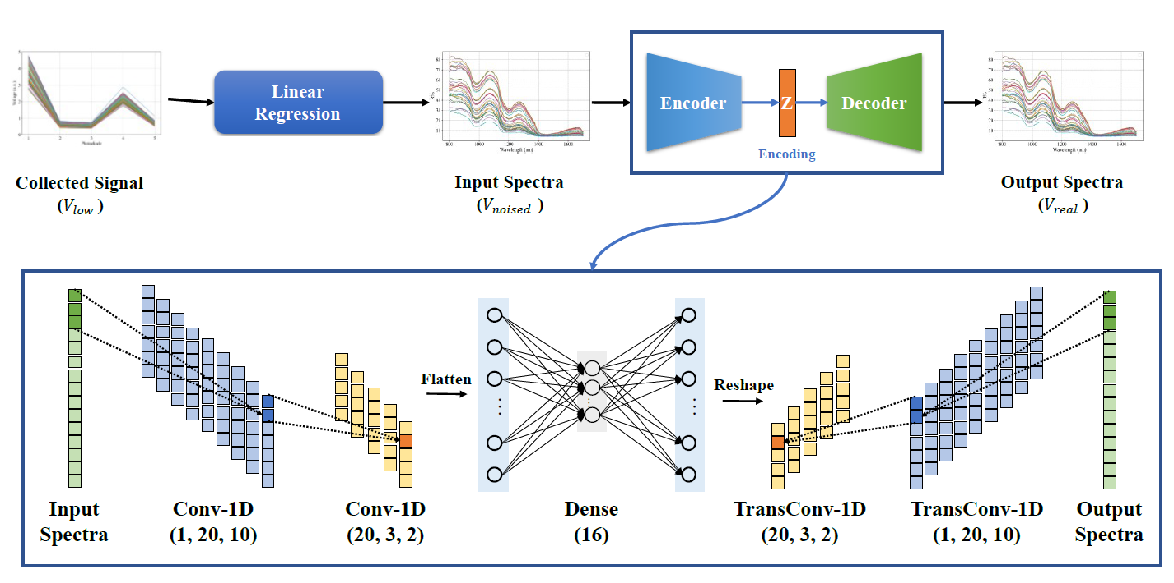


BabyNutri
We rephrase the problem of learning a stable reconstruction algorithm to the denoising problem of an unstable reconstruction algorithm
We propose a novel autoencoder-based spectra reconstruction algorithm
First: Linear Regression to obtain a roughly reconstruction output
Second: The first step output is taken as a noised high-dimensional spectrum feed into a DAE (Denoise Auto-Encoder)
Shape consistency loss
Notes:
We rephrase the problem of learning a stable reconstruction algorithm to the denoising problem of an unstable reconstruction algorithm and propose a novel autoencoder-based spectra reconstruction algorithm

Slide 8
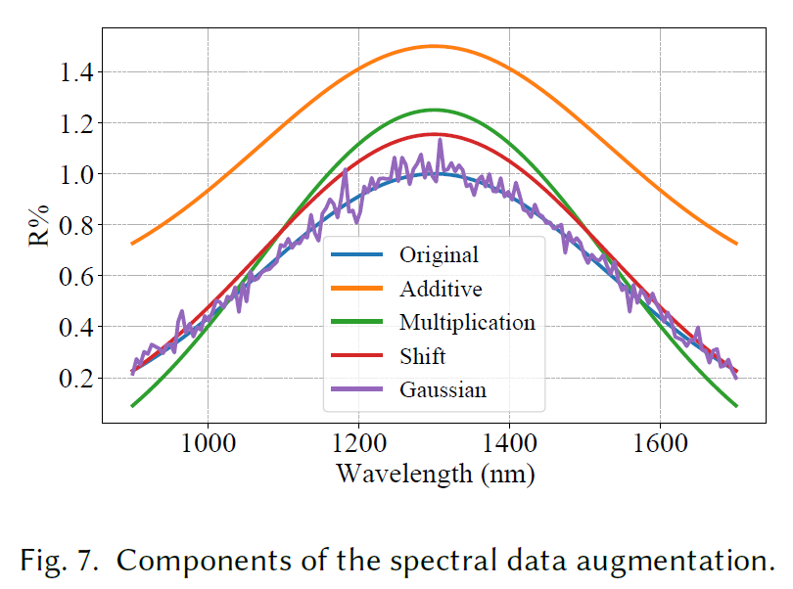
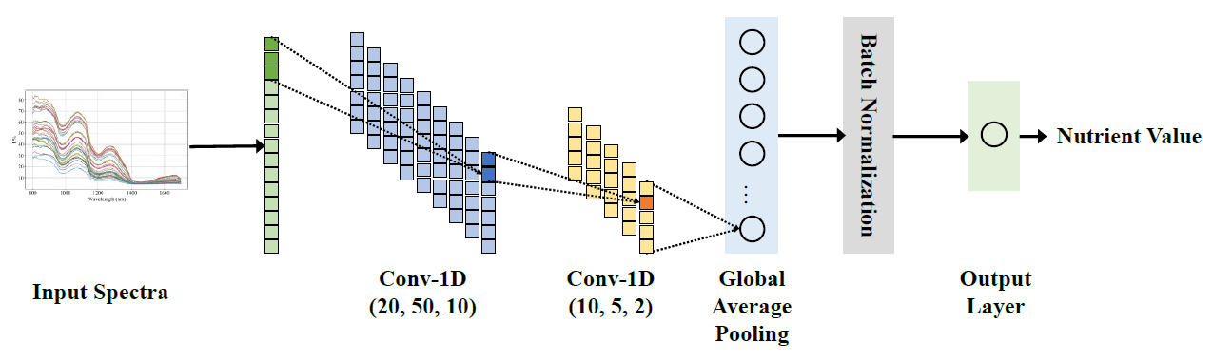
BabyNutri
For nutrients estimation, the challenge is that the baby food samples have various ingredients, such as fruits, vegetables, meats, and creamy, leading to different levels of nutrients.
We design a CNN-based model with several data augmentation methods to realize accurate estimations
§ 4.2 Nutrient Estimation

Slide 9
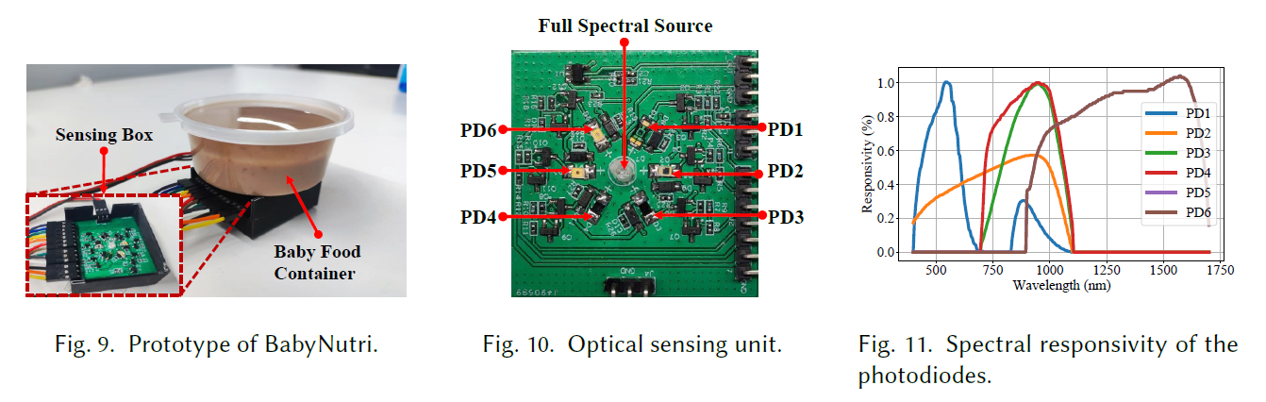
Implementation
We design and implement a compact and low-cost (less than 10 dollars except for the control unit) prototype using off-the-shelf hardware components

Slide 10
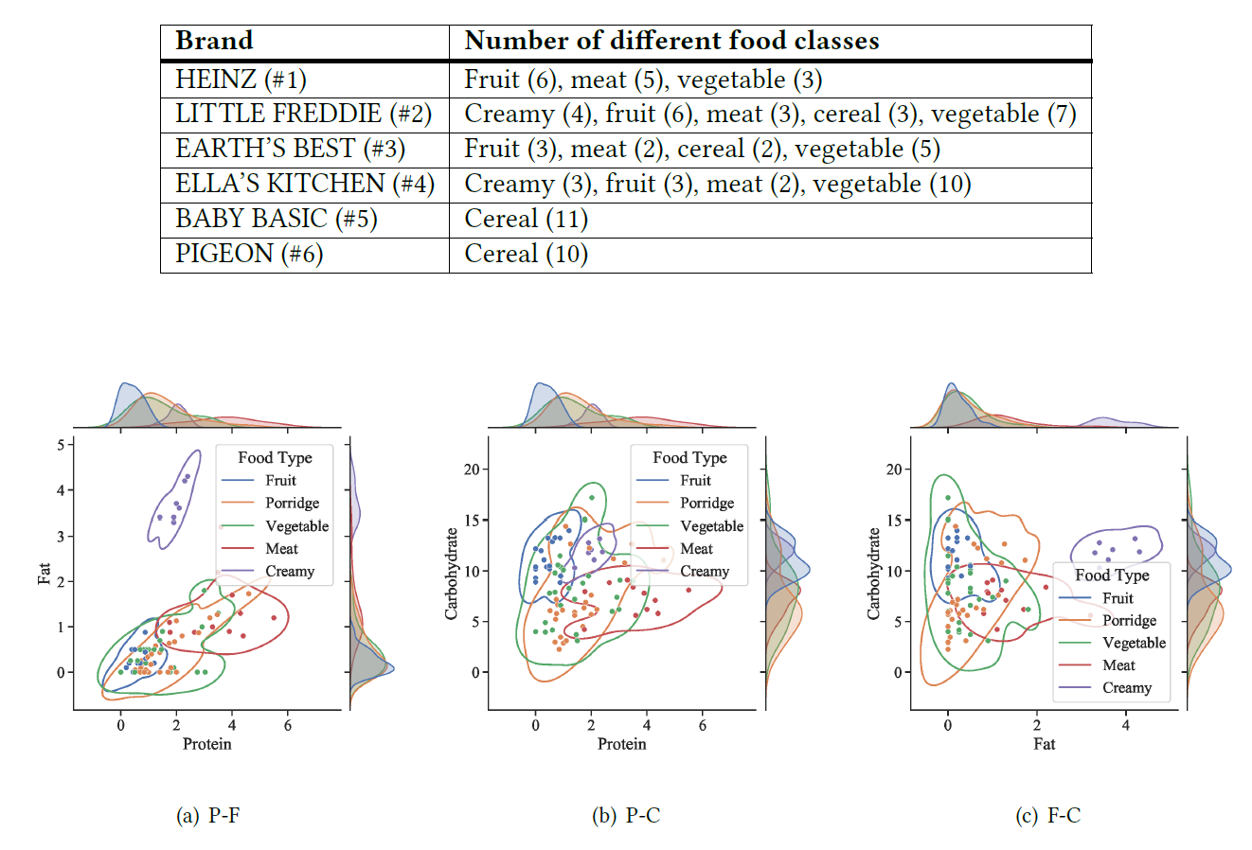
Evaluation: Set up
We evaluate the performance of BabyNutri on 88 types of baby food with various categories.

Slide 11
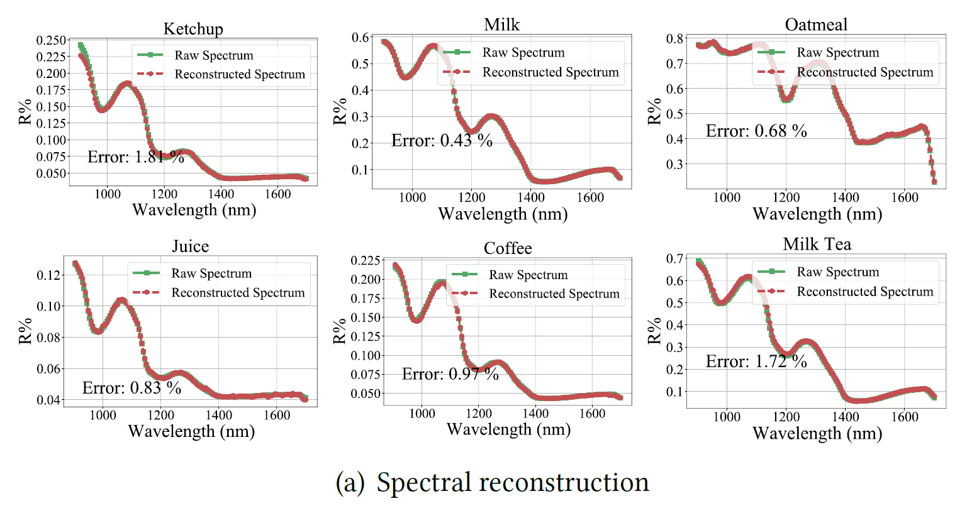
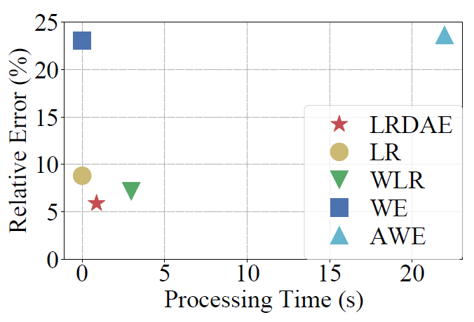
Evaluation: Spectral reconstruction
The spectral reconstruction error of BabyNutri is only 5.91%, reducing 33% than the state-of-the-art baseline with the same time complexity.

Slide 12
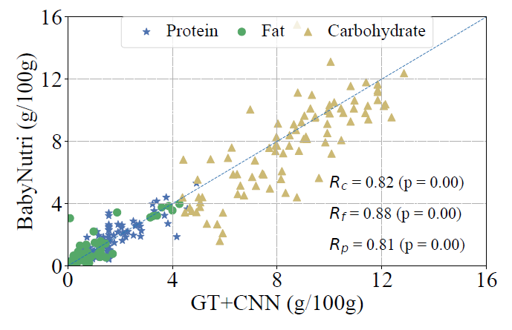
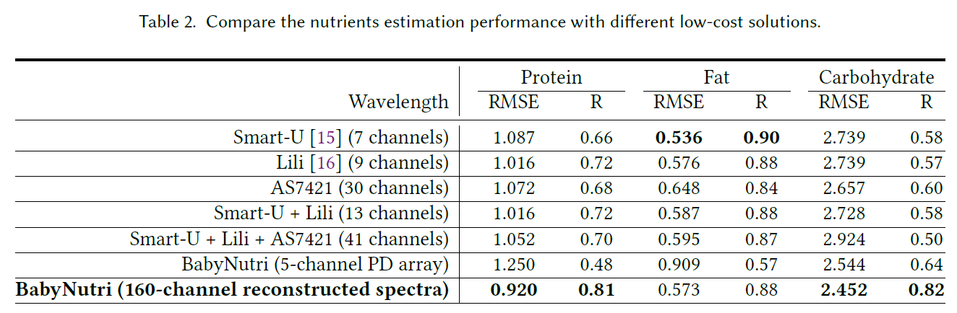
Evaluation: Macronutrients estimation
BabyNutri’s performance is highly correlated with the professional spectrometer, While the price of our system is only one percent of the commercial spectrometer.
Compare to existing LED-based low-cost solutions, BabyNutri achieves consistent good performance over all three macro-nutrients

Slide 13

THANK YOU!
Haiyan HU (HKUST)
Year-3 Ph.D.
Supervised by Prof. Qian Zhang
https://hyanhu.github.io/

