Slide 1



NIRSCAM: A Mobile Near-Infrared Sensing System for Food Calorie Estimation Haiyan Hu, Qian Zhang, Yanjiao Chen (IOTJ 2022)
Notes:
首先，第一份工作叫做NIRSCAM， 它是一个用于估算食物卡路里的移动近红外感知系统。

Slide 2
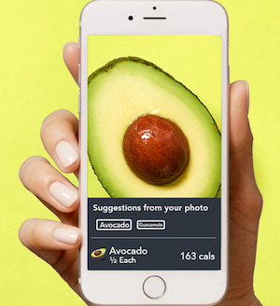
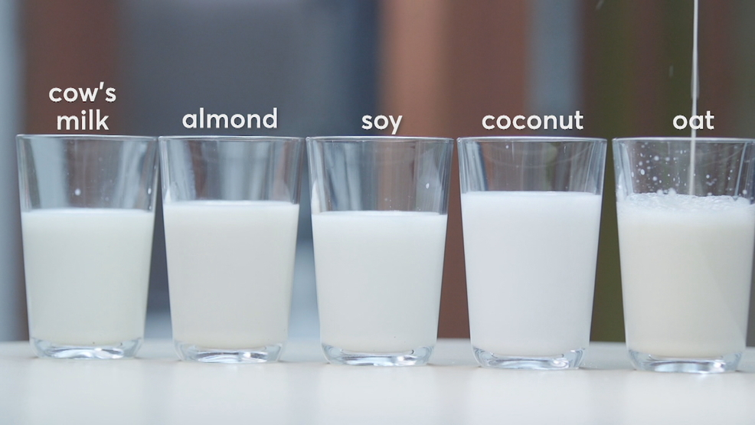
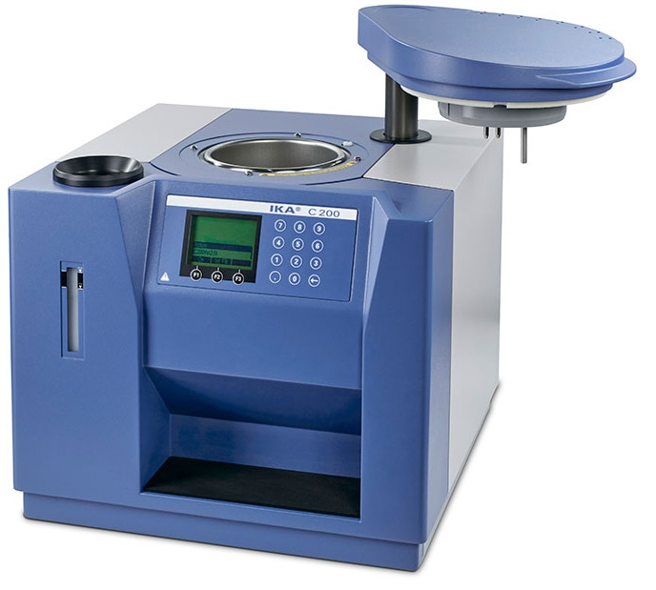
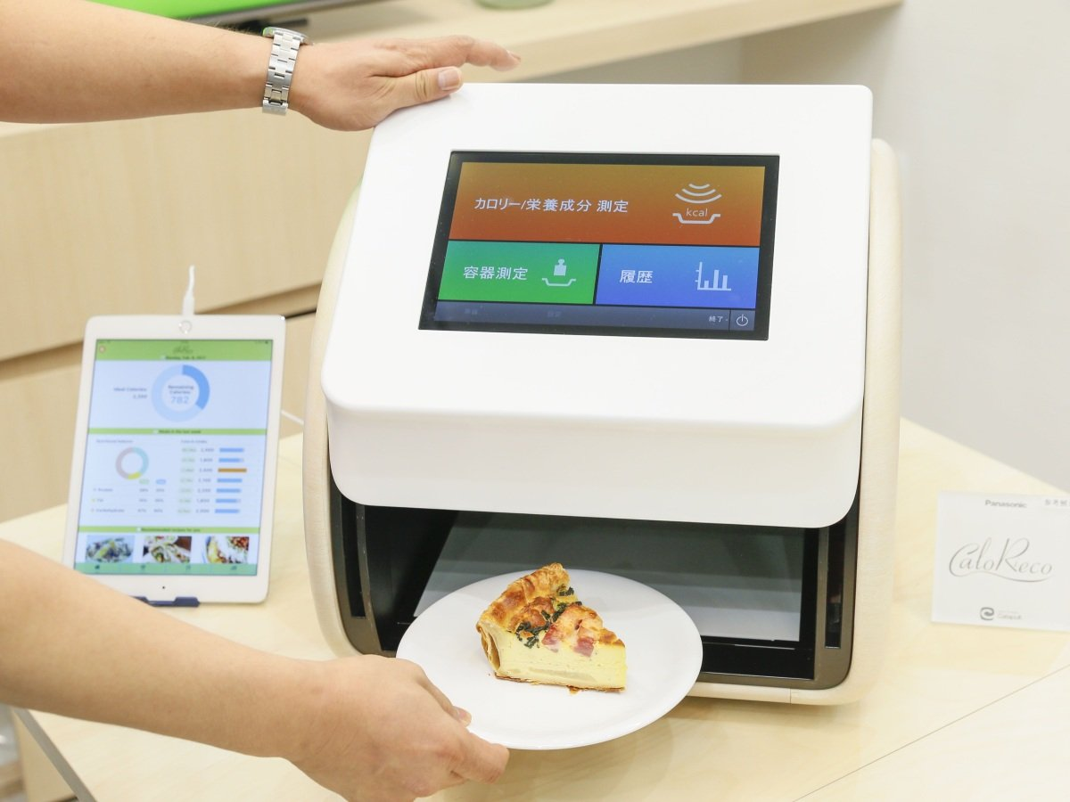

Motivation
Existing diet management solutions are expensive, complicated or unreliable, especially for similar-look food.
There is a pressing demand for affordable and reliable food calorie estimation systems in daily diet.
Food with similar appearances
Bomb Calorimeter
Spectrometer
Professional Solutions
Image-based Solutions
Can not distinguish
Give wrong calorie estimations
Complicated and Bulky
Expensive
Limited to superficial features
Unreliable
Notes:
这份工作的motivation在于，我们发现日常饮食中的卡路里检测存在很大的需求，但是现有的方案还不够完善。
首先，有一些专业的设备能够提供准确的卡路里估计，但是贵
另外，基于

Slide 3
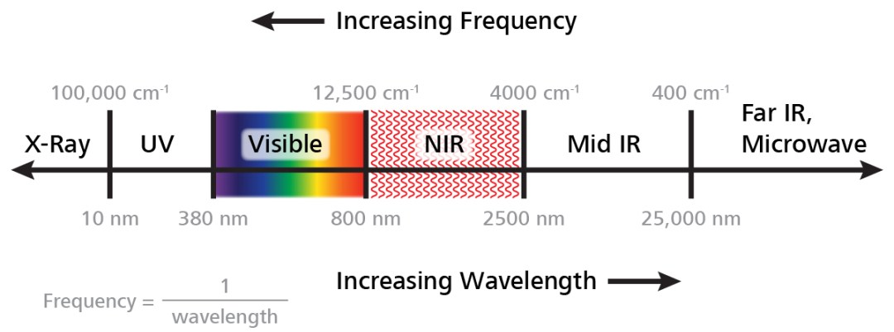
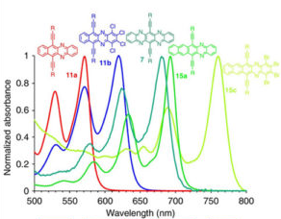
Observation
We find that Near-infrared spectroscopy (NIRS) technology may help.
NIR (Near Infrared) means low frequency radiation adjacent to red hues in the visible
Some chemical bands like, O-H, N-H, and C-H bonds will absorb NIR light with different wavelength

Slide 4
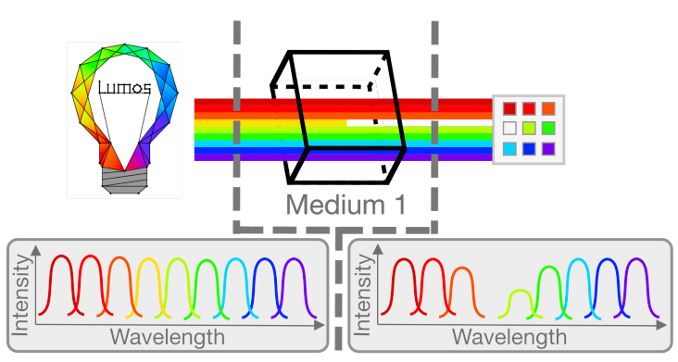
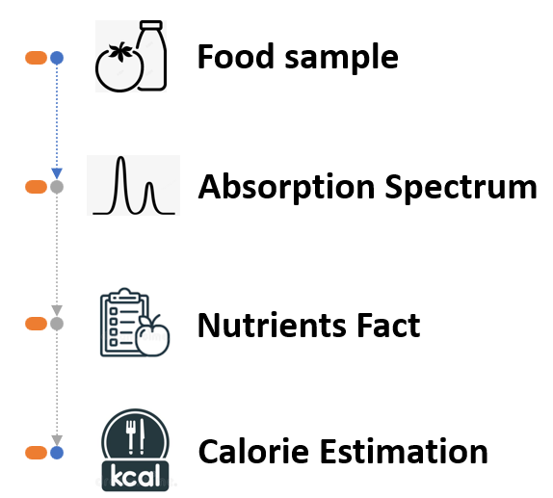

Observation
We find that Near-infrared spectroscopy (NIRS) technology may help.
NIR (Near Infrared) means low frequency radiation adjacent to red hues in the visible
Nutrient #1
Nutrient #2
Food Sample
Each food or nutrient has a distinctive near-infrared absorption spectrum
Notes:
近红外光谱可以检测食品的潜在化学特性，从而提供可靠的食品营养和卡路里估计。

Slide 5
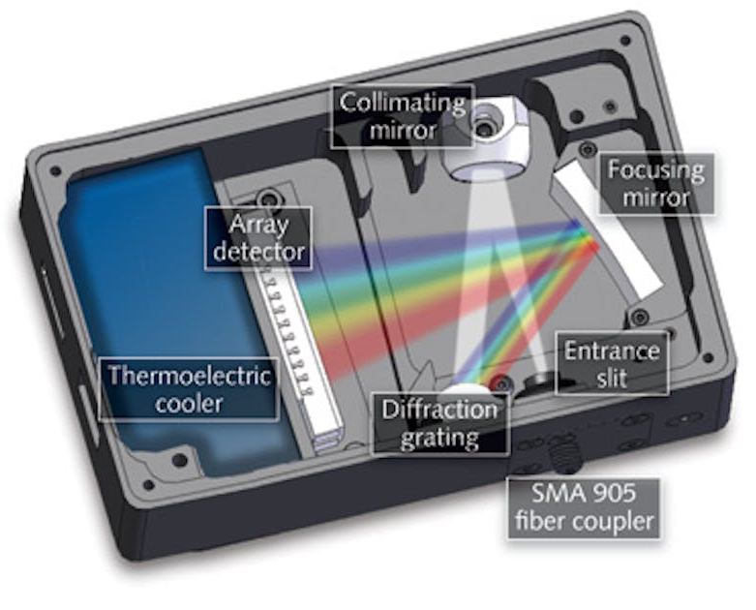
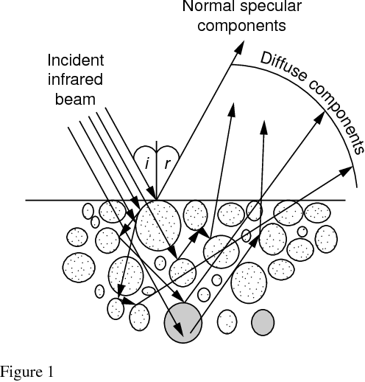
NIRSCAM
To transform this idea into a practical system, we have to address the following challenges:
How to build an affordable NIRS system?
How to improve the signal quality of the NIRS system?
How to accurately estimate calories for a variety of different foods?
Low emission power
Ambient light noise
Sophisticated and expensive grating
Low signal-to-noise ratio
Heterogeneous of Foods

Slide 6
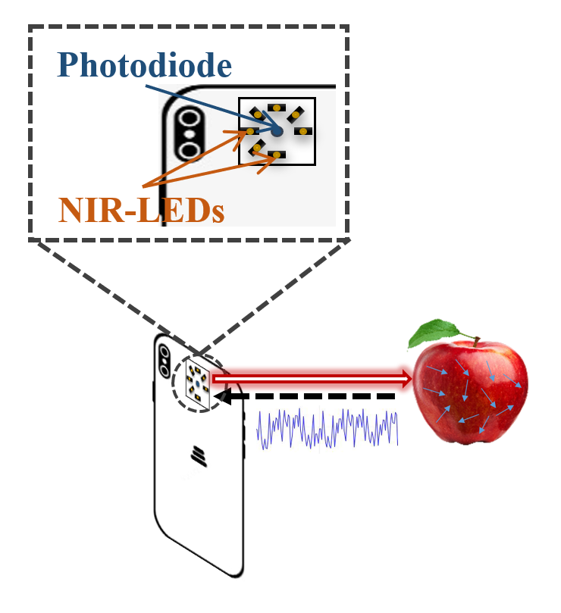
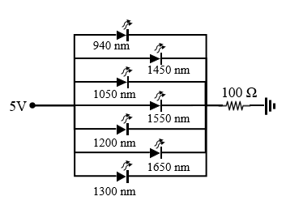
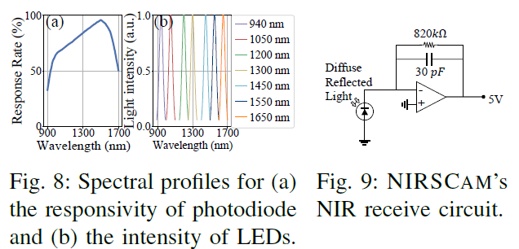
How to build an affordable NIRS system?
To reduce the cost, NIRCAM uses off-the-shelf cheap LEDs and photodiodes components
Time division multiplexing LED to simulate monochromatic light extraction
Remove Expensive Monochromatic light extraction component
Sophisticated and expensive grating
Notes:
与Smart-U相似的观点，就是利用多个LED，和PD通过时分复用不同波长的LED，来实现

Slide 7
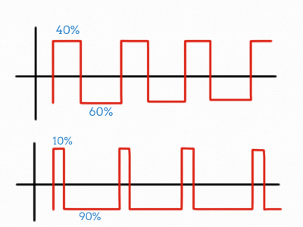
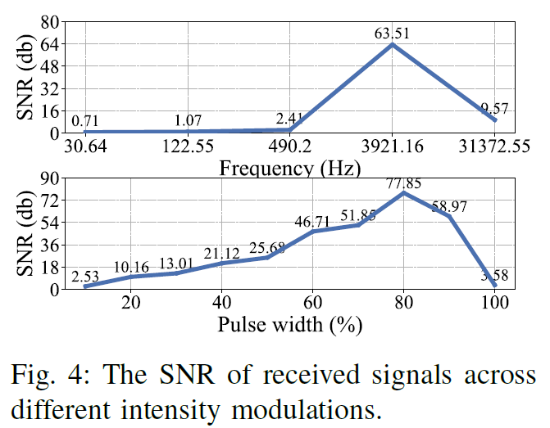
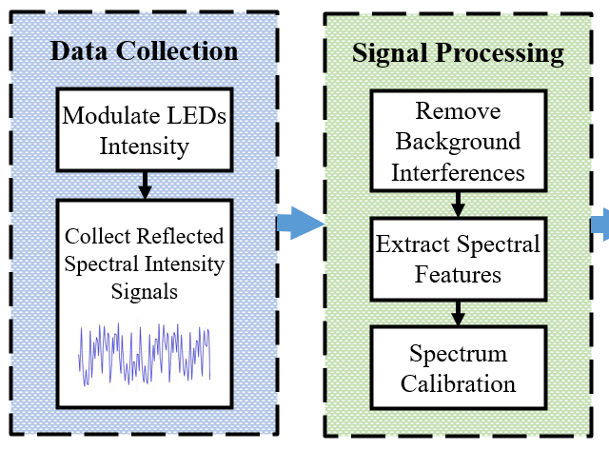
How to improve the signal quality?
To improve the signal quality of the system:
We modulate the light source to find best inter-action pattern
We apply background subtraction algorithm
Insight: The frequency and the pulse width of pulse wave light sources will affect the path of light through food particles.
Notes:
需要扩展，讲细一点

Slide 8
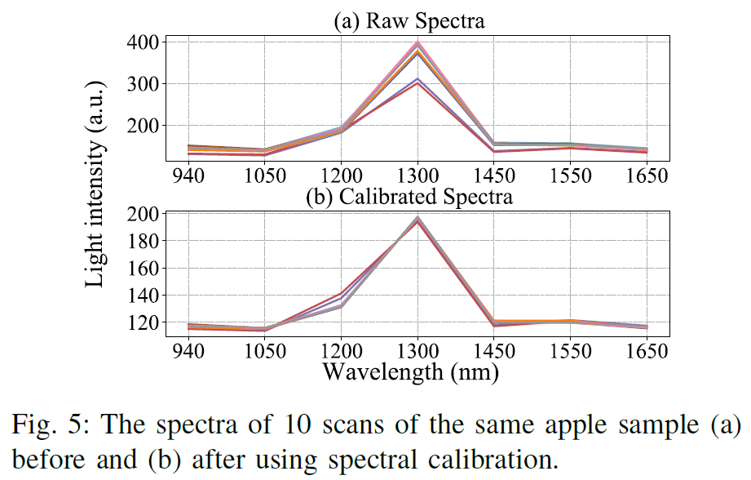
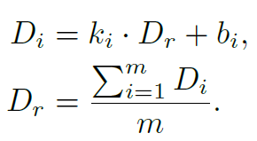

How to estimate calories for different foods?
To fit uneven surfaces and heterogeneous particle compositions:
We calibrate the raw spectra with multiplicative scatter correction
We apply non-linear machine learning model to regress nutrients
Without correction
With correction
Heterogeneous of Foods
Notes:
需要扩展，讲细一点

Slide 9
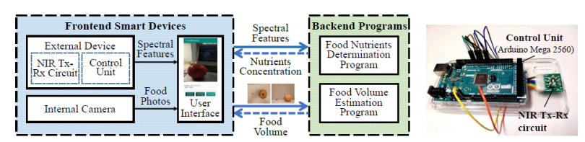
NIRSCAM
We implement a full-functional NIRSCAM, which takes three steps:
Obtains food spectra signature by a NIRS gadget
Takes food photos to calculate food volume
Regression and estimate food calories
Notes:
需要扩展，讲细一点

Slide 10
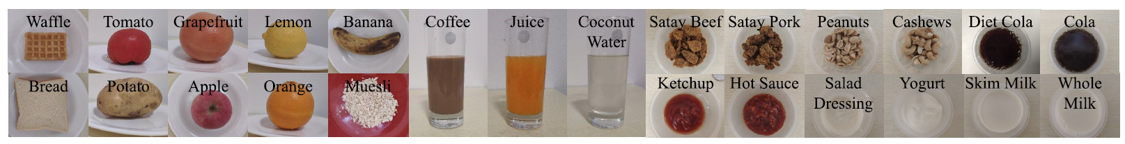
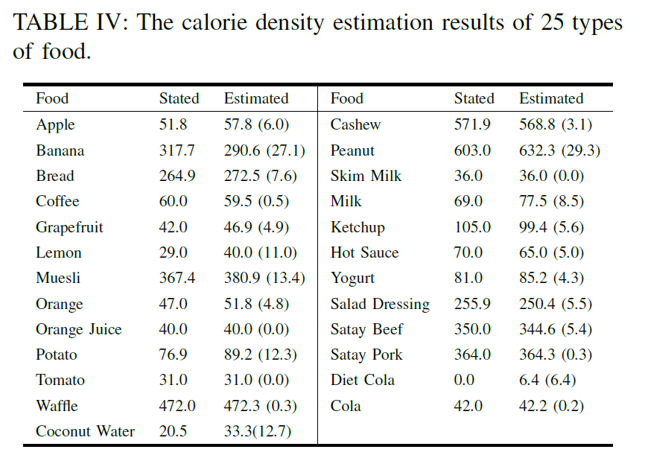
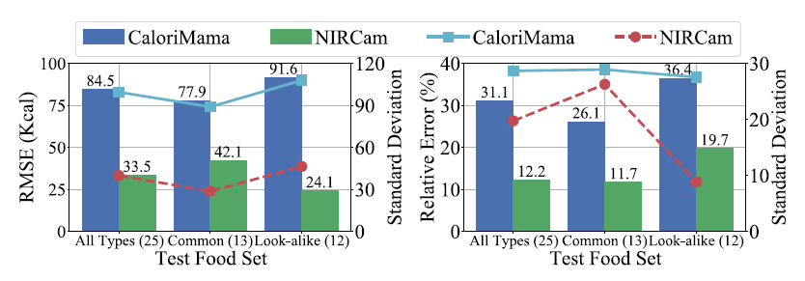
Evaluation
NIRSCAM is 15.32% more accurate in calorie estimation than the image-based baseline over 25 types of food.
NIRSCAM can differentiate foods with strong resemblance and gives accurate calorie estimation, like cola and diet cola.

Slide 11
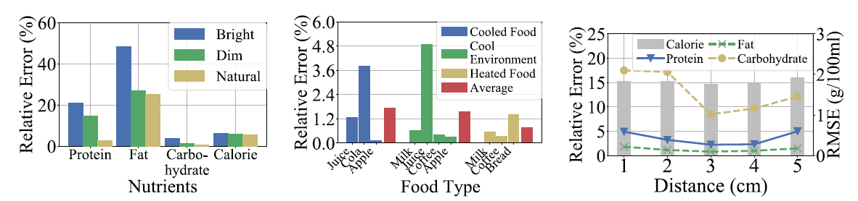
Evaluation
NIRSCAM is robust to various environmental factors, such as temperature, illumination, and distance.

Slide 12

THANK YOU!
Haiyan HU (HKUST)
Year-3 Ph.D.
Supervised by Prof. Qian Zhang
https://hyanhu.github.io/

