Slide 1
ARG Visualizations with D3.js
James Kitchens
tskit dev group meeting
September 13, 2023
https://github.com/kitchensjn/tskit_arg_visualizer

Slide 2
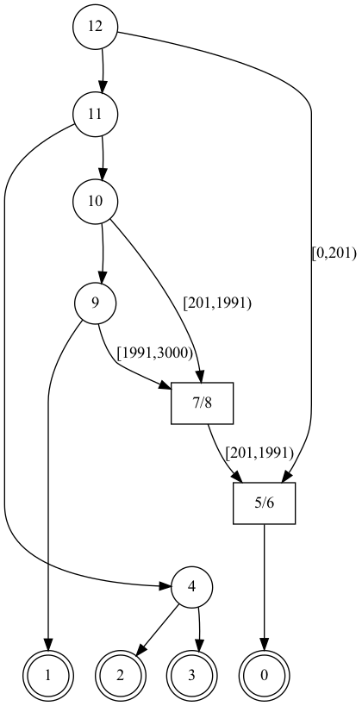
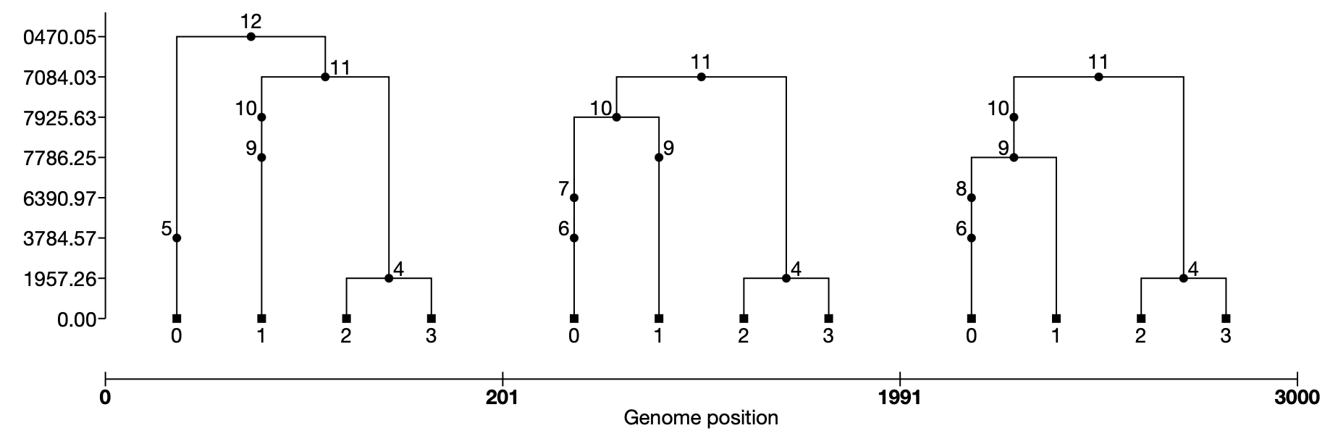
Current Visualizations
3
Viewing the Tree Sequence versus Full ARG
https://tskit.dev/tutorials/viz.html

Slide 3
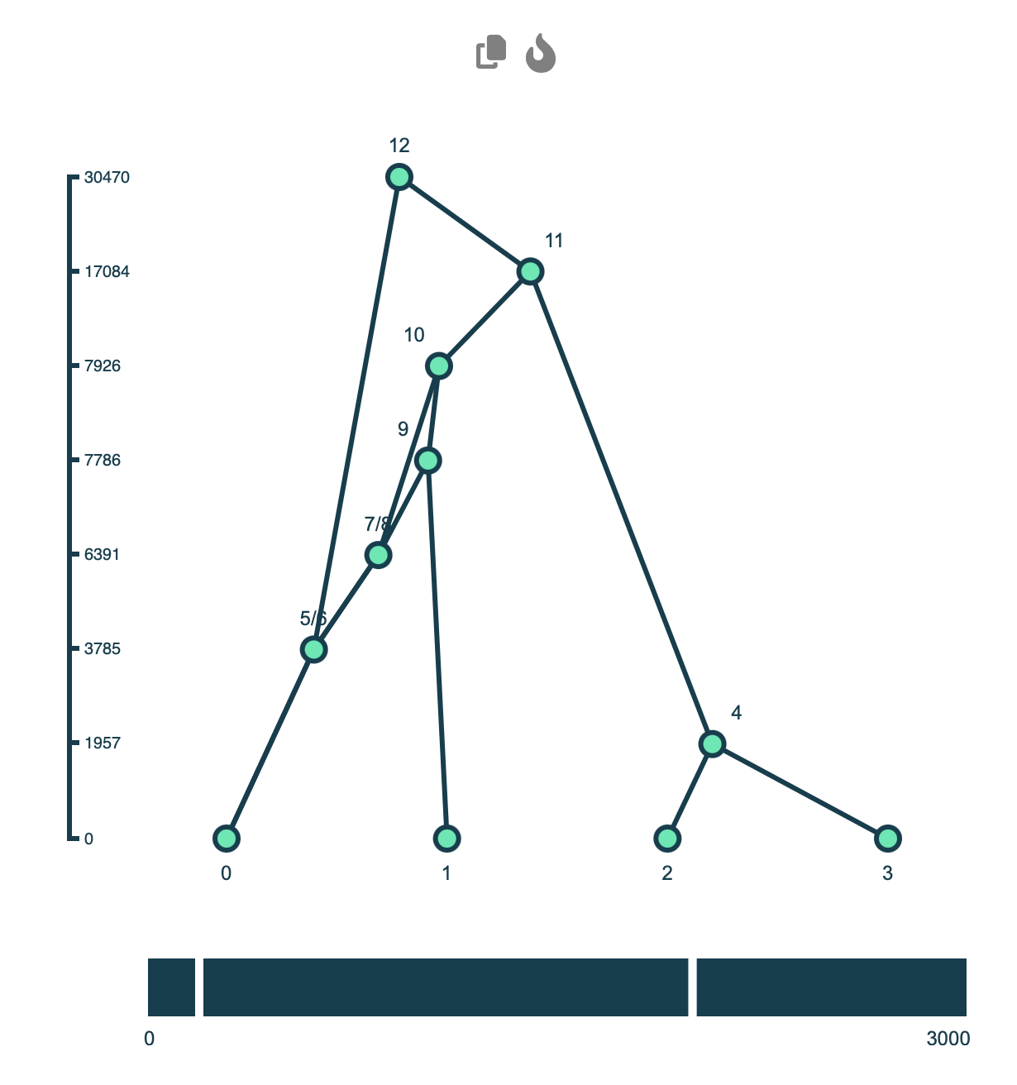
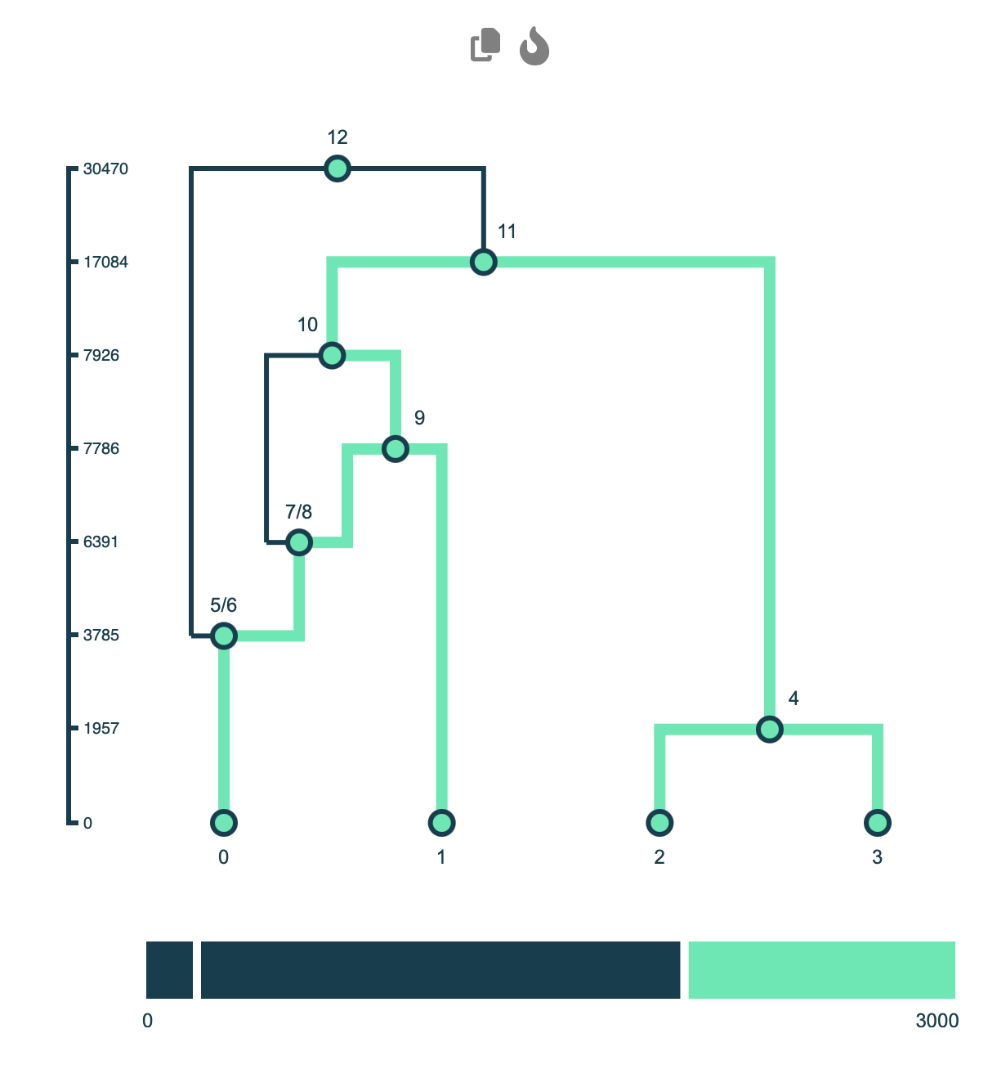

Slide 4




Workflow

Slide 5
Workflow
Styling
Displays the SVG either in a Juptyer Notebook or browser
Using D3.js, creates an SVG from the JSON object
Converts tree sequence to JSON object

Slide 6
JSON
nodes
links
breakpoints
width
height
tree_highlighting
y_axis
edge_type
subset_nodes
Modified versions of the tables from tskit
Describes the graph styling
https://github.com/kitchensjn/tskit_arg_visualizer/blob/main/plotting.md

Slide 7
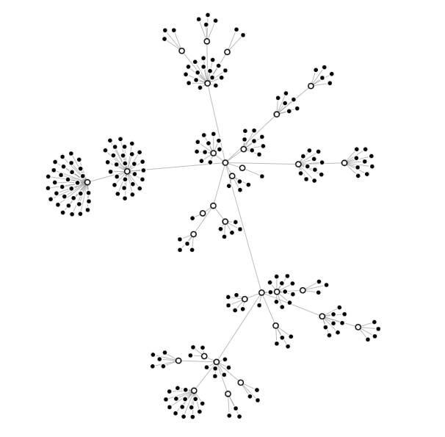
D3.js Force Directed Graph
Node positions are determined by a physics-based simulation:
Nodes repel each other, whereas edges pull connected nodes closer together
Energy of the simulation decreases overtime and nodes come to rest
Nodes’ x and/or y coordinates can be fixed
Nodes are draggable
https://github.com/d3/d3-force

Slide 8
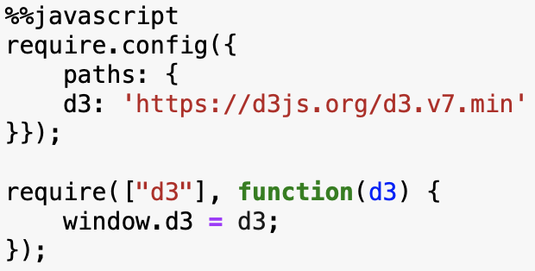
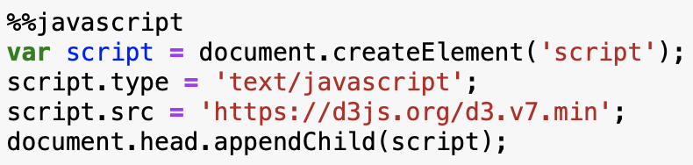
How To Run
Terminal
Creates a temporary HTML file and launches in default browser
Jupyter Notebook
Add this header to the top of the notebook:
Jupyter Lab
Add this header to the top of the notebook:

Slide 9
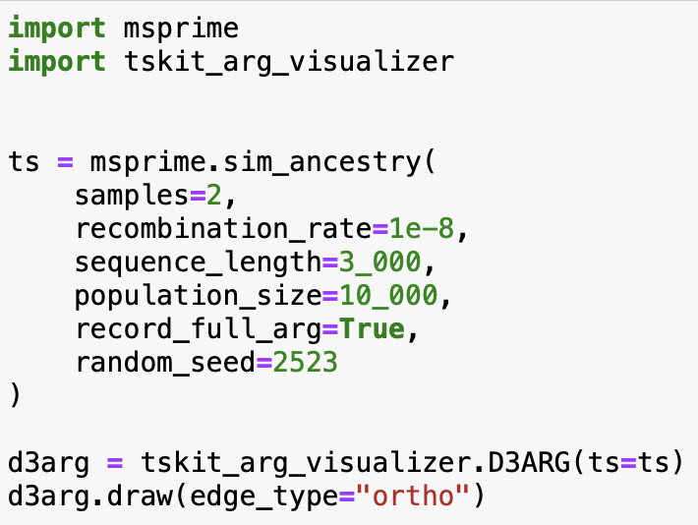

Slide 10
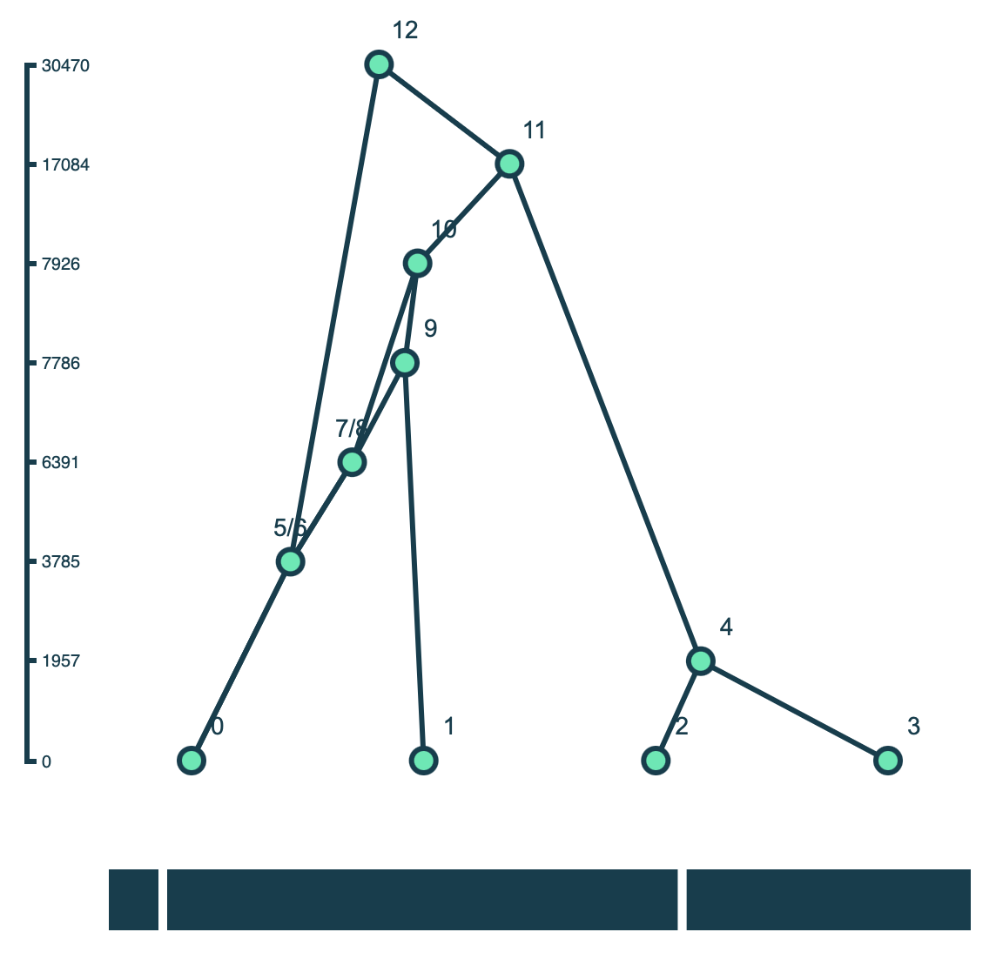
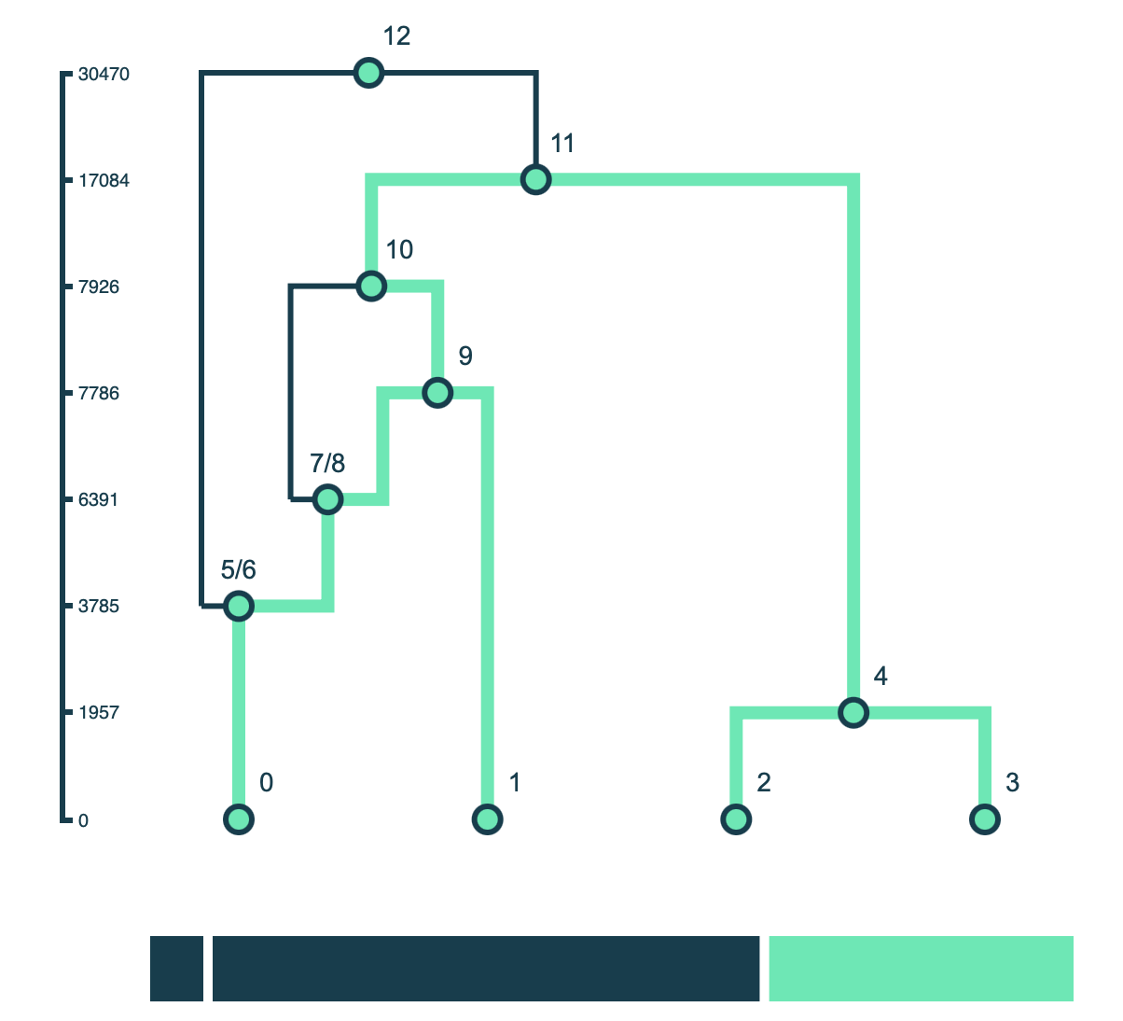
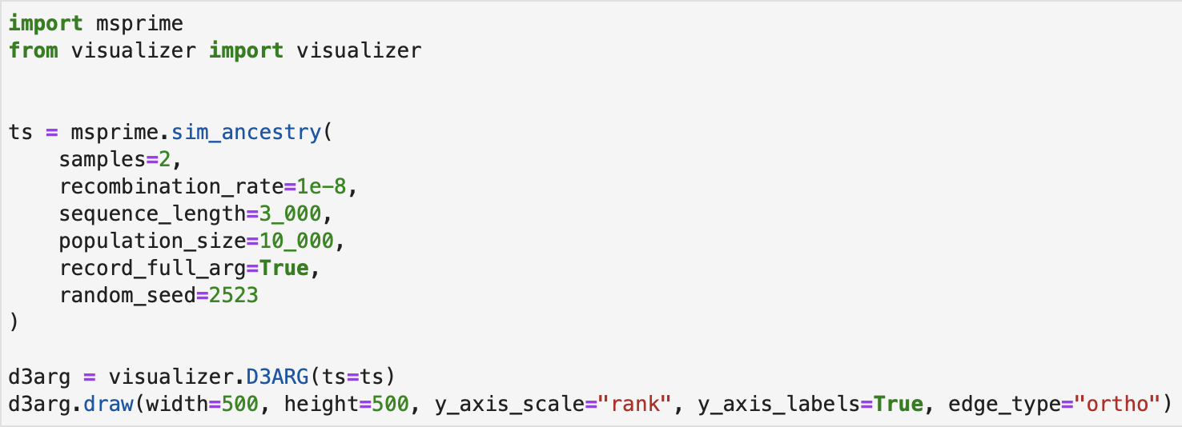

Slide 11
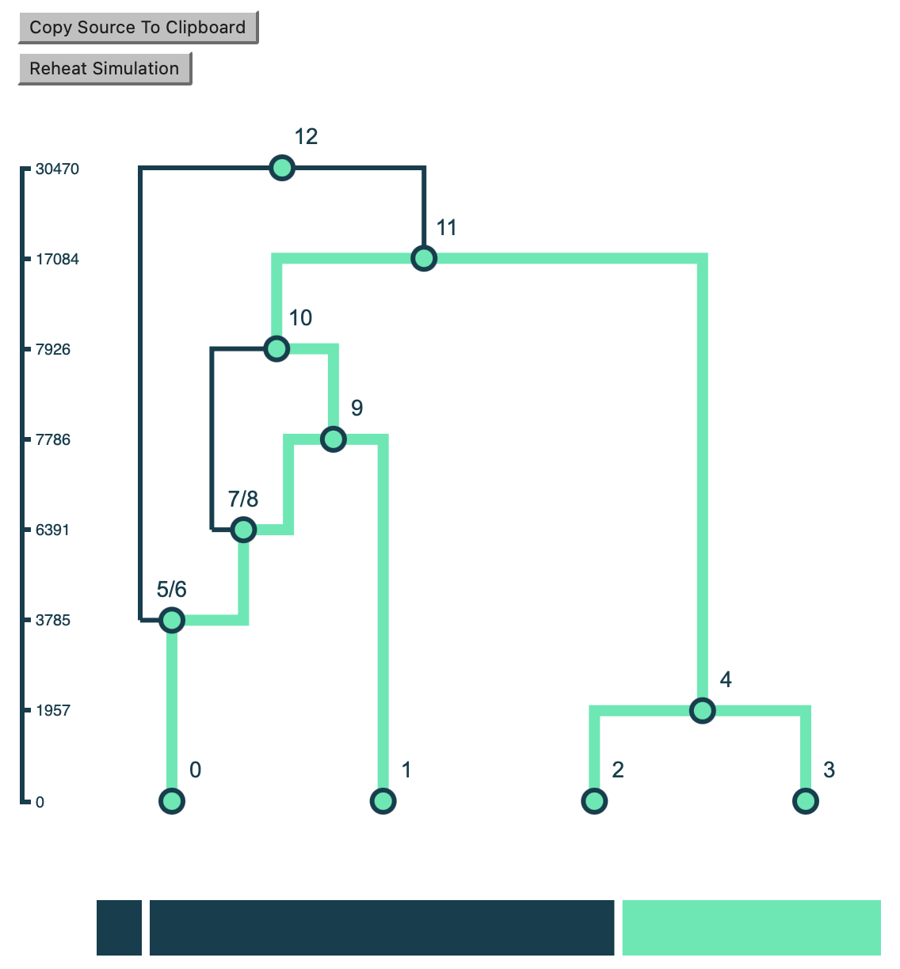
JSON object is updated as the simulation runs, which means this can be copied, giving user’s the ability to replicate figures
EXPERIMENTAL: a node’s position becomes fixed after dragging, this unfixes the x-axis positions of all nodes except the samples
Three options for the y-axis scale: rank, time, and log_time (all nodes have fixed y-axis positions)
Ordering of sample nodes is set by the first tree in the tree sequence (these are the only nodes with fixed x-axis positions at the start)
Hoverable blocks corresponding to the different trees in the tree sequence

Slide 13
Three options for the y-axis scale: rank, time, and log_time

Slide 14
Corresponding recombination nodes have been merged

Slide 15
With `edge_type=“ortho”`, the visualizer uses the flags of the source and target nodes to set the pathing rules
https://github.com/kitchensjn/tskit_arg_visualizer/blob/main/pathing.md

Slide 16
Ordering of sample nodes is set by the first tree in the tree sequence (these are the only nodes with fixed x-axis positions at the start)

Slide 17

All nodes are draggable along the x-axis (nodes have fixed y-axis positions); a node’s position becomes fixed after dragging

Slide 18
Hoverable blocks corresponding to the different trees in the tree sequence

Slide 19
Reheat Simulation (experimental): this unfixes the x-axis positions of all nodes except the samples and allows the simulation to reposition the nodes

Slide 20
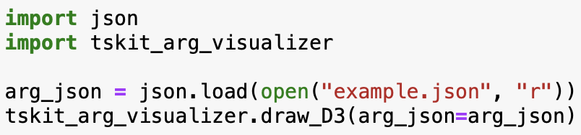
JSON object is updated as the simulation runs, which means this can be copied, giving user’s the ability to replicate figures
Steps to Replicate a Figure
Paste the copied JSON object into a “.json” file and run the following (replacing “example.json” with your file):

Slide 21
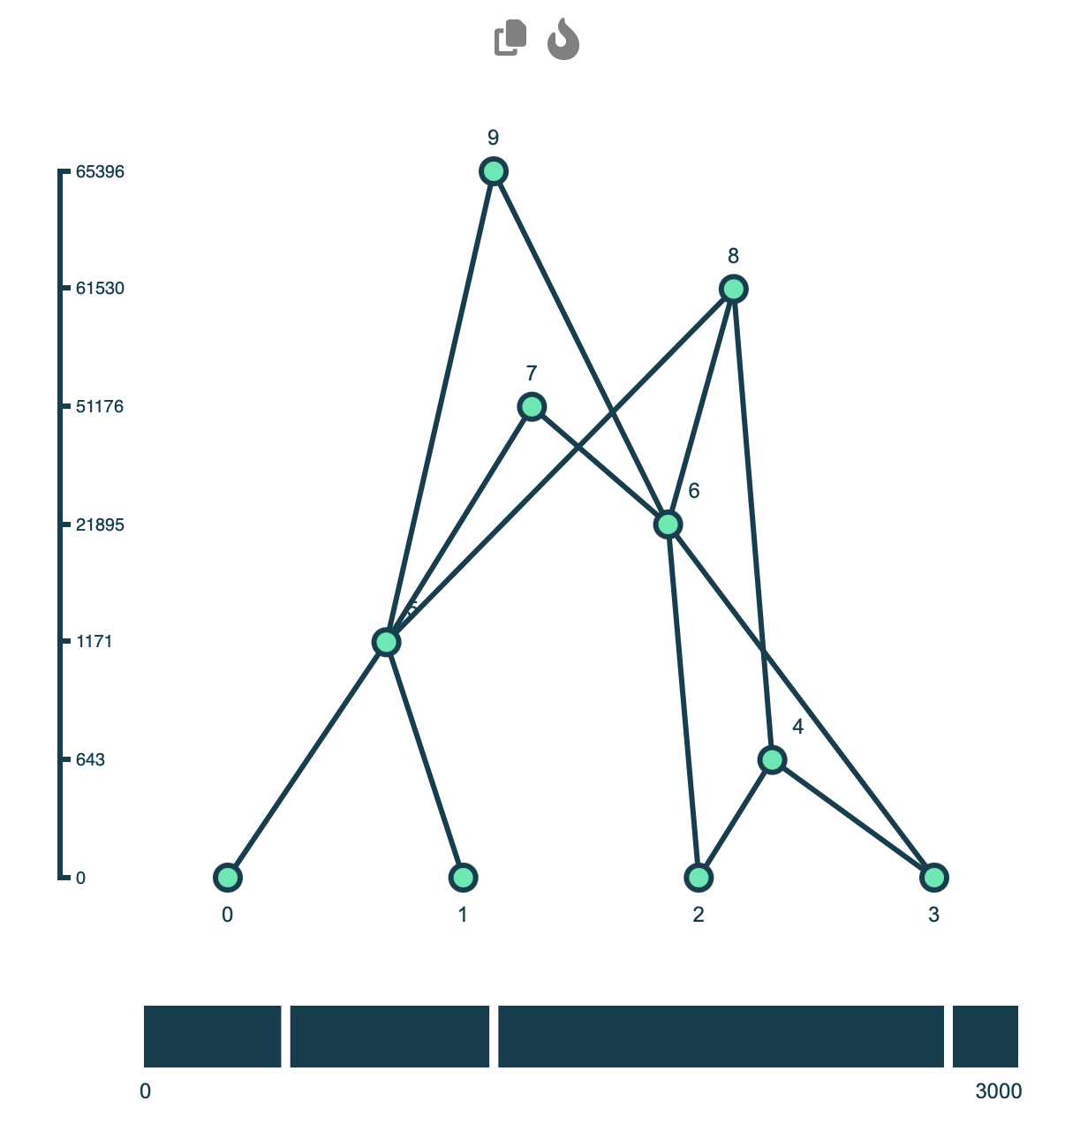
”Simplified” Tree Sequences
Visualizer also works for tree sequences that don’t have marked recombination nodes as long as `edge_type=“line”` (default).
“ortho” edge pathing does not work for that type of tree sequences. All other functionality is the same.

Slide 22
Considerations
Best for smaller ARGs
Node positions will still require fine tuning/untangling, particularly around recombination nodes or if the order of the sample nodes isn’t optimal
“ortho” edge pathing can’t yet handle polytomies; `edge_type=“line”` is better for this
Requires a connection to the internet to load D3.js from a CDN

Slide 23
Feature Requests
Fix pathing for polytomies
Add a collapsible graph option to better show large ARGs through a subset of nodes
Give ability to easily save the figures to SVG or JPG
Display mutations on edges
Automatically position recombination nodes above there children, if applicable
Stylize line crosses for `edge_type=“line”` as they are for “ortho”
https://github.com/kitchensjn/tskit_arg_visualizer/issues

Slide 24
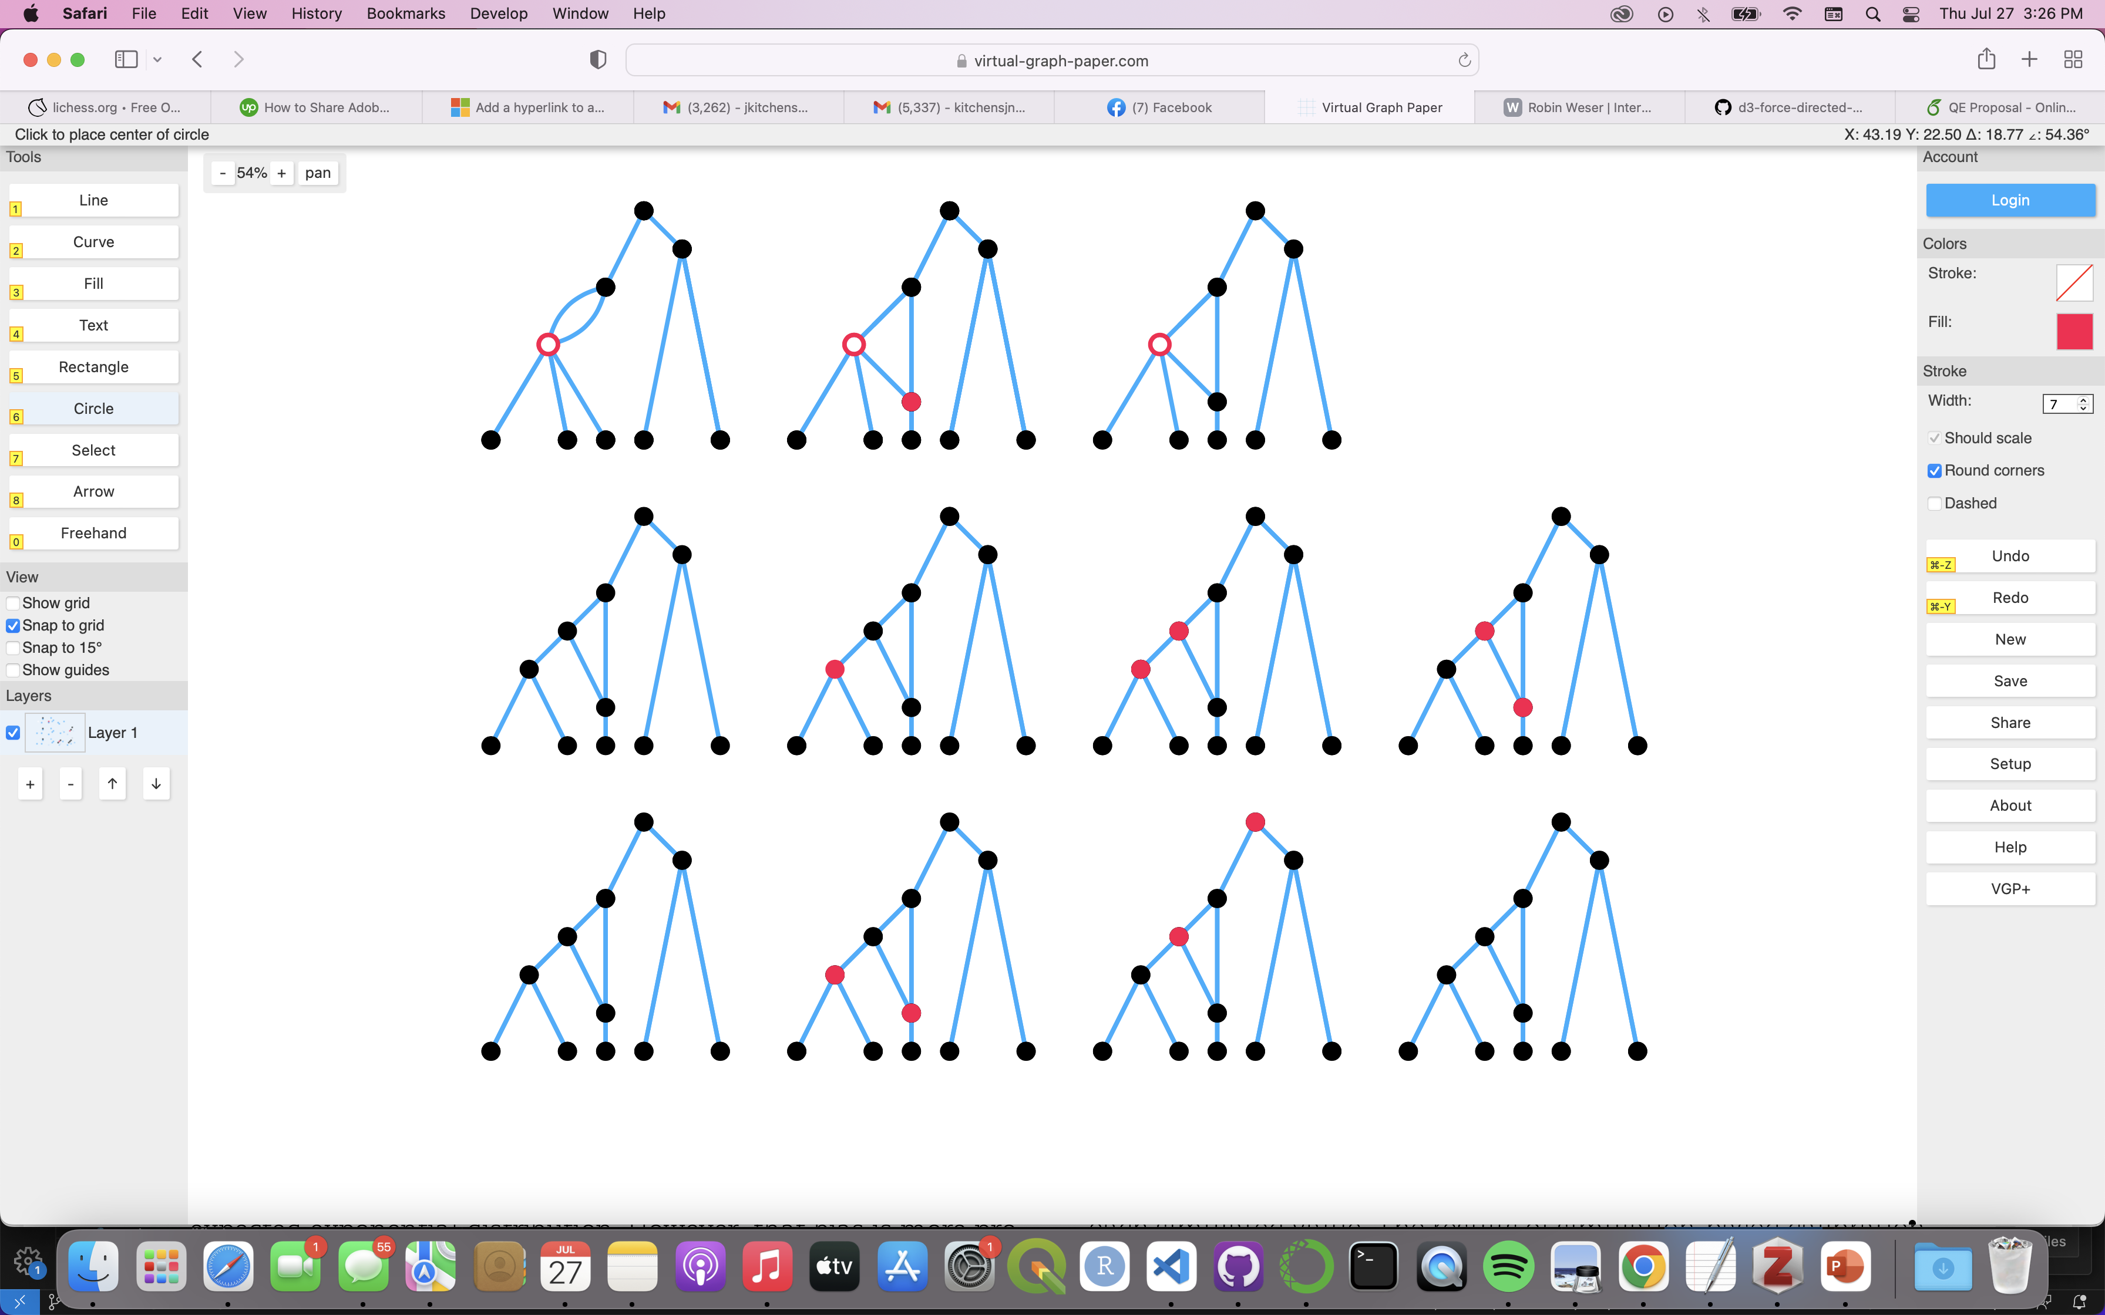
Original ARG
If two neighboring nodes are marked for collapse, they automatically merge.
Collapsed nodes will continue to merge with neighboring nodes that are later marked for collapse.
Nodes can be highlighted for collapse
These nodes are not neighbors and will not merge.

