Slide 2
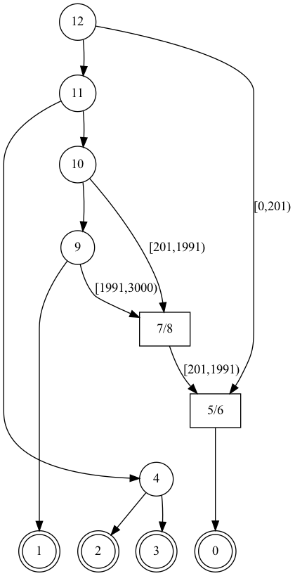
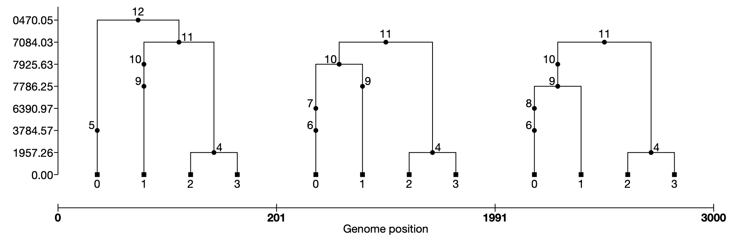
https://tskit.dev/tutorials/viz.html
Visualizations
3
Viewing the Tree Sequence versus Full ARG

Slide 3
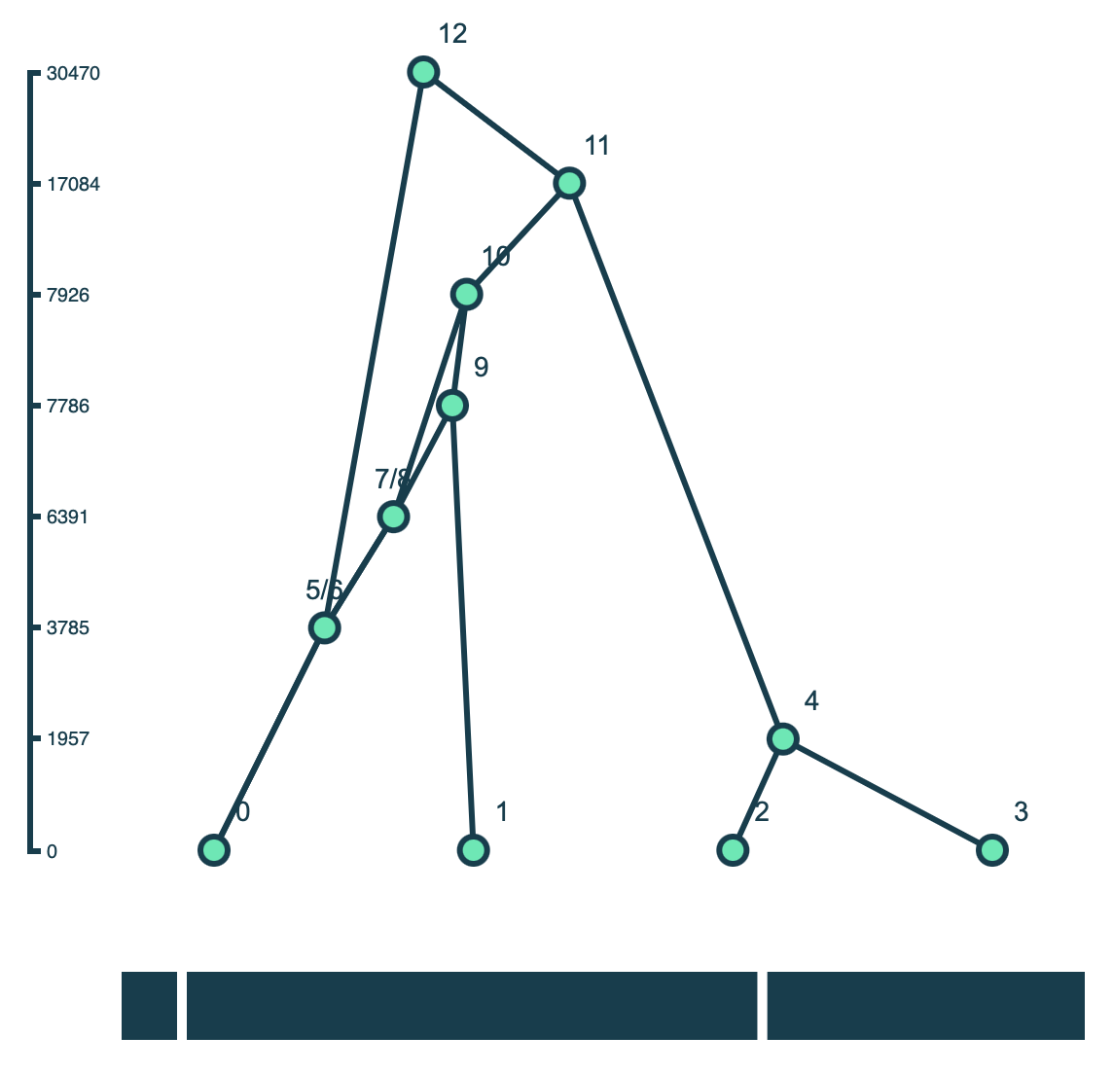
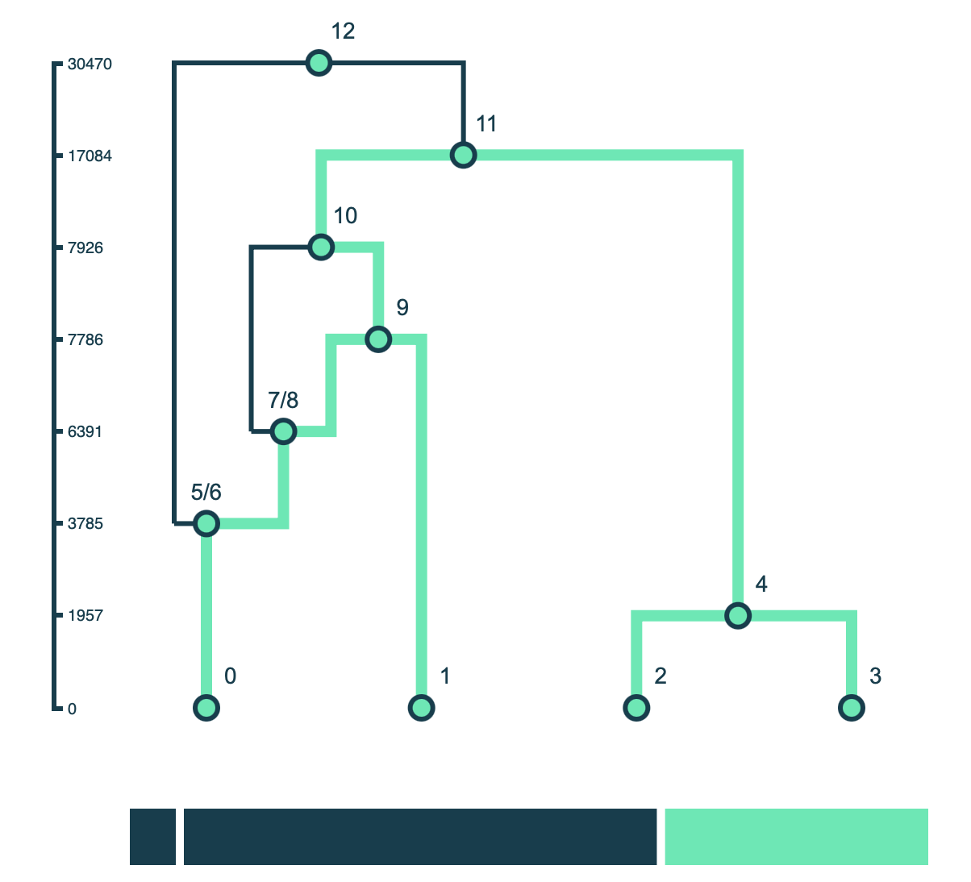

Slide 4




Workflow

Slide 5
Workflow
Styling
Displays the SVG either in a Juptyer Notebook or browser
Using D3.js, creates an SVG from the JSON object
Converts tree sequence to JSON object

