Slide 1

Big Data Topic: Blockchain
Junha Song

Slide 2
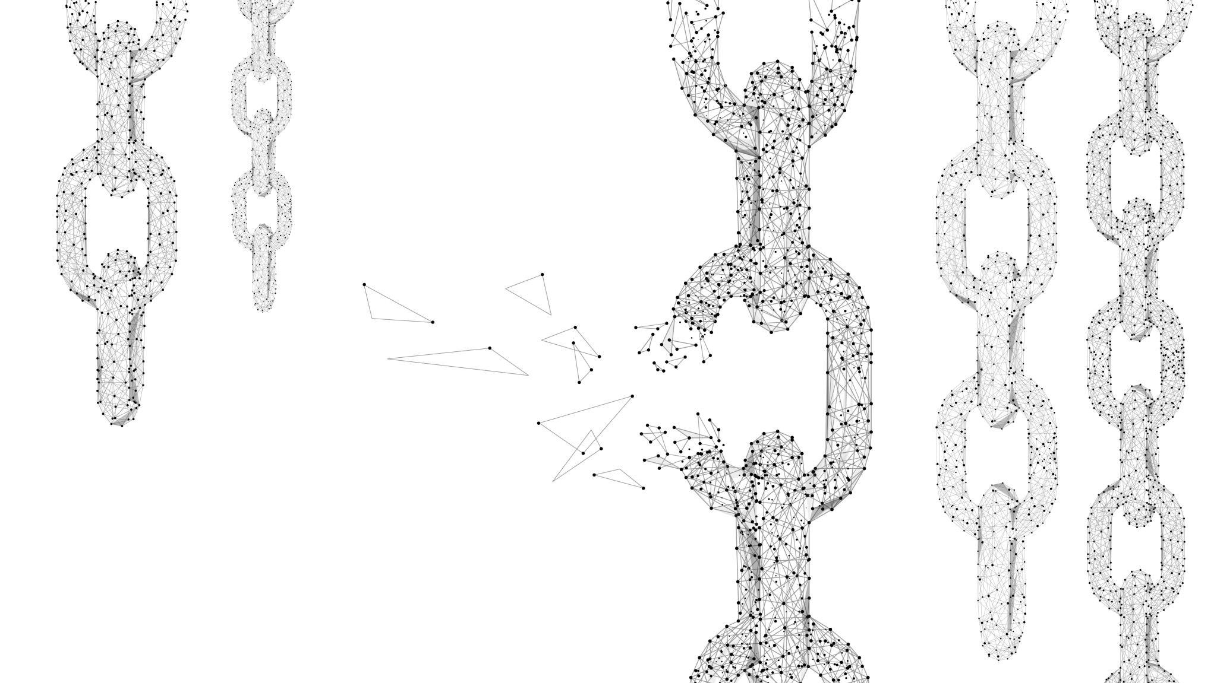
Contents
What is blockchain
How does blockchain work
The relationship between blockchain and big data
Advantages of using blockchain for big data
Problems caused while using blockchain
Business using blockchain with big data
Demo

Slide 3
Definition
A blockchain is a decentralized, distributed, and oftentimes public, digital ledger, consisting of records called blocks that are used to record transactions across many computers so that any involved block cannot be altered retroactively, without the alteration of all subsequent blocks.
https://en.wikipedia.org/wiki/Blockchain

Slide 4
Structure of a blockchain
Block 1
Block 2
Block 3
Data 1
Data 2
Data 3
Previous hash
Previous hash
Previous hash
Current hash
Current hash
Current hash
Timestamp
Timestamp
Timestamp

Slide 5
How are the blocks connected
Block 1
Block 2
Block 3
Data 1
Data 2
Data 3
Previous hash
Previous hash
Hash
Previous hash
Hash
Hash
Current hash
Current hash
Current hash
Timestamp
Timestamp
Timestamp

Slide 6
Hash Verification
1
2
3
4
5
Data: a
Hash: ‘ ’
Data: b
Hash: ‘e2c23eq ’
Data: c
Hash: ‘’23ecwdq’
Data: d
Hash: ‘’rtbf44s’
Data: e
Hash: ‘ be4f5te’
Same
Same
Different
Different
Different
Data: a
Hash: ‘ ’
Data: b
Hash: ‘e2c23eq ’
Manipulated
Data: x
Hash: ‘’34rwze2’
Data: d
Hash: ‘’23rf34e’
Data: e
Hash: ’32r35ec ’

Slide 7

The relationship between blockchain and big data
Blockchain =
Decentralized database
Because…
A block can include data
Blockchain is a decentralized digital ledger

Slide 8

Advantages of using blockchain for big data
Blockchain-based Big Data is secure and clean
The data in the blockchain can’t be forged. Because adding a block needs always a verification of the whole blocks from multiple users
As the same reason, blockchain can help address problems such as human error, data duplication, and false information often encountered when dealing with huge volumes of data

Slide 9
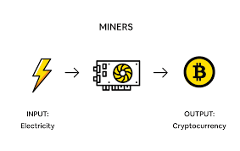
Problems caused while using blockchain

Slide 10
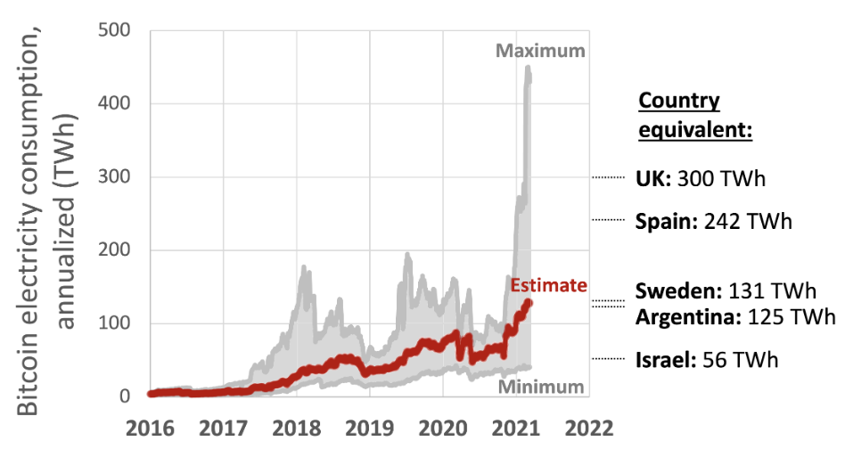
Problems caused while using blockchain

Slide 11
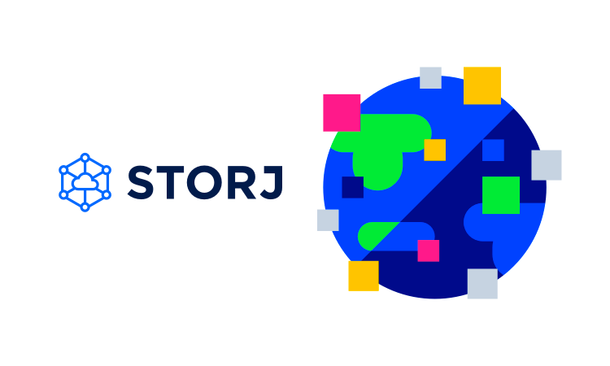
Storj
Storj is a decentralized cloud storage which uses the excess capacity hard drives and bandwidth around the world.

Slide 12
Demo
https://github.com/hybgah/blockchain-database

