Slide 1
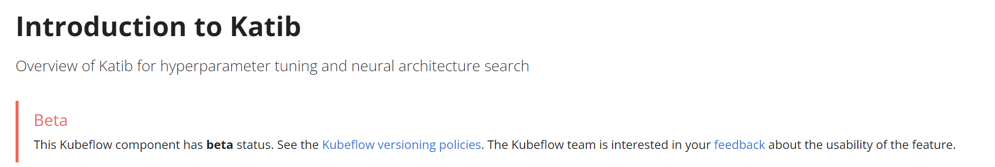
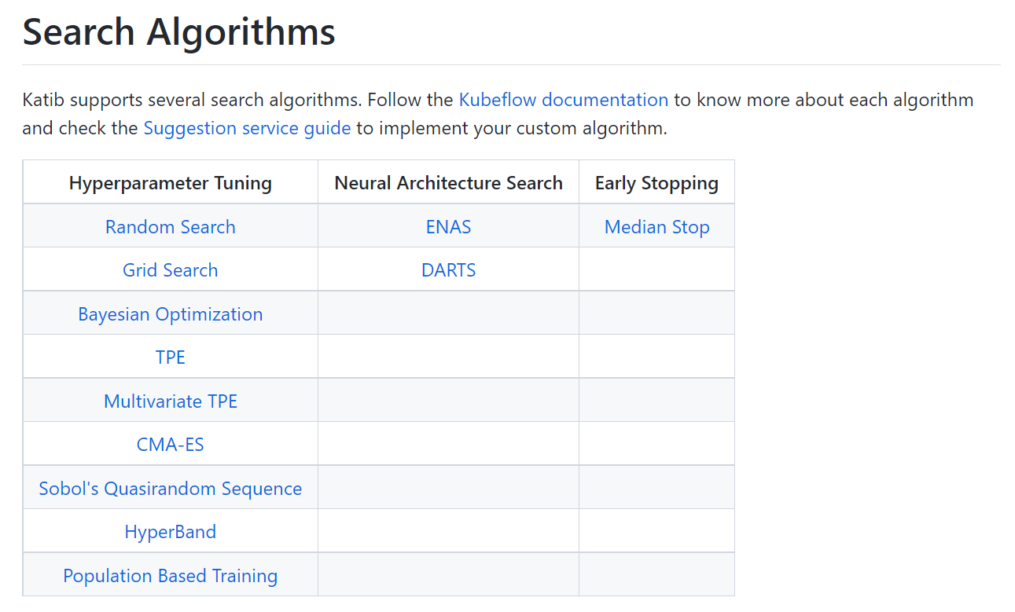
Katib hyperparameters tuning
Support from the Kubeflow community
https://github.com/kubeflow/katib

Slide 2
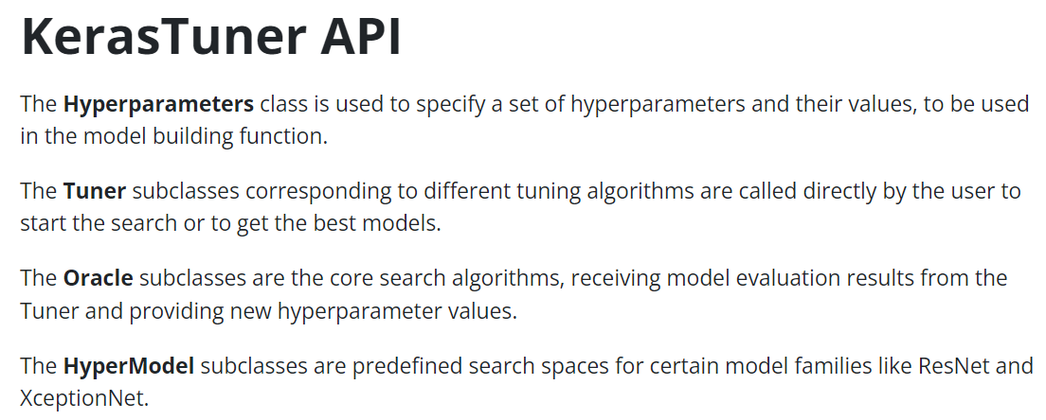
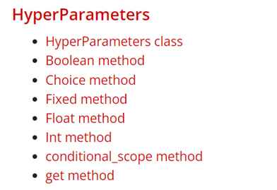
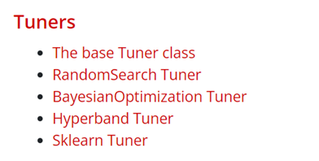
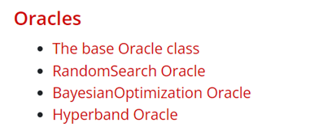
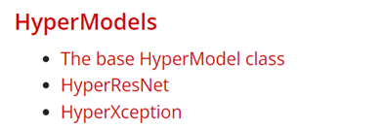
KerasTuner hyperparameters tuning
https://keras.io/api/keras_tuner/

Slide 3





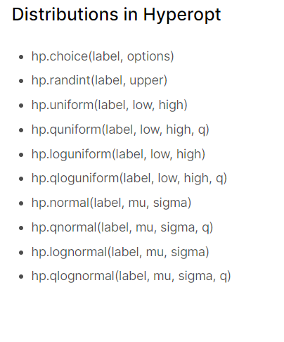




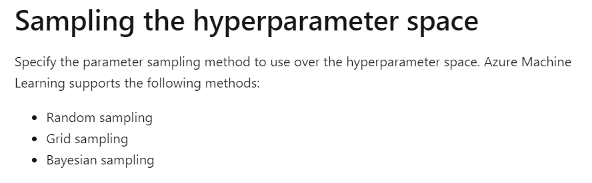
Azure hyperparameters tuning
Bayesian Optimization
HyperOpt
Distributed Asynchronous Hyper-parameter Optimization
https://learn.microsoft.com/en-us/azure/machine-learning/how-to-tune-hyperparameters#sampling-the-hyperparameter-space

Slide 4
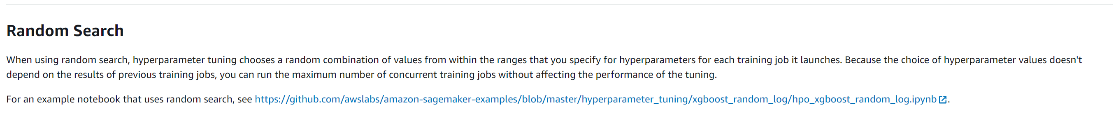
AWS hyperparameters tuning
Amazon SageMaker
https://docs.aws.amazon.com/sagemaker/latest/dg/automatic-model-tuning-how-it-works.html

Slide 5
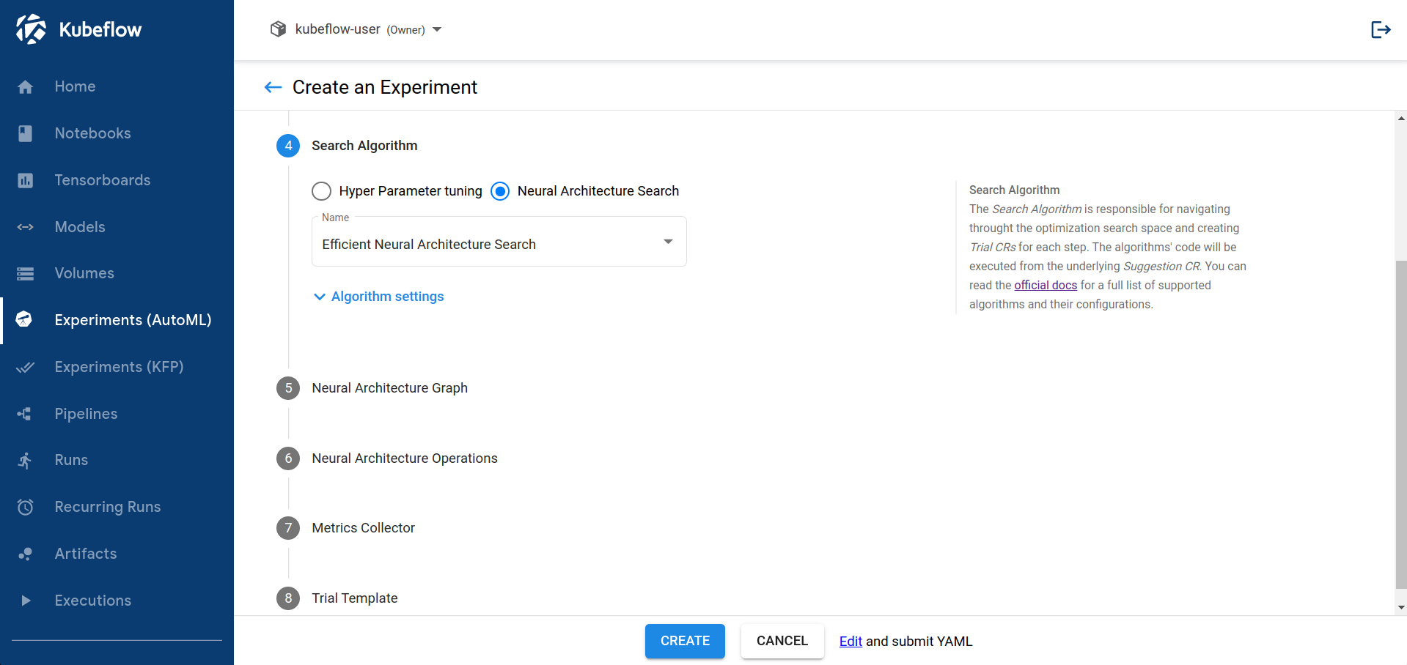
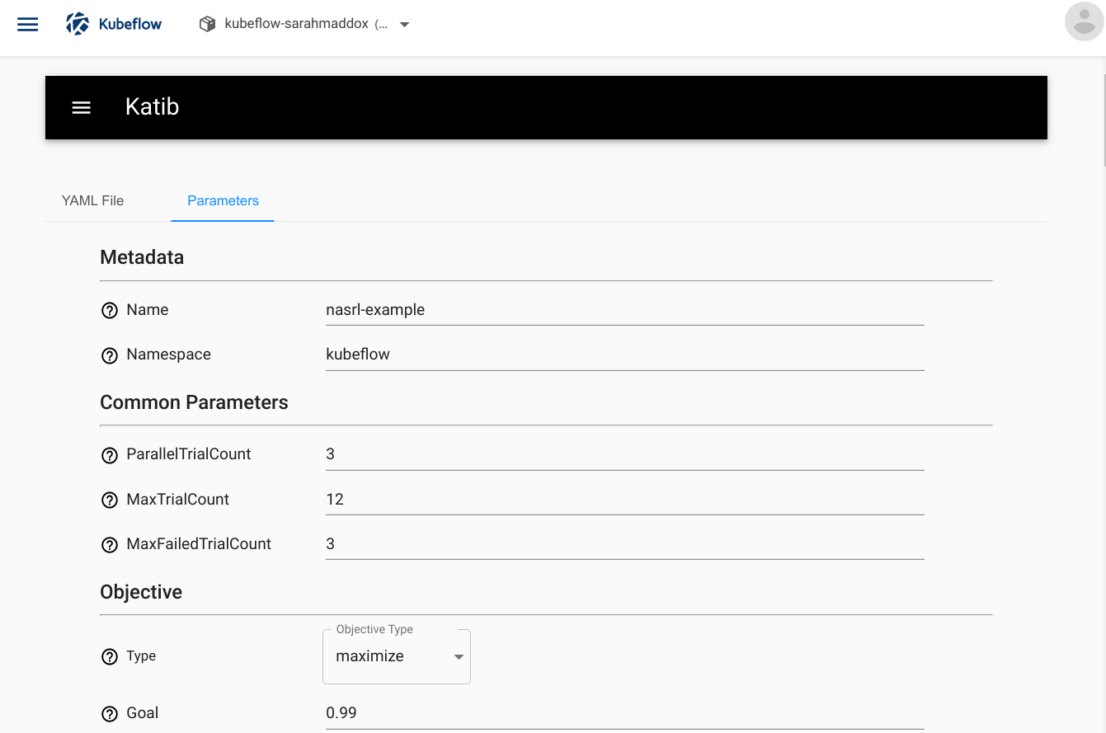
Introduction to Katib
https://v0-7.kubeflow.org/docs/components/hyperparameter-tuning/overview/

