Slide 1

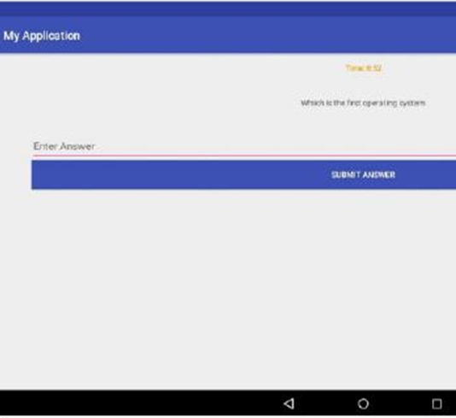

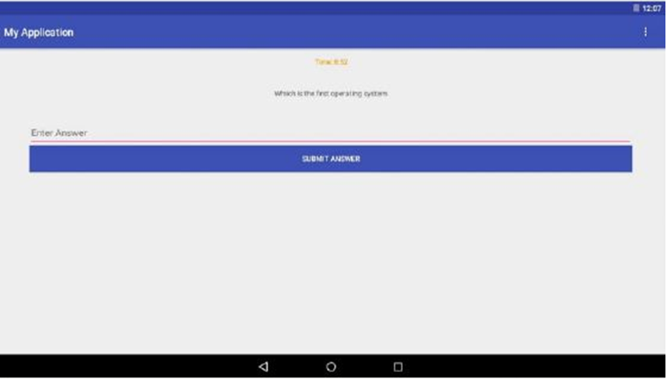
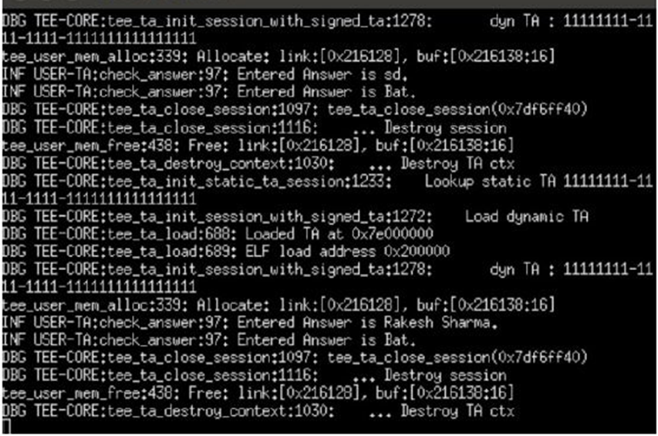
Using Trusted Execution Environments to Enable Integrity of Offline Test Taking
Rahul Mahadev Department of ISE PES Institute of Technology rahul.mahadev7@gmail.com | Arvind Seshadri IBM Research asesdri@gmail.com | Sriram Rajamani Microsoft Research sriram@microsoft.com | Viraj Kumar Department of CSE PES University viraj.kumar@pes.edu
`
Abstract
Some online course platforms assist learners with unreliable internet by making content downloadable.
However, MOOCs/SPOCs typically require learners to be online for high-stakes assessments (quizzes/assignments). Authenticated learners must upload solutions to a server, where they are evaluated, and scores/feedback is given.
This places some learners at a disadvantage, and also puts a high load on the server (for some types of assessment).
We address both problems with a prototype Android quiz app that allows secure, offline evaluation on learner devices.
Quiz solutions are stored and evaluated in a secure enclave, and they are inaccessible even to learners with root-level access on their own devices.
System Architecture
Normal world
Secure world
Encrypted Questions/Answers
Quiz
evaluation
system
TCP Channel
Secure Server
Encrypted Scores
Quiz front end
(GUI)
Encrypted
Scores
Learner
Input
Encrypted Q&A
Decrypt Q&A
Learner
Input
Encrypted
Scores
Android Library
Driver process
OP-TEE library
Android Kernel
OP-TEE OS
OPTEE kernel module
For Images,
it should be at least 150dpi,
i.e. for 35cm width image,
The width is about 2067 pixels
ARM-based SoC with ARM TrustZone
Learner’s device
Limitations
The current model is unable to transfer cryptographic keys between the server and the learner’s device.
The keys are hard coded in the secure world, so the Quiz app has to be shipped with the trusted OS.
Screenshots

