Slide 1
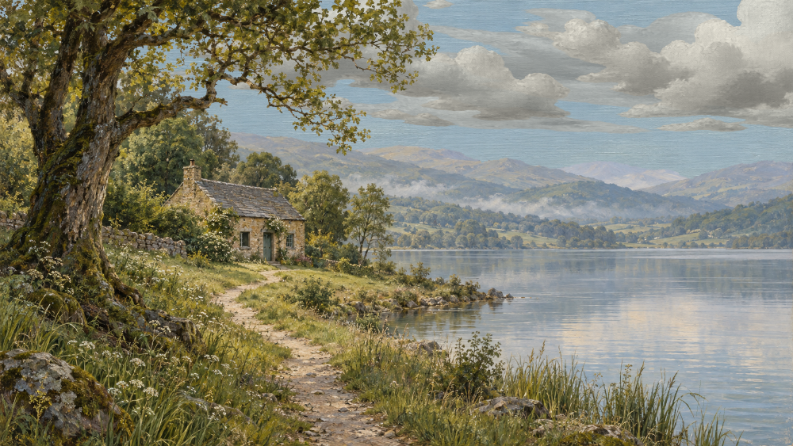
a view.
Keep
this view
A personal memory of
a shared, living world
Feature storyboard
Proposal for the next release
22 October 2026
Notes:
Feature selection follows the explicit recommendation after field notes in ENGAGEMENT_PLAN.md. The current Git checkout includes merged field notes at 89aa6ff. This deck proposes a first release and does not imply implementation or deployment.
Source context: C:/Users/brian/source/theplaces.online/ENGAGEMENT_PLAN.md (Keep this view recommendation), C:/Users/brian/source/theplaces.online/README.md (implemented scope), C:/Users/brian/source/theplaces.online/public/index.html and public/style.css (existing controls and visual language). All Keep this view screens and behavior are proposals. Scene dates and personal notes are illustrative, not records of the source frame. Existing generated painting provenance: C:/Users/brian/source/theplaces.online/ARTWORK.md. Background captures: C:/Users/brian/source/theplaces.online/docs/engagement-validation/README.md. Captures predate celestial motion and field notes; they serve as storyboard backgrounds, not evidence of the latest renderer.

Slide 2
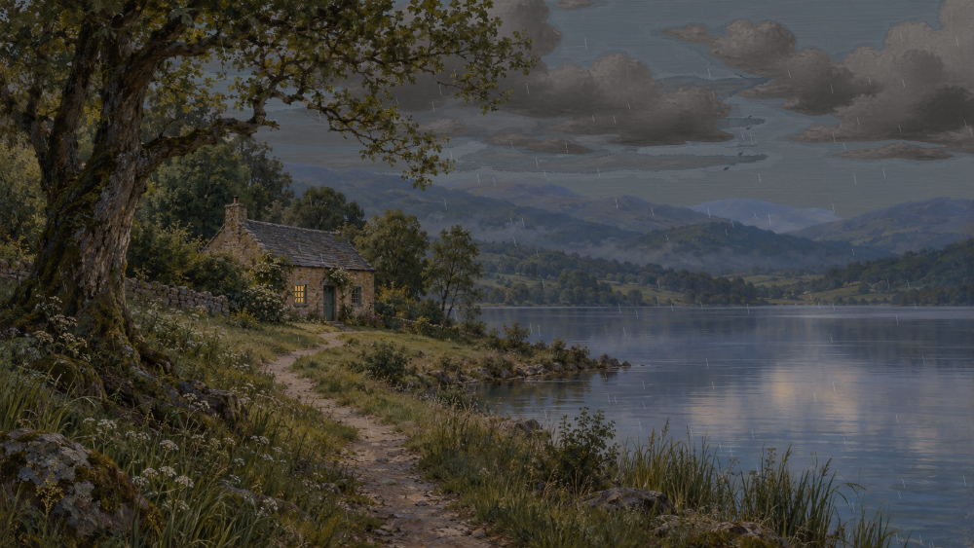
A moment worth keeping
The next small addition after field notes
The place already carries history
Weather leaves traces. The cottage has a routine. The familiar bird returns. Field notes recall committed changes.
This feature adds a personal record
A visitor can keep the light, weather, and framing that caught their eye.
“I want to remember this evening.”
Notice Capture Add a note Download
A VIEW / PROPOSED FEATURE STORYBOARD
02
Notes:
The first paragraph summarizes implemented behaviors listed in README.md. The visitor quote is an illustrative user intention. The proposed release is an image download with an optional personal note, with no changes to shared history.
Source context: C:/Users/brian/source/theplaces.online/ENGAGEMENT_PLAN.md (Keep this view recommendation), C:/Users/brian/source/theplaces.online/README.md (implemented scope), C:/Users/brian/source/theplaces.online/public/index.html and public/style.css (existing controls and visual language). All Keep this view screens and behavior are proposals. Scene dates and personal notes are illustrative, not records of the source frame. Existing generated painting provenance: C:/Users/brian/source/theplaces.online/ARTWORK.md. Background captures: C:/Users/brian/source/theplaces.online/docs/engagement-validation/README.md. Captures predate celestial motion and field notes; they serve as storyboard backgrounds, not evidence of the latest renderer.

Slide 3
01 A visitor notices the light
The action appears with the existing view controls
a view.
Other places
VISITOR
A SHARED, LIVING WORLD
“That window just caught my eye.”
They reveal the controls and choose Keep this view.
STILLWATER VALLEY
The Lakeside Cottage
No prompt interrupts the visit. The control follows the existing fade and keyboard behavior.
Follow
Field notes
Keep this view
♪
Spring Passing rain 19:15
A VIEW / PROPOSED FEATURE STORYBOARD
03
Notes:
New button proposed after Field notes, before sound, pause, and fullscreen. It participates in existing chrome visibility rules and has an accessible name. The line about a window is the fictional visitor’s observation, not an automatically generated factual claim. The depicted capture uses an existing rainy-dusk test frame.
Source context: C:/Users/brian/source/theplaces.online/ENGAGEMENT_PLAN.md (Keep this view recommendation), C:/Users/brian/source/theplaces.online/README.md (implemented scope), C:/Users/brian/source/theplaces.online/public/index.html and public/style.css (existing controls and visual language). All Keep this view screens and behavior are proposals. Scene dates and personal notes are illustrative, not records of the source frame. Existing generated painting provenance: C:/Users/brian/source/theplaces.online/ARTWORK.md. Background captures: C:/Users/brian/source/theplaces.online/docs/engagement-validation/README.md. Captures predate celestial motion and field notes; they serve as storyboard backgrounds, not evidence of the latest renderer.

Slide 4
02 The moment stays while a note takes shape
The preview and its date belong to the same displayed frame
RESPONSE
Keep this view
×
A held preview, ready to keep
The Lakeside Cottage
Stillwater Valley
Year 2 / Day 135 / 19:15
Live view
The visitor can add a short note or leave the field empty. Download image is the only primary action.
Your view is held here. The world carries on.
A note to remember it by (optional)
Rain on the lake. A light in the window.
Download image
Closing the dialog returns to the previous viewing mode. A note never changes field notes or world history.
Cancel
A VIEW / PROPOSED FEATURE STORYBOARD
04
Notes:
Capture intent: acquire pixels and metadata atomically from one completed displayed render, at activation or the next complete frame if necessary. Do not re-sample live time when the note changes or download begins. Freeze the capture buffer, crop/pan, calendar and mode together. The shared world continues independently. Proposed optional note maximum: 160 characters, visible counter and accessible validation in implementation. Keep note in memory for the dialog only; add only visitor-entered text, without generated prose. Date values are illustrative.
Source context: C:/Users/brian/source/theplaces.online/ENGAGEMENT_PLAN.md (Keep this view recommendation), C:/Users/brian/source/theplaces.online/README.md (implemented scope), C:/Users/brian/source/theplaces.online/public/index.html and public/style.css (existing controls and visual language). All Keep this view screens and behavior are proposals. Scene dates and personal notes are illustrative, not records of the source frame. Existing generated painting provenance: C:/Users/brian/source/theplaces.online/ARTWORK.md. Background captures: C:/Users/brian/source/theplaces.online/docs/engagement-validation/README.md. Captures predate celestial motion and field notes; they serve as storyboard backgrounds, not evidence of the latest renderer.

Slide 5
03 A small keepsake leaves the page
One PNG with a clean painting and a quiet caption beneath it
RESULT
The picture matches the preview
The image keeps the visitor’s framing. The caption records the place, world date, view mode, and optional note.
The Lakeside Cottage
Controls and dialogs stay out of the image. The caption sits outside the painted area.
Stillwater Valley / Year 2, Day 135, 19:15 / Live view
Rain on the lake. A light in the window.
A VIEW / PROPOSED FEATURE STORYBOARD
05
Notes:
Proposed first format: one PNG postcard. Preserve the full captured viewport aspect ratio inside the postcard, with a caption below rather than over the artwork. The preview omits transient controls but preserves actual rendered layers, framing and display modes. Example file name: lakeside-cottage-year-2-day-135-1915-live.png. Use real capture timestamp internally to disambiguate repeated filenames. The chosen caption is part of the proposal, not an existing export implementation.
Source context: C:/Users/brian/source/theplaces.online/ENGAGEMENT_PLAN.md (Keep this view recommendation), C:/Users/brian/source/theplaces.online/README.md (implemented scope), C:/Users/brian/source/theplaces.online/public/index.html and public/style.css (existing controls and visual language). All Keep this view screens and behavior are proposals. Scene dates and personal notes are illustrative, not records of the source frame. Existing generated painting provenance: C:/Users/brian/source/theplaces.online/ARTWORK.md. Background captures: C:/Users/brian/source/theplaces.online/docs/engagement-validation/README.md. Captures predate celestial motion and field notes; they serve as storyboard backgrounds, not evidence of the latest renderer.

Slide 6
04 The visit continues
A brief acknowledgement, then the painting fills the attention again
a view.
Other places
AFTER DOWNLOAD
A SHARED, LIVING WORLD
Back to the shared present
The app starts the download, closes the dialog, and returns focus to Keep this view.
Download started
STILLWATER VALLEY
The Lakeside Cottage
The message says “Download started.” The app does not claim that the file reached the device.
Follow
Field notes
Keep this view
♪
Spring Passing rain 19:15
A VIEW / PROPOSED FEATURE STORYBOARD
06
Notes:
For an initially live visit, return to the current shared present, allowing time elapsed during note writing. Restore an initially paused or private-study mode unchanged. Announce status once through the existing polite status region. Do not enable sound, set follows, mark field-note milestones as read, or trigger world actions. Restore the normal chrome idle behavior after focus moves away. If a browser opens the image instead of downloading, use the fallback described on slide 9.
Source context: C:/Users/brian/source/theplaces.online/ENGAGEMENT_PLAN.md (Keep this view recommendation), C:/Users/brian/source/theplaces.online/README.md (implemented scope), C:/Users/brian/source/theplaces.online/public/index.html and public/style.css (existing controls and visual language). All Keep this view screens and behavior are proposals. Scene dates and personal notes are illustrative, not records of the source frame. Existing generated painting provenance: C:/Users/brian/source/theplaces.online/ARTWORK.md. Background captures: C:/Users/brian/source/theplaces.online/docs/engagement-validation/README.md. Captures predate celestial motion and field notes; they serve as storyboard backgrounds, not evidence of the latest renderer.

Slide 7
05 A phone keeps the view the visitor framed
The export preserves the current pan and portrait crop
a view.
The crop stays personal
Keep this view
×
The Lakeside
Cottage
Panning changes what the visitor keeps. The download uses that same crop.
Year 2
Day 135
15:30
Live view
The dialog fits the screen
Note (optional)
A quiet afternoon.
Large touch targets. A scrollable note area when the keyboard opens. Clear download and close actions.
The Lakeside
Cottage
Download image
Keep this view
Current view
Capture dialog
A VIEW / PROPOSED FEATURE STORYBOARD
07
Notes:
Mobile illustration preserves an authored crop of the existing daytime painting; it is a concept, not a measured screenshot of a proposed implementation. Existing mobile toolbar is already tight, so implementation should retain all current controls through a second row or a compact labeled Keep action, and verify at 320, 390 and 800 CSS pixels. Minimum 44 CSS-pixel interactive targets. Dialog must retain a visible close action, label the textarea, trap focus, support Escape and return focus to the entry control. Preserve pan at capture even if resizing occurs afterward.
Source context: C:/Users/brian/source/theplaces.online/ENGAGEMENT_PLAN.md (Keep this view recommendation), C:/Users/brian/source/theplaces.online/README.md (implemented scope), C:/Users/brian/source/theplaces.online/public/index.html and public/style.css (existing controls and visual language). All Keep this view screens and behavior are proposals. Scene dates and personal notes are illustrative, not records of the source frame. Existing generated painting provenance: C:/Users/brian/source/theplaces.online/ARTWORK.md. Background captures: C:/Users/brian/source/theplaces.online/docs/engagement-validation/README.md. Captures predate celestial motion and field notes; they serve as storyboard backgrounds, not evidence of the latest renderer.

Slide 8
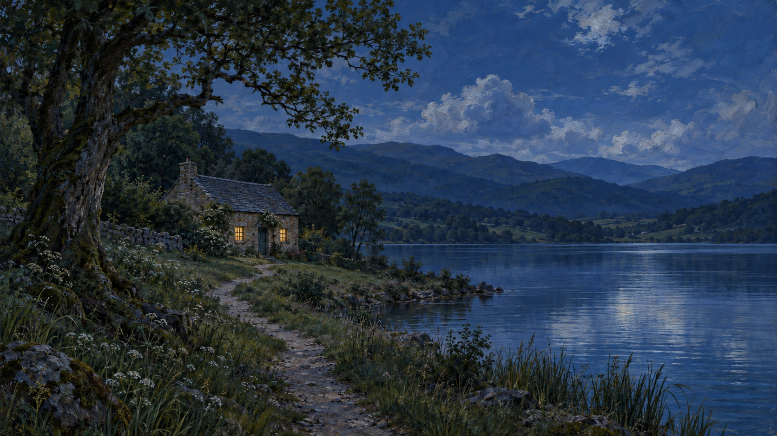
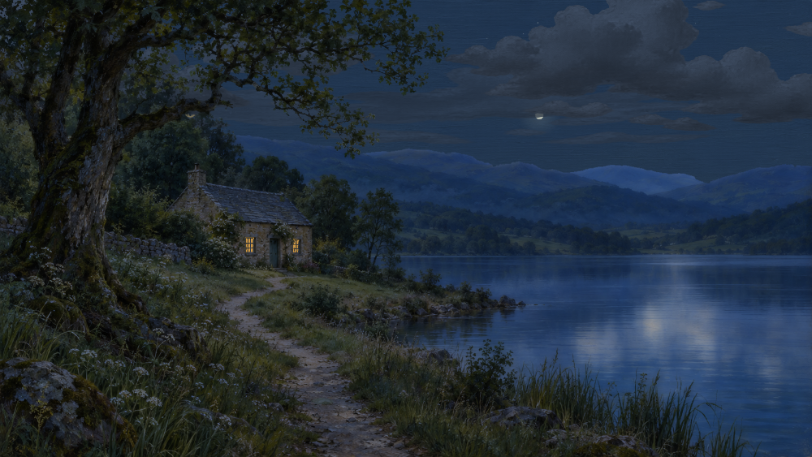
Every keepsake says what kind of view it is
The card describes the captured state, including combinations of modes
Live view
Paused view
A moment from the shared world.
The world date matches the capture.
The already-held moment.
The date stays at the paused time.
Private light study: Night
Connection lost / Last displayed view
A private lighting choice.
No claim of a live shared event.
The held view remains available.
The label never presents it as live.
A visible static fallback carries a “Static painting” qualifier. Reduced motion preserves the pose on screen.
A VIEW / PROPOSED FEATURE STORYBOARD
08
Notes:
Existing modes are evidenced in public/app.js, public/painting.js and README.md. Proposed capture labeling should use independent fields so combinations such as private study plus paused, or disconnected plus static fallback, cannot silently lose a qualifier. For a study, label the selected light explicitly and treat its displayed date/time as study context, never as a historical observation. When no world snapshot has loaded, a static image may be saved only with a Static painting label and no invented world date. Reduced-motion geometry must use the already held pose, not a newly sampled animation frame.
Source context: C:/Users/brian/source/theplaces.online/ENGAGEMENT_PLAN.md (Keep this view recommendation), C:/Users/brian/source/theplaces.online/README.md (implemented scope), C:/Users/brian/source/theplaces.online/public/index.html and public/style.css (existing controls and visual language). All Keep this view screens and behavior are proposals. Scene dates and personal notes are illustrative, not records of the source frame. Existing generated painting provenance: C:/Users/brian/source/theplaces.online/ARTWORK.md. Background captures: C:/Users/brian/source/theplaces.online/docs/engagement-validation/README.md. Captures predate celestial motion and field notes; they serve as storyboard backgrounds, not evidence of the latest renderer.

Slide 9
A failed download keeps the moment within reach
The preview and personal note remain available for another attempt
RECOVERY
Keep this view
×
No silent loss of the note
The Lakeside Cottage
Stillwater Valley
Year 2 / Day 135 / 19:15
Live view
A failed export keeps the dialog open. Try download again uses the same captured image and text.
Your view is held here. The world carries on.
A note to remember it by (optional)
Rain on the lake. A light in the window.
The download could not start. Your view is still here.
If direct download is unavailable, Open image offers the browser’s own save controls.
Close
Try download again
A VIEW / PROPOSED FEATURE STORYBOARD
09
Notes:
Distinguish two failures. If capture itself fails before a complete image exists, explain that the app could not prepare this view and offer Try capture again or Cancel; do not display a fabricated preview. Recapture is explicit and can represent a new moment. If encoding or download preparation fails after capture, retain immutable pixels, caption and note for retry. Do not announce successful file saving from anchor activation. Offer Open image only after a valid image exists. Browser-specific download/save behavior requires implementation validation on desktop and mobile browsers. These are proposed product requirements, not verified platform compatibility claims.
Source context: C:/Users/brian/source/theplaces.online/ENGAGEMENT_PLAN.md (Keep this view recommendation), C:/Users/brian/source/theplaces.online/README.md (implemented scope), C:/Users/brian/source/theplaces.online/public/index.html and public/style.css (existing controls and visual language). All Keep this view screens and behavior are proposals. Scene dates and personal notes are illustrative, not records of the source frame. Existing generated painting provenance: C:/Users/brian/source/theplaces.online/ARTWORK.md. Background captures: C:/Users/brian/source/theplaces.online/docs/engagement-validation/README.md. Captures predate celestial motion and field notes; they serve as storyboard backgrounds, not evidence of the latest renderer.

Slide 10
The first release has a narrow finish line
A capture, an optional note, and one downloadable image
1
2
3
The image is faithful
The flow stays quiet
The moment survives errors
One completed displayed frame
Matching crop, layers, and time
Honest mode and fallback labels
Existing control placement
One optional personal note
Download, close, and return focus
Capture stays fixed during edits
Retry retains image and note
Mobile and keyboard completion
Later options
A saved-view gallery, cloud sync, sharing links, and alternate export formats.
A VIEW / PROPOSED FEATURE STORYBOARD
10
Notes:
Proposed build sequence: first a renderer capture pilot that composites actual visible WebGL painting or fallback image with the life canvas and intended scene shading, at the same completed render and current crop. Then an accessible dialog, note validation, PNG caption composition and browser download. Finally mode/failure coverage and visual comparison across wide and narrow views. Verify a known completed frame against the export, including bird, smoke, rain and foliage layers; ensure no UI or dialogs enter the export. Check live, paused, reduced motion, light study, reconnect and static fallback, including combined modes and resizing. Keep the shared simulation, database and field-note history unchanged. Scope is a recommendation for review, not an implemented feature.
Source context: C:/Users/brian/source/theplaces.online/ENGAGEMENT_PLAN.md (Keep this view recommendation), C:/Users/brian/source/theplaces.online/README.md (implemented scope), C:/Users/brian/source/theplaces.online/public/index.html and public/style.css (existing controls and visual language). All Keep this view screens and behavior are proposals. Scene dates and personal notes are illustrative, not records of the source frame. Existing generated painting provenance: C:/Users/brian/source/theplaces.online/ARTWORK.md. Background captures: C:/Users/brian/source/theplaces.online/docs/engagement-validation/README.md. Captures predate celestial motion and field notes; they serve as storyboard backgrounds, not evidence of the latest renderer.

