Slide 1




ReviewerNet
A visualization tool for scholarly data
April 2019
Mario Leonardo Salinas, Paolo Cignoni, Daniela Giorgi, Federico Ponchio
1. University of Pisa m.salinas@studenti.unipi.it
2. ISTI VC-Lab, CNR Pisa
1 2 2 2
ReviewerNet.org

Slide 2
Problem
reviewer finding by journal editors and IPC members:
  Identify research communities by searching the literature
  Look for active experts with good topic coverage
  Check conflict of interest and distribution of candidate in the community

Slide 3
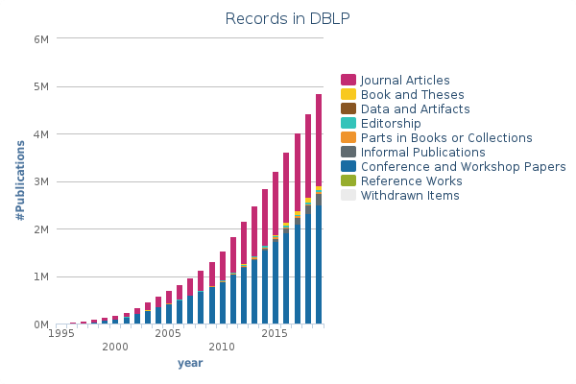
Introduction
The number of academic uploaded documents grows very fast
The volume, variety and velocity generated satisfies the big data definition
More automation needed

Slide 4
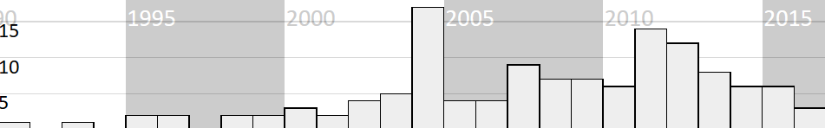
Related Work
More than 100 visual approaches for document collections proposed in the last 10 years
Most of the works focused on static visualization
Number of visual approaches papers per publication year [FED17]
[FED17] Paolo Federico, Florian Heimerl, Steffen Koch, and Silvia Miksch. “A Survey on Visual Approaches for Analyzing Scientific Literature and Patents”.
In: IEEE Transactions on Visualization and Computer Graphics 23.9 (2017), pp. 2179–2198.

Slide 5
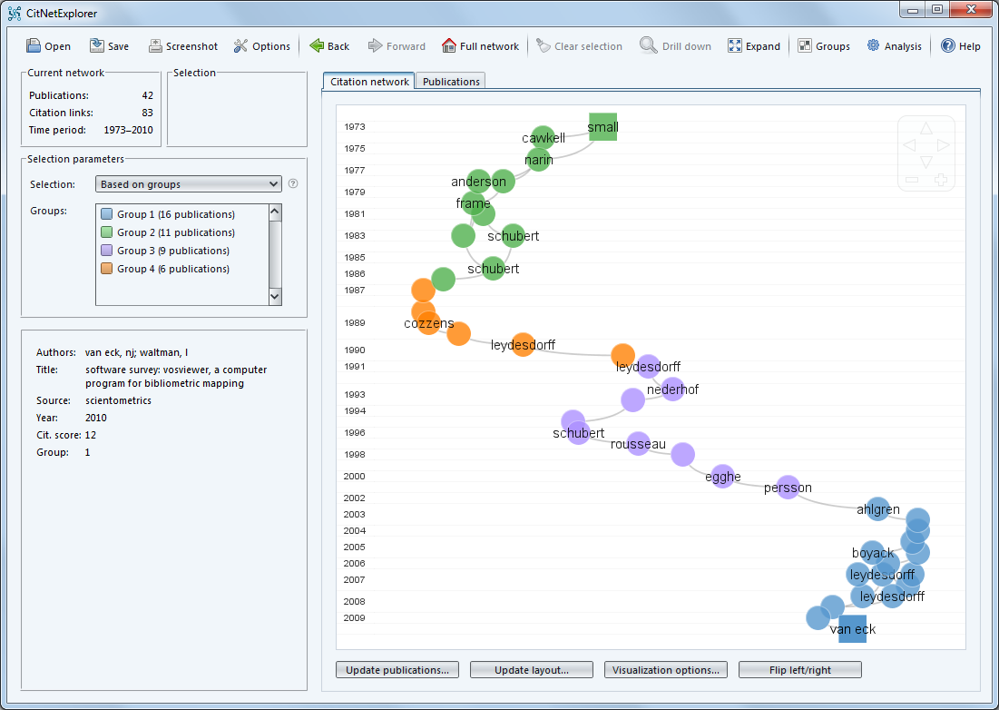
Related Work
The visualization of bibliometric networks is an active area of research
History and development of research fields can be analyzed with citation networks
CiteNetExplorer

Slide 6
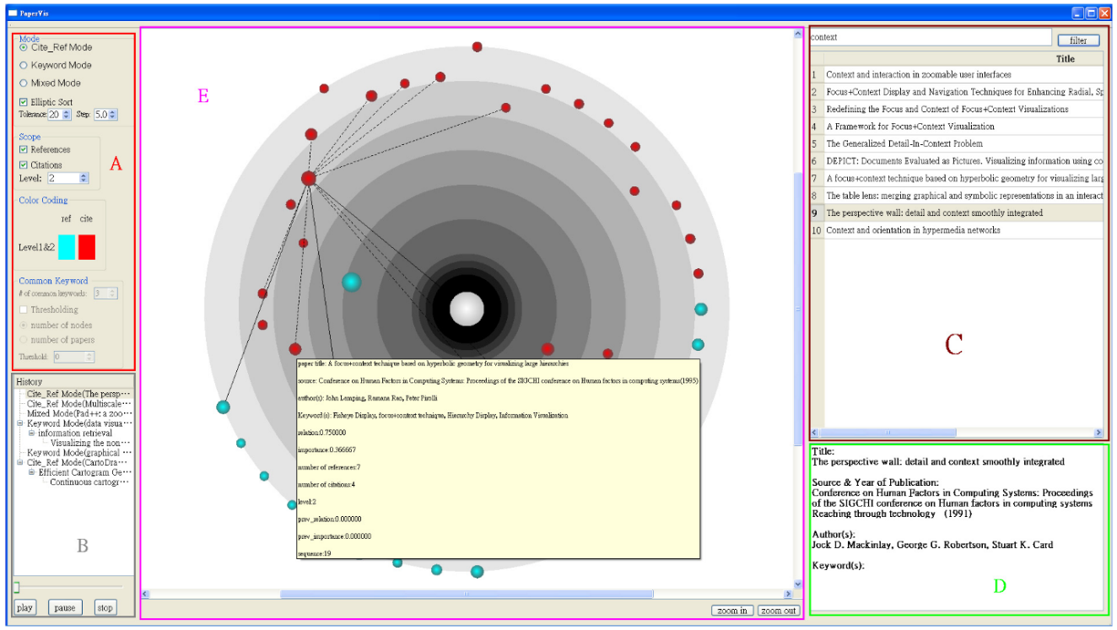
Related Work
Exploit graph structure to obtain semantically meaningful hierarchies
PaperViz

Slide 7
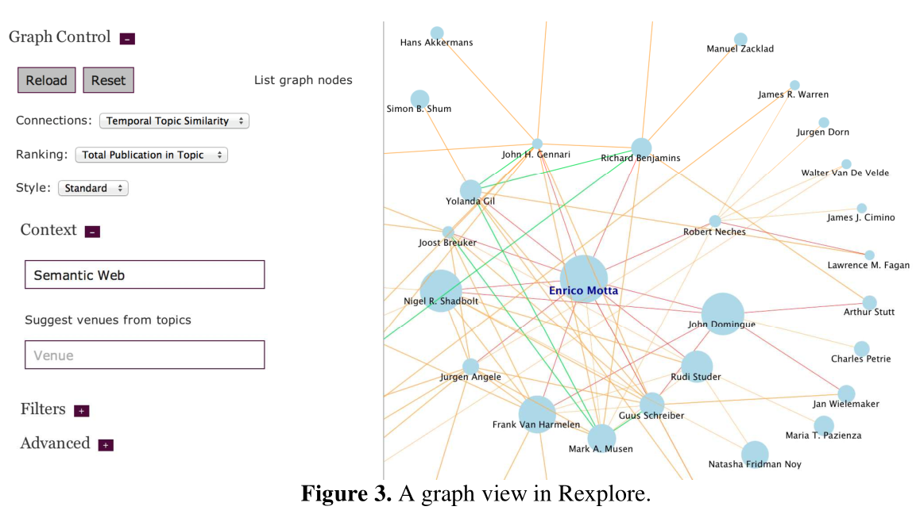
Related Work
Rexplore includes a graph connecting similar authors
Rexplore

Slide 8
Main Intuition & The Reviewer Selection Process
specific goal: provide enough understanding to help editors IPC members in picking reviewers
To support the user in the reviewer selection process we only rely on citations.
Identify relevant papers
Navigate&Expand Citations Network
Authors of relevant papers are good candidate reviewers
Assess the suitability and conflicts of researchers

Slide 9
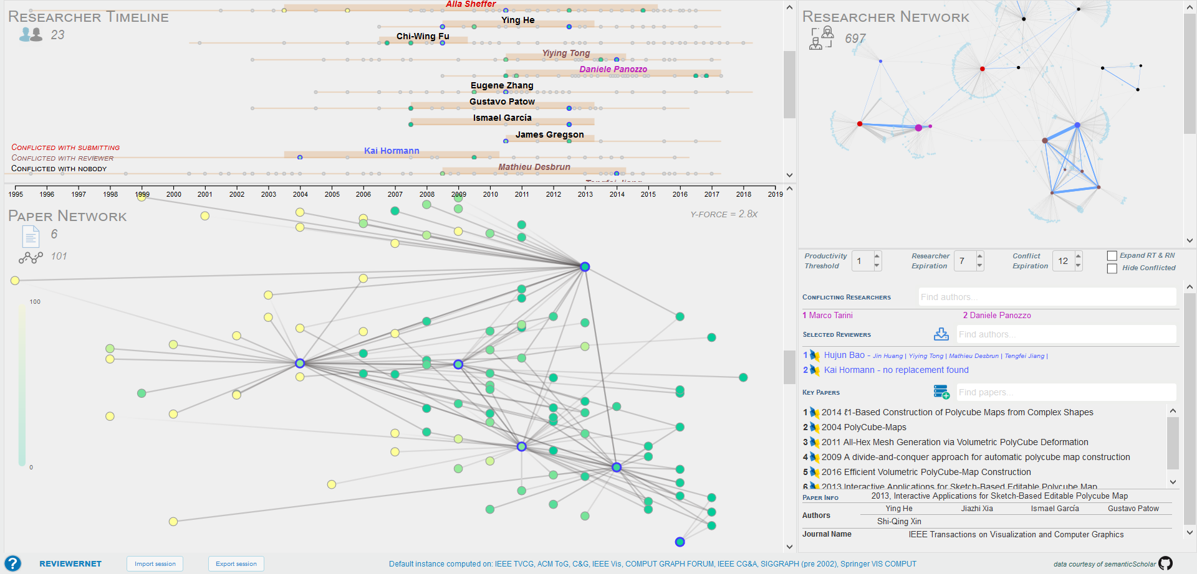
User Interface
ReviewerNet User Interface

Slide 10
User Interface
ReviewerNet User Interface

Slide 11
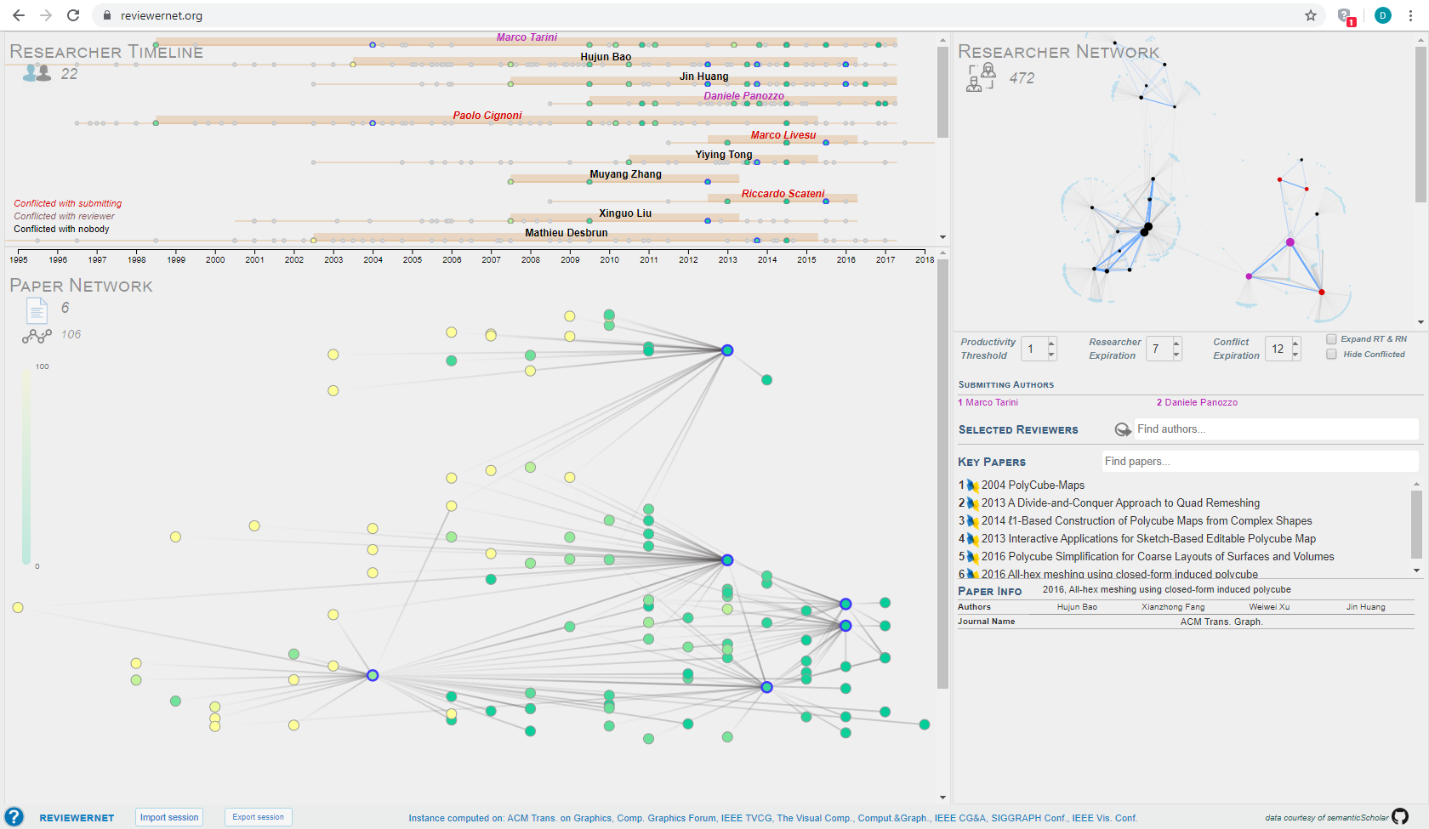
User Interface: the Paper Network
Time axis

Slide 12
User Interface: the Paper Network
RELEVANT/KEY PAPERS

Slide 13
User Interface
ReviewerNet User Interface

Slide 14
User Interface: the Researcher Timeline

Slide 15
User Interface: the Researcher Network

Slide 16
User Interface
ReviewerNet User Interface

Slide 17
User Interface: the Control Panel

Slide 18
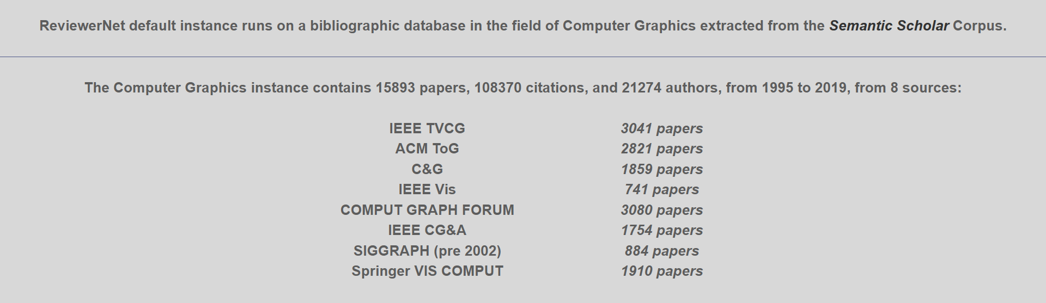


Dataset
The Semantic Scholar corpus contains more than 70M publications
We filtered the dataset to keep complexity low and offer a cleaner visualization.
Computer Graphics Instance statistics

Slide 19
Architecture & Implementation Detais
Data source Semantic Scholar
Python for preprocessing
HTML, JS for UI and D3js for graph drawing
ReviewerNet is a client-side application
{
"id": "4cd223df721b722b1c40689caa52932a41fcc223",
"title": "Knowledge-rich, computer-assisted composition of Chinese couplets",
"paperAbstract":
…
"year": 2016,
"venue": "DSH",
"journalName": "DSH"
}
Generic JSON record of the Semantic Scholar corpus

Slide 20

publicly available @ reviewernet.org
Code on github @ cnr-isti-vclab/ReviewerNet
Now a brief demonstration

Slide 21

Conclusions
ReviewerNet fully supports the reviewer selection process
Only relies on citations and
co-authorship relationships
Avoids conflicts and builds a distributed pool of reviewers

Slide 22


Conclusions: pros&cons
easy to use
fast to learn
multifunctional
page-zero problem
no customizable data coverage

Slide 23

Conclusions:
Further Work
easy to use
fast to learn
multifunctional
Automated choice of key papers
user-friendly procedure to generate custom instances
page-zero problem
no customizable data coverage

Slide 24
Thanks for your attention

