Slide 1
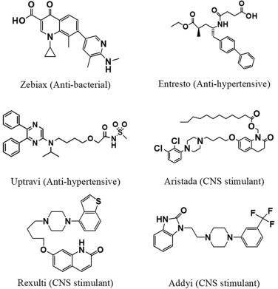

Exploring Molecular Interactions through Docking Simulations
A new approach to drug discovery and development
Chen Mingxi, GTIIT MCS
[1]
2023.12.26

Slide 2
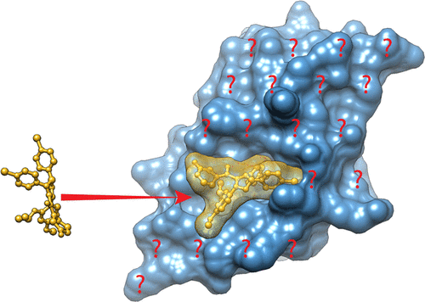
Docking simulation
Agenda
Introduction
Basic concepts of Docking simulation
Application
Summary
[2]

Slide 3

1. Introduction
Docking simulation : A computational method to predict the preferred orientation of a ligand when bound to a target receptor.
Drug molecules discovery approaches
(Traditional way vs Docking simulation)
Traditional way
Significant resources required
Time consuming
Potential oversight of important binding conformations
May miss subtle interactions
Docking simulation
Low cost in resources
Efficient evaluation in silico
Captures details about conformations during the reaction

Slide 4
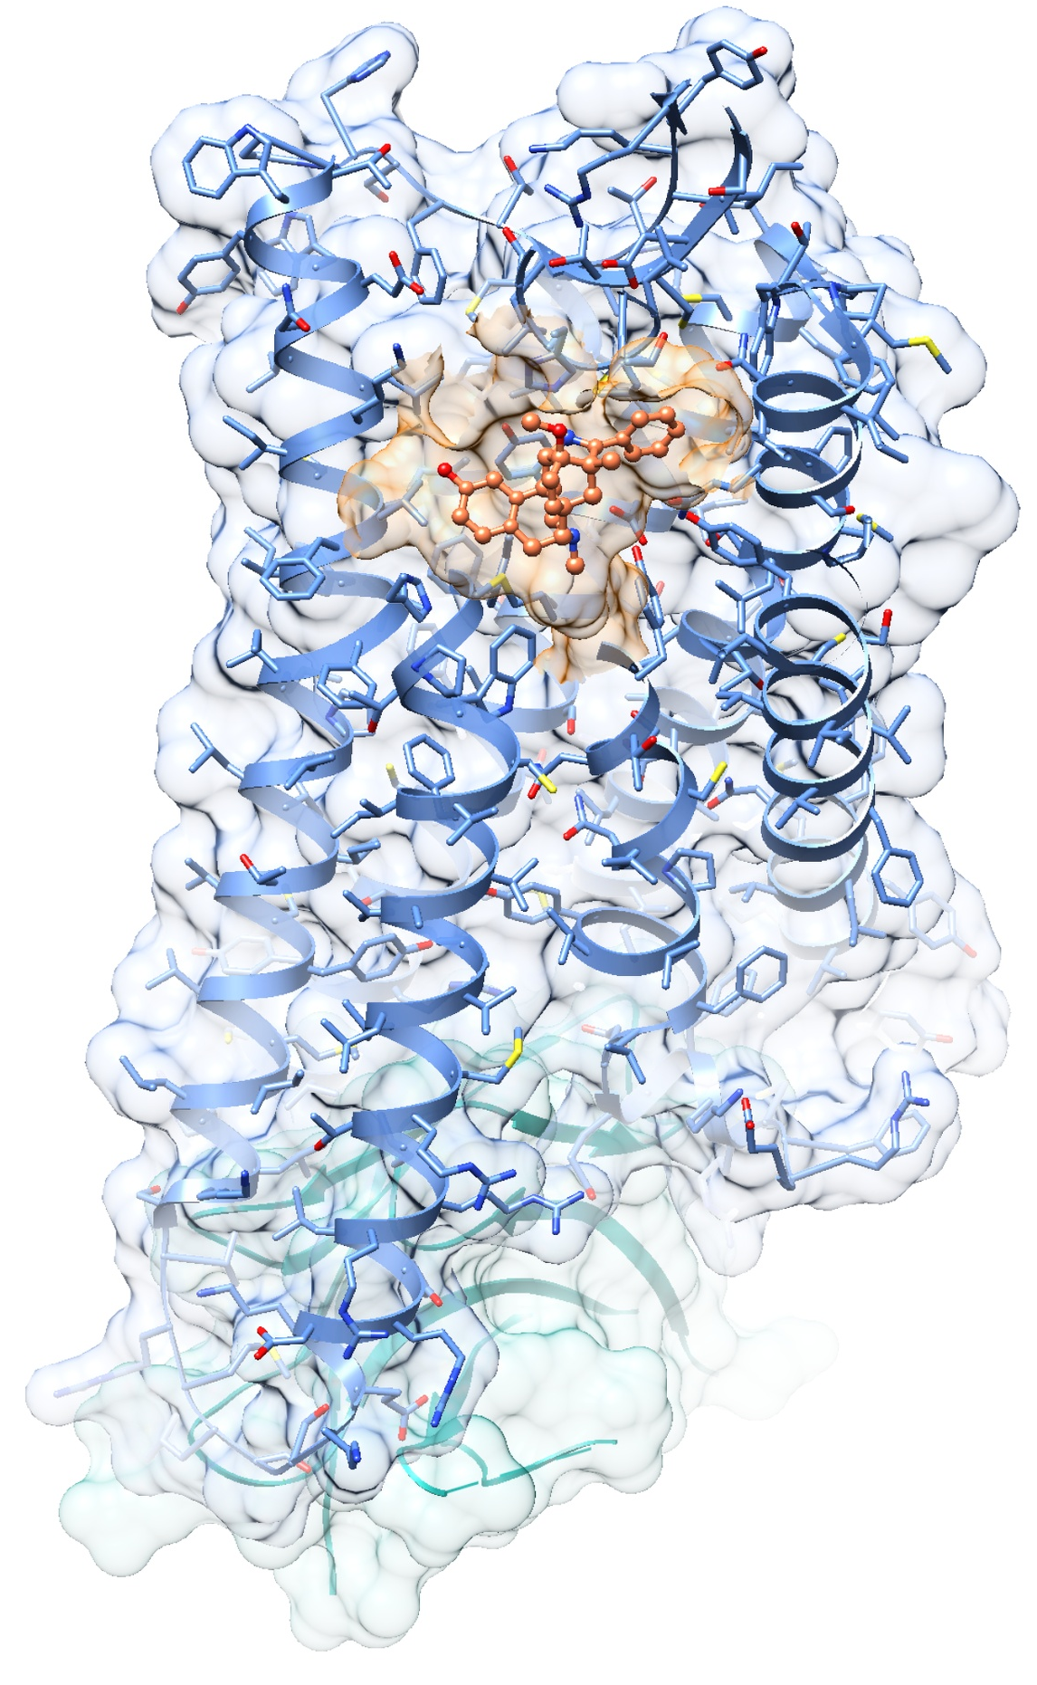
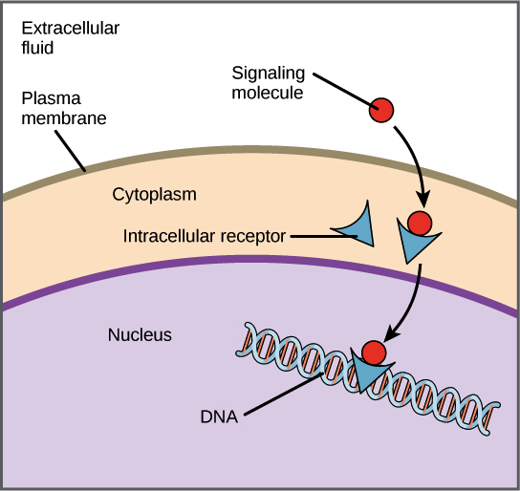
2. Basic concepts of Docking simulation
Ligand and Receptor Interaction
Molecular docking focuses on the study of ligand-receptor interactions. Ligands, typically small organic molecules, interact with receptors such as proteins, nucleic acids, or other biomolecules. Understanding these interactions is critical for drug design and understanding biological processes.
[4]
[3]

Slide 5
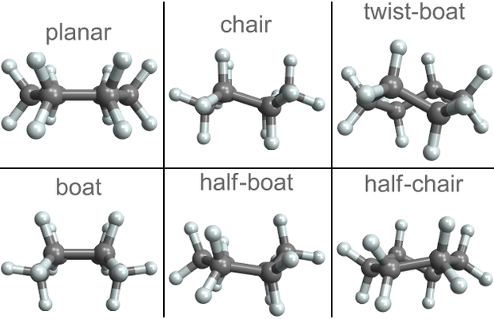
2. Basic concepts of Docking simulation
Conformational Search
Conformation refers to the spatial arrangement of atoms in a molecule, particularly the relative positions of atoms that result from rotation about single bonds. It describes the different shapes a molecule can adopt due to the free rotation of single bonds while maintaining the same connectivity of atoms.
Conformational search is a computational exploration of the different spatial arrangements or conformations, which are crucial for understanding the flexibility and behavior of molecules.
[5]

Slide 6

2. Basic concepts of Docking simulation
Force Fields and Energy Calculations
Force fields are mathematical models that describe the interactions between atoms and molecules in molecular modeling. They include parameters for atom types, bonded interactions (bonds, angles, dihedrals), and non-bonded interactions (Van der Waals, electrostatic).
Potential Energy (U): It represents the stored energy in a system due to its configuration and intermolecular interactions. Force fields provide the mathematical expressions for calculating potential energy.
Kinetic Energy (K): It accounts for the energy associated with the motion of atoms and molecules within the system. In molecular dynamics simulations, kinetic energy is calculated based on the velocities of particles.
Total Energy (E): The sum of potential and kinetic energy gives the total energy of the system (E = U + K).
Energy Minimization: In molecular modeling, energy minimization is often performed to find the most stable configuration of a molecular system by adjusting atomic coordinates to minimize potential energy.
The energy calculations help predict the stability of different binding poses between the ligand and receptor.

Slide 7

3. Application
Accelerating Drug Discovery: Reducing time and cost by prioritizing potential drug candidates.
01
Lead Identification and Optimization: Guiding the optimization of drug candidates for improved efficacy.
02
Drug Repurposing: Finding new uses for existing drugs.
03
Targeting Specific Proteins: Designing drugs for specific molecular targets.
04

Slide 8
3. Application
Existing algorithms can be categorized through different computational approaches and objects:
Rigid Docking
Suitable for small molecules and proteins with low flexibility
Algorithms: Autodock, Vina
Suitable for molecules with complex conformation, supports flexible molecules
Algorithms: FlexX, Glide
Flexible Docking
Protein-Protein
docking
Predicting protein-protein interactions
Algorithms: ZDOCK, ClusPro

Slide 9
4. Summary
In conclusion, docking simulations are more than predictive tools; they are gateways to the molecular realm.
Docking simulation : Key approach to accelerate drug discovery
[2]
Challenges
High-precision simulations consume large amounts of computational resources
The lack of generality. (Certain methods are only suitable for specific type of molecules)
Accuracy is still limited, especially flexibility and solvent effects are concerned.
Future
Integrating multi-scale and multi-mode simulation methods
Using Machine learning to improve the precision and accuracy
Developing AI-based methods to reduce the costs of computational resources

Slide 10
Reference & QA session
,
,
Shavani Verma, Discovery and optimization of lead molecules in drug designing, https://doi.org/10.1016/B978-0-323-89775-4.00004-3
Crystal structures could help develop new medications, https://www.fau.eu/2015/08/11/news/receptor-shown-in-3d/
LIGANDS AND RECEPTORS, https://slcc.pressbooks.pub/collegebiology1/chapter/ligands-and-receptors/
Julien Orts, NMR-Based Determination of the 3D Structure of the Ligand–Protein Interaction Site without Protein Resonance Assignment, Journal of the American Chemical Society, https://doi.org/10.1021/jacs.5b12391/

