Slide 1
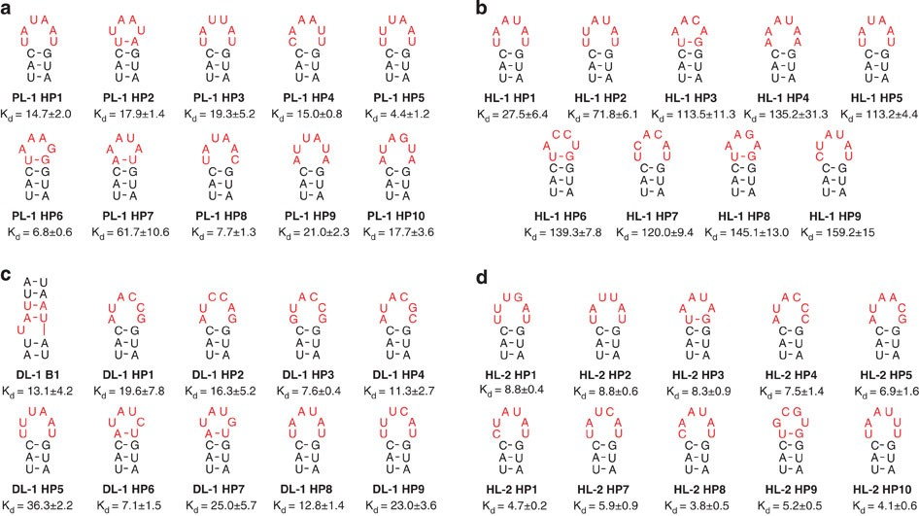



Small RNA-Targeting Molecule Design
Identify, validate and optimize small molecules that target the functional transcriptome.
Chen Mingxi

Slide 2
Introduction
Predict Structure
Determine Function
Predict Binding Selectivity

Slide 3
Methods to Model RNA Structure
Use algorithms like mFold, RNAFold, and RNAStructure for predicting RNA structure with 70% accuracy.
1
Free Energy Minimization
Will pause of reverse transcriptase and mutation for modeling RNA structure.
2
Chemical Modification
Genetic difference preserved in secondary structure Covariation-based structural prediction is highly accurate(compared to crystal structures)
2
Biophysical 3D Assay
2
Homology modelling
Program: FARFAR2,MC-Fold/MC-Sym and iFoldRNA, RNAdolf,Sfold,CONTRAfold, Scoring method: ARES
2
3D structure prediction

Slide 4
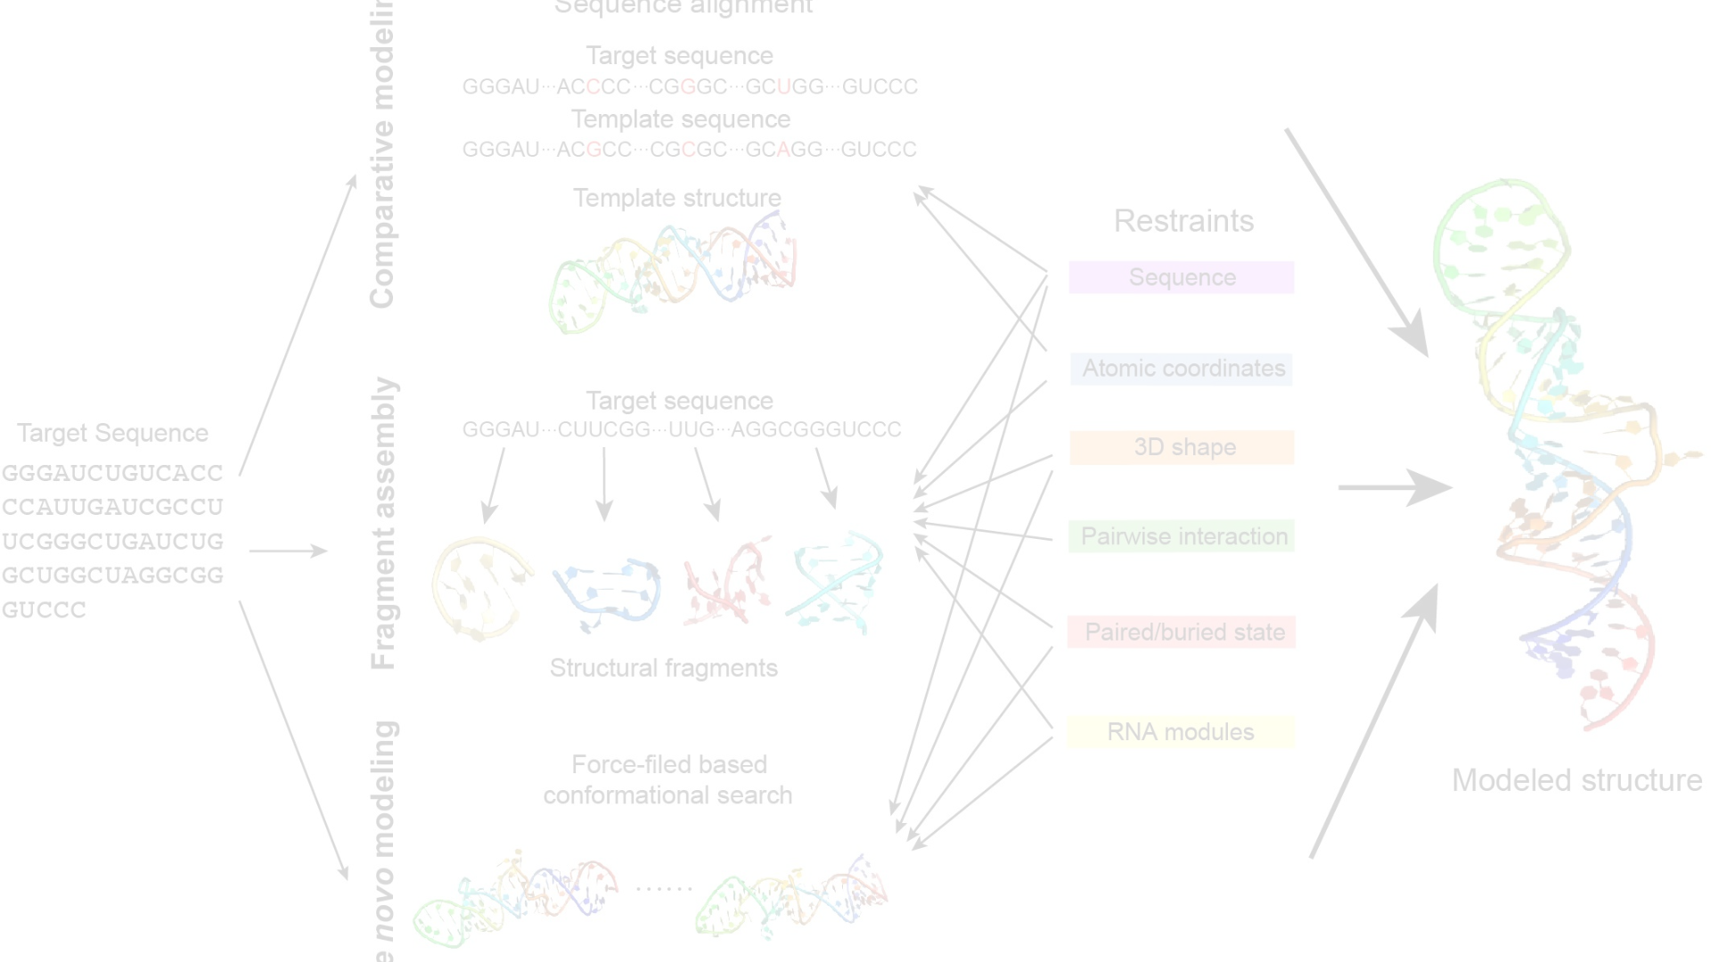
Assessing Quality of Predictions
1
Partition Function
2
Statistics
It contains all of the thermodynamic information of system. This function has been incorporated into various programs.( RNAfold, Sfold and CONTRAfold)
Phylogenetic comparisons have applied statistics to demonstrate the significance in evolutionary covariation, associating with the functionality.

Slide 5
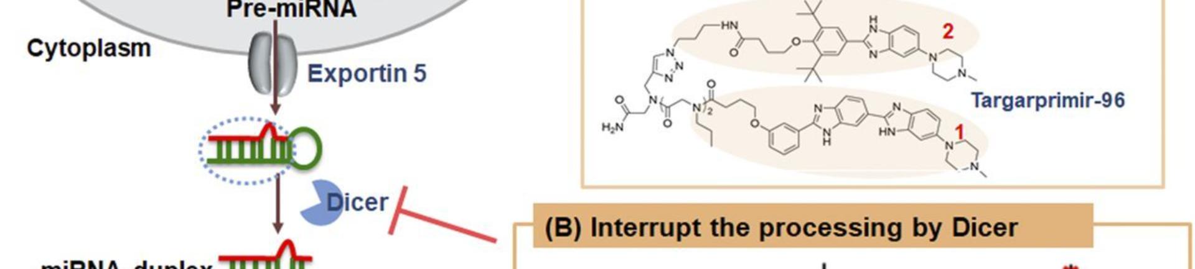
Selectivity of Small Molecules Targeting RNA
1
Factors Affecting Selectivity
2
Accessibility of the Target Site
3
Target Site Functionality
Understand the factors that affect the selectivity of small molecules targeting RNA.
Consider the accessibility of the target site for designing selective small molecules.
Take into account the functionality of the binding site for small molecule design.

Slide 6
Approaches for Identifying Small-Molecule RNA Binders
1
Target-Centric Approaches
Understand different target-centric approaches for identifying small-molecule RNA binders.
2
Affinity Mass Spectrometry
Explore the use of ALIS for indirect detection of target-ligand interaction before liquid chromatography.
3
Microarray-Based Screening
Learn about microarray-based screening methods for identifying small-molecule RNA binders.
4
Fragment-Based Ligand Discovery
Understand the use of fragment-based ligand discovery for efficient exploration of chemical space for RNA binding.

Slide 7
Methods Applied in Paper: Targeting SARS-CoV-2
Determine the binding site of SARS-CoV-2, which is an attenuator hairpin (AH), for small molecule design.
Identify common scaffolds including indole, 2-phenyl indole, 2-phenyl benzimidazole, and pyridinium groups.
Understand the conclusions from Tuan's research on identifying preferred RNA motifs and chemotypes.

Slide 8
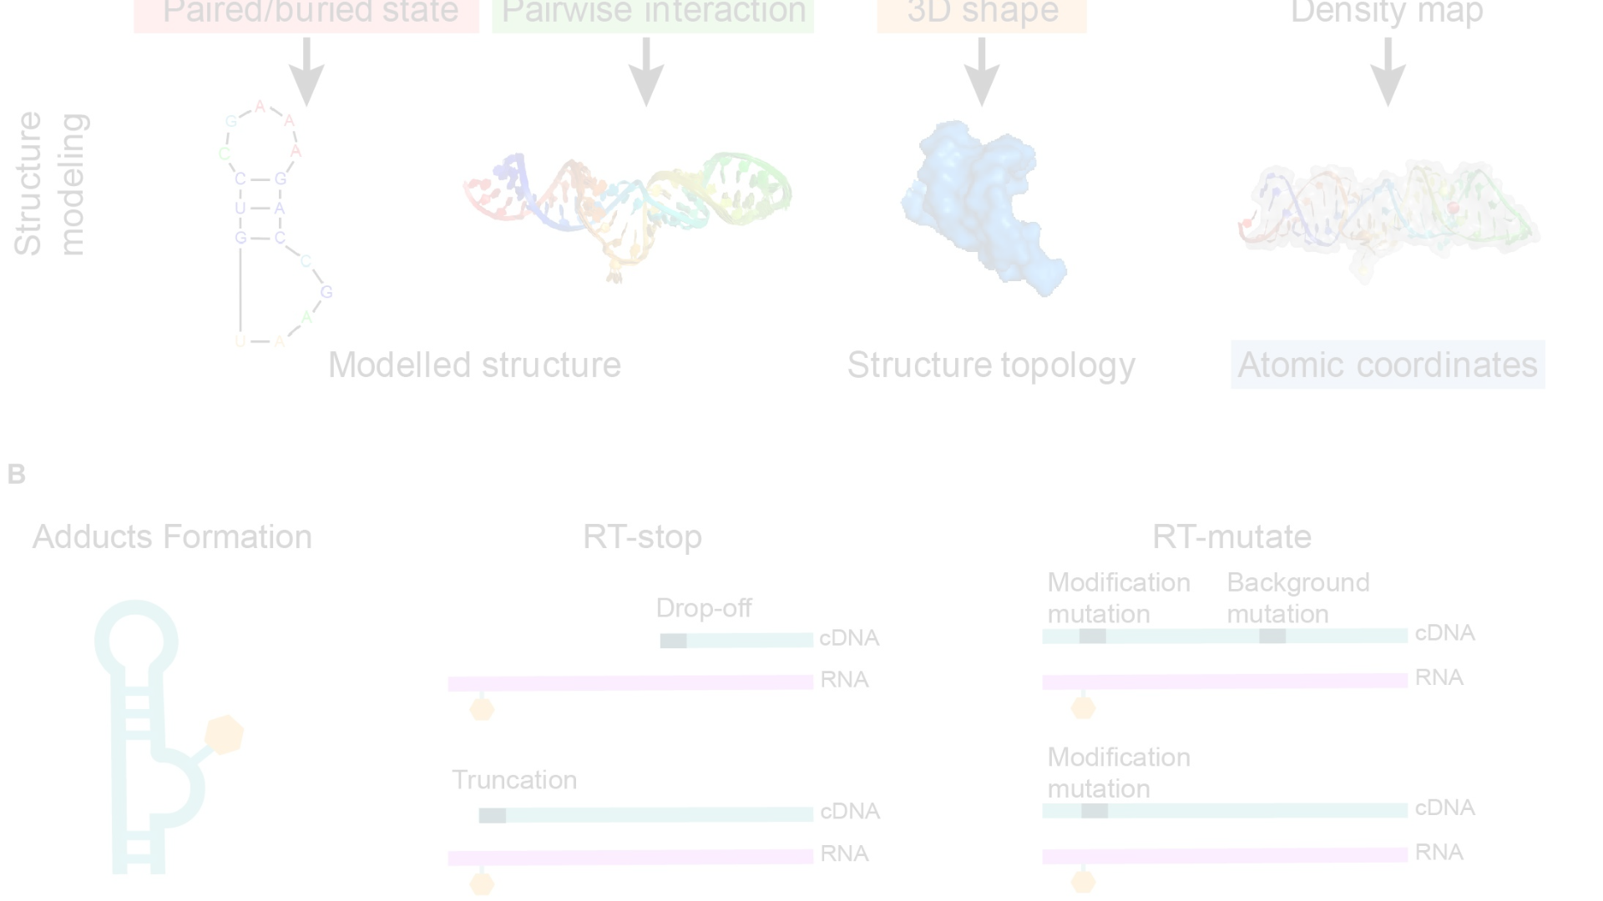
Verifying the Structure of Binding Target
1
Free Energy Minimization & Phylogenetic Conservation
2
Structural Mapping Data
Utilize DMS-MaPseq to study RNA structure of SARS-CoV-2 for small molecule binding.
Determine and verify the 3D structure of the binding site using ScanFold and RNAz.

Slide 9
Identify Candidates of Small Molecule Binders
Physiochemical Properties of Known Ligands Binding Target

Slide 10
Screening the Binders
Phenyl Benzimidazoles (n=11)
Phenyl Thioureas (n=6)
2,4-Diaminoquinazolines (n=7)
Dose Response/Competitive Screening
Identify the categories of small molecule binders and the screening process.
Remain only 5

Slide 11
Research of Qiangfeng Zhang
PrismNet
SmrtNet
Understand the paper related to PrismNet and its contribution to predicting RNA binders.
Learn about the innovative approach of SmrtNet for predicting small molecule interactions with RNA targets.

