Slide 1
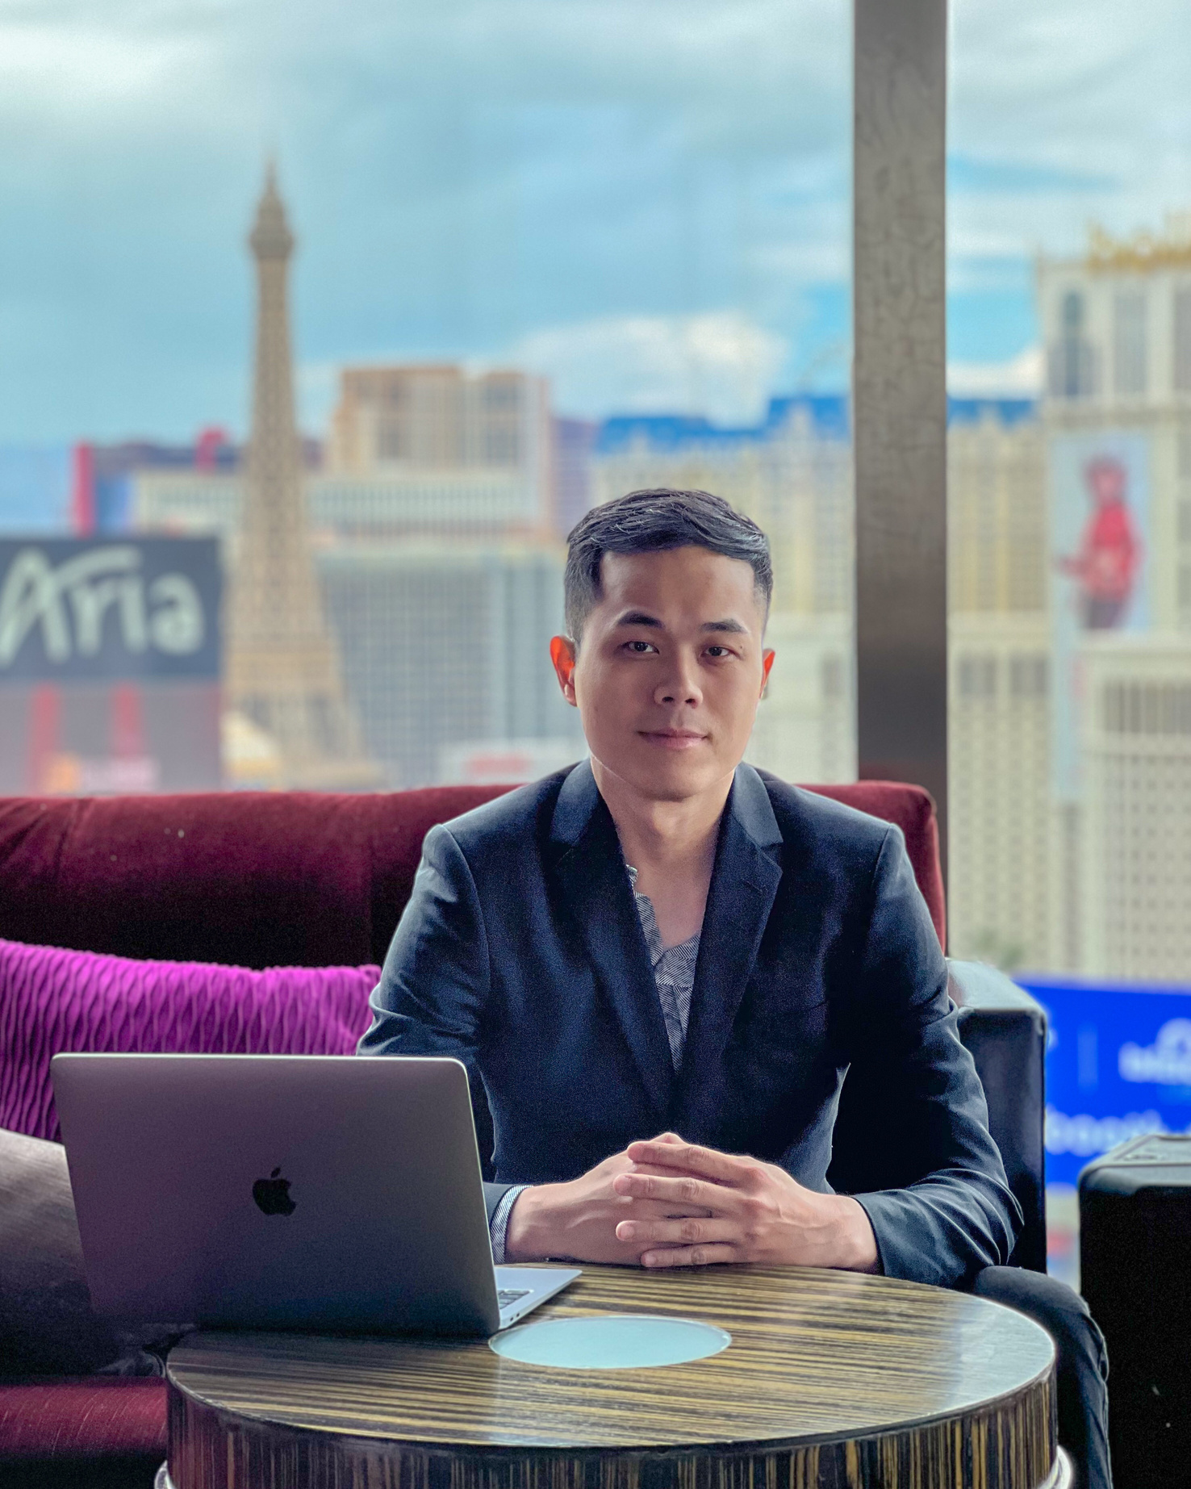


HANK CHEN
PRESENTATION
Get Started!

Slide 2
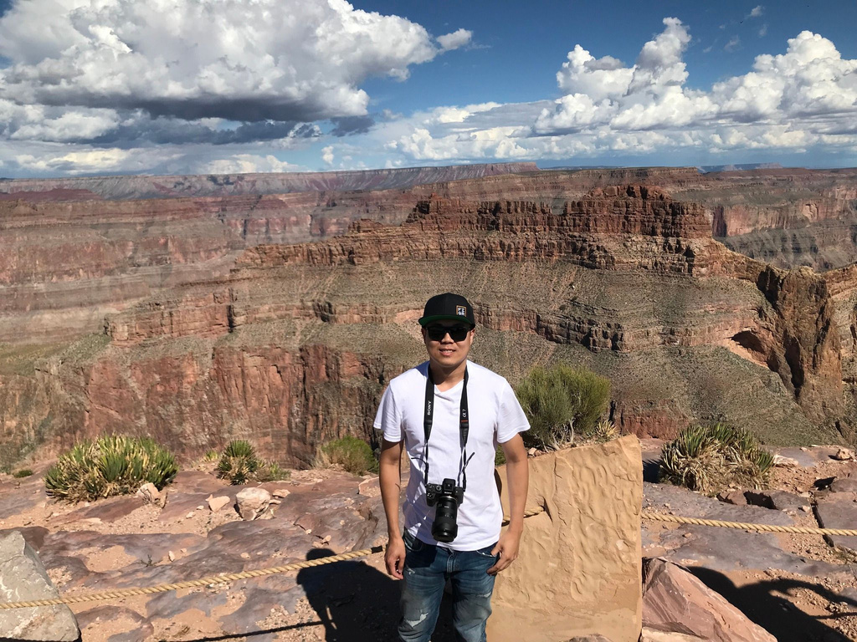
ABOUT
ME
Hi,My name is Hank,here is a bit of my background
Economics Analysis
Cannabis Industry
Musical Instrument sales
"Having just moved to Calgary and planning to start a new life here, currently pursuing a career in full-stack developer."

Slide 3



Technical skills used
HTML
CSS
Javascript

