Slide 1
How to Use a Cross Table to Solve A Interview Question
Hongyu Dai

Slide 2
Question
Suppose there are 5 coins. Four of the coins are fair with P(heads)=0.5, and one of the coins is biased with P(heads)=0.75. Suppose a coin is randomly selected and flipped 4 times resulting in 4 heads.
What is the probability that the selected coin was biased? That is, what is P(biased coin selected | HHHH)?
Note: The following calculation only retains four decimal places for the convenience of calculation

Slide 3
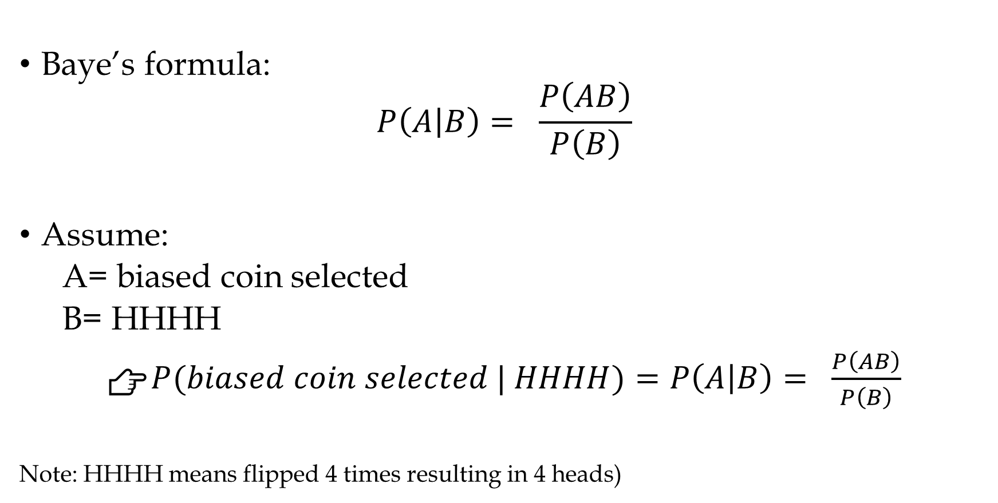
Baye’s formula:
$$P\left(A | B\right)= \frac{P\left(AB\right)}{P\left(B\right)}$$
Assume:
A= biased coin selected
B= HHHH
👉$P(biased coin selected | HHHH)=P\left(A | B\right)= \frac{P\left(AB\right)}{P\left(B\right)}$
Note: HHHH means flipped 4 times resulting in 4 heads)

Slide 4
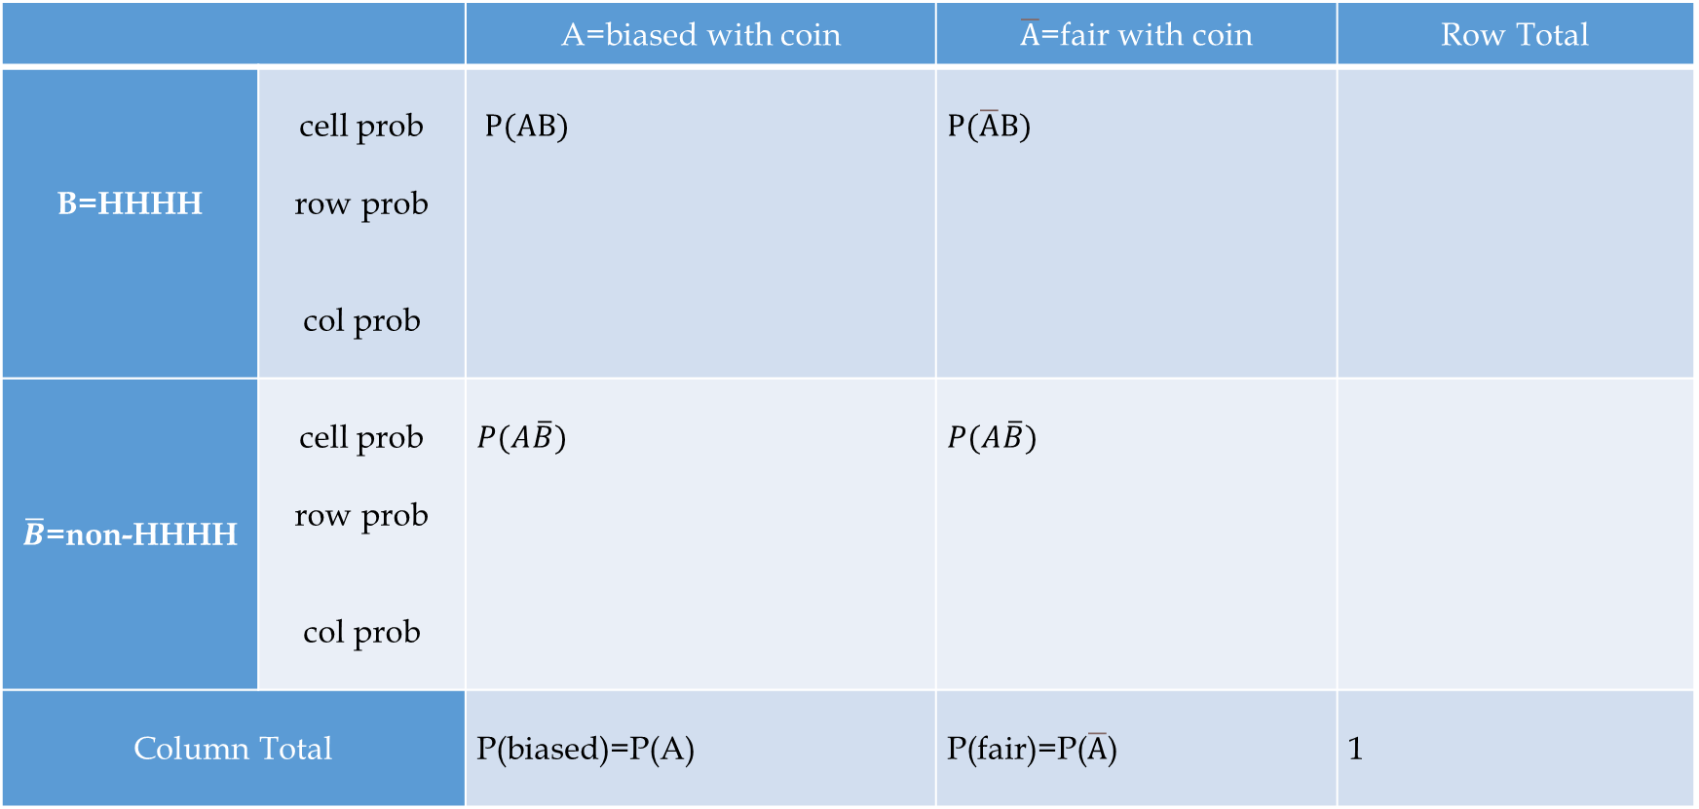
Cross Table
5 coins
One biased with P(heads)=0.75
Four fair with P(heads)=0.5
 |  | A=biased with coin | $\overline{A}$=fair with coin | Row Total
B=HHHH | cell prob row prob col prob | $P(AB)$ | $$P(\overline{A}B)$$
$\overline{B}$=non-HHHH | cell prob row prob col prob | $$P(A\overline{B})$$ | $$P(A\overline{B})$$
Column Total | Column Total | P(biased)=P(A) | P(fair)=P($\overline{A}$) | 1

Slide 5
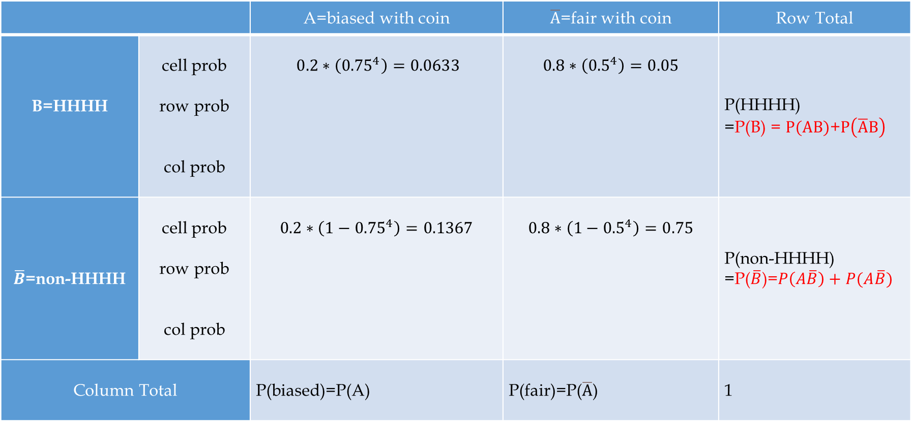
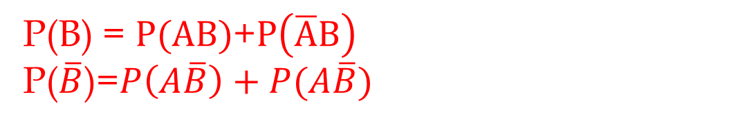
Cross Table
P(B) = $P(AB)$+$P\left(\overline{A}B\right)$
P($\overline{B}$)=$P\left(A\overline{B}\right)+P(A\overline{B})$
 |  | A=biased with coin | $\overline{A}$=fair with coin | Row Total
B=HHHH | cell prob row prob col prob | $0.2∗\left({0.75}^{4}\right)=0.0633$ | $$0.8∗\left({0.5}^{4}\right)=0.05$$ | P(HHHH) =P(B) = $P(AB)$+$P\left(\overline{A}B\right)$
$\overline{B}$=non-HHHH | cell prob row prob col prob | $$0.2∗\left(1−{0.75}^{4}\right)=0.1367$$ | $$0.8∗\left(1−{0.5}^{4}\right)=0.75$$ | P(non-HHHH) =P($\overline{B}$)=$P\left(A\overline{B}\right)+P(A\overline{B})$
Column Total | Column Total | P(biased)=P(A) | P(fair)=P($\overline{A}$) | 1

Slide 6
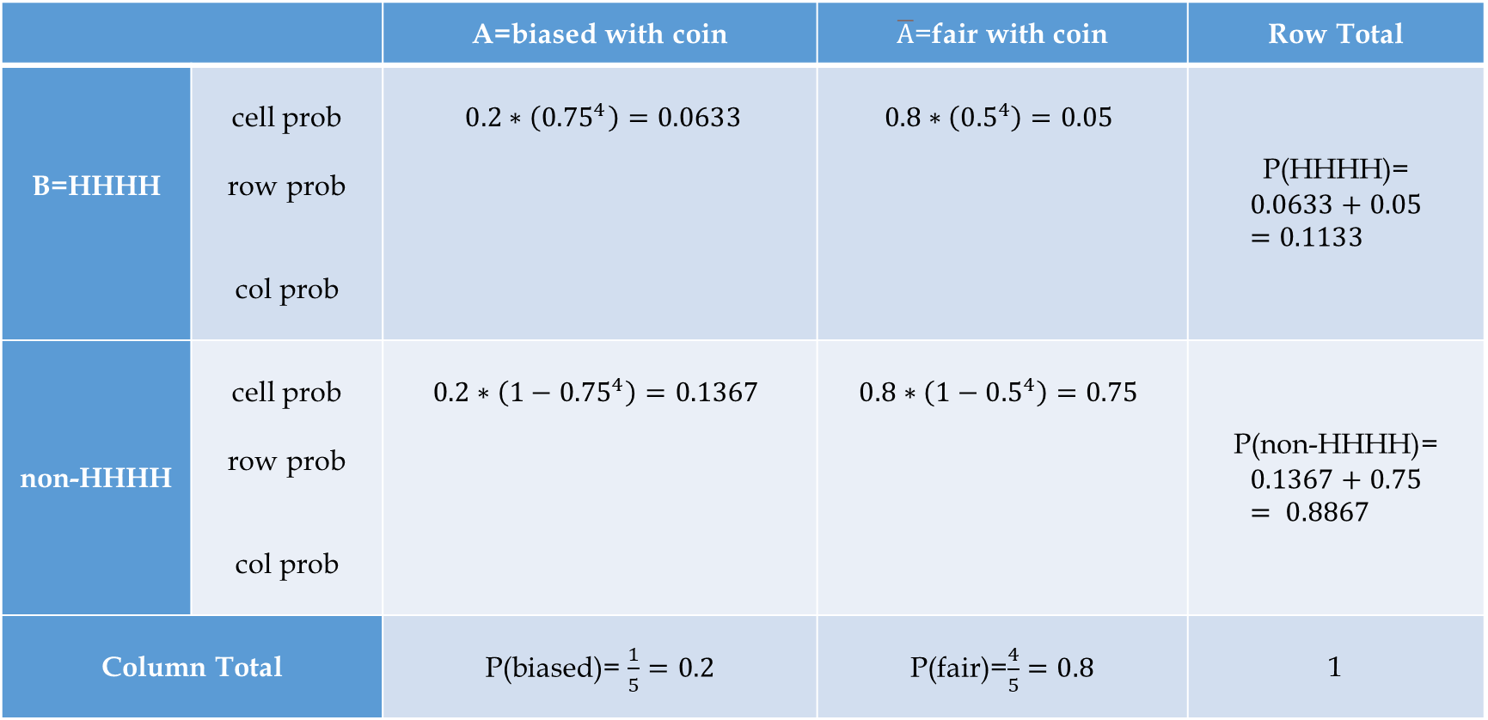
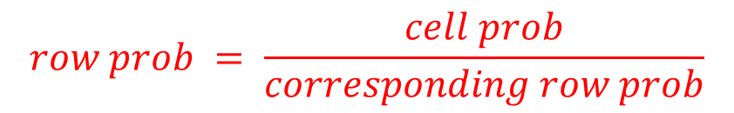
Cross Table
$$row prob = \frac{cell prob}{corresponding row prob}$$
 |  | A=biased with coin | $\overline{A}$=fair with coin | Row Total
B=HHHH | cell prob row prob col prob | $0.2∗\left({0.75}^{4}\right)=0.0633$ | $$0.8∗\left({0.5}^{4}\right)=0.05$$ | P(HHHH)= $$0.0633+0.05=0.1133$$
non-HHHH | cell prob row prob col prob | $$0.2∗\left(1−{0.75}^{4}\right)=0.1367$$ | $$0.8∗\left(1−{0.5}^{4}\right)=0.75$$ | P(non-HHHH)= $$0.1367+0.75= 0.8867$$
Column Total | Column Total | P(biased)= $\frac{1}{5}=0.2$ | P(fair)=$\frac{4}{5}=0.8$ | 1

Slide 7
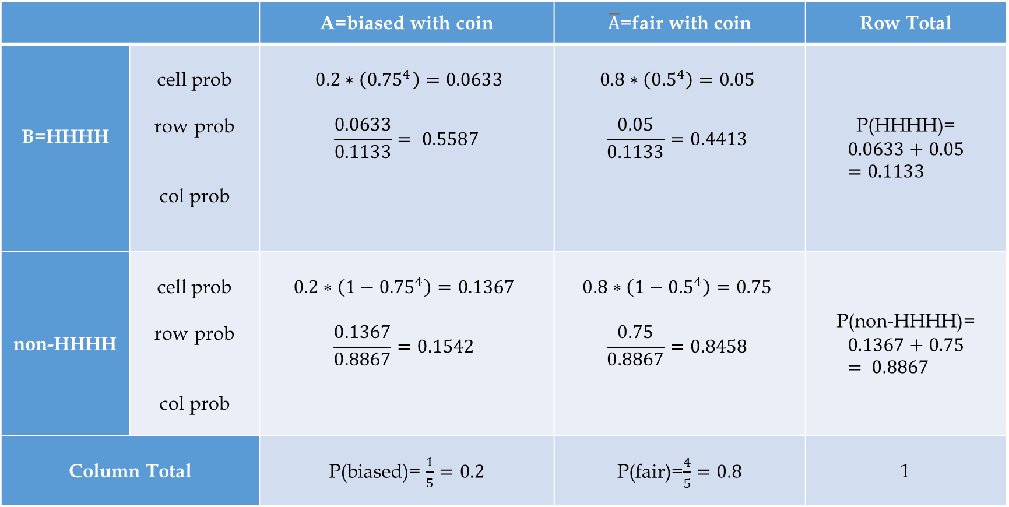
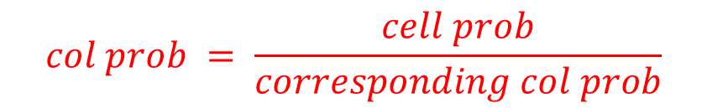
Cross Table
$$col prob = \frac{cell prob}{corresponding col prob}$$
 |  | A=biased with coin | $\overline{A}$=fair with coin | Row Total
B=HHHH | cell prob row prob col prob | $0.2∗\left({0.75}^{4}\right)=0.0633$ $$\frac{0.0633}{0.1133}= 0.5587$$ | $$0.8∗\left({0.5}^{4}\right)=0.05$$ $$\frac{0.05}{0.1133}=0.4413$$ | P(HHHH)= $$0.0633+0.05=0.1133$$
non-HHHH | cell prob row prob col prob | $$0.2∗\left(1−{0.75}^{4}\right)=0.1367$$ $$\frac{0.1367}{0.8867}=0.1542$$ | $$0.8∗\left(1−{0.5}^{4}\right)=0.75$$ $$\frac{0.75}{0.8867}=0.8458$$ | P(non-HHHH)= $$0.1367+0.75= 0.8867$$
Column Total | Column Total | P(biased)= $\frac{1}{5}=0.2$ | P(fair)=$\frac{4}{5}=0.8$ | 1

Slide 8
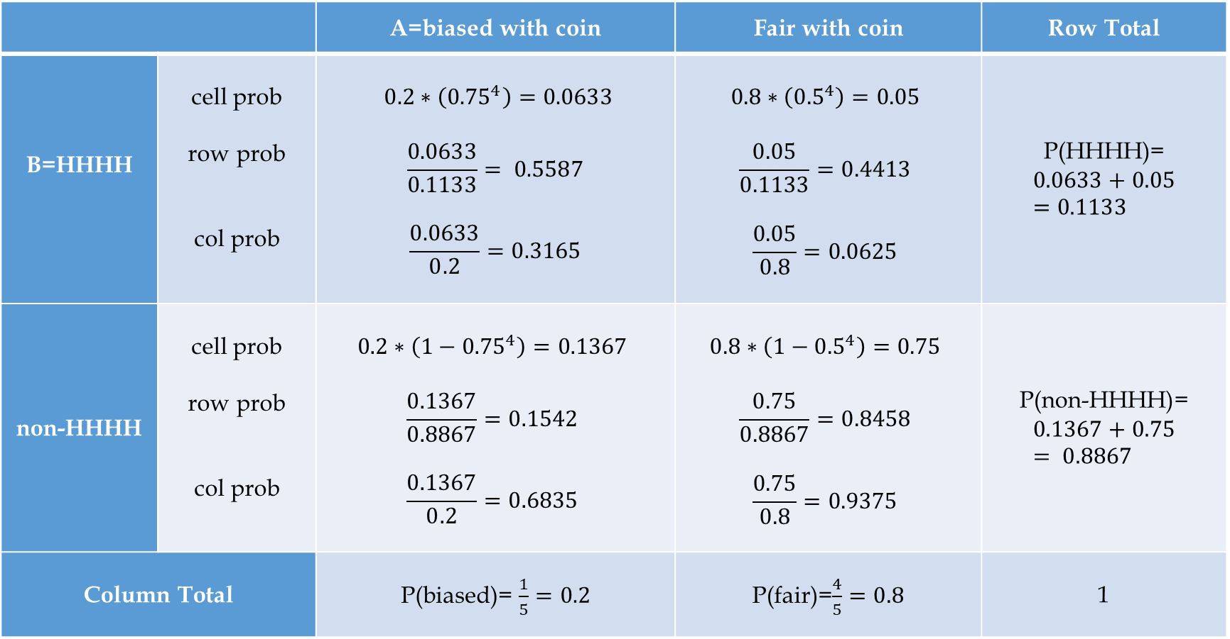
 |  | A=biased with coin | Fair with coin | Row Total
B=HHHH | cell prob row prob col prob | $0.2∗\left({0.75}^{4}\right)=0.0633$ $$\frac{0.0633}{0.1133}= 0.5587$$ $$\frac{0.0633}{0.2}=0.3165$$ | $$0.8∗\left({0.5}^{4}\right)=0.05$$ $$\frac{0.05}{0.1133}=0.4413$$ $$\frac{0.05}{0.8}=0.0625$$ | P(HHHH)= $$0.0633+0.05=0.1133$$
non-HHHH | cell prob row prob col prob | $$0.2∗\left(1−{0.75}^{4}\right)=0.1367$$ $$\frac{0.1367}{0.8867}=0.1542$$ $$\frac{0.1367}{0.2}=0.6835$$ | $$0.8∗\left(1−{0.5}^{4}\right)=0.75$$ $$\frac{0.75}{0.8867}=0.8458$$ $$\frac{0.75}{0.8}=0.9375$$ | P(non-HHHH)= $$0.1367+0.75= 0.8867$$
Column Total | Column Total | P(biased)= $\frac{1}{5}=0.2$ | P(fair)=$\frac{4}{5}=0.8$ | 1
$P(biased coin selected | HHHH)=P\left(A | B\right)$ $= \frac{P\left(AB\right)}{P\left(B\right)}=\frac{0.0633}{0.1133}=0.5587$

