Slide 1
YOUTH4JOBS
- TEAM 7

Slide 2
Objective
" SIMPLE, CLEAR AND ADAPTABLE "

Slide 3
Student
Admin
Corporate
Registration/Login
Work Flow
Mock Test
Practice Tests
Job opportunity
Filtering & Mapping
Career graph
Update vacancies
Send feedback

Slide 4

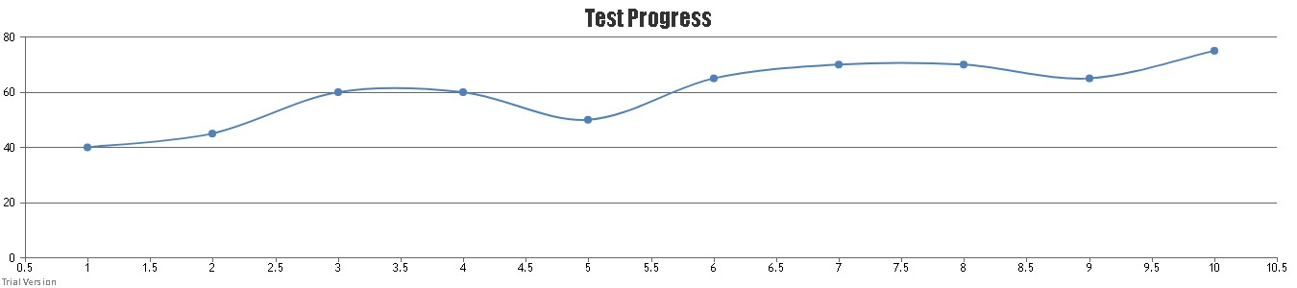

Additional Features
Student progress graph
Donations
Text-to-speech converter
Speech-to-text converter
Level system for test
HeatMap
Excel to DB
DB to excel

Slide 5

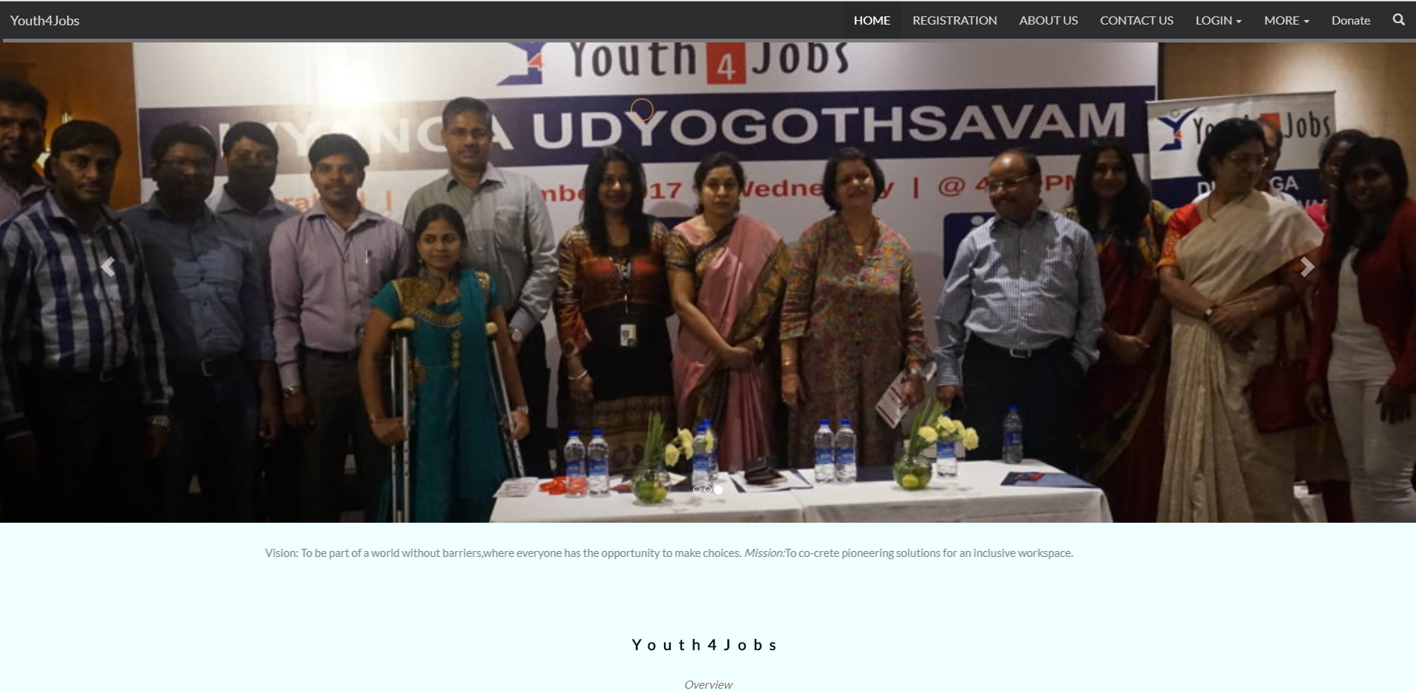
Before
Manual mock and practise tests
Manual filtering and mapping
Excel sheel
After
Online mock and practice tests
Auto filtering and mapping
Centralised database

Slide 6



Future Scope
QR code for registration
Analisys of resume
API for questions

