Slide 1

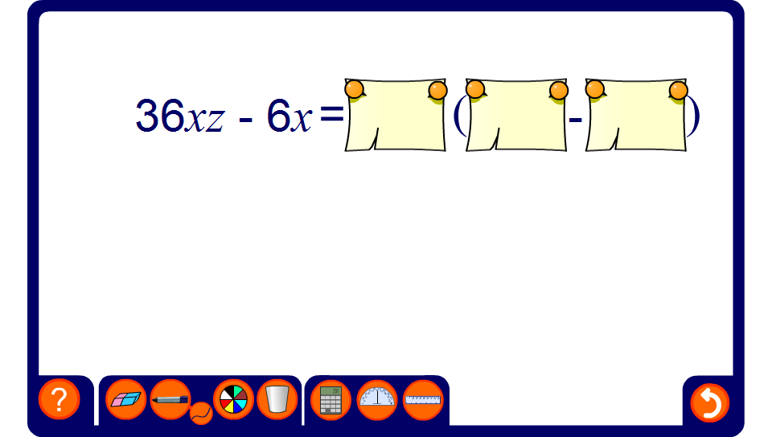


Factorization
Notes:
Start by asking pupils to give you the value of the highest common factor of the two terms. Reveal this and then ask pupils to give you the values of the terms inside the brackets.

