Slide 1









Whiteboardmaths.com
7
2
1
5
© 2004 All rights reserved

Slide 2

Recognising Graphs of Equations (1)
y
y
Examples (Linear Graphs)
The highest power of x is 1. y = 3x + 2 y = -x + 8
y = x - 4 y = ½x - 7
y = - 2x + 1 y = ¾x
y = x y = -5x - 4
Linear
x
x
y = mx + c
Examples (Quadratic Graphs)
The highest power of x is 2.This parabolic curve has one turning point.
y = x² + 2 y = -x² - 8
y = 5x² + 4x - 1 y = ½x² - x
y = - 2x² - 3x + 6
y = 3x² + 2 y = -3x² + x - 4
y
y
Quadratic
a > 0
a < 0
x
x
Parabolas
y = ax² + bx + c, a ≠ 0

Slide 3
Recognising Graphs of Equations (2)
y
y
Examples (Cubic Graphs)
The highest power of x is 3. This curve usually has two turning points
y = x³
y = -x³ + 2
y = 2x³ + x²
y = x³ - 3x² + 2x - 1
y = -3x³ + 5x
y = ¾x³ - 2x + 7
y = 5x³ - 4x² + 3x - 9
y = -5x³ - 4
Y = -x³ -x² + 4
d > 0
d < 0
x
x
Cubic
y = dx³ + ax² + bx + c, d ≠0
y
y
y = x³
y = -x³
x
x

Slide 4
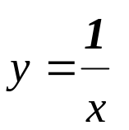
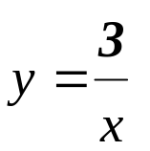
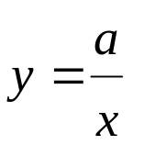
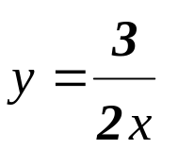
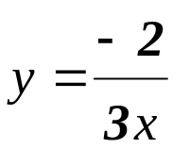
Recognising Graphs of Equations (3)
y
Examples (Reciprocal Graphs)
The reciprocal function has x in the denominator and is in two parts since it is not defined for x = 0.
y
Reciprocal
x ≠ 0
x
x
Hyperbolas
y
y
Exponential
y = a^{-x}
Examples (Exponential Graphs)
The exponential function raises any number to the power of x. This function always cuts the y axis at 1.
y = 2^{x} y = 3^{x} y = (½)^{x}
y = 5^{x} y = 2^{-x} y = 4^{-x}
1
1
x
x
y = a^{x}

Slide 5
Match each of the graphs below to an equation on the right.
1
2
3
4
y = -x + 1
7
y = 3^{x}
9
y = x² + 2x - 1
4
5
6
1
y = x³ - 4x
3
y = -x² + 3
2
y = 2x - 1
5
y = 2/x
7
8
9
6
y = -x³
1
8
y = -x³ + 3x + 2

Slide 6
Worksheet
Match each of the graphs below to an equation on the right.
1
2
3
y = -x + 1
y = 3^{x}
y = x² + 2x - 1
4
5
6
y = x³ - 4x
y = -x² + 3
y = 2x - 1
y = 2/x
7
8
9
y = -x³
1
y = -x³ + 3x + 2

