Slide 1

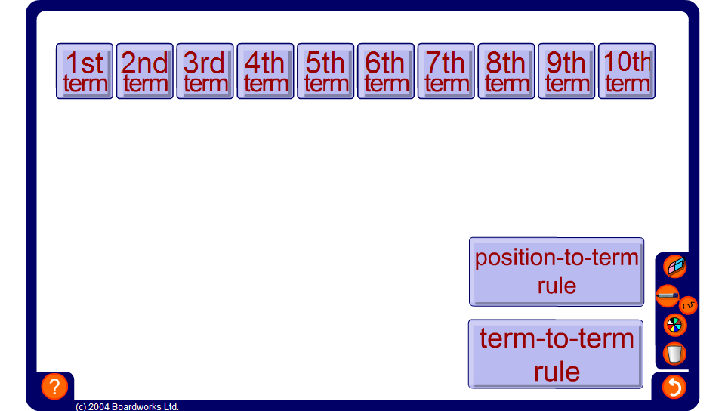


Sequence generator – linear sequences
Notes:
Use this activity to review finding position-to-term rules and term-to-term rules for simple arithmetic sequences.
Click on the position-to-term rule to edit it.

