Slide 1
Web Design
Home Page
Events
Jobs
Info
Links
How many links will you need to click on to check they are all working?

Slide 2
Web Design
Home Page
Jobs
Current Events
Info
Links
Contact Us
Admin
Teaching
Past Events
Games
Resources
Address
Email
How many links will you need to click on to check they are all working?
NB The answer is not 12!!!

Slide 3
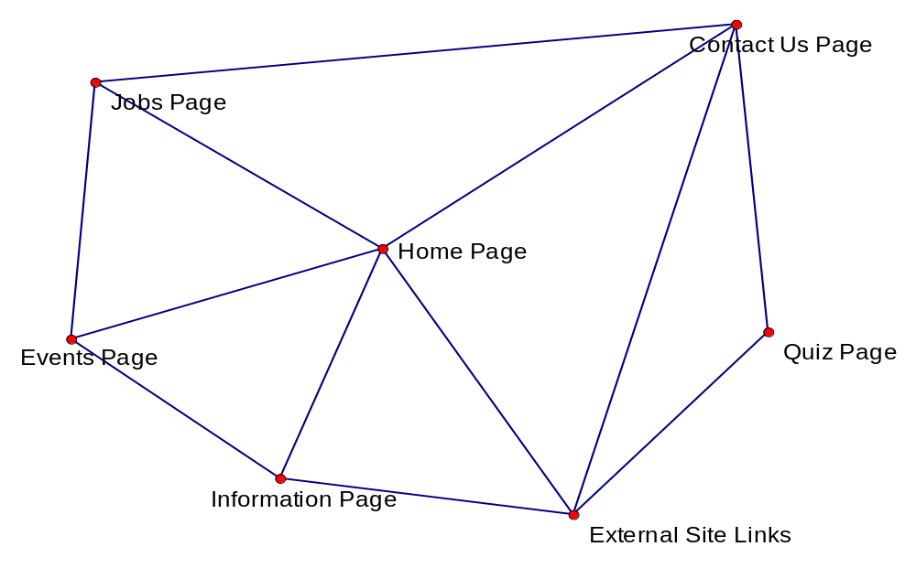
What about if it is not linear?

Slide 4
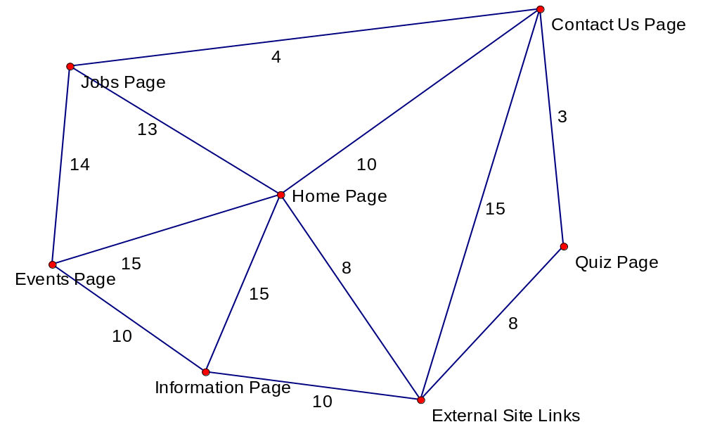
Web Page Design Structure

Slide 5
The Chinese Postman Algorithm
Used for
  Website layout Problems
  Delivering Mail Problems
  Policing type problems
  Gritting Roads Problems
  Clearing Snow Problems
  …..
Anywhere where I have to go along every arc at least once.

