Slide 1
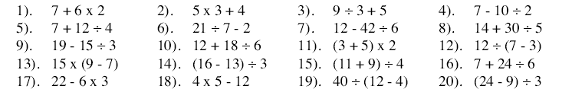
Work out the following in your head.
When you have finished check your answers on a calculator to see how many you got correct

Slide 2
Why were some of your answers different to those on the calculator?
BIDMAS
B = Brackets
I = Indices
D = Division
M = Multiplication
A = Addition
S = Subtraction

Slide 3
How does it work?
4+ 6² ÷ 4 + 5 x (3+2) - 36
First Brackets
(3 + 2) = 5
4+ 6² ÷ 4 + 5 x (3+2) - 36
5
Next Indices
6² = 6 x 6 = 36
4+ 6² ÷ 4 + 5 x (3+2) - 36
36
5
Then Division
36 ÷ 4 = 9
4+ 6² ÷ 4 + 5 x (3+2) - 36
36
9
5
Then Multiplication
5 x 5 = 25
4+ 6² ÷ 4 + 5 x (3+2) - 36
36
9
25
5
Then Addition
4 + 9 + 25 = 38
4+ 6² ÷ 4 + 5 x (3+2) - 36
38
36
9
25
5
Then Subtraction
38- 36 = 2
=2

Slide 4
Now try these..
=18
1) 30 - 3 x 4 8) 10 – (4 - 3) x 5
2) 2 + 5 x 3 9) 2 + 3 x (4+2)
3) 4 x ( 3 + 4) 10) 18 ÷ 9 + 2 x 4
4) 6 + (4 – 2) x 2 11) 16 – 4 x 3 - 2
5) 10 – 2 x 5 12) 27 ÷ (3 + 6) x 3
6) 15 ÷ (5 – 2) 13) 3 + 4 x 2 - 4
7) 30 ÷ (7 + 3) 14) 100 – 5 x 5
=5
=17
=20
= 28
=10
= 10
=2
= 0
=9
= 5
=7
= 3
=75

