Slide 1
Arrangements
Permutations and arrangements

Slide 2
Warm up
How many different 4-digit numbers can you make using the digits 1,2,3 and 4 without repetition?
1234
1243
1324
1342
1423
1432
2134
2143
2314
2341
2413
2431
3124
3142
3214
3241
3412
3421
4123
4132
4213
4231
4312
4321

Slide 3
ABCD
If I wanted to arrange these letters, how many ways could I do it?
A
B
C
D
then B, C or D:
then A, C or D:
then A, B or D: then A, B or C:
AB... AC... AD...
BA... BC... BD...
CA... CB... CD...
DA... DB... DC...
There are 12 possibilities for 1st 2 letters.
For each of the above, there are two possibilities for the final two letters. How many is this altogether???
4 x 3 x 2 x 1 = 24

Slide 4
ABCD
4 x 3 x 2 x 1 = 24
4 options for the 1st letter
1 option for the 4th letter
3 options for the 2nd letter
2 options for the 3rd letter

Slide 5
ABCDE
If I wanted to arrange these letters, how many ways could I do it?
5 x 4 x 3 x 2 x 1 = 120
1 option for the 5th letter
5 options for the 1st letter
4 options for the 2nd letter
2 options for the 4th letter
3 options for the 3rd letter

Slide 6
Factorial!
Another way to say 5 x 4 x 3 x 2 x 1 is 5! (5 factorial)
What is the value of 6!?

Slide 7
AABC
If I wanted to arrange these letters, how many ways could I do it?
We need to think of A, A, B, C as A₁, A₂, B, C
A₁
A₂
C
D
then A₂, C or D:
then A₁, C or D:
then A₁, A₂ or D:
then A₁, A₂ or C:
A₁A₂... A₁C... A₁D...
A₂A... A₂C... A₂D...
CA₁... CA₂... CD...
DA₁... DA₂... DC...
There are 12 possibilities for 1st 2 letters.

Slide 8
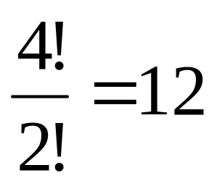
AABC
If we consider the arrangements of A₁A₂BC, we may decide that there 24 ways of arranging them.
We must remember, however, that A₁ and A₂ are the same. If we list the arrangements, we may notice that pairs of the same arrangements are formed.
A₁A₂CD
A₂CDA₁
A₂A₁CD
A₁CDA₂
So although there are 24 arrangements, half of them will be the same. This means that there are actually only 12.
Number of ways of arranging A₁A₂CD
Number of ways of arranging A₁A₂

Slide 9

AAABCD
How many ways are there to arrange A₁A₂A₃BCD?
How many ways are there to arrange A₁A₂A₃?
How many ways are there to arrange AAABCD?
Write down a rule for the number of arrangements a set of n objects, where r of them are identical.

Slide 10
A special case…
In order for us to be able to use this to expand expressions, we need to consider a special case…
We need to consider a set on n objects of which r are of one kind and the rest (n – r) are of another.
For example: A A A A A B B B

Slide 11
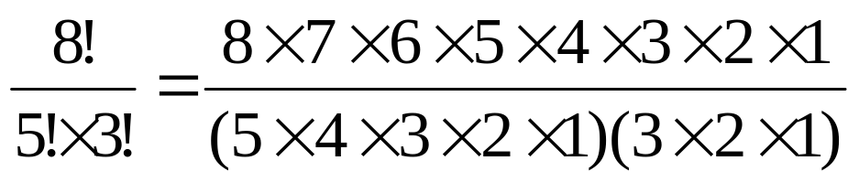
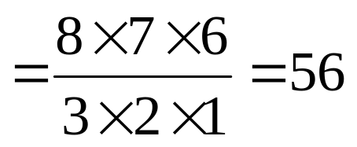
Arrangements with objects of only two types
A A A A A B B B
If they were all different, there would be 8! Ways of arranging them.
As there are 5 identical As, we need to divide by 5!
However, there are 3 identical Bs, so we need to divide this by 3!

Slide 12

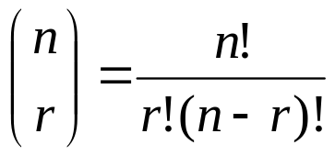
Arrangements with objects of only two types
A A A A A B B B
The number of ways of arranging n objects of which r are of one type and (n – r) are of another is denoted by the symbol:
We can find its value by:

Slide 13
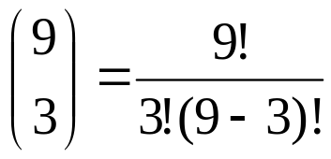
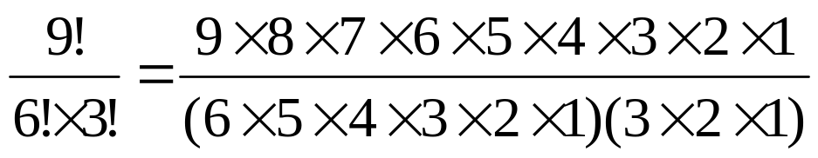
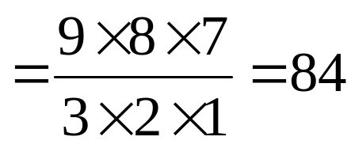
Example
A A A B B B B B B
How many ways are there of arranging these?
n = 9
r = 3

Slide 14


Example – using a calculator
A A A B B B B B B
How many ways are there of arranging these?
n = 9
r = 3
To calculate this, type “9” followed by “_{n}C_{r}” followed by “3” and press equals?
Use your calculator to work out
Explain your answer.

Slide 15
Activity
Time allowed – 4 minutes
Turn to page 64 of your Core 2 book and answer questions B6 and B7

