Slide 1


KS4 Mathematics
D1 Sampling

Slide 2
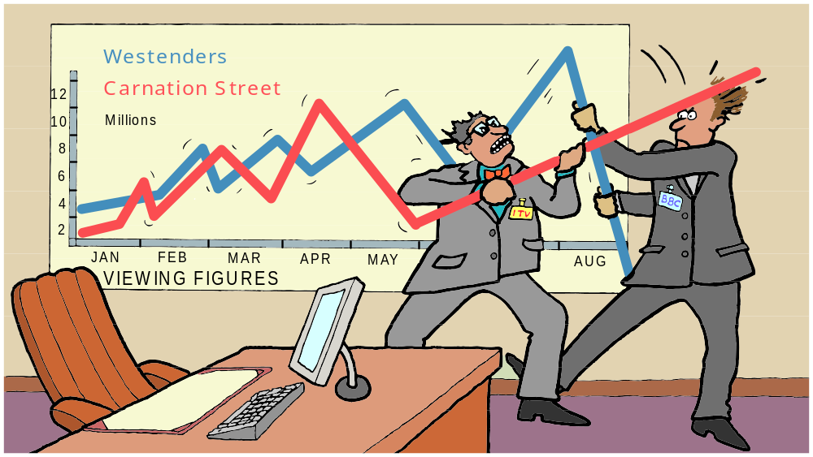

Soap wars
How are TV viewing figures compiled?
Notes:
Discuss how pupils think television viewing figures are compiled.

Slide 3
Television viewing figures
When compiling television viewing figures, it is impractical to find out what everyone in the country is watching at a particular time.
Instead, the viewing habits of a sample of households is carefully monitored and the data collected is used to compile the figures.
To avoid bias, it is important that the sample is representative of all television viewing households across the country.
This is done by dividing households into categories and taking samples in proportion to the size of each category.
This is an example of a stratified sample.
Notes:
Discuss what categories of households would be important when monitoring viewing habits. For example, geographical location and household income levels.

Slide 4


Different sampling methods
Random sampling
People are chosen at random e.g. names picked from a hat or using a random number generator on a calculator.
Every member of the population has an equal
chance of being chosen.
27
Systematic sampling
Members of the population are chosen at regular intervals, such as every 100th person from a telephone directory.
Quota sampling
You keep asking until you have enough people from each category. An example would be a survey in the street where you stop when you have enough people from each age category.
Notes:
These kind of methods are used in research in contexts such as psychology, sociology, social policy, medicine, marketing, politics, economics. It will be useful to relate them to pupils’ own interests and future career plans.

Slide 5

Stratified sampling
Imagine you are going to investigate the hypothesis
“People who get married at 20 are more likely to divorce than people who get married at 30”
Assume the population is that of married people in Great Britain.
How would you select a sample?
Relevant factors could be:
the year when they got married
socio-economic class
parents’ marital status
Notes:
For most Intermediate and all Foundation pupils, stratified sampling will not be appropriate. Although it is not on the Intermediate syllabus, it can be used in GCSE coursework at any level.
Year of marriage is relevant because people who got married, say, twenty years ago may have different divorce patterns than those marrying now.

Slide 6
Stratified sampling
The relevant factors are also called variables.
Year of marriage is one variable. We could split this into decades.
The different decades are called strata. For example, the 1970s might be one stratum.
What are the strata for the variable “parents’ marital status”?
The strata for “parent’s marital status” could be:
married
widowed
divorced
single
separated
living with partner
Notes:
The strata are the values the variable can take. The variable “gender” can take two values, male and female.

Slide 7
Stratified sampling
If we want the sample to represent a cross section of the population, we need the size of each stratum to be chosen to reflect their proportions in the population.
For example, if 10% of all married people in Great Britain were married in the 1970s, then the sample needs to contain 10% of people in this strata.
The actual number then depends on the number of people in the sample.
For example, if there are 3000 people in the sample, 30 of them should be people married in the 1970s.

Slide 8
Using stratified sampling
“Pupils from Town A are more likely to be late for school than pupils from Town B.”
40% of pupils in a school are boys and 60% are girls.
30% live in Town A and 70% in Town B.
There are 450 pupils in the school.
You want a sample of 60.
Construct a stratified sample which reflects both the proportions of male and female and where they live.
Notes:
Assume that the same proportions of girls and boys are represented in each town.

Slide 9
Using stratified sampling
If there are 60 pupils in our sample then 30% must come from Town A and 70% from Town B.
Number of pupils from Town A = 30% of 60 = 18
Number of pupils from Town B = 70% of 60 = 42
Of the 18 pupils from Town A, 40% are boys and 60% are girls.
Number of boys from Town A = 40% of 18 = 7.2
≈ 7
Number of girls from Town A = 60% of 18 = 10.8
≈ 11
Of the 42 pupils from Town B, 40% are boys and 60% are girls.
Number of boys from Town B = 40% of 42 = 16.8
≈ 17
Number of girls from Town B = 60% of 42 = 25.2
≈ 25
Notes:
Explain that all decimals must be rounded to the nearest whole number because the sample must consist of a whole number of people.
Check that 7, 11, 17 and 25 add together to make 60 as required.

Slide 10
A guide to using stratified sampling
First decide which variables are relevant to your hypothesis.
Decide how many strata there are for each variable.
Find out what percentage of the population each of the
different strata makes up.
Decide on your sample size.
Calculate how many people you need for each of the strata.
To select the people in each of the strata, use another sampling method, for example random sampling.

Slide 11
Using a calculator to generate a random sample
Suppose you have a list of 100 people and want to select 20 of them randomly. This can be done using the random number generator on your calculator.
Number each person from 0 to 99.
Key 100 into your calculator, followed by the RAN # button.
Press equals. This gives you a number between 0 and 99.
The number may have a decimal. This should be rounded
down (or the decimal ignored).
Press the equals button twenty times, making a note of each
number.
Find the people on your list of 100 people that match your
twenty numbers.
Notes:
It is important to use 0 – 499 as the calculator will include 0 but not 100.
Explain that the calculator can only be used to generate numbers up to 1000, as only three digits are generated.
To generate a sample from n people, we press n followed by the Ran # button.

Slide 12
Evaluating different sampling methods
Random sampling
✓ Every member of the population has an equal chance of
being chosen, which makes it fair.
✗ It can be very time consuming and usually impractical.
Systematic sampling
✓ You are unlikely to get a biased sample.
✗ It is not strictly random: some members of the population cannot be chosen once you have decided where to start on the list.
Notes:
These advantages and disadvantages are most useful in discussions in the context of particular hypotheses. Evaluating the choice of sampling method is a higher order thinking skill which is most appropriate to pupils aiming for A and A* grades. Ask pupils to come up with their own advantages and disadvantages before displaying these.

Slide 13
Evaluating different sampling methods
Quota sampling
✓ This is easier to manage.
✗ It could be biased. For example, if you are only asking
people on the street or in a shop, the sample might not
represent people at work all day.
Stratified sampling
✓ It is the best way to reflect the population accurately.
✗ It is time consuming and you have to limit the number of
relevant variables to make it practical.
Notes:
Ask pupils to come up with their own advantages and disadvantages before displaying these.

