Slide 1

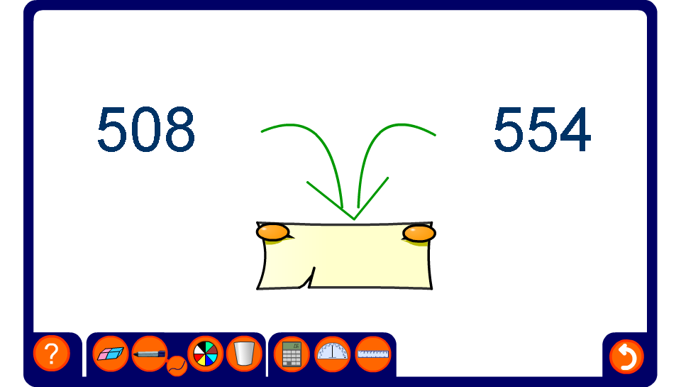


Midpoints
Notes:
In this activity, pupils should add the two number together and divide by 2 to find the midpoint in preparation for drawing a frequency polygon.

