Slide 1


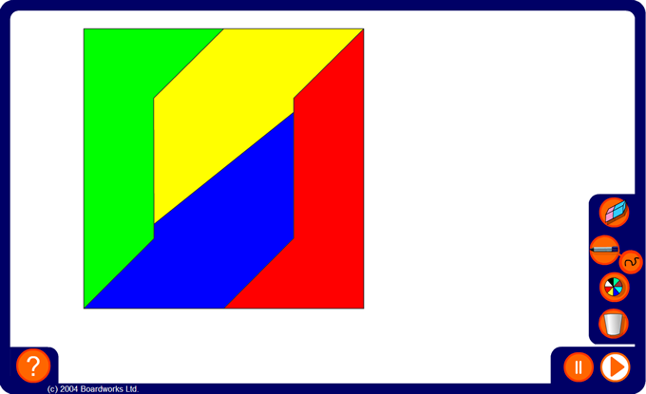


Quarters
Notes:
Each quarter can be a different shape as long as each part has the same area. There are infinitely many ways to divide this shape into four equal parts.

