Slide 1

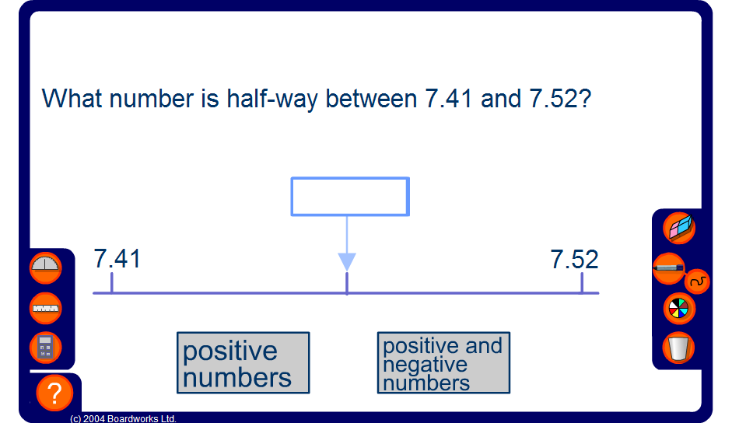


Mid-points
Notes:
This activity focuses on finding the mid-point between two numbers by looking at the next decimal place.
For more difficult examples encourage pupils to deduce that a mid-point can be found by adding the two end points and dividing by two. Discuss why this works, referring to the mean.
Extend the activity by using negative numbers; and by finding the mid-point between a negative and a positive number.
Link:
D3 Representing and interpreting data – calculating the mean

