Slide 1
Why you should do A-Level Maths
10
Good Reasons

Slide 2

It will help you in your other
A-Level Subjects
Physics, Chemistry, Biology, Geology
Computing
Geography, Psychology, Sociology
PE
Business Studies
History
Other Subjects
1
Licensed by: http://creativecommons.org/licenses/by/2.0/
Notes:
All of the sciences use mathematical techniques- doing maths A level will give you a head start in these subjects. Other A levels such as the Social Sciences use statistics, so doing A-level maths will give you an advantage. Even in essay based subjects such as history, A level maths can be useful. It teaches you to think in a logical way, something which is vital when putting across a coherent logical argument.

Slide 3

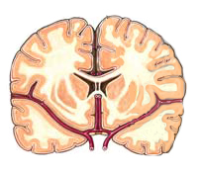
Want to do well in your degree?
Geography
Psychology, Sociology
Sports Science
Earth Sciences
Medicine
Chemistry, Biology
Business
Mathematics
Statistics
Computer Science
Physics
Accountancy
Engineering
2
Notes:
The subjects in the left hand column have A-level maths as an entry requirement.
Geography, Psychology, Sociology degrees will all usually have a module in mathematical techniques relating to the subject.
Sports Science Degrees often have modules relating to bio mechanics which has a high content of mathematics.
The sciences such as Biology, Chemistry and Earth Sciences use more and more mathematics as you progress with the subjects and A level mathematics will vastly enhance your ability to do well.
Business and management degrees all use maths in areas such as accounting and financial indicators.
Mathematics will help understanding in medicine, as well as enhance your application.

Slide 4
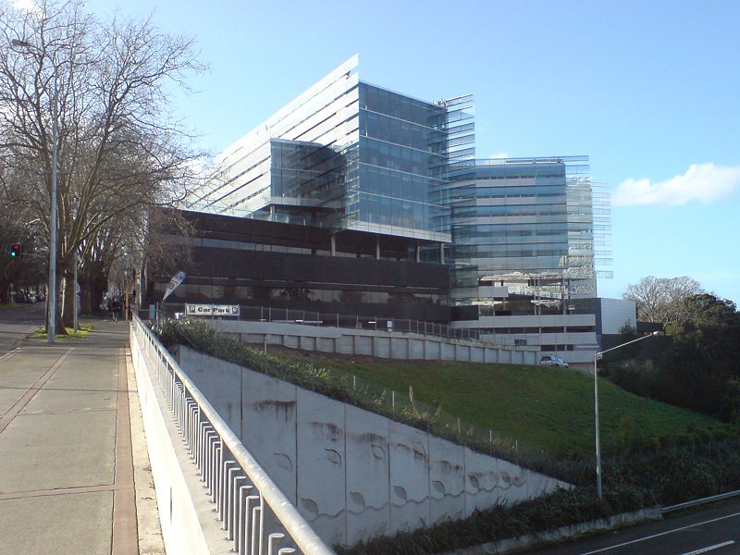
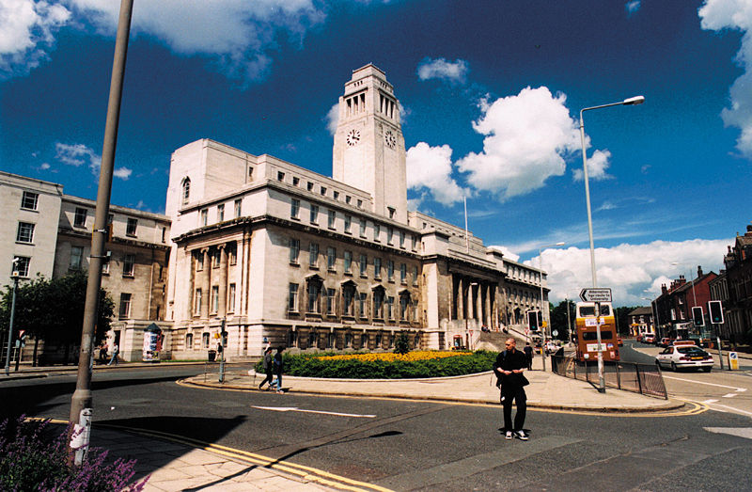
Mathematics A-Level is well respected by employers and admissions tutors for all degree subjects
3

Slide 5
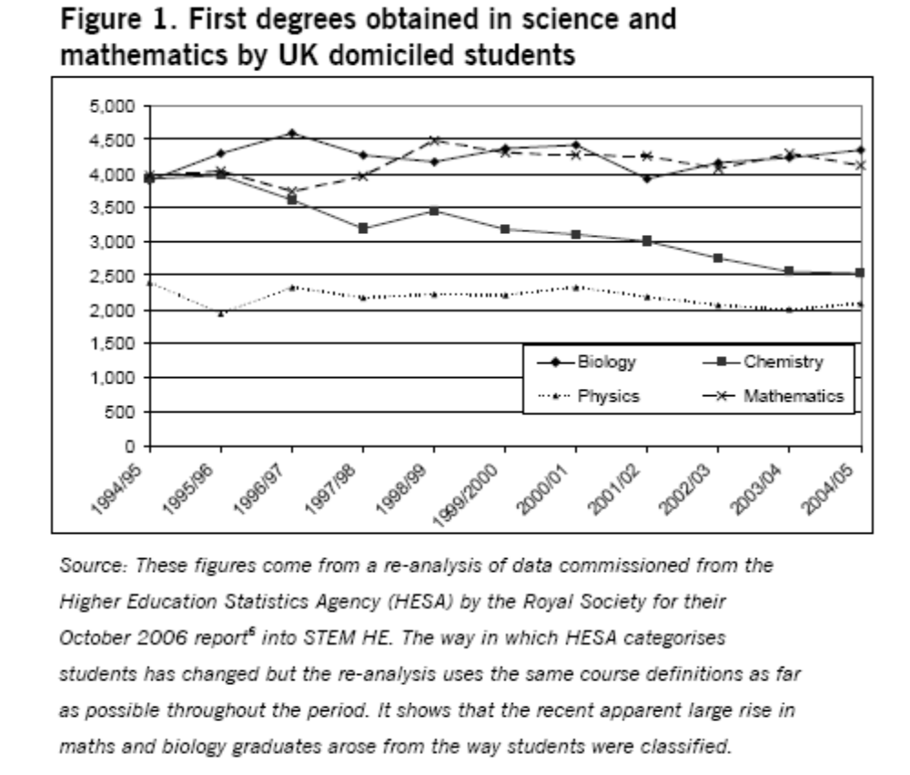
Do the maths
CBI forecasts that 2,400,000 people with STEM skills are needed to enter the workforce between 2004 – 2014
Using HESA projections (left) there will be around 130, 000 graduates from STEM subjects entering the workforce over this period
Do the maths – that is around 20 times less than required for industry and employers
4

Slide 6
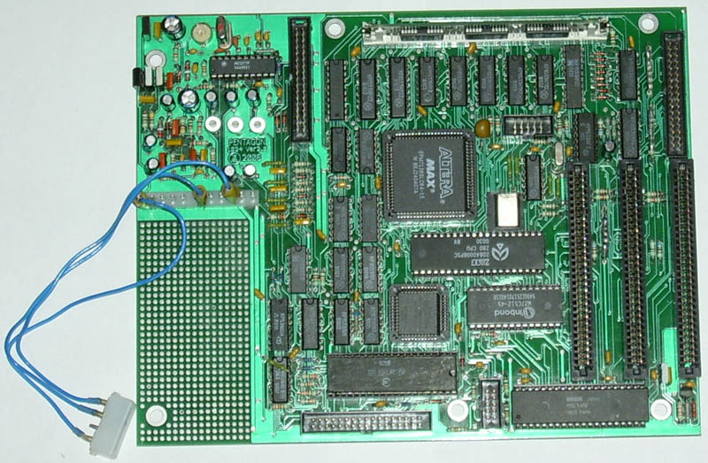

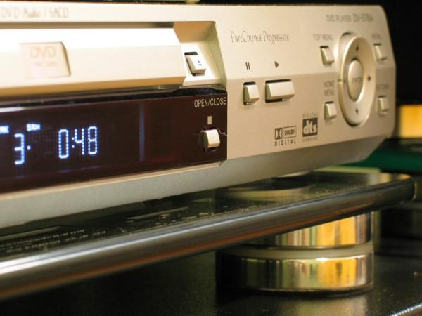
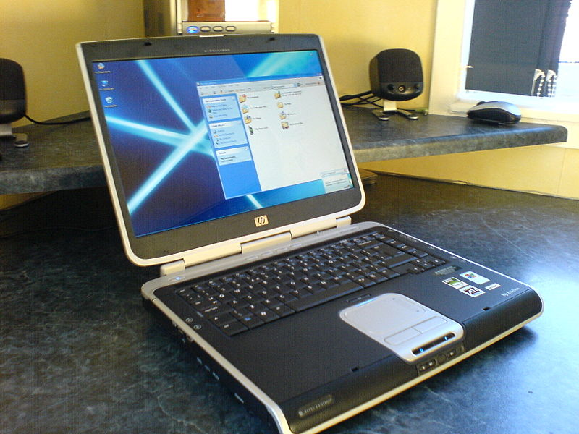

New technologies
Notes:
One of the reasons mathematics is so useful in the modern world is that the amount of technology we are using is increasing all the time. New technology relies on a lot of mathematics.

Slide 7

Earn more
On average people who have done A level Maths earn 10% more than those who haven’t. Even those who don’t get the top grades earn 8% more.
Earning potential is huge
in certain areas
5
Notes:
We don’t think that this should be the main reason for studying maths, but it is encouraging to know that if you do, you have a good chance of getting a comfortably paid job.

Slide 8
The types of Careers which lead on from Mathematics are some of the most interesting and well paid available.
Finance- Actuarial Work, Accountancy, Financial Modelling, Investment Banking
Computing- Games Design, Internet Security, Telecommunications
Mathematical Biology- Population Modelling, Epidemics and Vaccination
Engineering- Aircraft Modelling, Fluid Flows, Acoustic Engineering, Quantity Surveyor, Planner
Teaching and Lecturing
Statistics- Medical Statistics, Market Research, Government Statistics
Business- Logistics, Traffic Planning, Project Management, Business Consultancy
6
Notes:
Careers which lead on from mathematics aren’t only well paid, they are also often very interesting. People who have studied mathematics are in a fortunate position because they will have a good choice of career opportunities. This slide shows only a sample of possible careers. The main message is that you can do anything with maths.

Slide 9


© Ironclad Games Corporation Vancouver, BC.
You would use:
> 3D shapes
> transformations
> vectors
> matrices
© Ironclad Games Corporation Vancouver, BC.
Notes:
Computer Games designers use a lot of mathematics in order to simulate real life effects such as movement, or the way light reflects from different surfaces. A lot of the mathematics involved is taught in A level maths or A level Further Maths, including transformations, vectors and matrices.

Slide 10
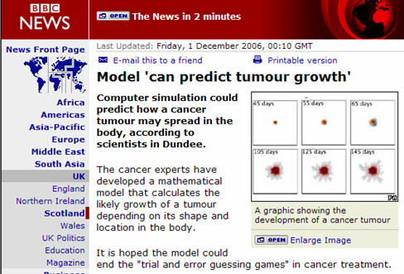


Notes:
Mathematical medicine is a fast growing area. Mathematicians are needed to model the way cancers grow, or analyse the effectiveness of different treatments.

Slide 11
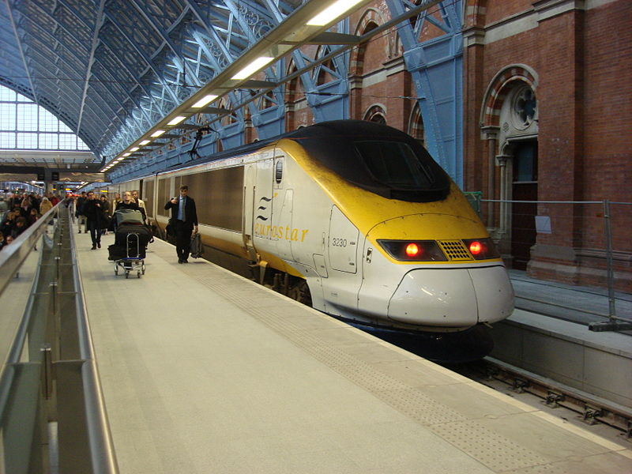
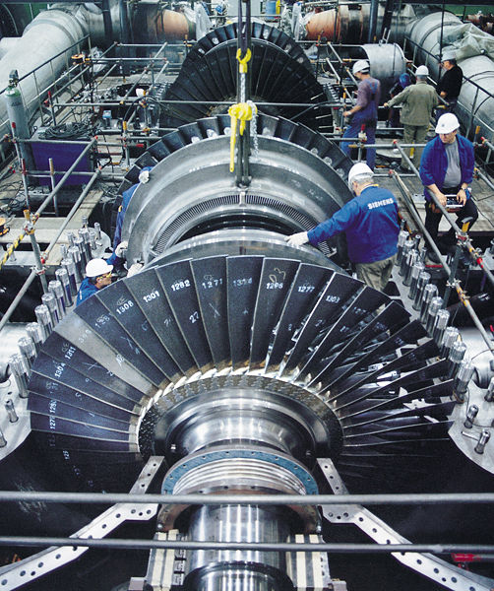
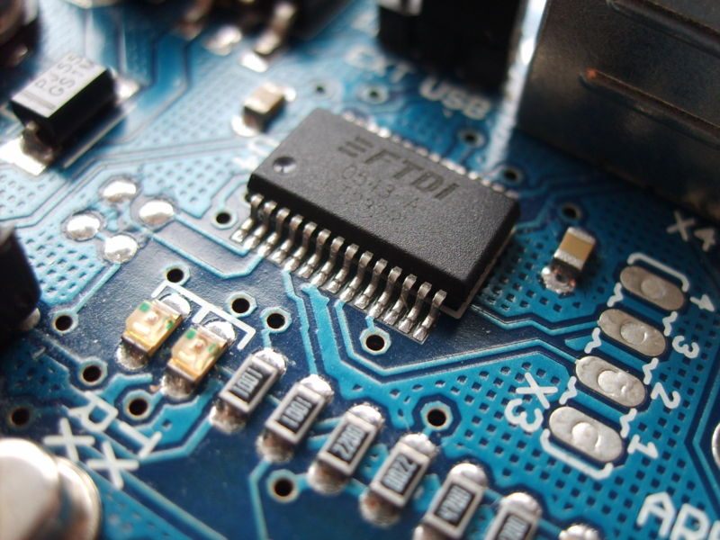
Notes:
A level mathematics is compulsory for entry into an engineering degree. There is a nationwide shortage of qualified engineers. These pictures are related to mechanical, civil and electronic engineering.

Slide 12
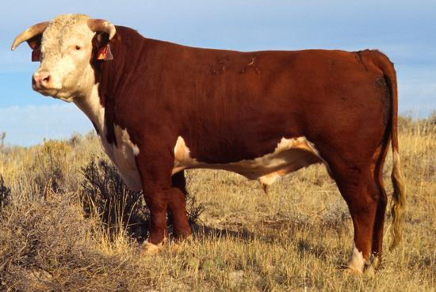
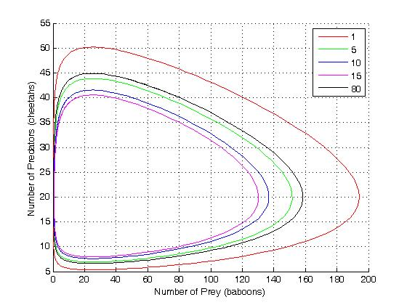
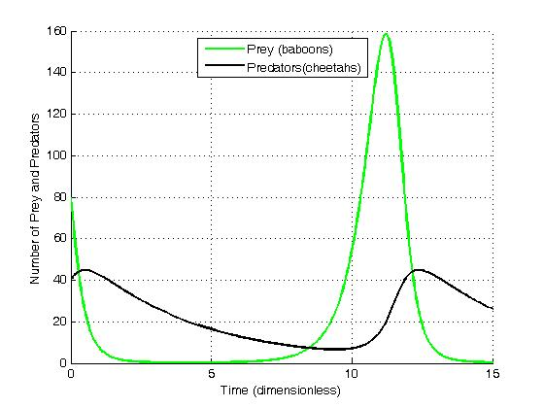

FOOT AND MOUTH
OUTBREAK!
Notes:
Do any of you remember the Foot and Mouth Outbreak a few years ago? Mathematicians were used by the government to model the spread of the disease and to decide where to cull animals in order to prevent any further outbreaks. Mathematicians are still working to model potential outbreaks of diseases like Bird Flu, so that the government can have a preventative strategy in place. Mathematics is also used to model population growth for different species which are at risk of extinction.

Slide 13
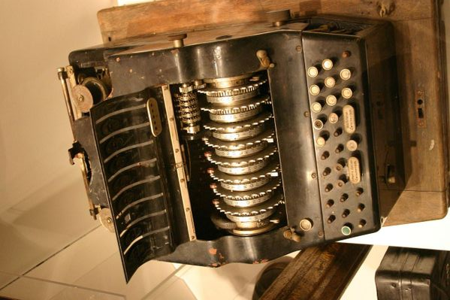

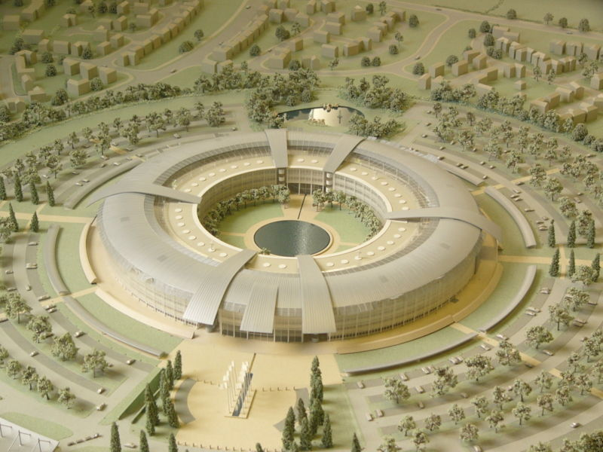
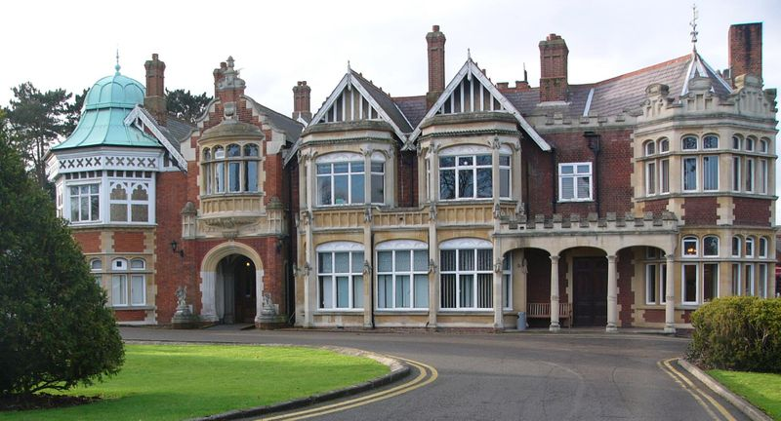
Keeping Information Safe
Cracking Codes
Notes:
GCHQ is the government’s communication headquarters and it has the largest group of mathematicians working anywhere in the country. They are employed to find better ways of encrypting data as well as trying to decode other encrypted messages. Above is a picture of GCHQ’s headquarters as well as a picture of an enigma machine and a picture of Bletchley Park. During the war mathematicians deciphered messages which were encoded using the enigma machine, an achievement which helped win the war. Today GCHQ recruits mathematics graduates every year. There is also a lot of mathematics behind making credit cards secure or keeping information safe as it is transmitted over the internet.

Slide 14
A level maths gives you transferable skills for the real world
Logical Skills
Analytical Skills
Problem Solving
7

Slide 15
What do people say?
Many people do succeed at Maths
 | A | B | C | D | E | U
Business Studies | 17.9 | 27.7 | 28.3 | 18.0 | 6.5 | 1.6
English | 22.8 | 26.7 | 27.7 | 16.8 | 5.1 | 0.9
Law | 20.7 | 22.6 | 24.1 | 18.3 | 9.9 | 4.4
Mathematics | 44.0 | 22.1 | 15.2 | 10.1 | 5.8 | 2.8
Psychology | 19.3 | 23.8 | 24.6 | 18.6 | 10.3 | 3.4
All Subjects | 25.9 | 24.9 | 23.1 | 15.7 | 7.6 | 2.8
8
Data from 2008 A-Level Results
Notes:
There are many rumours which circulate regarding A level maths. Some say that it is impossibly hard or that they know lots of people who have failed it after getting good grades at GCSE. The truth is that a larger percentage of people fail law and Psychology than mathematics. We are not saying that A level maths is easy, however, if you work hard at it, then you have a good chance of doing well.

Slide 16
Different Aspects
Mechanics
Further Maths
Pure
9
Decision
Statistics
Notes:
A-Level maths has modules in several different types of maths. There may be the opportunity to study mechanics, which looks at the mathematics of the real world by studying forces and equations of motion. You might also get the chance to study statistics in more depth, or a module in decision maths. Decision maths is the kind of maths which can be useful in business, studying problems such as finding the shortest route in a network. There may also be the chance to study Further Mathematics, which can offer you an extra A-Level or AS-Level in mathematics.

Slide 17

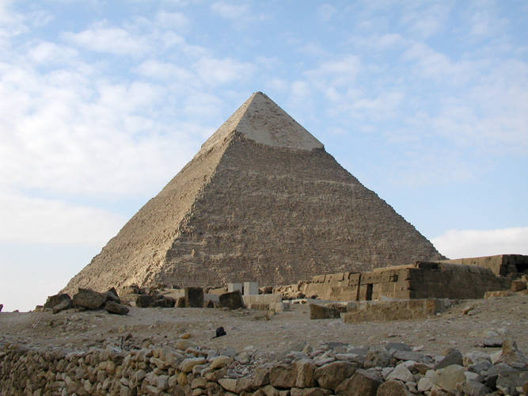

You need to find this out for yourself
10
Notes:
Our opinion is that mathematics gets more interesting the further you take it. At GCSE you are building the foundations so that you have the tools which will enable you to understand many interesting A-Level topics. However you will only find this out if you try it for yourself. (Learning mathematics can be a bit like a pyramid- at GCSE you are laying the foundations and are constantly moving on upwards to more interesting and challenging mathematics. However unlike a pyramid, mathematics also broadens and there is no limit to what you can learn!)

Slide 18


Thank You for Listening
www.mathscareers.org.uk
www.moremathsgrads.org.uk
Notes:
www.mathscareers.org.uk is the main website for mathematical careers related information.

