Slide 1

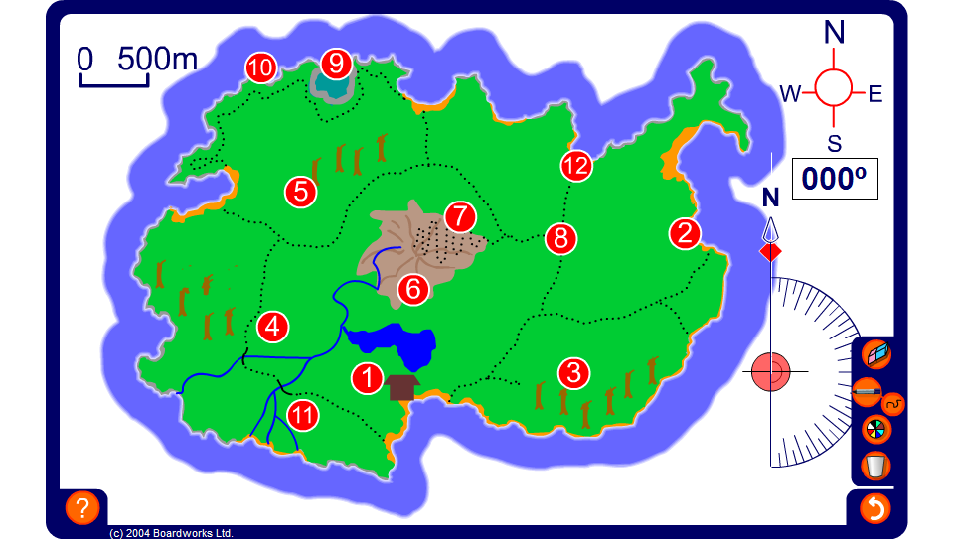


Bearings
Notes:
Use this activity to demonstrate how to find the bearing from one numbered place on the map to another. Also, ask pupils to use the scale given on the map to estimate the distance between two points.
Ask, for example,
What is the approximate bearing from 6 to 5?
Approximately how far in metres is it between 1 and 3?
What point is on a bearing of 255° from 6?
Find the bearing from 7 to 9. Ask pupils if they can give you the bearing from 9 to 7 without measuring.
Link:
S5 Coordinates and transformations 2 – Scale drawings.

