Slide 1




KS4 Mathematics
S9 Loci

Slide 2

The locus of points from a fixed point
Imagine placing counters so that their centres are always 5 cm from a fixed point P.
5 cm
P
Describe the locus made by the counters.
The locus is a circle with a radius of 5 cm and centre at point P.
Notes:
Tell pupils that some loci are defined in exact mathematical terms. These loci have to be constructed exactly using a compass and a ruler.
Ask pupils to describe how we could construct the locus of points a fixed distance from a point (using a compass).
As an extension ask pupils to imagine this locus of points in three dimensions (the surface sphere).

Slide 3
The locus of points from a line segment
Imagine placing counters that their centres are always 3 cm from a line segment AB.
A
B
Describe the locus made by the counters.
The locus is a pair of parallel lines 3 cm either side of AB. The ends of the line AB are fixed points, so we draw semi-circles of radius 3 cm.
Notes:
Ask pupils to describe the locus.
As an extension ask pupils to imagine this locus of points in three dimensions (the surface of a cylinder with a hemi-sphere at each end).

Slide 4
The locus of points from two fixed points
Imagine placing counters so that they are always an equal distance from two fixed points P and Q.
P
Q
Describe the locus made by the counters.
The locus is the perpendicular bisector of the line joining the two points.
Notes:
Ask pupils how the locus of the points equidistant from two fixed point can be constructed. Review the use of a compass to construct a perpendicular bisector, if necessary.
As an extension, ask pupils to imagine this locus of points in three dimensions (a flat plane bisecting the line joining the two points at right angles).

Slide 5
The locus of points from two lines
Imagine placing counters so that they are an equal distance from two straight lines that meet at an angle.
Describe the locus made by the counters.
The locus is the angle bisector of the angle where the two lines intersect.
Notes:
Ask pupils how the locus of the points an equidistant from two lines can be constructed. Review the use of a compass to construct an angle bisector, if necessary.
Ask pupils what the locus would look like if the two lines were extended back beyond the intersection.

Slide 6
The locus of points from a given shape
Imagine placing counters so that they are always the same distance from the outside of a rectangle.
Describe the locus made by the counters.
The locus is not rectangular, but is rounded at the corners.
Notes:
Discuss the fact that the locus is not rectangular but rounded at the corners.
We can think of this as a combination of the locus of points that are a fixed distance from a line (around the edges) and the locus of points that are a fixed distance from a point (around the corners).

Slide 7
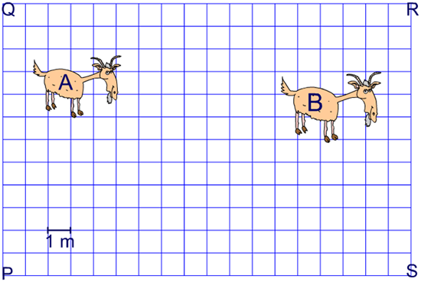
Combining loci
Suppose two goats, Archimedes and Babbage, occupy a fenced rectangular area of grass of length 18 m and width 12 m.
Archimedes is tethered so that he can only eat grass that is within 12 m from the fence PQ and Babbage is tethered so that he can eat grass that is within 14 m of post R.
Describe how we could find the area that both goats can graze.

Slide 8
The intersection of two loci
Suppose we have a red counter and a blue counter that are 9 cm apart.
6 cm
5 cm
Draw an arc of radius 6 cm from the blue counter.
Draw an arc of radius 5 cm from the red counter.
9 cm
6 cm
5 cm
How can we place a yellow counter so that it is 6 cm from the blue counter and 5 cm from the red counter?
There are two possible positions.
Notes:
Explain that when we use counters to represent points we always take measurements from the centre of the counter.
Explain that all the points that lie on the first arc are 6 cm from the blue counter and all the points that lie on the second arc lie 5 cm from the red counter. The points where the two arcs cross are both 6 cm from the blue counter and 5 cm from the red counter.
Stress to pupils that all construction lines should be left in place and not rubbed out.

