Slide 1



KS3 Mathematics
S6 Loci
Notes:
The aim of this unit is to teach pupils to:
Construct lines, angles and shapes
Find simple loci, both by reasoning and by using ICT
Material in this unit is linked to the Key Stage 3 Framework supplement of examples pp 220-227.

Slide 2



Imagining paths
A locus is a set of points that satisfy a rule or set of rules.
The plural of locus is loci.
We can think of a locus as a path traced out by a moving point.
For example,
Imagine the path of a golf ball as it is driven on to the green.
The ball bounces several times and drops into the hole.
Notes:
Ask pupils to describe the path of the golf ball by sketching it or tracing the path in the air with their fingers.

Slide 3
Imagining paths
The path of the ball might look something like this:
The red dotted line shows the locus of the points traced out by the golf ball.

Slide 4
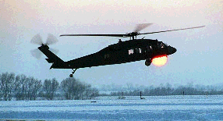
Imagining paths
A helicopter takes off and rises to a height of 30 m.
It accelerates forward and rises to 1000 m where it levels out then continues on its way.
Can you imagine the path traced out by the helicopter?
How could you represent the path in two dimensions?
What about in three dimensions?
Notes:
Ask pupils to trace out the path using their finger tips or by sketching it.

Slide 5
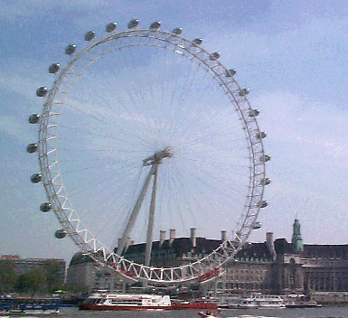
Imagining paths
A nervous woman paces up and down in one of the capsules on the Millennium Eye as she ‘enjoys’ the view.
Can you imagine the path traced out by the woman?
How could you represent the path in two dimensions?
What about in three dimensions?
Notes:
Ask pupils to trace out the path using their finger tips or by sketching it.

Slide 6
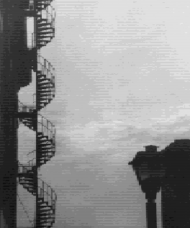
Imagining paths
A man has been out for the evening, has locked himself out of his flat and has to climb the spiral fire escape.
Can you imagine the path traced out by the man?
How could you represent the path in two dimensions?
What about in three dimensions?
Notes:
Ask pupils to trace out the path using their finger tips or by sketching it.

Slide 7
Imagining paths
A spider is hanging motionless from a web.
Imagine moving your hand so that the tip of your finger is always 10 cm from the spider.
Can you imagine the path traced out by your finger tip?
How could you represent the path in two dimensions?
What about in three dimensions?
Notes:
Ask pupils to trace out the path using their finger tips or by sketching it.
In two dimensions the locus would be a circle.
In three dimensions the locus would be the surface of a sphere.

Slide 8
The locus of points from a fixed point
Imagine placing counters so that their centres are always 5 cm from a fixed point P.
5 cm
P
Describe the locus made by the counters.
The locus is a circle with a radius of 5 cm and centre at point P.
Notes:
Tell pupils that some loci are defined in exact mathematical terms. These loci have to be constructed exactly using a compass and a ruler.
Ask pupils to describe how we could construct the locus of points a fixed distance from a point (using a compass).
As an extension ask pupils to imagine this locus of points in three dimensions (the surface sphere).

Slide 9
The locus of points from a line segment
Imagine placing counters so that their centres are always 3 cm from a line segment AB.
A
B
Describe the locus made by the counters.
The locus is a pair of parallel lines 3 cm either side of AB. The ends of the line AB are fixed points, so we draw semi-circles of radius 3 cm.
Notes:
Ask pupils to describe the locus.
As an extension ask pupils to imagine this locus of points in three dimensions (the surface of a cylinder with a hemi-sphere at each end).

Slide 10
The locus of points from two fixed points
Imagine placing counters so that they are always an equal distance from two fixed points P and Q.
P
Q
Describe the locus made by the counters.
The locus is the perpendicular bisector of the line joining the two points.
Notes:
Ask pupils how the locus of the points equidistant from two fixed point can be constructed. Review the use of a compass to construct a perpendicular bisector, if necessary.
As an extension ask pupils to imagine this locus of points in three dimensions (a flat plane bisecting the line joining the two points at right angles).

Slide 11
The locus of points from two lines
Imagine placing counters so that they are an equal distance from two straight lines that meet at an angle.
Describe the locus made by the counters.
The locus is the angle bisector of the angle where the two lines intersect.
Notes:
Ask pupils how the locus of the points equidistant from two lines can be constructed. Review the use of a compass to construct an angle bisector, if necessary.
Ask pupils what the locus would look like if the two lines were extended back beyond the intersection.

