Slide 1




KS4 Mathematics
S1 Similarity

Slide 2

Similar shapes
If one shape is an enlargement of the other then we say the shapes are similar.
The angle sizes in two similar shapes are the same and their corresponding side lengths are in the same ratio.
A similar shape can be a reflection or a rotation of the original.
These triangles are similar because
Q
Q
Q
Q
Q
Q
B
Q
∠A = ∠ P,
∠B = ∠Q,
B
B
B
B
B
B
C
and ∠C = ∠R.
C
C
C
C
C
C
R
R
R
R
R
R
R
A
A
A
A
A
A
A
PQ
QR
PR
=
=
P
AB
BC
AC
P
P
P
P
P
P
Notes:
Give an example of what is meant by the corresponding side lengths being in the same ratio. For example, if the lengths of all the sides in the second shape are double the lengths of the corresponding sides in the first shape then the ratios of the corresponding side lengths will all simplify to 2. This number is the scale factor for the enlargement.

Slide 3
Similar shapes
Which of the following shapes are always similar?
Any two rectangles?
Any two squares?
Any two isosceles triangles?
Any two circles?
Any two equilateral triangles?
Any two cubes?
Any two cylinders?
Notes:
Establish that any two regular polygons with the same number of sides are mathematically similar as are any two circles. Any two regular polyhedra (of the same number of sides) are also similar.

Slide 4
Finding the scale factor of an enlargement
We can find the scale factor for an enlargement by finding the ratio between any two corresponding lengths.
length on enlargement
Scale factor =
corresponding length on original
If a shape and its enlargement are drawn to scale, the the two corresponding lengths can be found using a ruler.
Always make sure that the two lengths are written using the same units before dividing them.

Slide 5
Finding the scale factor of an enlargement
The following rectangles are similar. What is the scale factor for the enlargement?
6 cm
9 cm
The scale factor for the enlargement is ⁹/₆ = 1.5

Slide 6
Finding the lengths of missing sides
The following shapes are similar. What is the size of each missing side and angle?
3.6 cm
c
3 cm
37°
a
6 cm
5 cm
37°
4.8 cm
e
4 cm
53°
53°
b
6 cm
7.2 cm
d
The scale factor for the enlargement is ⁶/₅ = 1.2
Notes:
Mare sure that pupils realize that all corresponding angles in similar shapes are equal.
Point out that to scale from the left-hand shape to the right-hand shape we multiply by 6/5 (or 1.2). In other words, we multiply by 6 and divide by 5.
To scale from right-hand shape to the left-hand shape we multiply by the reciprocal 5/6 (or divide by 1.2). in other words we multiply by 5 and divide by 6.

Slide 7
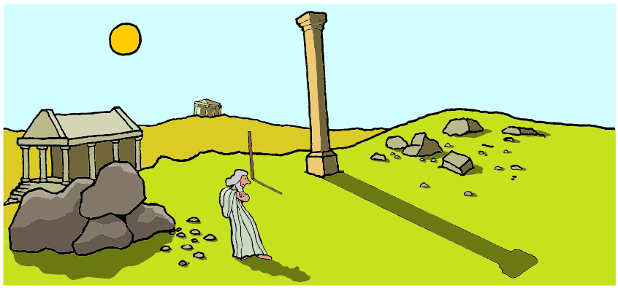
Using shadows to measure height
In ancient times, surveyors measured the height of tall objects by using a stick and comparing the length of its shadow to the length of the shadow of the tall object.

