Slide 1
Quadrilaterals
Aim: to describe/use properties of quadrilaterals
But to start….
Can you describe what these words mean?
Reflex
Parallel
Opposite
Regular
Symmetrical
Obtuse
Perpendicular
Acute
Right
Angle
Adjacent

Slide 2
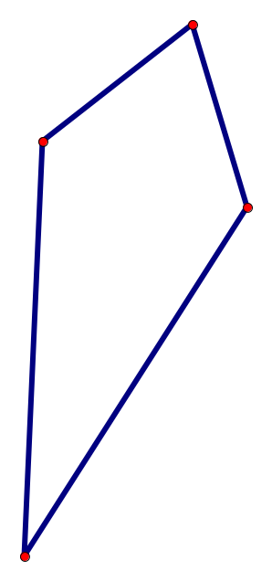
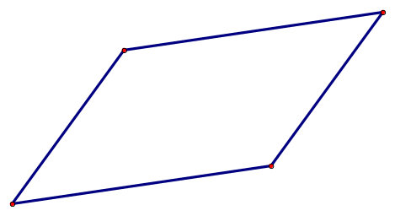
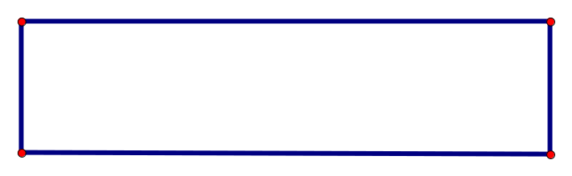
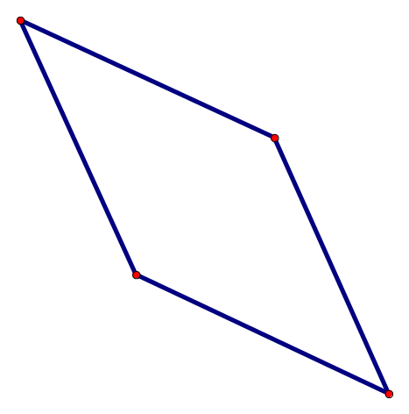
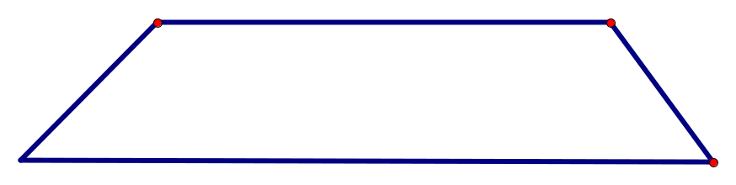
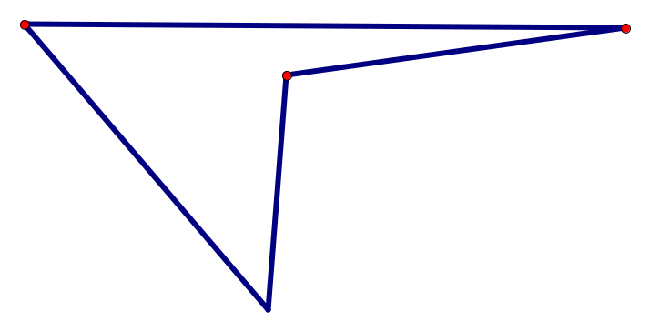

Which quadrilateral is which?
S________
Square
D________
Delta
R_____s
Rhombus
T________
Trapezium
K________
Kite
R_____e
Rectangle
P________
Parallelogram

Slide 3
Properties of quadrilaterals
Your task is to match the property cards to the shapes so that no property cards are left. Be careful – a property may match more than one shape!!!
What’s behind the wall?

