Slide 1

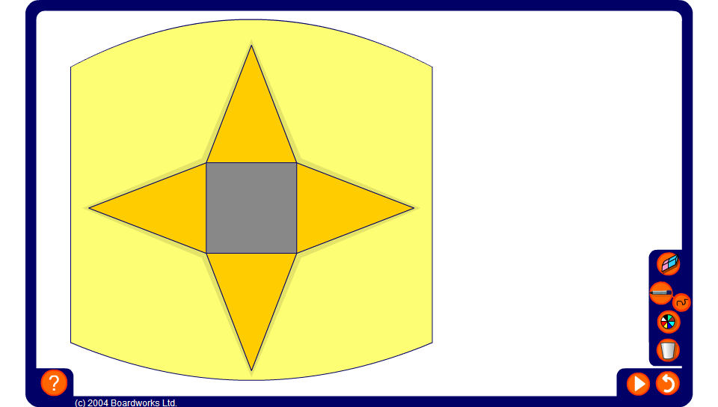


Nets
Notes:
This animation shows how the net can be folded up to make to make a pyramid.

